Slide 1


Mathieu Pierre Mentor : Francis Banville Lecturer at UEH
Abundance and distribution of Photosynthetic Picoeukaryotes

Slide 2
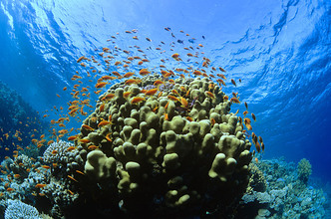
Context
71% of the earth surface
absorbing 30% of the carbon dioxide produced by anthropogenic factors
50% of the earth’s primary biomass production takes place in the ocean.
Field, 1998
Source: https://urlz.fr/hOEi

Slide 3
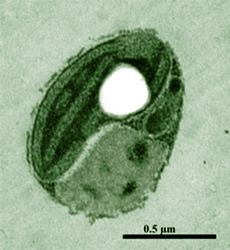
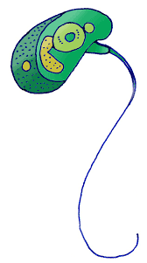
Photosynthetic Picoeukaryotes (PPEs)
PPEs are the photosynthetic and eukaryotic cells having cells less than 3 µm
Role
They are a key contributor to phytoplanktonic biomass and primary production in a variety of marine pelagic ecosystems.(Kirkham et al. 2011).
Nutrient cycling
They are major players in carbon production in all aquatic ecosystems (Callieri and Stockner, 2002).
Understanding how microorganisms work to predict changes in ecosystems is crucial

Slide 4
Objectives
Determine the abundance of marine PPEs in the oceanic microbiome
Assess the effect of different environmental factors on PPEs abundance
The global distribution of marine PPEs in the oceanic microbiome

Slide 5


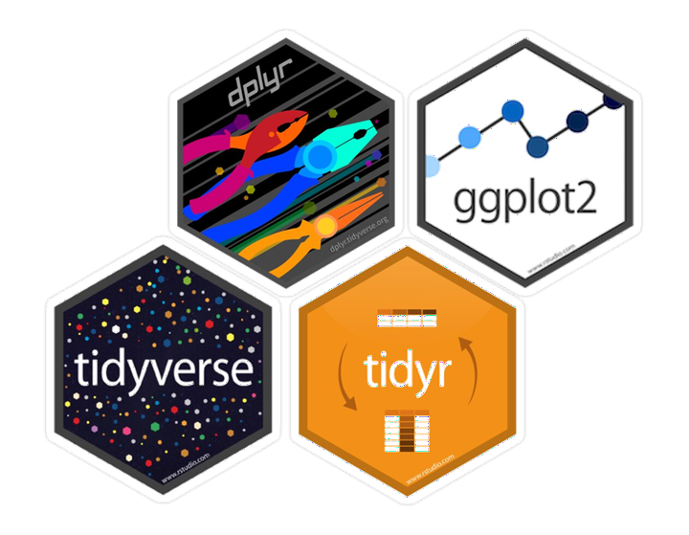

Material and methods
Metagenomic sequencing covers all genetic information in a sample
Data source : Tara Oceans
https://ocean-microbiome.embl.de/companion.html

Slide 6
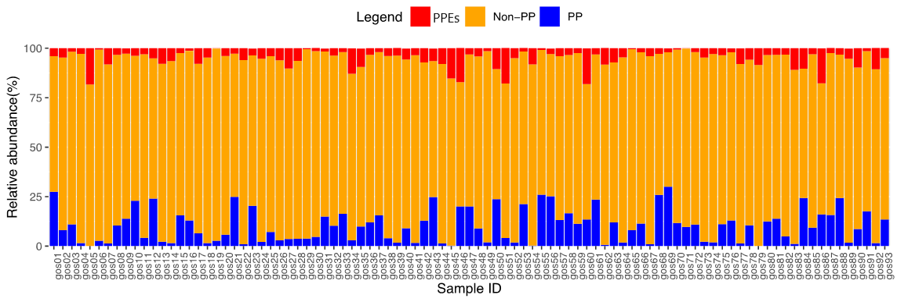
Marine picoplankton is dominated by pico-heterotrophs
Photosynthetic microbes (PPEs) represent a minor component of total marine microbiome in all samples

Slide 7
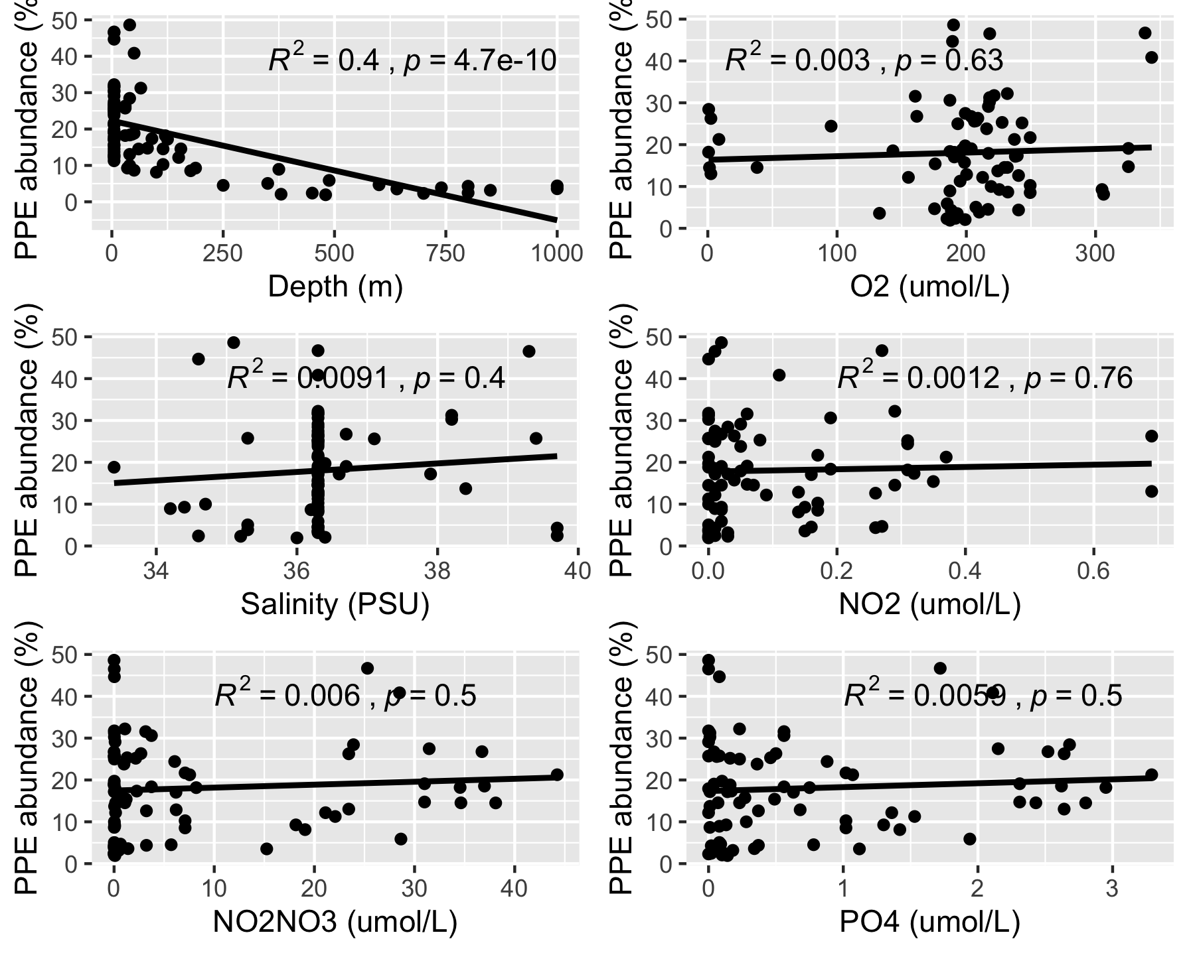
Relationship of PPE abundance to different environmental variables.
Abundance of PPE showed a large negative exponential correlation with sampling depth.

Slide 8
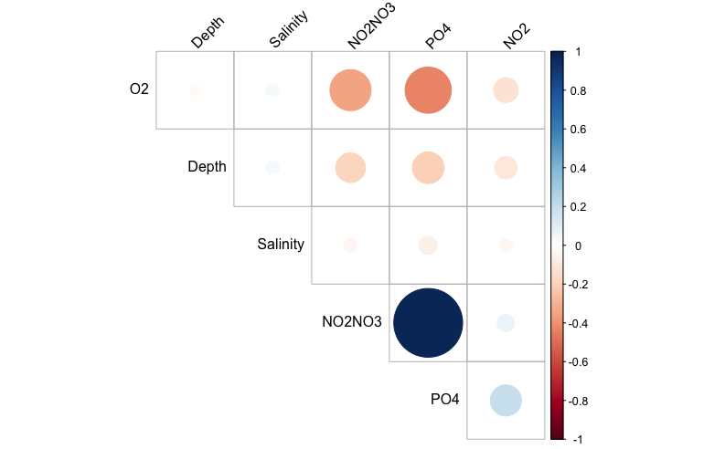
Correlation between environmental variables

Slide 9
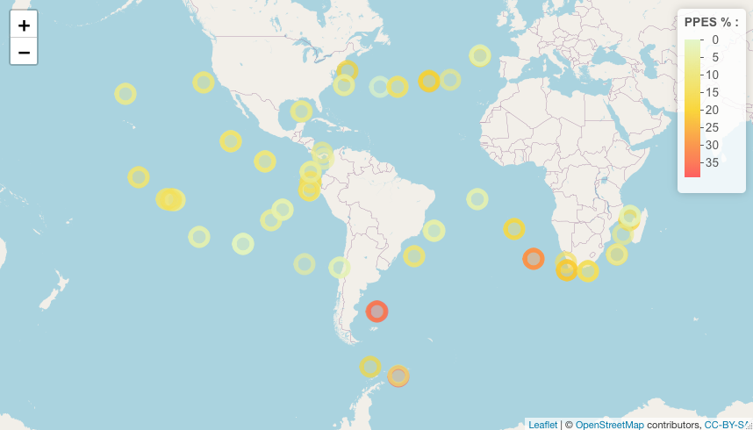
Global distribution of PPEs

Slide 10
Conclusion and perspectives
Primary producers represent a minor fraction of the overall picoplankton community…
Sampling depth and geographical provinces represent respectively the main environmental drivers shaping PPE abundance in global oceans.
To go further in the analysis, it would have to extract a lot more data and carry out a principal component analysis

Slide 11

Acknowledgments
Thanks to my mentor Francis
Thanks to Dr Dieunel Derilus
Thank you Data.Trek Team

