Slide 1
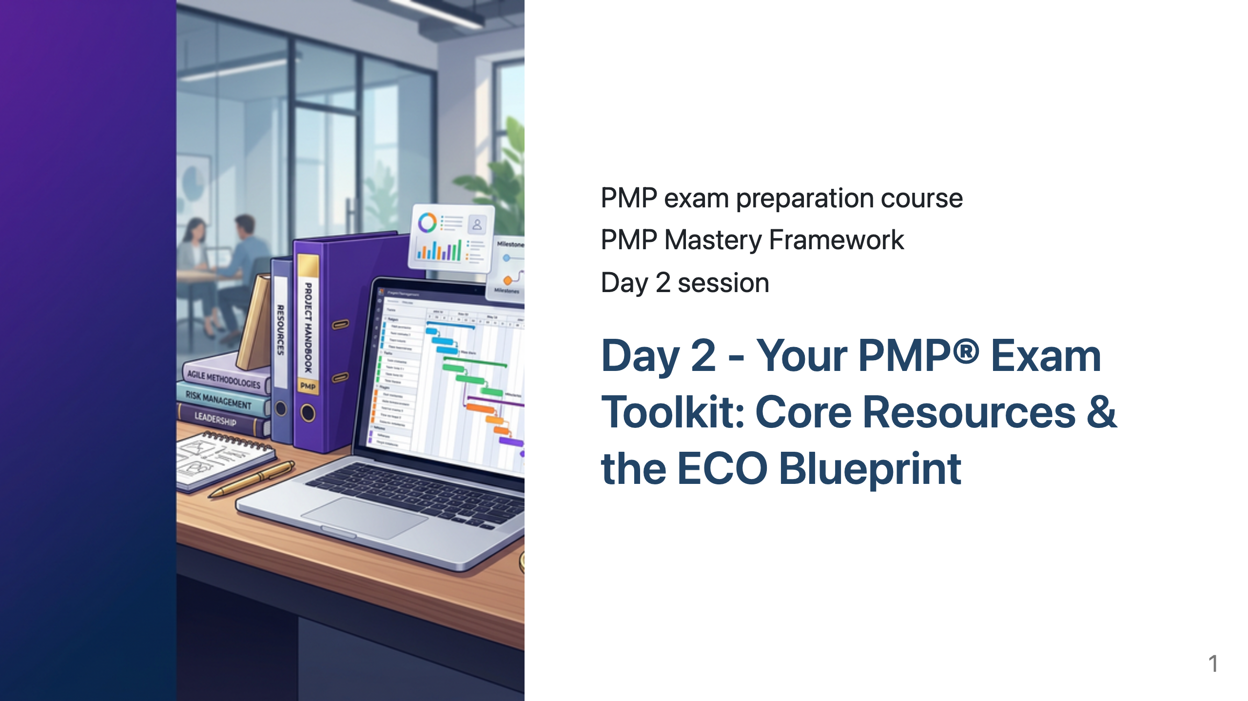

Slide 2
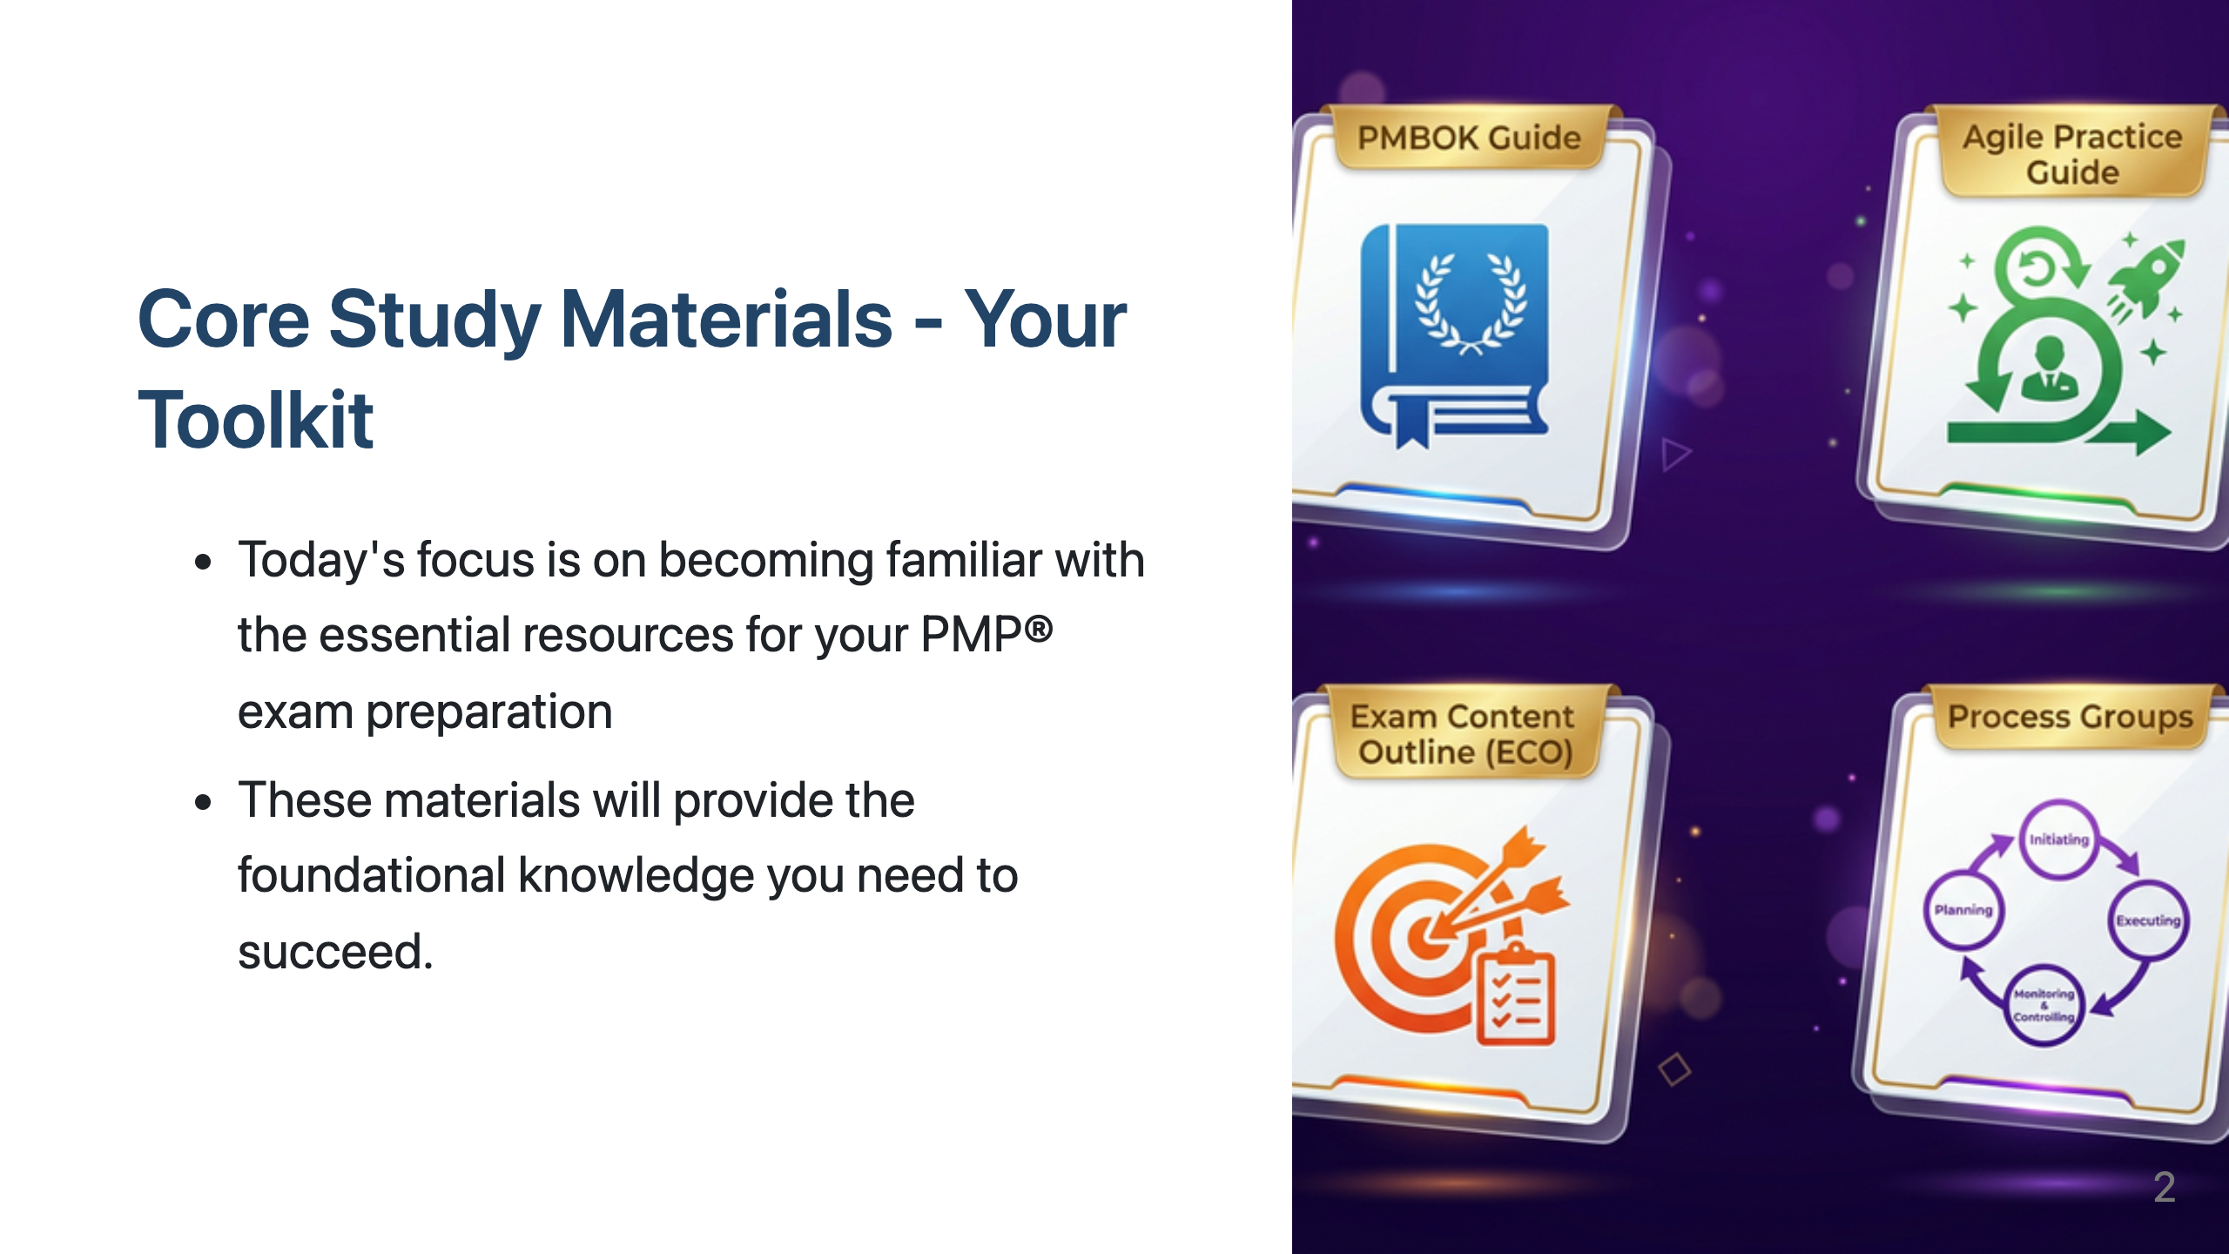
Notes:
_class: cover

Slide 3
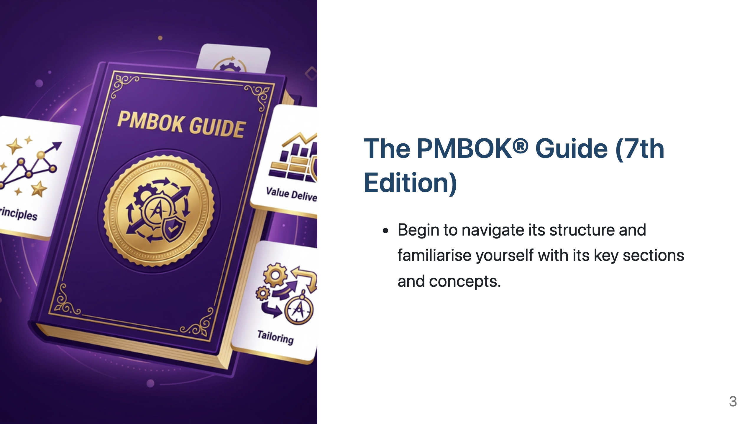
Notes:
_class: agenda

Slide 4
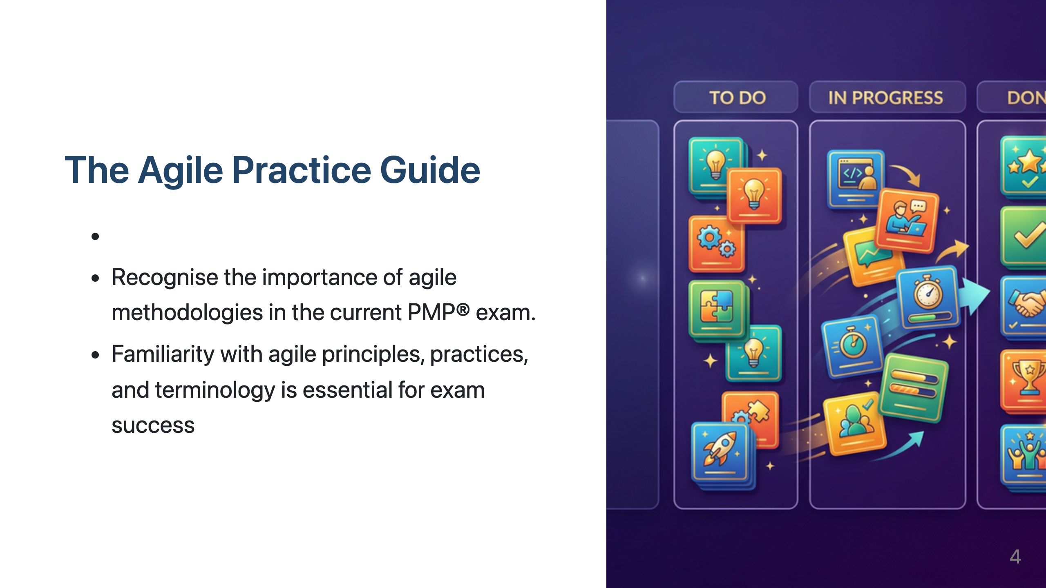
Notes:
The Project Management Body of Knowledge, or PMBOK® Guide, is a foundational document in the field of project management and a key reference for the PMP® exam.
It encompasses a vast array of knowledge areas and provides a structured approach to managing projects.
While our course prioritises the ECO, the PMBOK® Guide offers crucial context and detailed explanations of many of the concepts you'll encounter.
Your task is to start becoming comfortable navigating the PMBOK® Guide, understanding its structure, and identifying the broad range of topics it addresses. Don't feel you need to master it all immediately; we will guide you through the relevant sections as we progress.

Slide 5
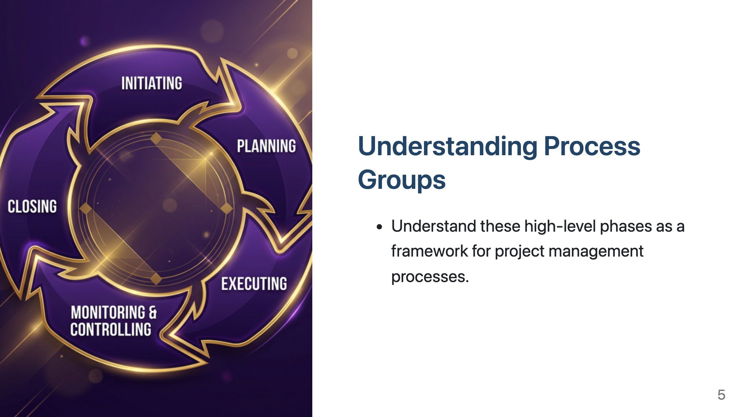
Notes:
Next, we have the Agile Practice Guide.
The PMP® exam today significantly tests your knowledge of agile and hybrid approaches, and this guide is an essential resource for mastering those concepts.
Co-created by PMI and the Agile Alliance, the Agile Practice Guide provides the principles and practices needed to manage projects in environments that are not purely predictive.
Becoming familiar with its contents is crucial for exam success.

Slide 6
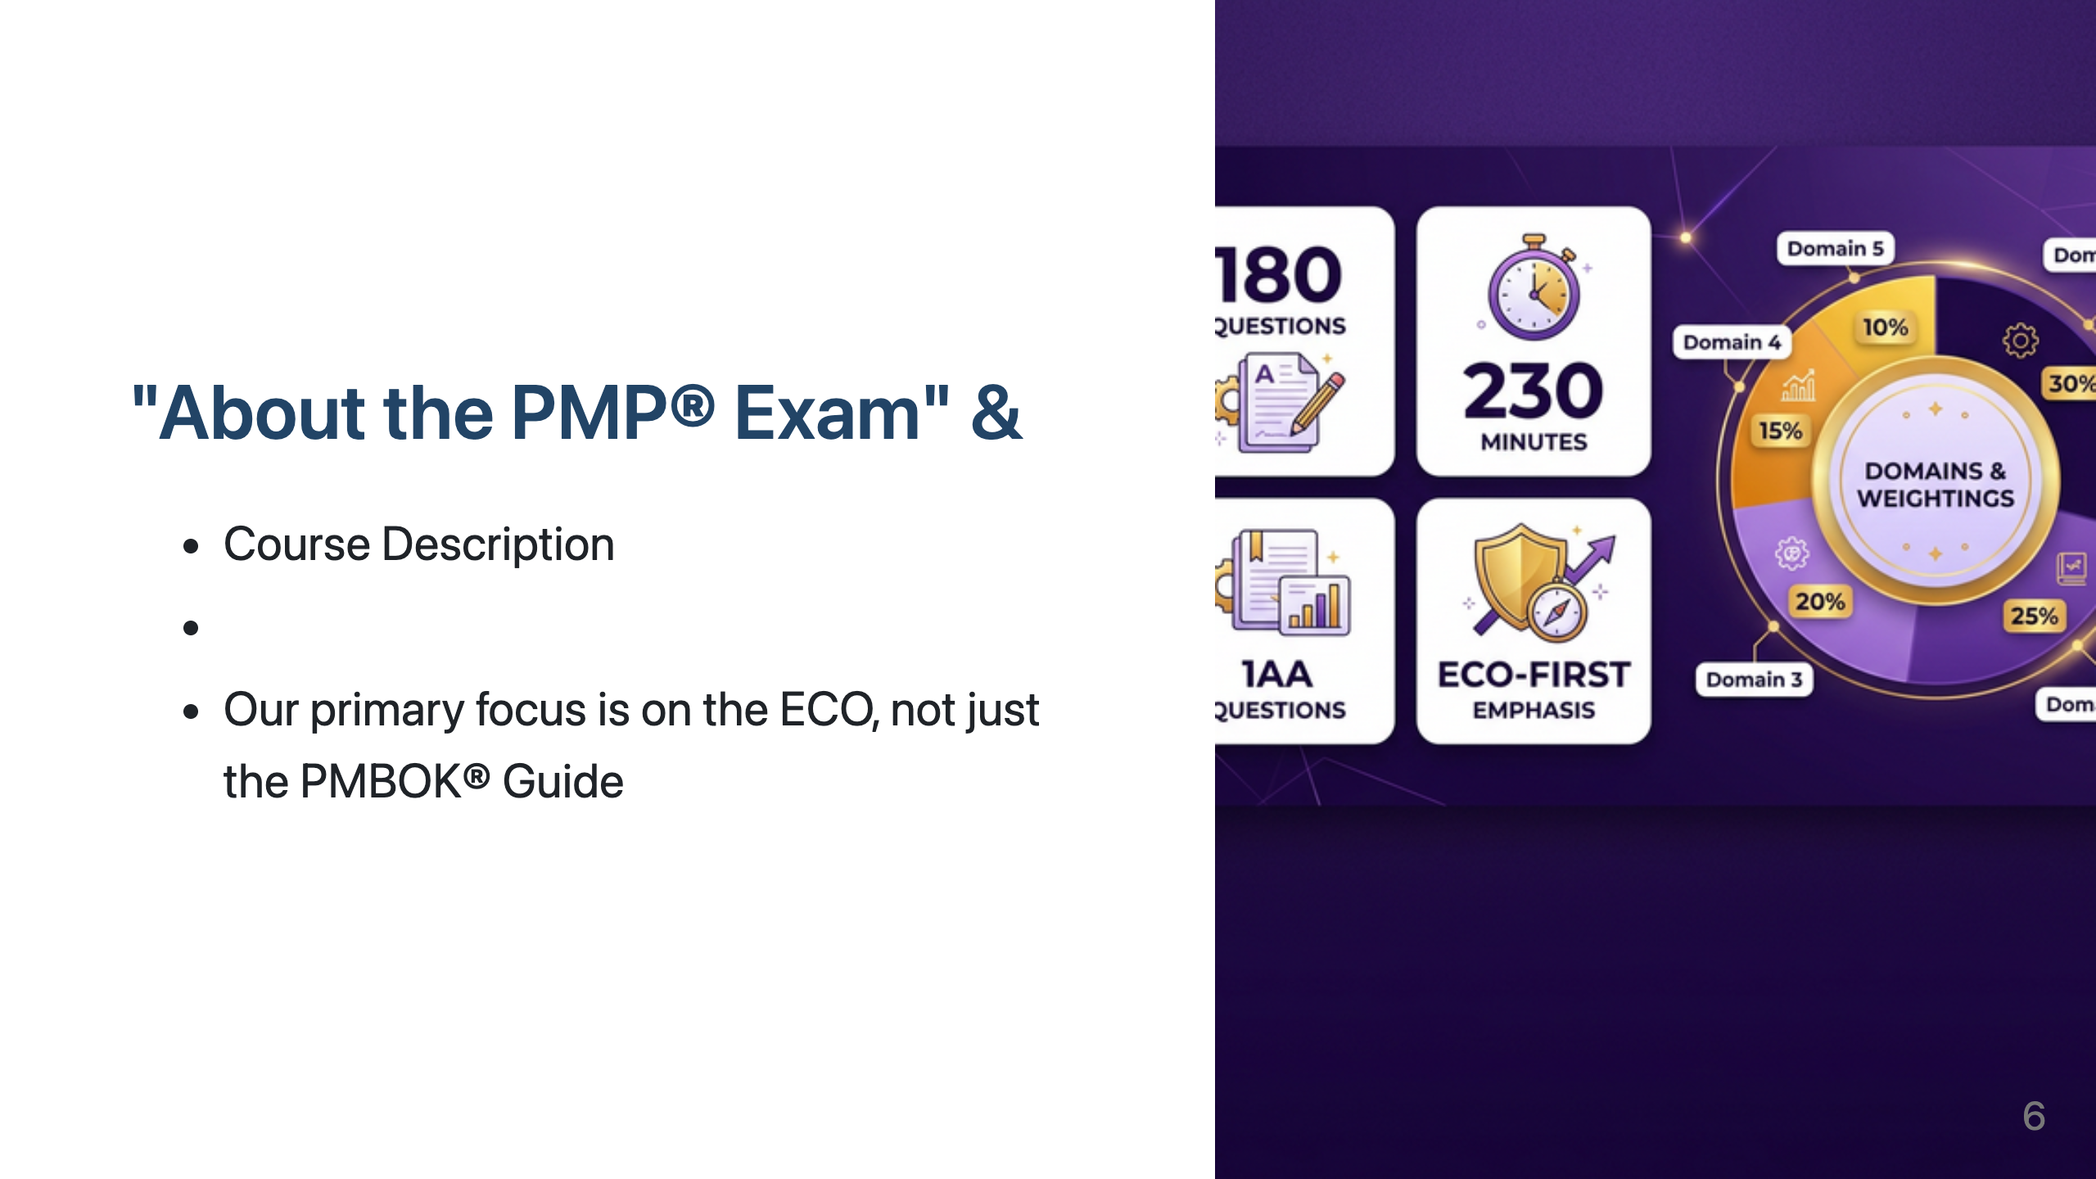
Notes:
Finally, let's briefly review the Project Management Process Groups.
These five groups – Initiating, Planning, Executing, Monitoring and Controlling, and Closing – represent the high-level phases of a project lifecycle.
Think of them as a framework that helps categorise when different project management processes typically occur, regardless of the specific methodology being used.
While the ECO is the blueprint for what to study, the Process Groups provide context for when certain processes are performed.

Slide 7
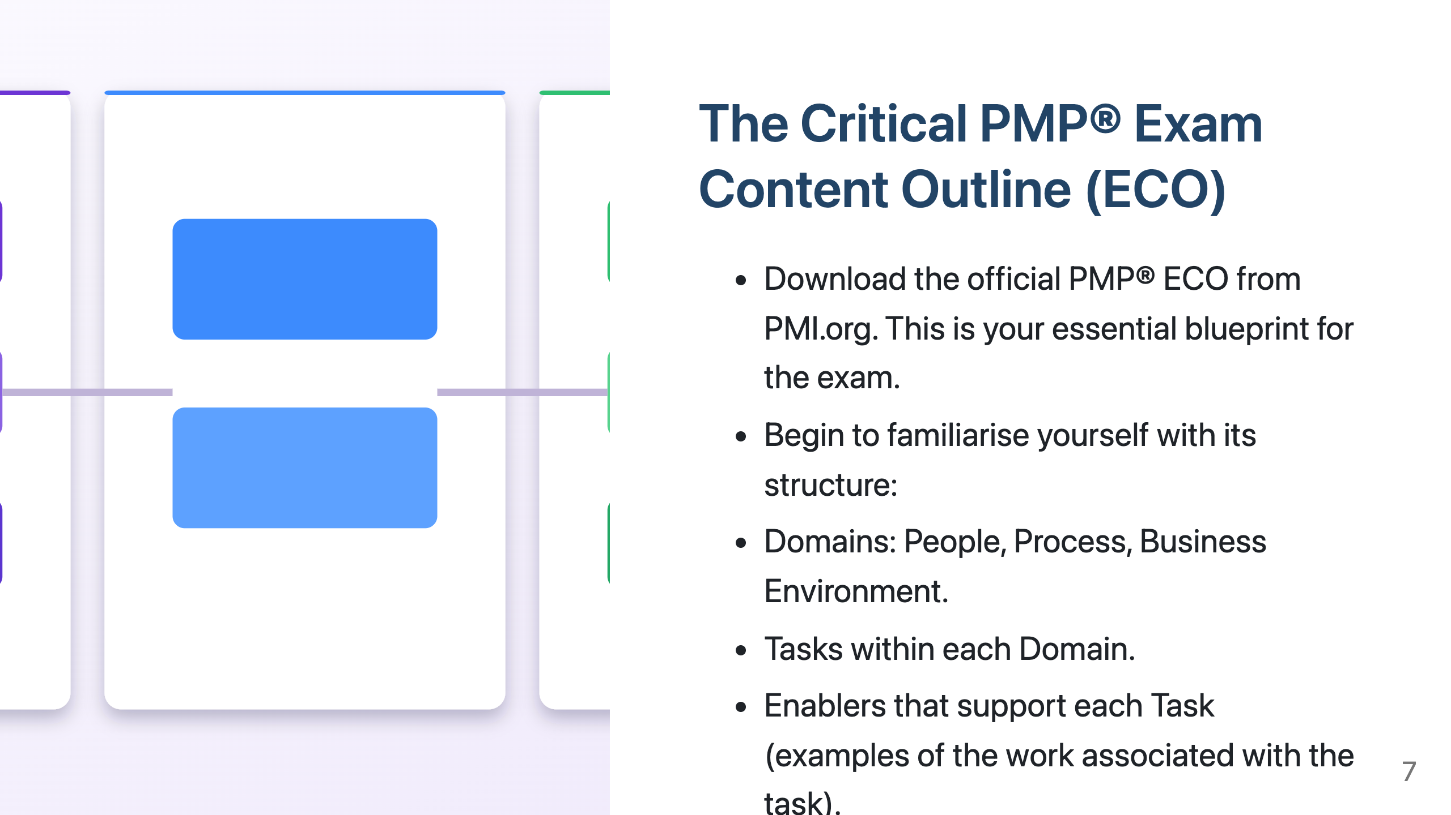
Notes:
Hopefully, you've already had a chance to look at any introductory materials we've provided about the PMP® Exam itself.
These sections usually cover important details about the exam format, the number of questions, the duration, and the types of questions you can expect.
Crucially, I want to reiterate the point made in our course description: our primary focus is on the PMP® Exam Content Outline, or ECO.
While the PMBOK® Guide is a valuable resource, the ECO is the document that directly outlines what you will be tested on. Our course is structured to ensure we cover each domain, task, and enabler within the ECO in detail.
Crucially, I want to reiterate the point made in our course description: our primary focus is on the PMP® Exam Content Outline, or ECO

Slide 8
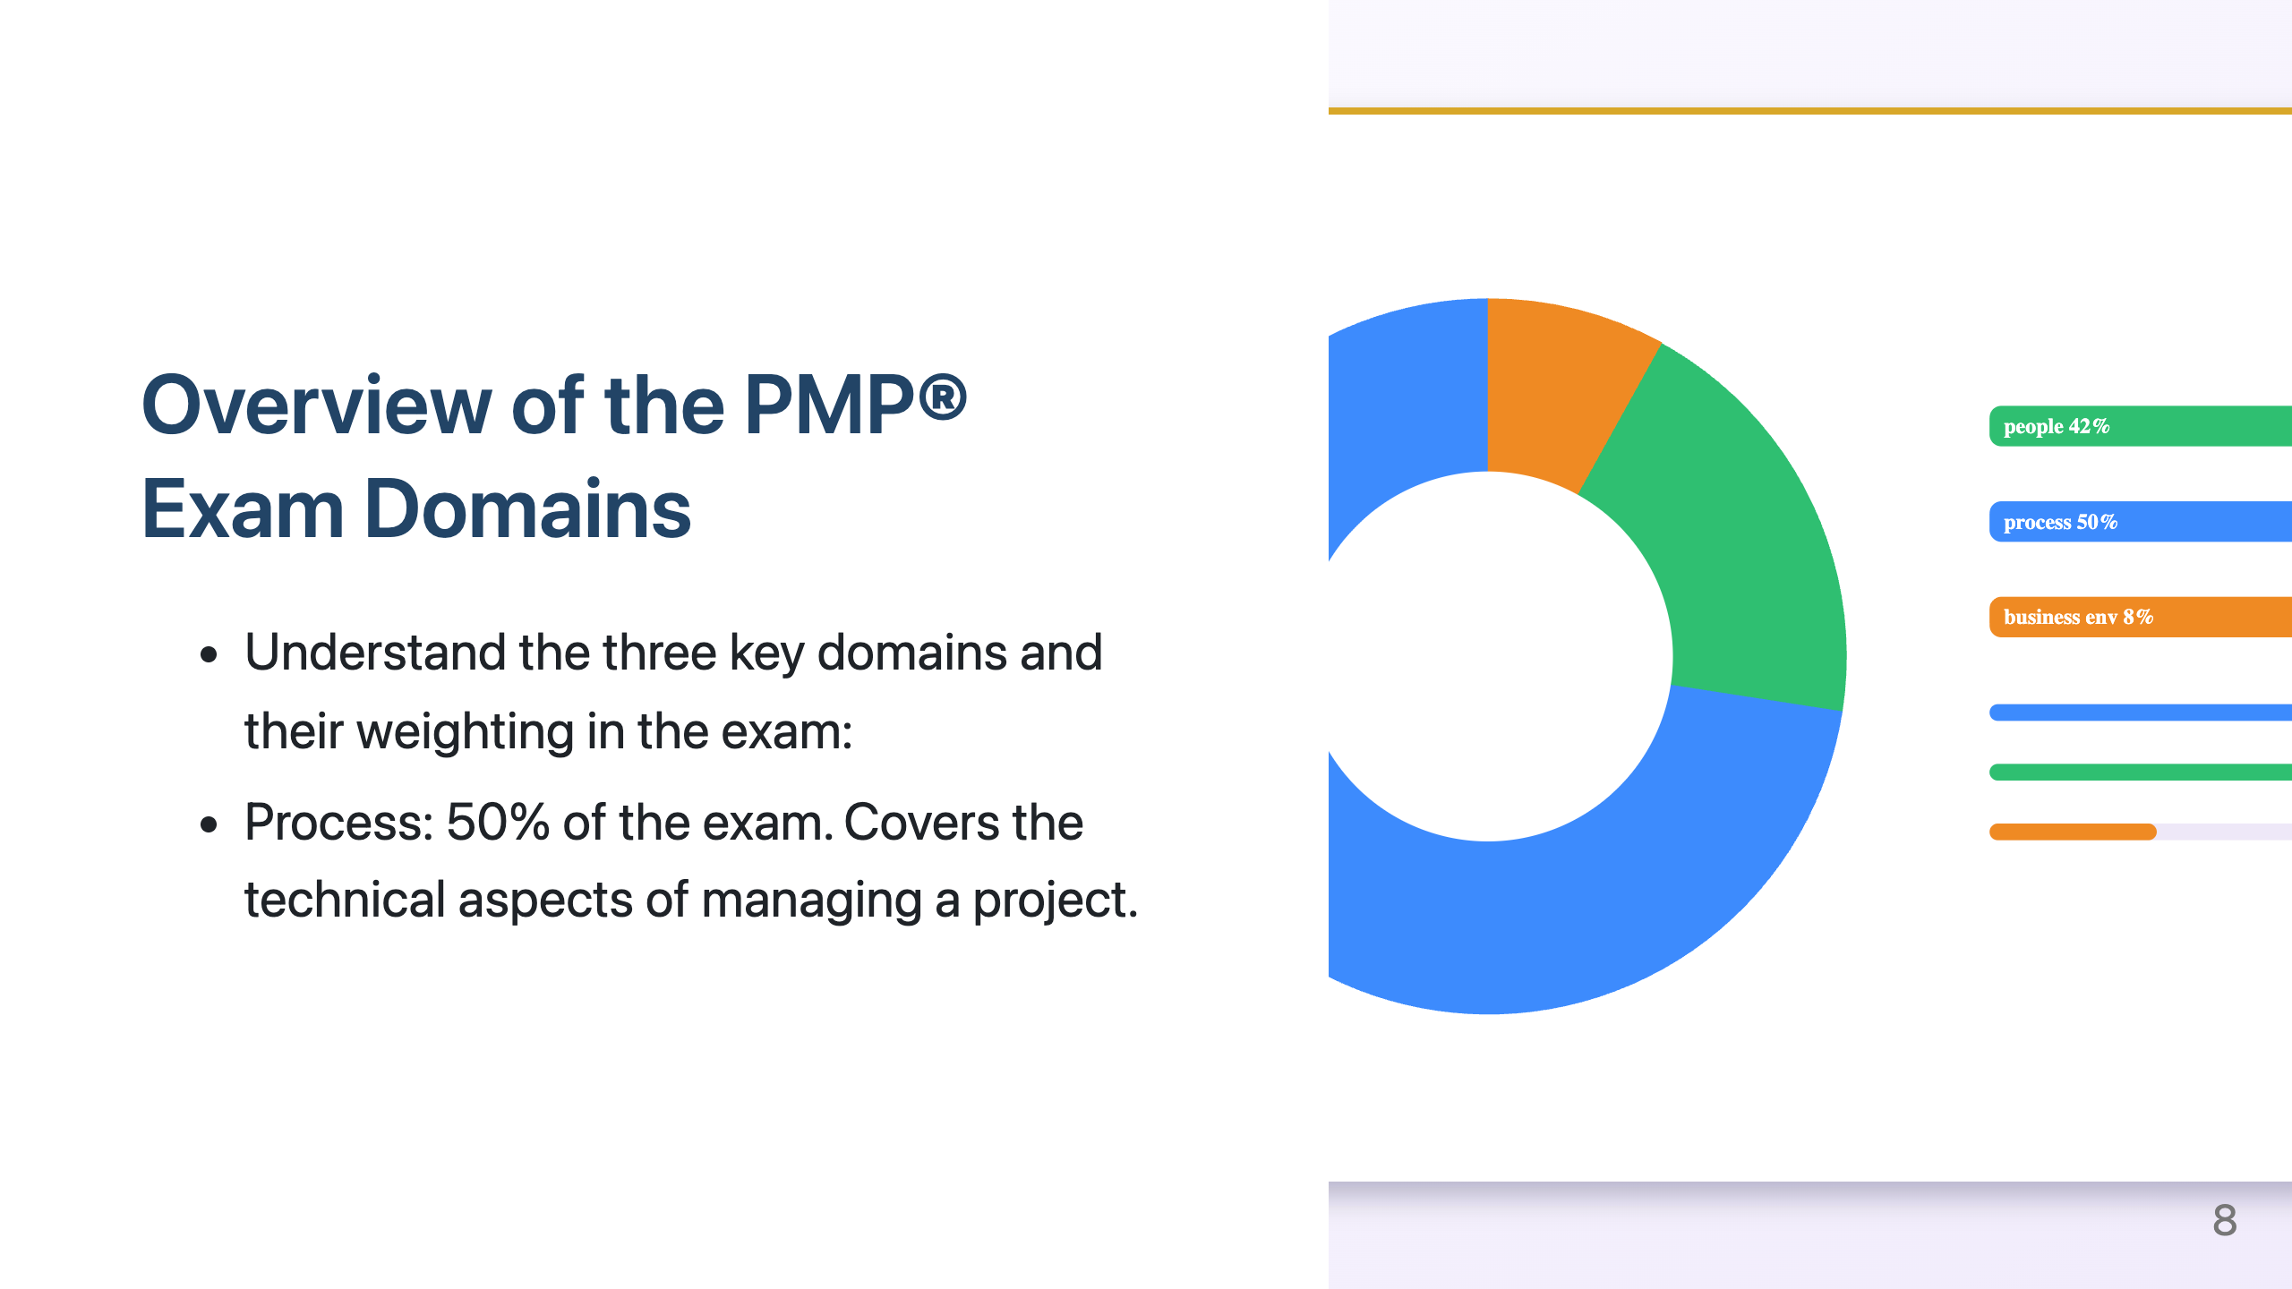
Notes:
If you haven't already, your absolute priority today is to download the official PMP® Exam Content Outline from the PMI website (www.pmi.org). Consider this document your most important guide throughout your preparation.
The ECO is structured into three key Domains: People, Process, and Business Environment.
Within each Domain, the ECO lists specific Tasks that a competent project manager should be able to perform.
For each Task, it then provides Enablers, which are examples of the types of activities or work that help you accomplish that task.
Understanding this hierarchical structure is key to navigating the exam content effectively.

Slide 9
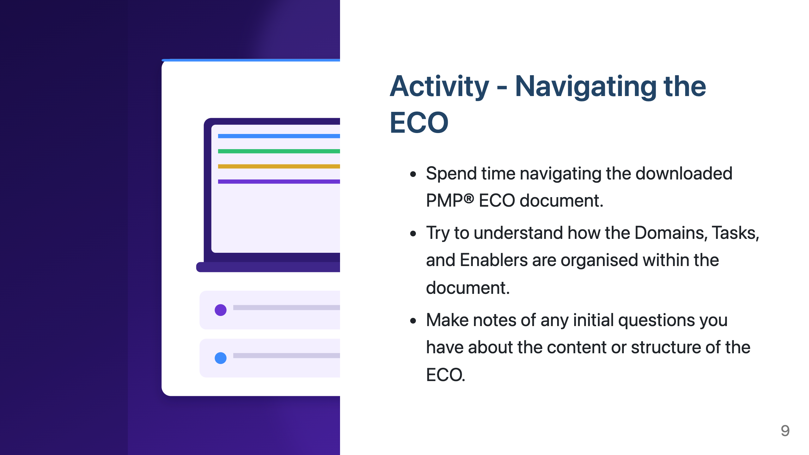
Notes:
Let's take a closer look at the three domains.
The 'People' domain, carrying 42% of the exam weight, emphasises the crucial skills needed to lead and manage project teams and engage effectively with all stakeholders.
The 'Process' domain, which constitutes the largest portion at 50%, focuses on the technical project management skills and knowledge required to plan, execute, monitor, and control the project.
Finally, the 'Business Environment' domain, at 8%, examines your understanding of how projects align with the overall business strategy, how to deliver value, and how to manage compliance and organisational change.
Keep these weightings in mind as you plan your study, as they indicate the relative emphasis on each area in the exam.

Slide 10

Notes:
_class: tips

Slide 11
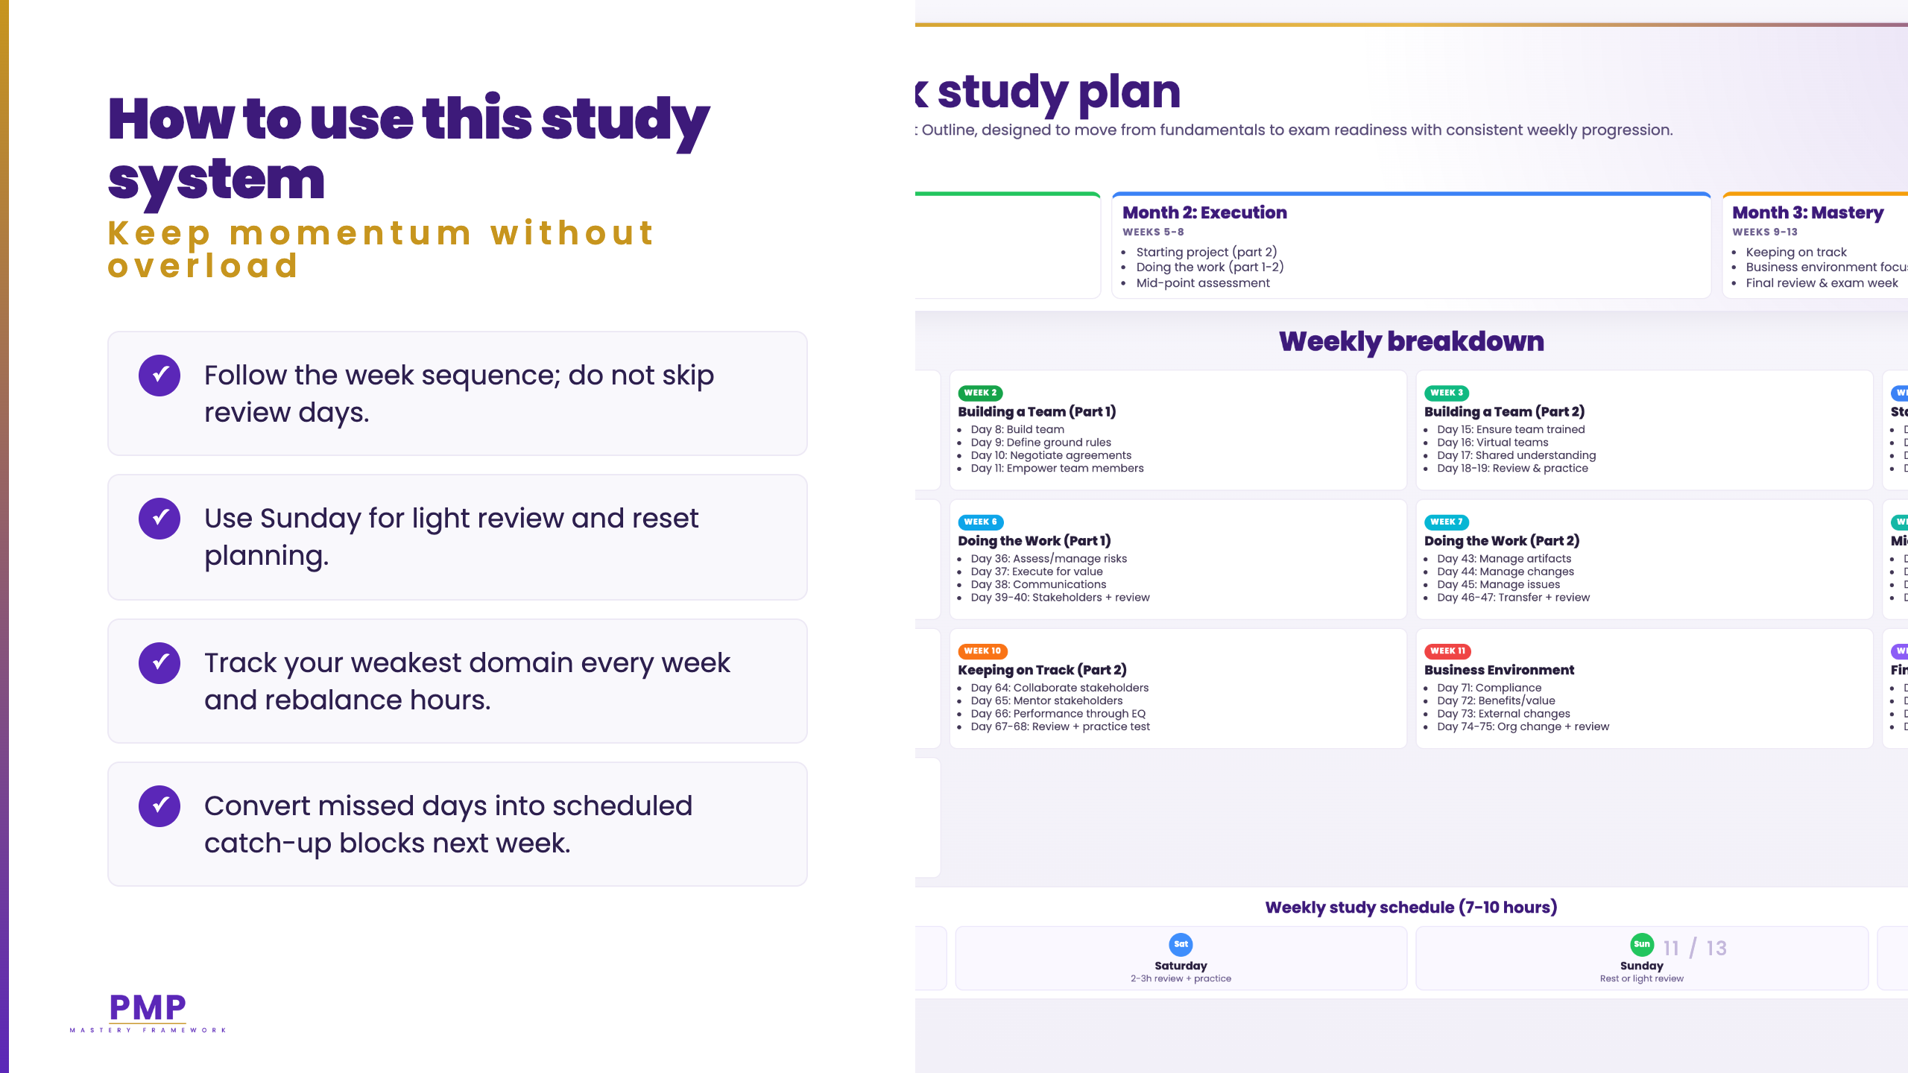

Slide 12
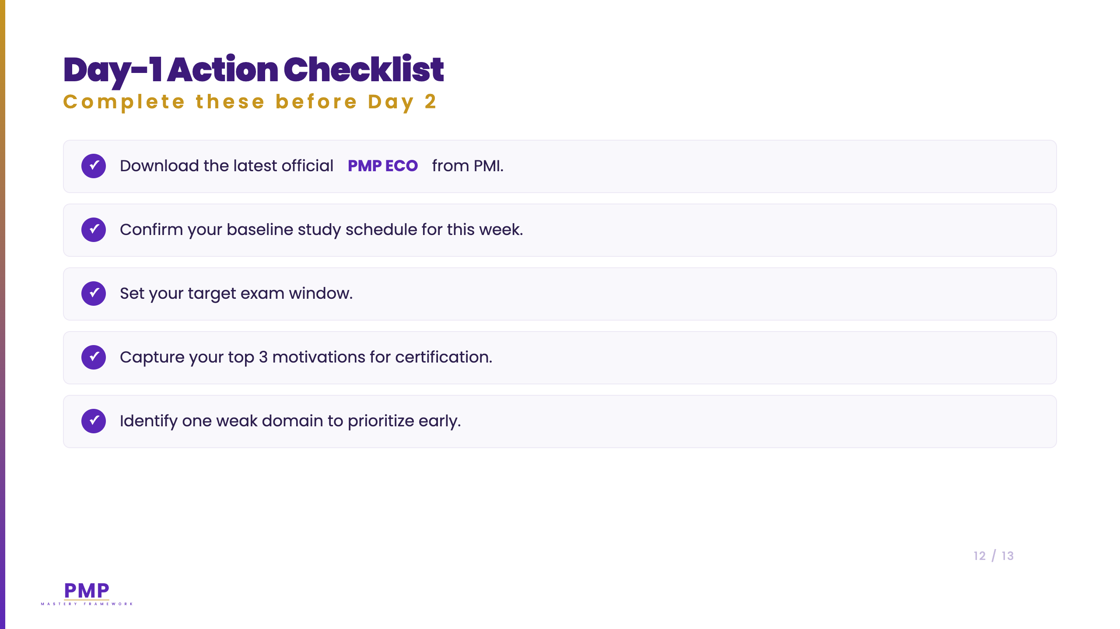

Slide 13
