Slide 1
Analysis of Early MOOC Participant Data
Draft Presentation
Fannie Tseng, Fall 2015

Slide 2
Early Expectations about MOOCs
“(MOOCs): The End of the University as We Know It”, The American Interest, December 12, 2012
“I can see a day soon where you’ll create your own college degree by taking the best online courses from the best professors from around the world — some computing from Stanford, some entrepreneurship from Wharton, some ethics from Brandeis, some literature from Edinburgh — paying only the nominal fee for the certificates of completion. It will change teaching, learning and the pathway to employment.”, Thomas Friedman, NY Times, January 26, 2013,

Slide 3
The Dataset
Available from HarvardX and MITX
Example courses: Quantitative Methods in Clinical & Public Health Research, Electricity and Magnetism, The Ancient Greek Hero, Introduction to Computer Science I
Advantages: Large (641,138 person-course observations), relatively clean, already in rectangular format
Disadvantages: Already pre-processed by EdX researchers and much of the class interaction data has been summarized, leaving a lot of valuable information out.

Slide 4
Outcome variables
registered: signed up for course
viewed: anyone who accessed the ‘Courseware’ tab (the home of the videos, problem sets, and exams) within the edX platform for the course.
explored: administrative, 0/1; anyone who accessed at least half of the chapters in the courseware
certified: anyone who earned a certificate. Certificates are based on course grades, and depending on the course, the cutoff for a certificate varies from 50% - 80%.

Slide 5
Class Interaction Variables
nevents
ndays_act
nplay_video
nchapters
nforum_posts

Slide 6
Key research questions
Can unsupervised learning be used to identify alternate outcome groups, based on limited class interaction variables.
Possible Methods: Clustering
Can supervised learning, class information and limited demographic information be used to predict class outcomes?
Possible Methods: K-nearest neighbor

Slide 7
Possible Implications
By detecting alternate groups, we can more fully describe students’ experiences with MOOCs and identify places where students typically give up.
If MOOCs truly democratizes education, we would expect that demographic variables cannot predict whether or not a student finishes a course. I hope that this analysis can shed some light on this.

Slide 8
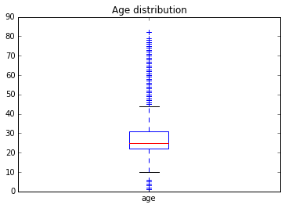
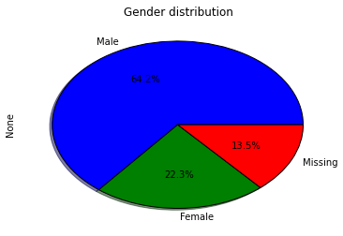
Basic demographic characteristics of sample

Slide 9
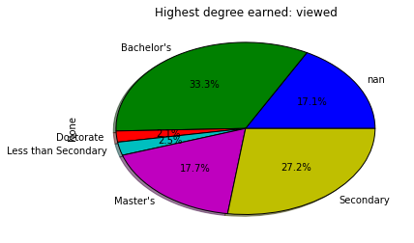
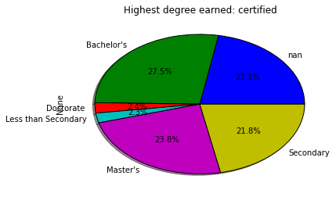
Comparison of Highest Degree Earned by Outcome

