Slide 1
Analysis of Early MOOC Participant Data
Final Presentation
Fannie Tseng, January 2016

Slide 2
The Dataset
Course-taking during 2012-13 school year
Example courses: Quantitative Methods in Clinical & Public Health Research, Electricity and Magnetism, The Ancient Greek Hero, Introduction to Computer Science I
Looked specifically at: Introduction to Computer Science (CS50)and Justice
Sample Sizes
Introduction to Computer Science: 169,621
Justice: 57,406

Slide 3
Outcome variables
registered: signed up for course
viewed: anyone who accessed the ‘Courseware’ tab (the home of the videos, problem sets, and exams) within the edX platform for the course.
explored: administrative, 0/1; anyone who accessed at least half of the chapters in the courseware
certified: anyone who earned a certificate. Certificates are based on course grades, and depending on the course, the cutoff for a certificate varies from 50% - 80%.

Slide 4
Class Interaction Variables
nevents
ndays_act
nplay_video
nchapters
nforum_posts

Slide 5
Analyses Conducted
K-means clustering to define student groups based on their interactions with the online course materials
Used supervised learning methods to predict class outcomes based on demographic variables

Slide 6
K-Means Clustering
Used different methods to determine optimal number of clusters (plotting, silhouette score, within cluster sum of squares)
Most clear cut method: silhouette score
Plotting and within cluster sum of squares good to narrow down possible ranges of clusters

Slide 7
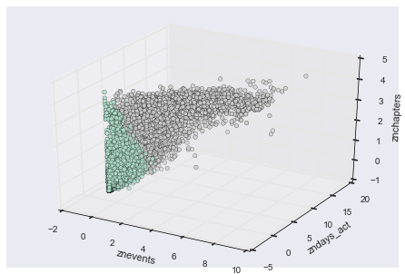
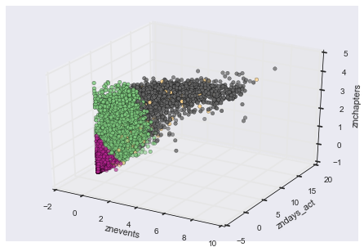
Example: Justice Clustering
TWO CLUSTERS
FOUR CLUSTERS

Slide 8
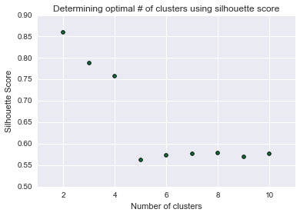
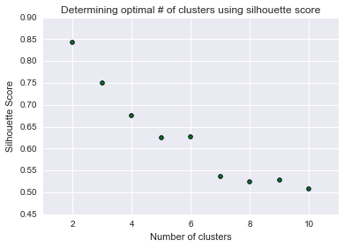
Conclusion: 2 clusters worked best for both courses
CS50
Justice

Slide 9
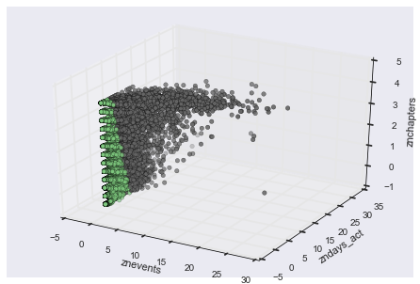
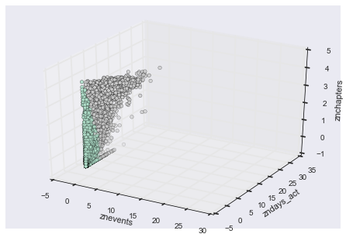
Course Interaction Clustering
CS50
Justice
SILHOUETTE SCORE = 0.86
SILHOUETTE SCORE = 0.84

Slide 10
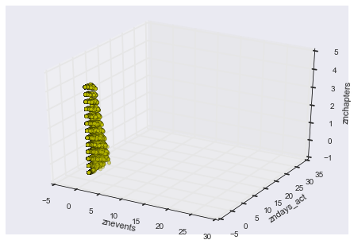
Characterizing Cluster 1 (CS50)
N = 164,145
Shallow interactions with course.
On average, interacted with the course about 5 times, with 1 chapter (out of 12) and was active for 1 day total.
Interestingly, 51 students in cluster 1 received certificates

Slide 11
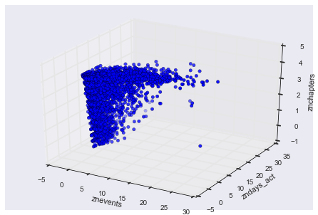
Characterizing Cluster 2 (CS50)
N = 5,471
Active with course, especially distinguished by number of interaction events
On average, interacted with the course about 219 times, with 10 chapters (out of 12) and was active for 23 days total.
23% received certificates

Slide 12
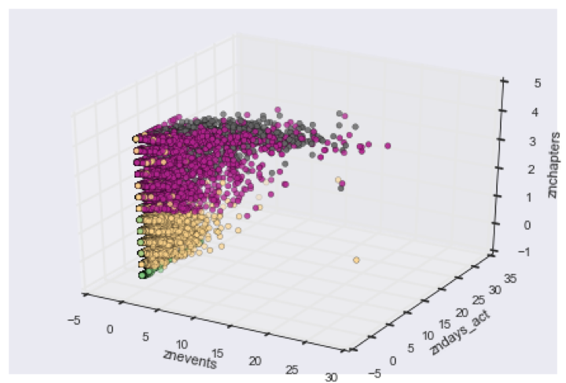
Comparing Clustering to Course Outcomes (CS50)

Slide 13
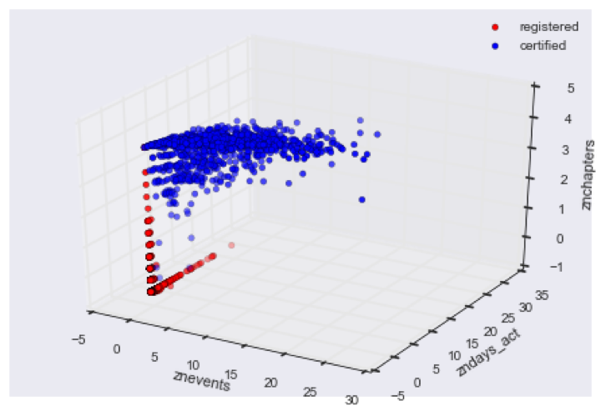
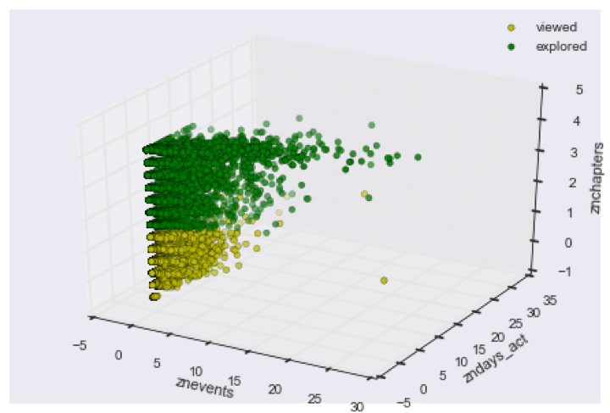
Outcomes Registered and Certified Vs. Viewed and Explored (CS50)

Slide 14
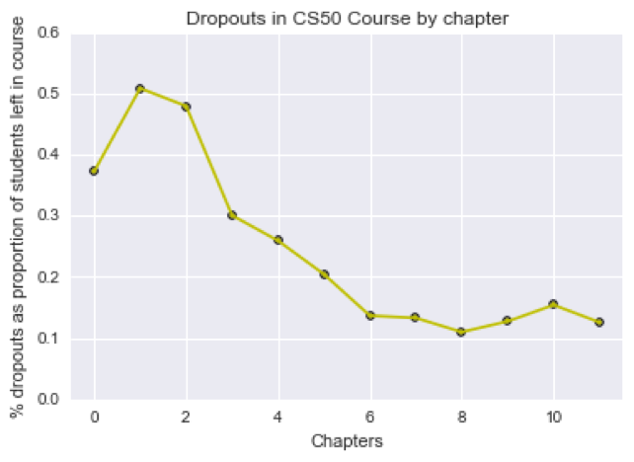
Where students drop out of CS50

Slide 15
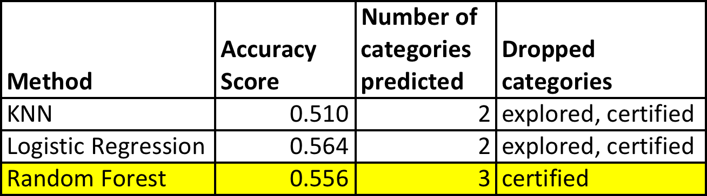
Finally, can demographic characteristics be used with supervised learning to predict course outcomes?
Used logistic regression, KNN and random forest to predict course outcomes

Slide 16
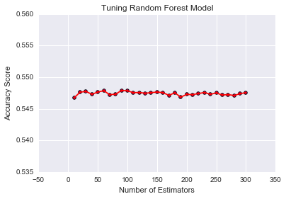
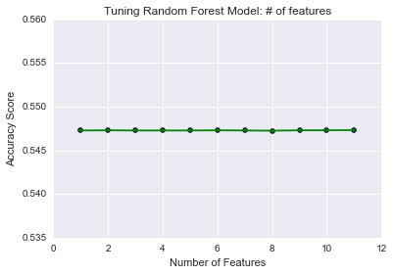
Random Forest Tuning

Slide 17
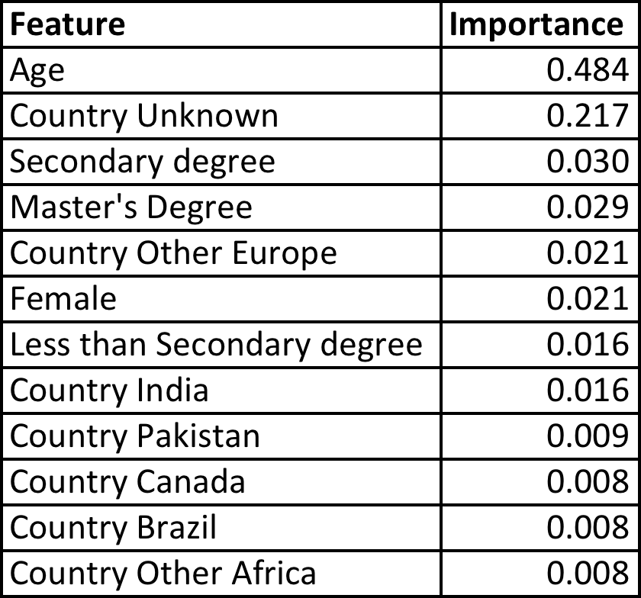
Feature Importance (demographic characteristics only)

Slide 18
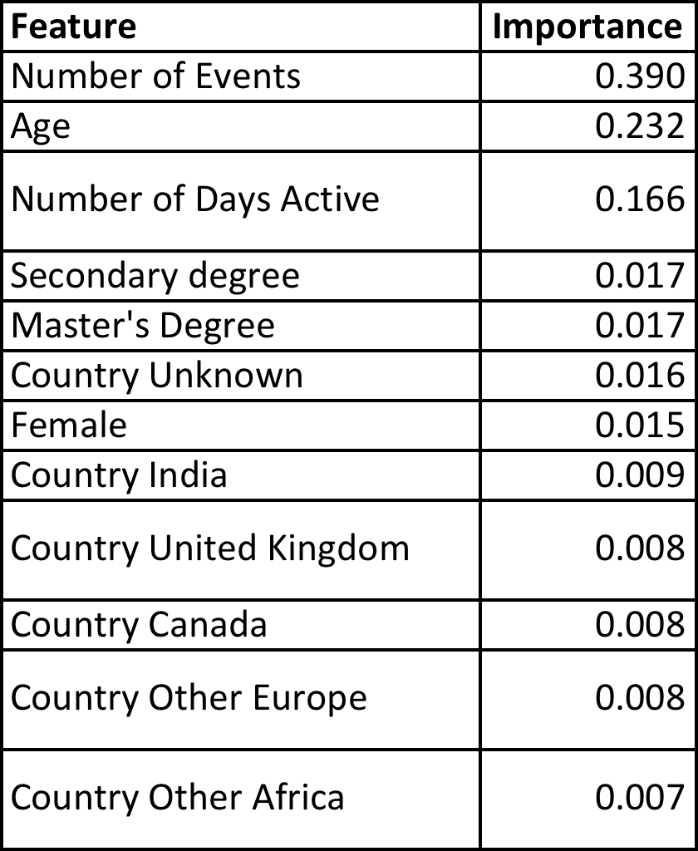
Feature importance (including course interactions)
Adding course interactions increased OOB R-squared from 0.556 to 0.581

Slide 19
Conclusions
To answer the question “Did the CS50 and Justice ‘democratize’ education for the course participants?”, my answer is: “sort of”.
Demographic characteristics (most prominently, age and education) were important factors in predicting course outcomes.
At the same time, the models were pretty weak overall, and every model dropped the “certified” outcome.
As shown in clustering analyses, MOOCs provide course participants with the freedom to interact with materials in different ways.
Definition of “success” is obscured by fact that a large percentage of students are very shallow participants in courses.

