Slide 1

Machine Learning Applications in Online Marketing: Challenges and Opportunities
Ms S Varsha, Assistant Professor,
A Muhilarasan,
D Bhuvaneshwar,
Department of Computer Science And Applications,
Jeppiaar College of Arts and Science ,Padur, Chennai

Slide 2
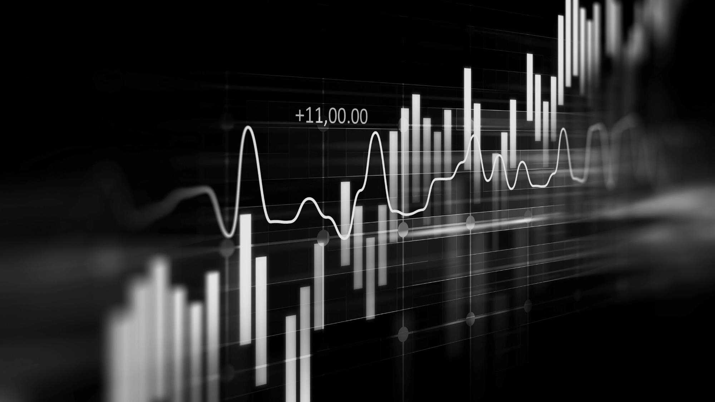
ABSTRACT
Abstract
Online marketing has become a crucial tool for businesses striving to engage effectively with their audiences in the digital age. The vast amounts of data generated through online interactions present unprecedented opportunities to apply machine learning techniques for enhancing marketing strategies. This paper examines the integration of machine learning approaches to optimize key aspects of online marketing, including audience segmentation, personalized content delivery, and campaign performance prediction. By employing acombination of supervised and unsupervised learning models, the study uncovers patterns in consumer behavior, forecasts future trends, and improves decision-making processes. Furthermore, it addresses ethical considerations and challenges, particularly concerning data privacy and algorithmic fairness, associated with the use of machine learning in marketing. The findings provide actionable insights for marketers and contribute significantly to the
evolving domain of AI-driven marketing practices.
Keywords: Online marketing, machine learning, Digital advertising.
COSTS
Loss of potential income by not offering investment opportunities for businesses
USABILITY
Customers want something that’s easy to adopt and simple to use

Slide 3
INTRODUCTION
The digital landscape has shifted towards data-driven strategies, leveraging consumer data for personalization, optimization, and engagement. Machine learning (ML) addresses challenges in extracting meaningful insights, improving customer engagement, and targeting strategies. By analyzing large datasets, uncovering trends, segmenting audiences, and personalizing content, ML predicts consumer actions, increasing engagement, conversions, and brand loyalty. However, ML raises ethical concerns, including data privacy, bias, and transparency, prompting businesses to adopt ethical practices and ensure fairness in decision-making processes. Furthermore, ML also enables businesses to automate repetitive tasks, enhancing efficiency and productivity. Additionally, ML-driven analytics provides real-time feedback, allowing businesses to refine their marketing strategies and stay competitive. ML also helps businesses to identify new opportunities and revenue streams. Moreover, ML enables personalized customer experiences across multiple touchpoints and devices.

Slide 4

LITERATURE REVIEW
Integration and Transformation- Machine learning (ML) transforms online marketing through data-driven insights.- ML recognizes patterns in large datasets,conversion rates, and predicts consumer behavior.- Improves marketing ROI by optimizing budget allocation.- Enables real-time marketing decision-making.
Predictive Analytics- Predictive analytics forecasts consumer actions using historical dataAllocates marketing resources efficiently and develops targeted campaigns.- Identifies high-value customer segments and prioritizes marketing efforts.- Optimizes marketing channels and messaging for better results.
Customer Segmentation and Personalization- ML revolutionizes segmentation, moving beyond demographics to behavior-driven segments.- Analyzes vast data to identify specific customer groups and offers personalized experiences.- Increases customer satisfaction, brand loyalty, and conversion rates.- Enables dynamic content optimization and product recommendations.- Enhances customer journey mapping and experience design.

Slide 5

EXISTING SYSTEM
Google Ads' machine learning platform optimizes advertising campaigns through personalized targeting, predictive analytics, and continuous evaluation. It collects vast user interaction data, employs machine learning for customer segmentation and targeting, and personalizes ad content. The platform utilizes predictive models like Smart Bidding for optimized bidding strategies and tracks KPIs like conversion rate, CTR, and ROAS. Additionally, it leverages automated bidding strategies, dynamic ad optimization, and audience insights to refine marketing efforts. With a strong emphasis on ethical considerations, Google Ads prioritizes data transparency, responsible data handling, and fairness, mirroring the goals of improving ad targeting, personalization, and predictive analytics. Furthermore, it ensures compliance with data protection regulations like GDPR and CCPA, and provides users with control over their data and ad preferences.

Slide 6
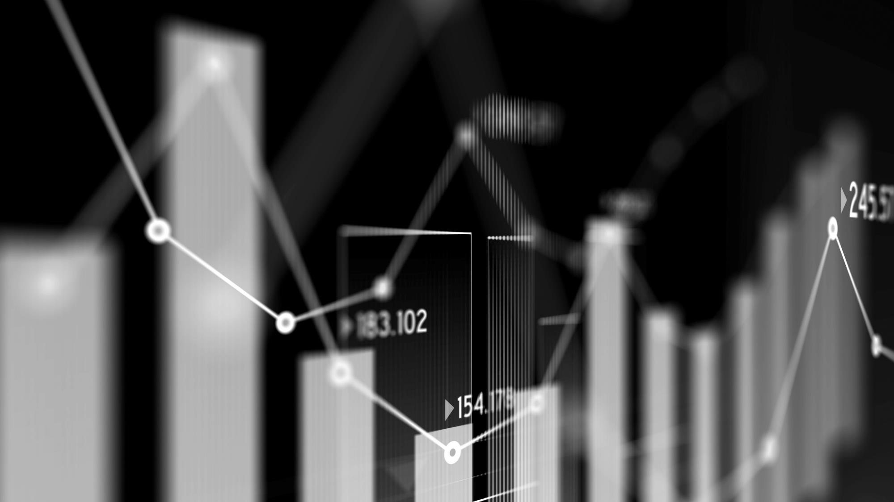
PROPOSED SYSTEM
This research proposes a machine learning (ml)-powered system to optimize online marketing by improving customer engagement, personalizing content, and increasing conversion rates. The system integrates data from multiple digital touchpoints, adhering to privacy regulations, and uses unsupervised ML techniques for customer segmentation. Advanced ML models enable personalized content recommendations, while predictive modeling forecasts customer behavior. The system optimizes campaigns in real-time, ensuring efficient marketing strategies and maximized ROI. An integrated ethical framework addresses data privacy concerns, minimizes algorithmic biases, and maintains transparency, aligning with data protection regulations. The system's success is evaluated through key performance indicators (kpis), including conversion rates, customer engagement, ROI and satisfaction

Slide 7

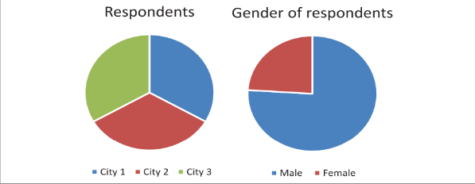
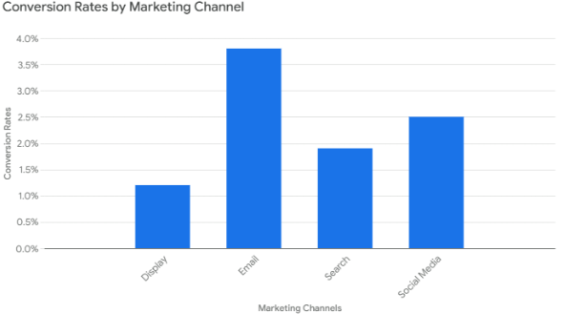
The image presents two pie charts displaying survey respondent data: one shows the distribution of respondents across three cities (City 1, City 2, and City 3) with each city represented by a distinct color, and the other shows the gender breakdown of the respondents (male and female, represented by blue and red respectively). Legends below each chart clarify the color coding for city and gender
This bar graph compares the conversion rates of different marketing channels (Display, Email, Search, and Social Media), with the height of each bar representing the percentage-based conversion rate achieved by that channel. The graph allows for a visual assessment of the relative effectiveness of each marketing strategy

Slide 8
RESULTS AND DISCUSSION
The proposed ML-powered system optimizes online marketing by enhancing customer engagement, personalizing content, and increasing conversion rates. It leverages techniques like unsupervised learning, collaborative filtering, and predictive modeling. ML-driven segmentation and personalization improve engagement and conversion rates, while predictive models optimize campaigns in real-time. The system prioritizes ethical considerations, including privacy compliance and data anonymization. Additionally, it enables real-time campaign optimization, improves return on investment (ROI), and enhances customer satisfaction. However, challenges remain, such as computational power, data quality, handling external factors, and mitigating algorithmic biases.

Slide 9
CONCLUSION
The proposed ML-powered system offers a promising approach to optimizing online marketing by enhancing customer engagement, personalizing content, and improving conversion rates through advanced techniques like customer segmentation, predictive modeling, and real-time campaign optimization. However, successful implementation requires addressing challenges related to data privacy, algorithmic bias, and computational resources. Ethical considerations, particularly around privacy and transparency, must be carefully managed to maintain consumer trust. As ML and AI technologies evolve, the capabilities will improve, enabling businesses to achieve even greater personalization and efficiency, but ongoing attention to ethical standards is crucial for success in the dynamic marketing landscape.

Slide 10
REFERENCES
[1] Ashok, M., Madan, R., Joha, A. and Sivarajah, U., 2022. Ethical framework for Artificial Intelligence and Digital technologies. International Journal of Information Management, 62, p.102433.
[2] Dohale, V., Akarte, M., Gunasekaran, A. and Verma, P., 2022. Exploring the role of artificial intelligence in building production resilience: learnings from the COVID-19 pandemic. International Journal of Production Research, pp.1-17.
[3] Vrontis, D., Christofi, M., Pereira, V., Tarba, S., Makrides, A. and Trichina, E., 2022.The International Journal of Human Resource Management, 33(6), pp.1237-1266.
[4] Ghillani, D., 2022. Deep Learning and Artificial Intelligence Framework to Improve the Cyber Security. Authorea Preprints.
[5] Jaiswal, A., Arun, C.J. and Varma, A., 2022. Rebooting employees: Upskilling for artificial intelligence in multinational corporations. The International Journal of Human Resource Management, 33(6), pp.1179-1208.

Slide 11
THANK YOU..!

