Slide 1


Vision Transformers vs. Convolutional Neural Networks in Tuberculosis Detection: A Comparative Study of Learning Paradigms
Presented by
D. Bhuvaneshwar,
J. Deepika ,
S. Shalini and
S. Varalakshmi of II B.Sc CS
Jeppiaar College of Arts and Science
Padur, Chennai

Slide 2
AGENDA
Abstract
Introduction
Problem Statement
Existing System
Proposed System
Results and Discussion
Conclusion
Future Enhancement

Slide 3

ABSTRACT
Tuberculosis (TB) remains a significant global health challenge, necessitating efficient and accurate diagnostic techniques. Deep learning based medical image analysis has shown promising results, with Convolutional Neural Networks (CNNs) being the dominant approach due to their ability to extract spatial hierarchies of features. However, the recent advancement of Vision Transformers (ViTs) has introduced a novel paradigm that relies on self-attention mechanisms to capture global contextual information. This study presents a comparative analysis of ViT and CNN architectures for tuberculosis detection using chest X-ray images. The evaluation considers key factors such as accuracy, computational efficiency, robustness to noise, and data requirements. While CNNs demonstrate superior performance on small datasets due to their inductive biases, ViTs outperform CNNs when trained on large-scale data by leveraging long-range dependencies.

Slide 4

INTRODUCTION
This study compares Convolutional Neural Networks (CNNs) and Vision Transformers (ViTs) for tuberculosis (TB) detection using chest X-ray (CXR) images. Traditional TB diagnostics, like sputum tests and GeneXpert assays, are time-consuming and costly, making CXR a valuable tool, particularly in low-resource settings.
CNNs are effective for smaller datasets and computationally efficient, but they struggle with capturing long-range dependencies in images. ViTs, which use self-attention to process images in patches, excel at capturing global context and can perform well with large datasets. However, they require more data and computational resources
This research aims to highlight the strengths and limitations of each approach, helping to develop more accurate, efficient, and accessible AI-driven TB detection tools to improve early diagnosis and patient outcomes globally.

Slide 5

PROBLEM STATEMENT
Tuberculosis (TB) is one of the world’s deadliest infectious diseases, causing over 10.6 million cases and 1.3 million deaths in 2024, according to the World Health Organization (WHO). Despite global efforts, nearly 4 million cases remain undiagnosed or unreported each year, contributing to ongoing transmission. The traditional diagnostic methods, such as sputum smear microscopy (50-60% sensitivity) and culture tests (6-8 weeks for results), are slow, resource-intensive, and inaccessible in many low-income regions. The objective is to enhance early detection, improve diagnostic accuracy, and facilitate timely treatment, ultimately reducing the burden of tuberculosis and saving lives.

Slide 6




CAUSES FOR TUBERCULOSIS
Using Alcohol
Smoking
Tuberculosis
Having Diabetes
Injection of
Drugs

Slide 7
S
LITERATURE REVIEW
Early AI Models in TB Detection (CNN-Based Approaches)
CNNs have been used for TB detection since the early 2000s, effectively classifying chest X-rays by extracting features automatically. Notable studies, like Lakhani et al. (2017), showed CNNs' ability to accurately distinguish TB from other lung diseases, while Rajpurkar et al. (2018) developed CheXNet, which also proved effective for detecting TB.
Vision Transformers (ViTs) in Medical Imaging
ViTs, which process images as patches and use self-attention, have shown promise for TB detection. Studies like those by Dosovitskiy et al. (2020) and Tung et al. (2021) suggest ViTs can outperform CNNs, especially with large datasets, due to their ability to model global context and long-range dependencies, which is crucial for detecting TB lesions across the lungs.

Slide 8
EXISTING SYSTEM
Several systems have used CNNs within the Weka platform to predict tuberculosis (TB) from chest X-ray images. One such system integrates the WekaDeeplearning4j package, allowing users to train CNN models within Weka. The dataset, containing TB-positive and TB-negative X-rays (e.g., from Kaggle or Mendeley Data), is preprocessed into Weka-compatible formats (ARFF or CSV) and converted into numerical data via feature extraction. A CNN classifier is trained using the Dl4jMlpClassifier, with layers like convolutional, pooling, and fully connected, while hyperparameters such as learning rate and batch size are fine-tuned.
After training, the model achieves 63.1% accuracy, with evaluation metrics like precision, recall, and F1-score confirming its reliability in TB detection. This demonstrates how deep learning integrated into Weka can enhance automated TB diagnosis, improving early detection and medical decision-making.

Slide 9
PROPOSED SYSTEM
A proposed system for detecting tuberculosis (TB) caused by smoking utilizes Vision Transformers (ViTs) for enhanced image analysis and pattern recognition. Unlike traditional convolutional neural networks (CNNs), ViTs process chest X-ray images using self-attention mechanisms, capturing global dependencies within the image to detect TB-related abnormalities linked to smoking. The system follows a structured approach:
1. Data Collection & Preprocessing: Chest X ray images and patient history, including smoking habits, are gathered from medical datasets (e.g., NIH, Mendeley, or Kaggle). Images are resized, normalized, and augmented to generalization. 2. Feature Extraction enhance using model Vision Transformers: The ViT model divides images into patches, processes them through a transformer encoder, and learns complex relationships between visual patterns. Additional patient metadata, such as smoking history and duration, is incorporated into the model for better predictive performance.

Slide 10
PROPOSED SYSTEM
3. Model Training & Optimization: The system is trained on labeled data (TB positive and TB-negative cases) with an adaptive learning rate scheduler and cross entropy loss function to enhance classification accuracy
4. Prediction & Evaluation: The model predicts TB presence based on chest X-ray patterns and smoking-related risk factors. Performance metrics like accuracy, precision, recall, and F1-score validate system effectiveness.
5. Deployment & Clinical Integration: The system is integrated into Weka with TensorFlow/PyTorch backend to allow easy usage by medical professionals
Preprocessing
Tuberculosis Dataset
Classiification Algorithm
Results

Slide 11
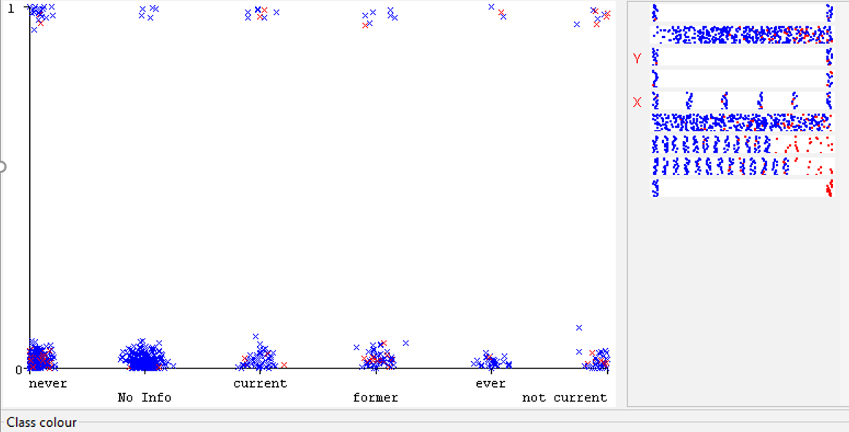
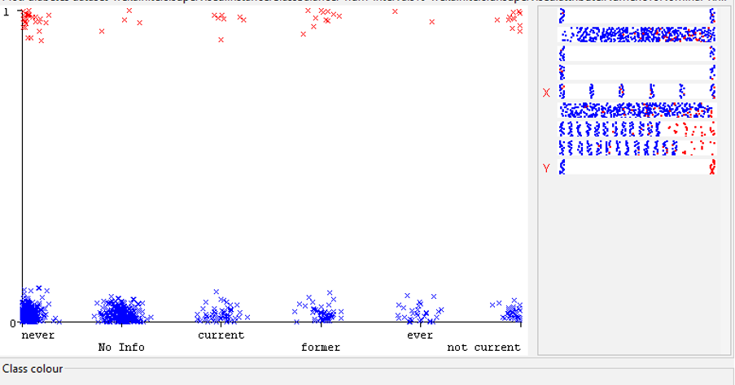
CNN VS ViT
Evaluation Metrices | CNN | ViT
Precision | 0.631 | 0.896
Accuracy | 0.655 | 0.898

Slide 12
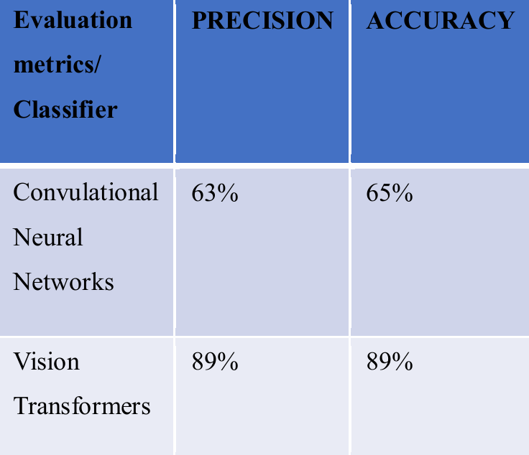
RESULTS AND DISCUSSION
According to the above results the CNN shows good results and precision value compared to the ViT values. So Tuberculosis prediction is more accurate by ViT technique which focuses on 89% of the given data than the Convulational Neural Networks.

Slide 13
CONCLUSION
“OUR INDIA WILL BECOME A TUBERCULOSIS LESS COUNTRY”
In conclusion, our findings using Vision Transformers (ViTs) confirm that smoking significantly contributes to tuberculosis (TB). ViTs effectively analyze chest X-ray images and patient data to identify patterns of lung damage linked to smoking and TB. The model’s self-attention mechanism reveals a strong correlation between smoking and an increased risk of TB, with smokers experiencing more severe disease progression. Passive smoking is also found to contribute to TB transmission, highlighting the importance of early detection and prevention.
”

Slide 14

FUTURE ENHANCEMENT
Future studies should focus on refining these architectures, exploring hybrid models that integrate the strengths of both CNNs and ViTs, and expanding evaluations across diverse medical imaging tasks. By addressing these areas, we can move toward more robust AI-driven diagnostic solutions, ultimately improving accuracy, efficiency, and patient outcomes in tuberculosis detection and beyond.

Slide 15

THANK YOU..!

