Slide 1

Mobile Angular UI

Slide 2

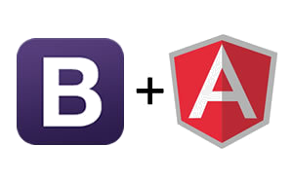

Mobile Angular UI
Mobile Angular UI is an HTML5 mobile UI framework that will let you use Angular Js and Bootstrap 3 for mobile app development.

Slide 3
Mobile Angular js contents
css
js

Slide 4
Bootstrap.css
css
base.css
hover.css
desktop.css

Slide 5
Angular js
js
core
components
gestures

Slide 6
Features of Mobile Angular UI
Accordion
Dropdowns
Modals And Overlays
Navbars
Scrollable Areas
Sections
Segmented Navigation
Sidebars
Toggle Switch
Tabs

Slide 7
Environmental setup
Install npm.
Install cordova .
npm install -g cordova.
create cordova project using the following command
cordova create hello com.example.hello HelloWorld
create android platform in cordova
cordova platform add android

Slide 8
Environmental setup
To get Mobile Angular UI 's js and bootstrap file inside the project
cordova project directory > yo mobileangularui
cordova project directory > gulp build
To run the project
cordova project directory > cordova build
cordova project directory > cordova emulate

Slide 9
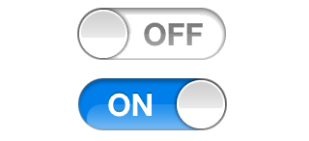
Toggle Switch
The ui-switch directive (not to be confused with ng-switch) lets you create a toggle switch control bound to a boolean ngModel value.
It requires ngModel.
Example
<ui-switch ng-model="invoice.paid"></ui-switch>

Slide 10

Tabs
css classes used Tabs are
nav-tabs
Mobile angular classes used in Tabs are
A SharedState state can be considered as a global variable identified by an id.
ui -state - Calls SharedState#initialize on the scope relative to the element using it.

Slide 11
ui-class
A simplified version of ngClass that evaluates in context of SharedState, it only suppors the {'className': expr} syntax.
ui-set
Calls SharedState#set when triggering events happens on the element using it.

