Slide 1

BCalculator
Aplicatie Android
Militaru Bogdan Alexandru

Slide 2


BCalculator help you to:
learn math
make homework
interaction with your smartphone or tablet
difference between long press and short press on a button
make your device to get alive
BCalculator

Slide 3
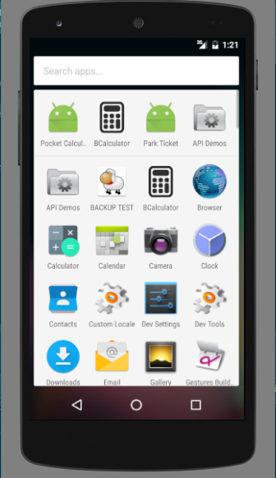
First Interaction With BCalculator
BCalculator

Slide 4
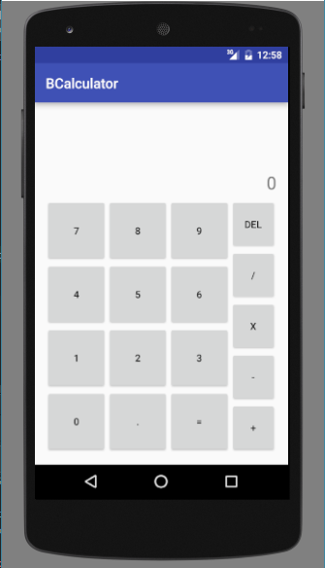
Application Window Bcalculator v1.0
You can execute operation like:
operation with decimal
addition
subtraction
multiply
divide
delete one or more character
show result
BCalculator

Slide 5
How it’s work ???
BCalculator

Slide 6
Type your equation and BOOOOOM
BCalculator

Slide 7
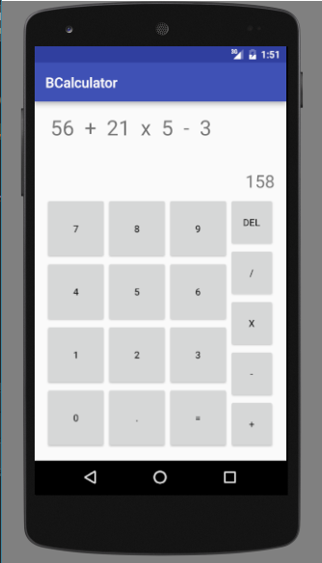
It’s simple and fast.
BCalculator

Slide 8
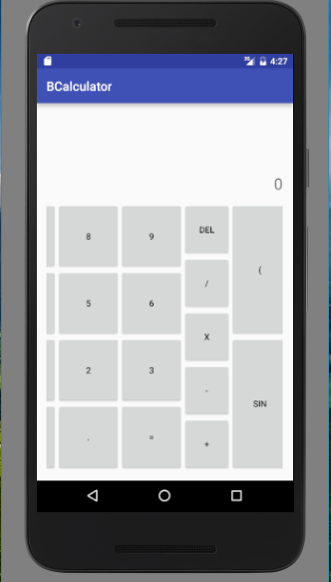
But now, just for your need, v2.0
BCalculator

Slide 9
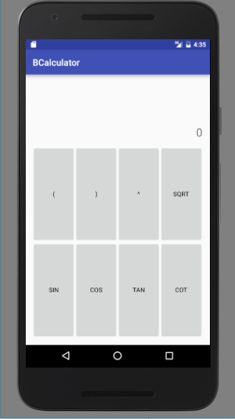
Which are the features?
parentheses
exponential operation
radical extraction
trigonometric functions
sin
cos
tangent
cotagent
BCalculator

Slide 10
It’s time for DEMO! BCalculator

Slide 11
That’s all! Thank you for watching.

