Slide 1
Enhancing the Angular Resolution of LHAASO
with Machine Learning
Zi-Hang Liu², Xing-Wei Gong¹, Xiao Tang¹, Lei He¹, Ruo-Yu Liu¹,
¹ School of Astronomy & Space Science, Nanjing University, Nanjing, China
² School of Physics, Nanjing University, Nanjing, China
Notes:
Good afternoon，I’m an undergraduate student from NANJING UNIVERSITY. I’m Liu ZIhang. On behalf of my parterner, and my teacher, I’m glad to have a talk about our research.

Slide 2
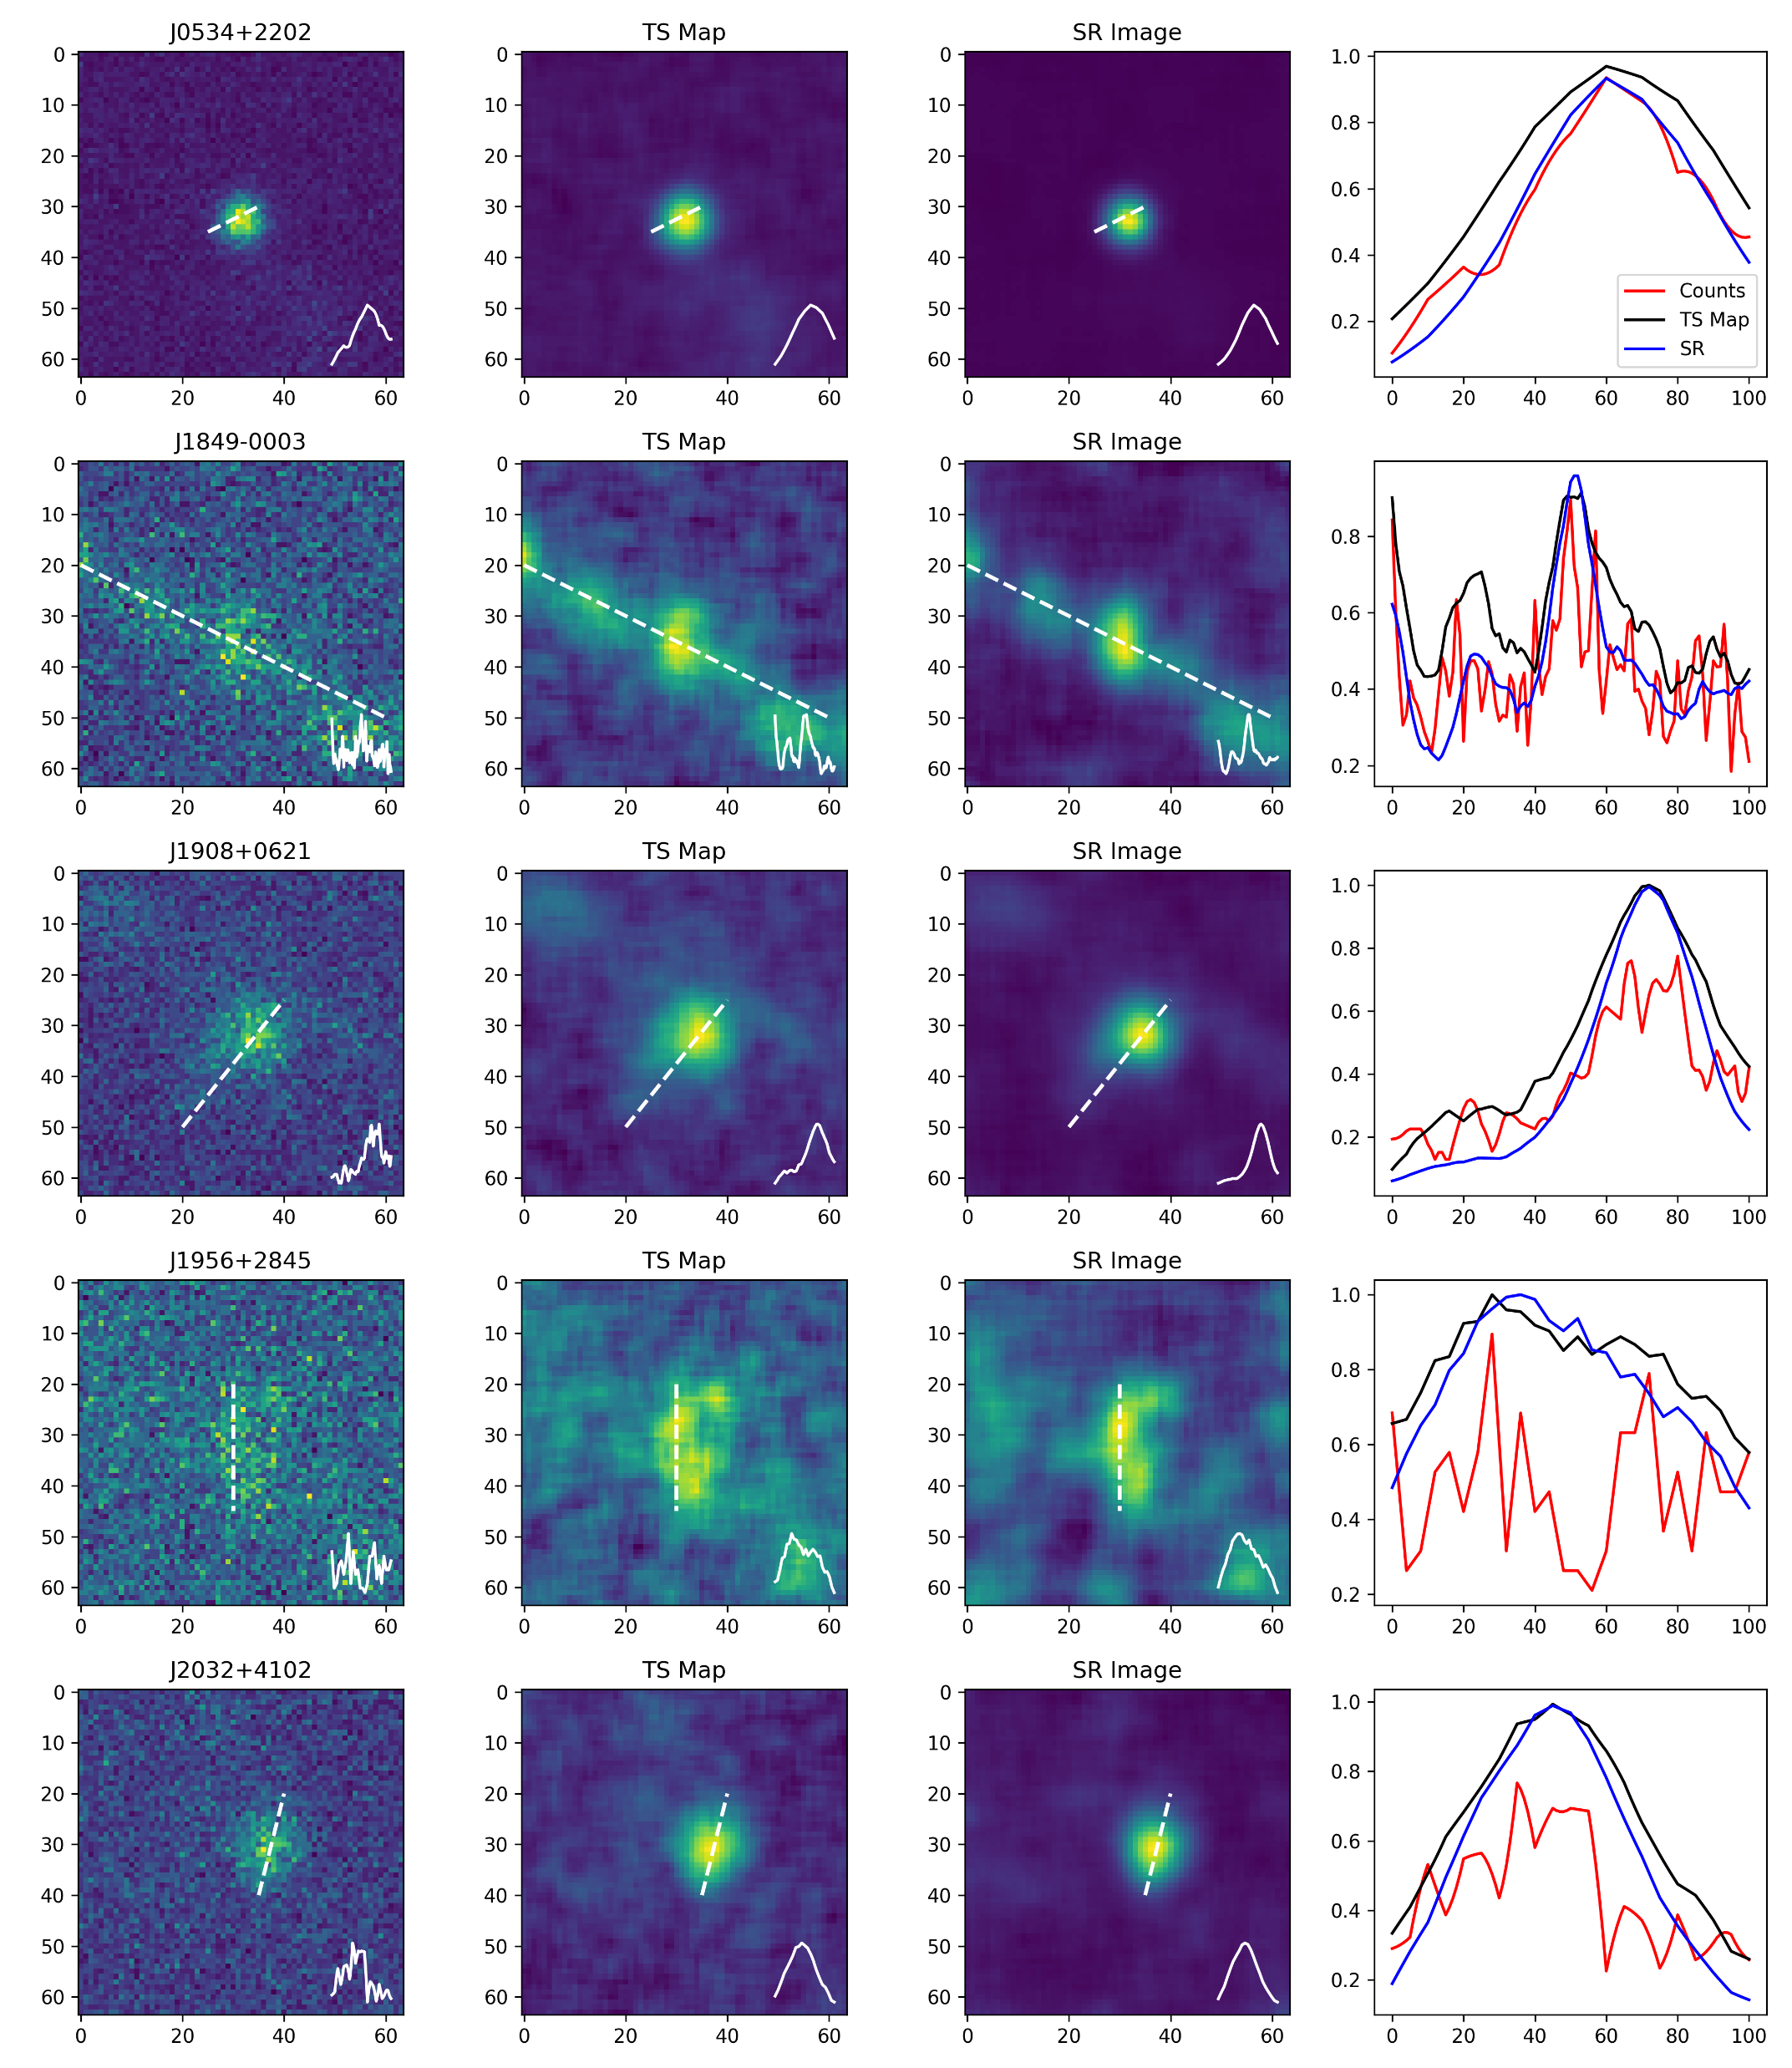
Fig 3. Application to Real LHAASO Observation
0 RESULTS 1
Reconstructed by SRCNN
Data along dashed white line
Counts Map
(25-40 TeV)
TS Map
Notes:
To begin with, I’m going to show some results. From this image, this column is LHAASO counts map, the second column is TS map, and the third column is reconstructed image using machine learning. We have correctly reconstructed the LHAASO image and significantly improved the angular resolution.

Slide 3
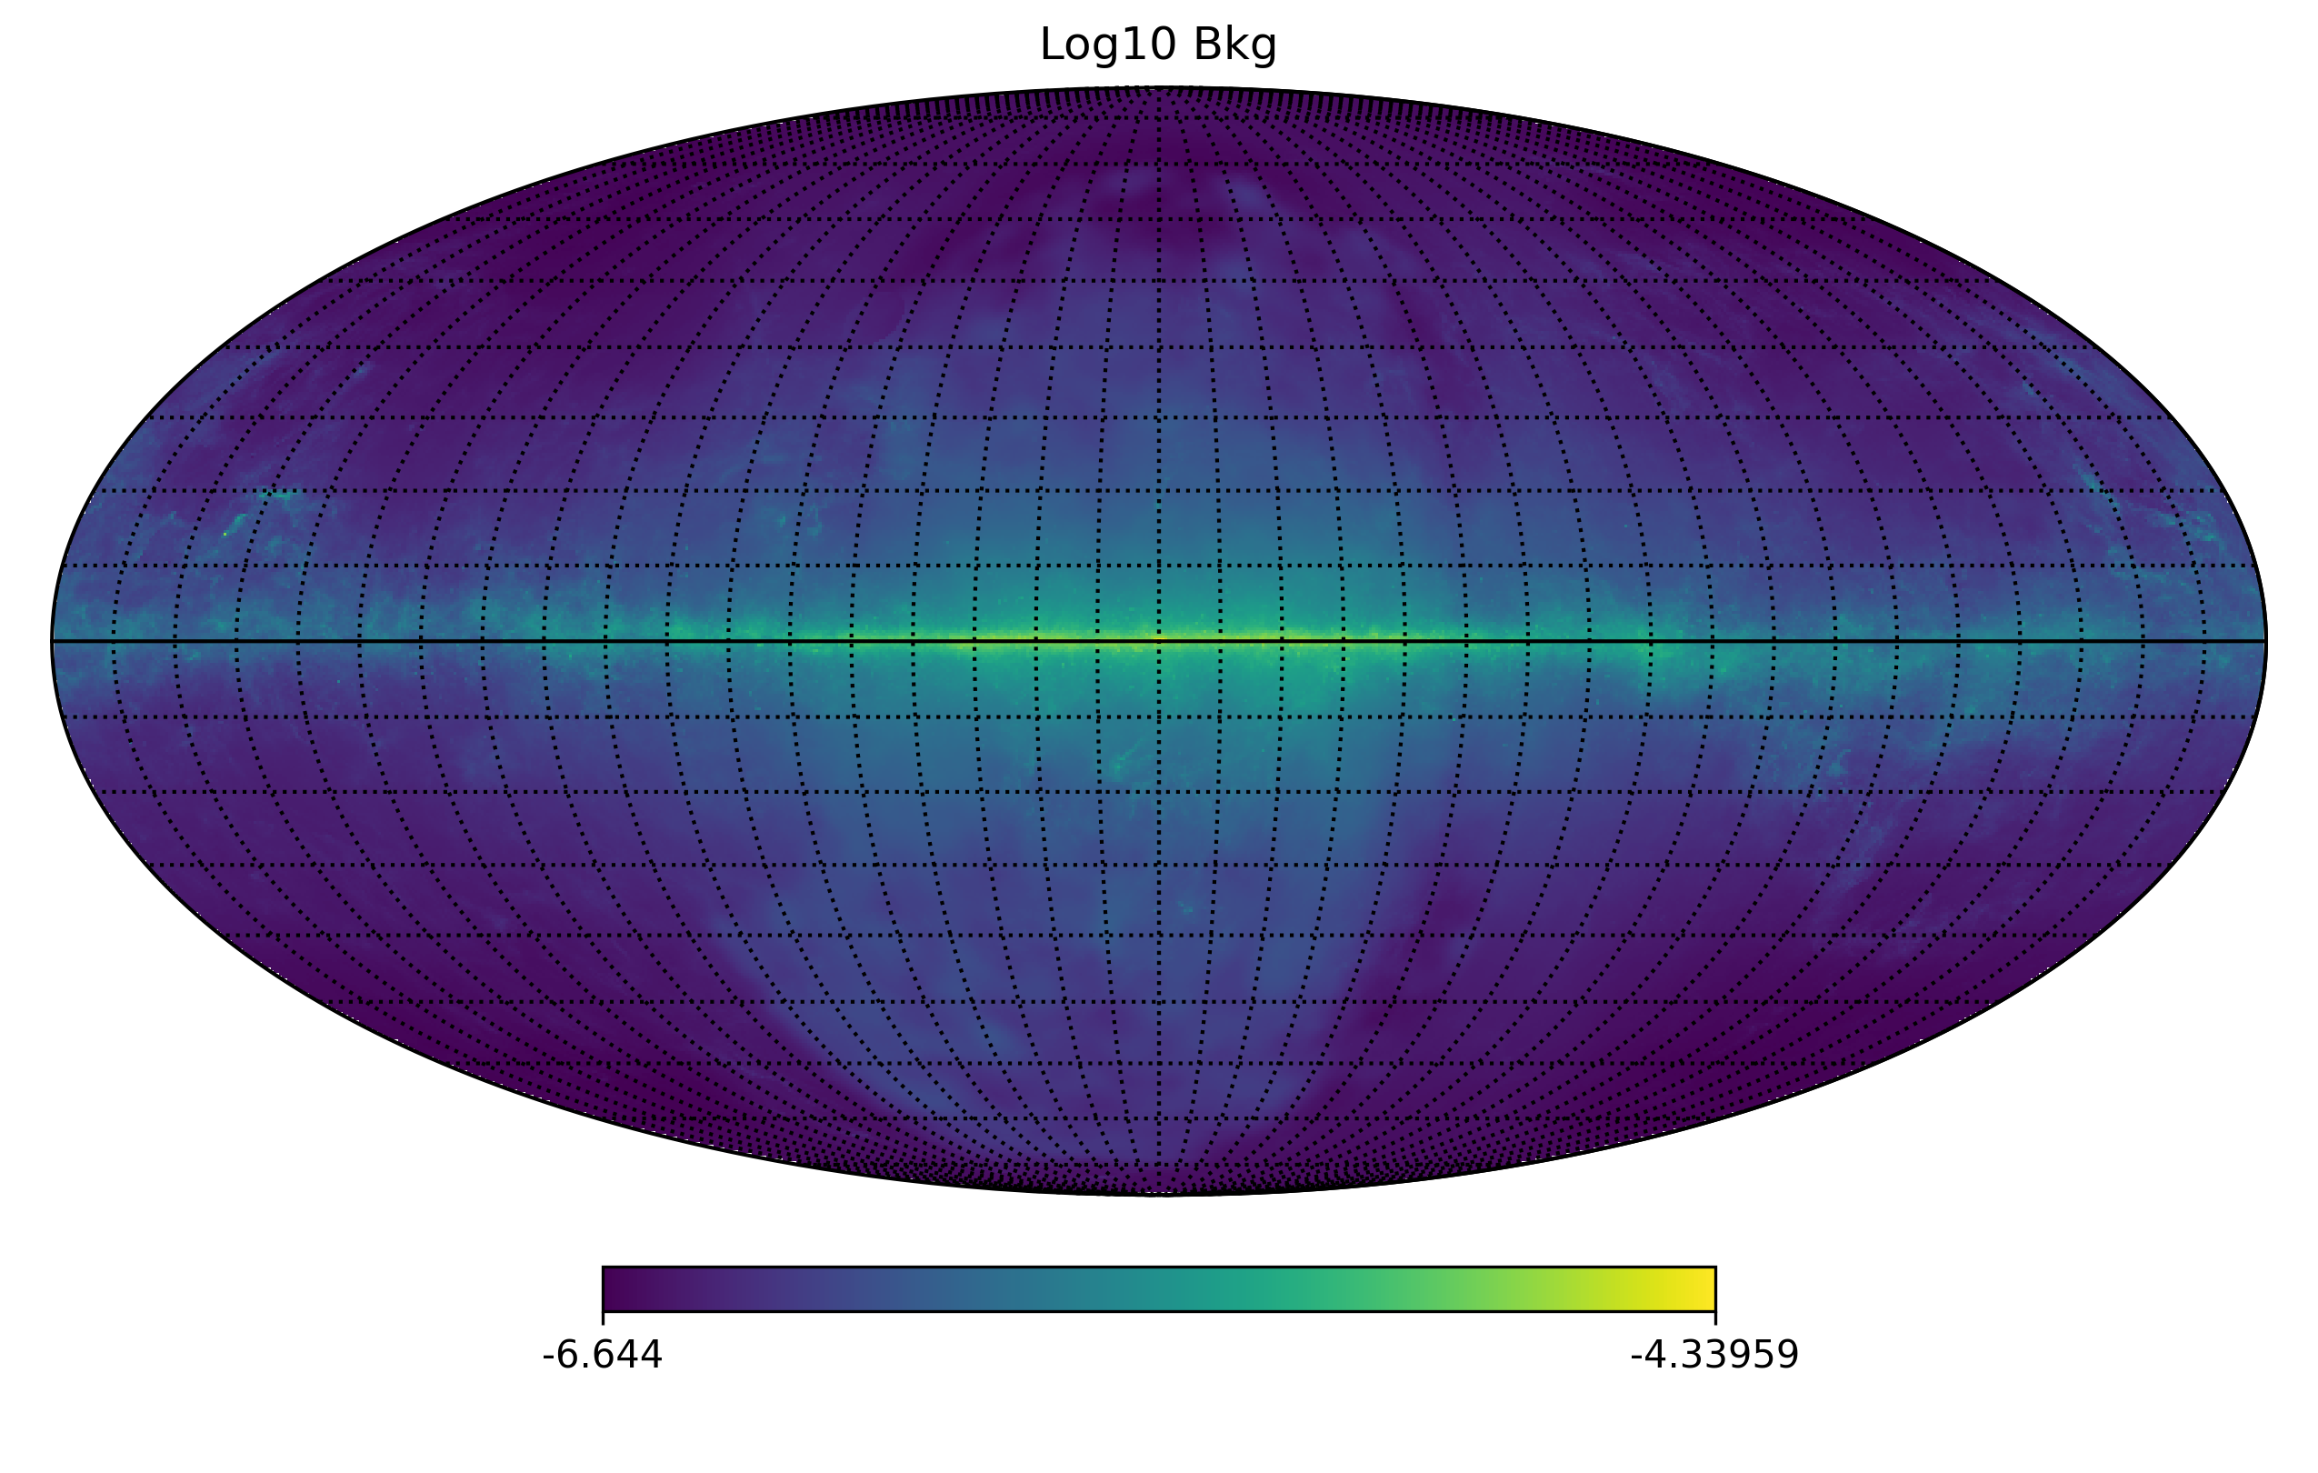
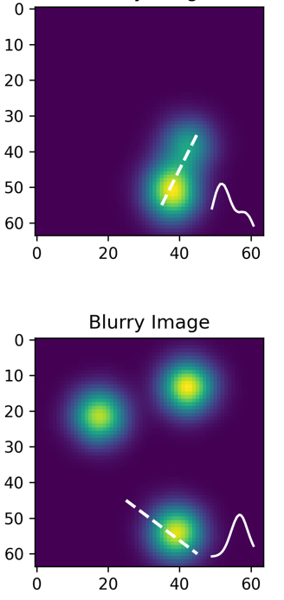
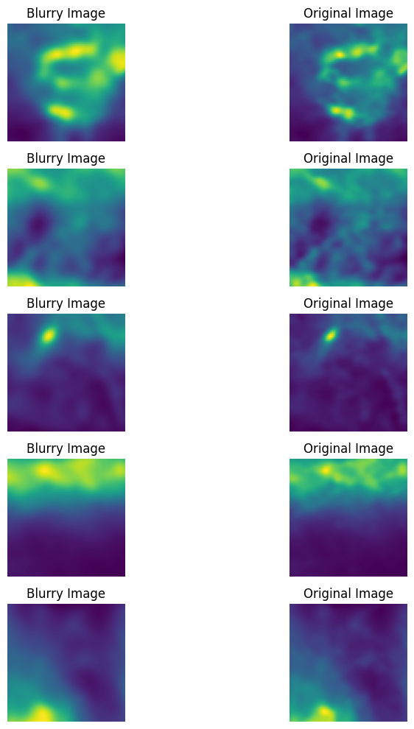
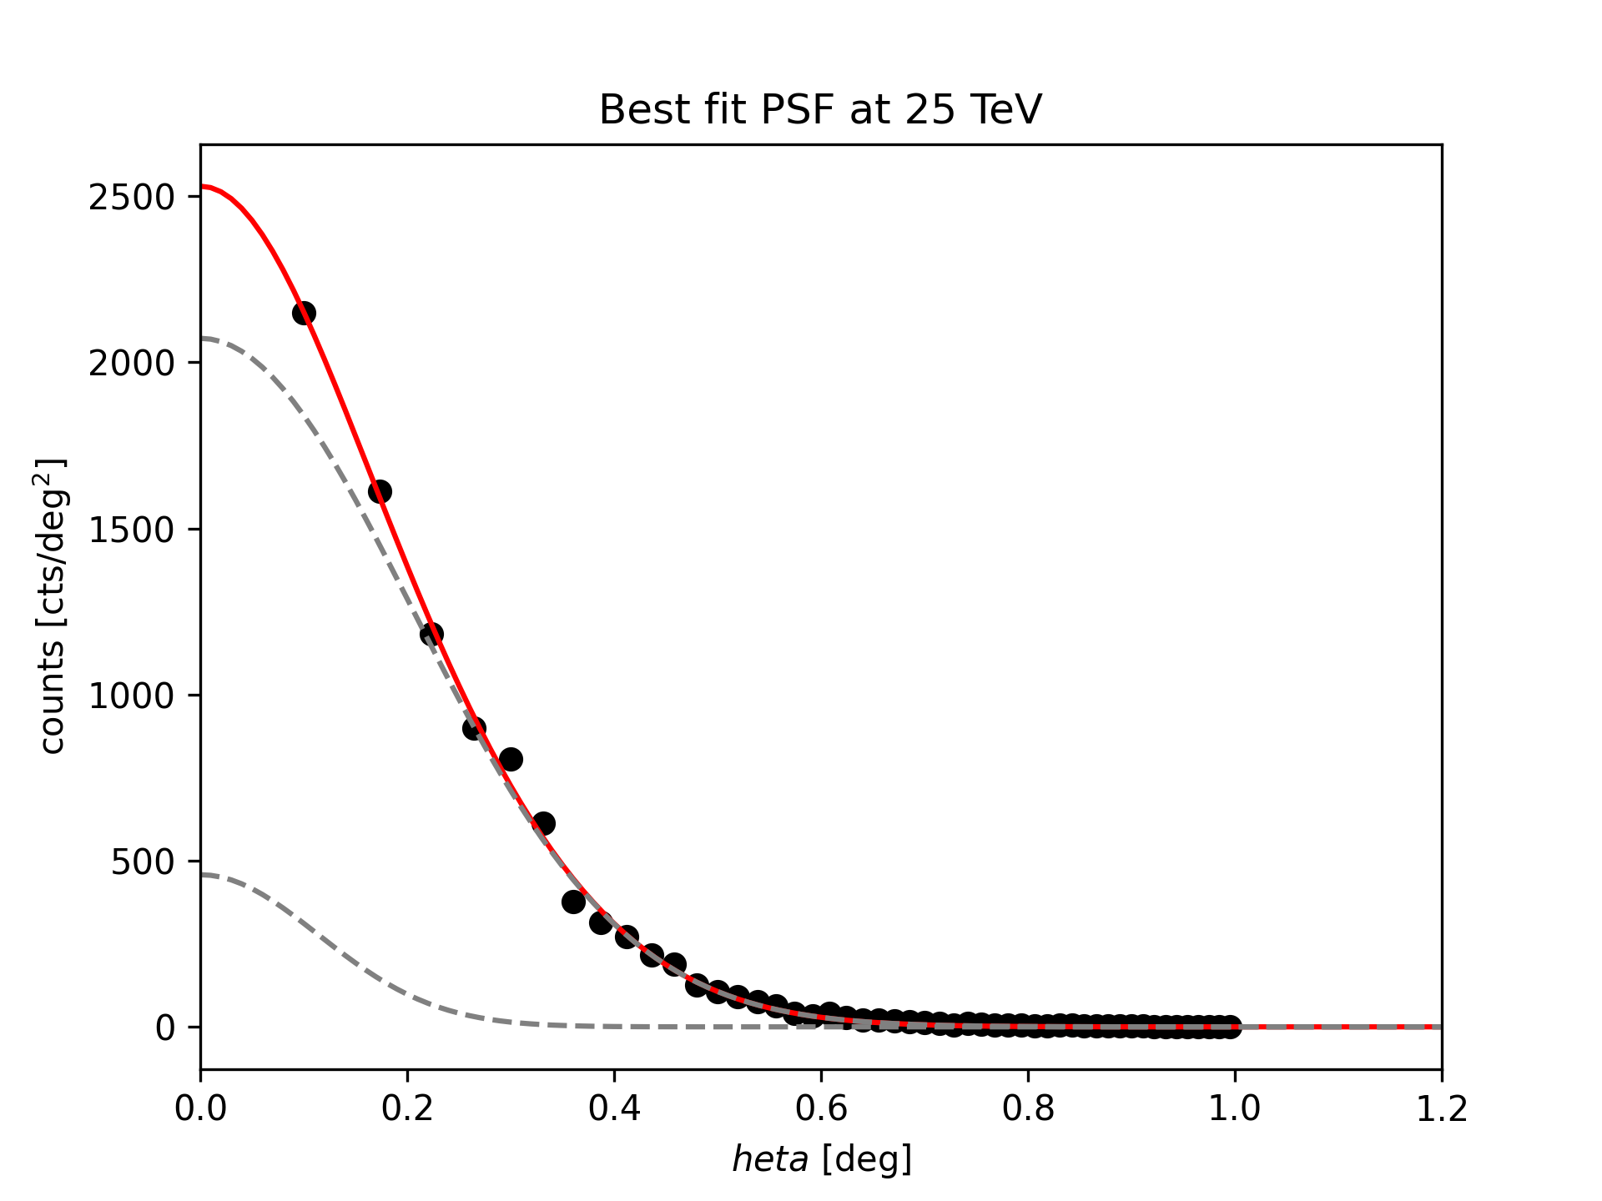
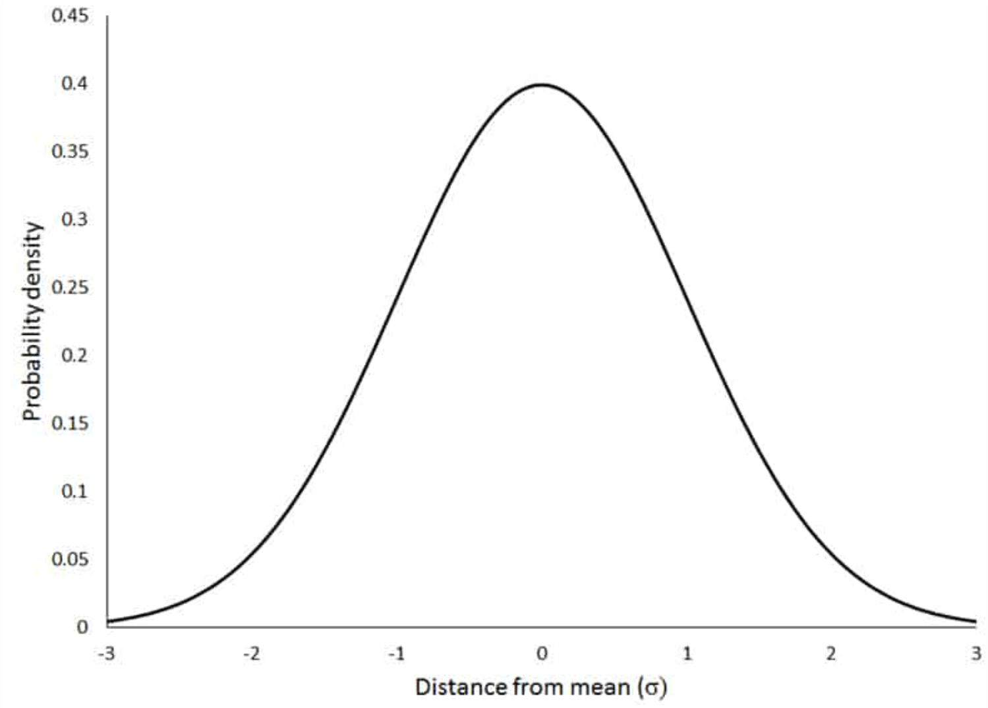
Fermi LAT BKG (to HEALPix, NSIDE=1024)
1 DATASET
Blurry Image
Clear Image
GENE
RATING
σ = 0.1
PSF
Notes:
Then, how do we do it? Firstly, we need to collect dataset. We obtained the data from Fermi gamma-ray background model. So imagine this as the real object far from the universe, and at one time it’s obtained by LHAASO detectors but due to the limitations on angular resolution, we can only get this blurry image. Then a few years latter we have built more detectors so we get this clear one. We get the real PSF data from LHAASO and fitted it, we improved it to 0.1 for the clear image. What’s more, we used the simulated Gaussian type extended source as the source type dataset.

Slide 4
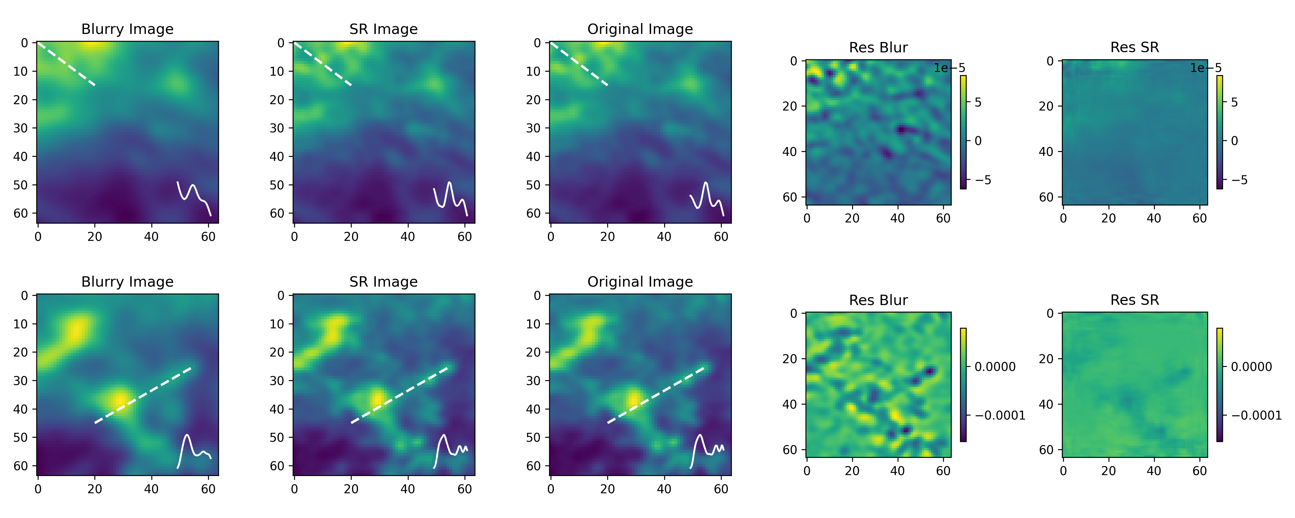
2 TEST - BKG
Reconstruction of SRCNN, tested on Fermi BKG dataset
Residual map to original image
Notes:
So we put 20000 pairs of this kind of images into training for 1000 times. These are the blurry ones, and these are the clear ones, and these are the reconstructed ones we produced. They are quite similar, right? We did more analysis. This is the residual map to original image, which means the difference to the clear image. This is the J-S Divergence graph, which could kindly respond to the PSF distribution. The RES map shows that the reconstructed image is RIGHT, and the JS graph shows that it’s good.

Slide 5
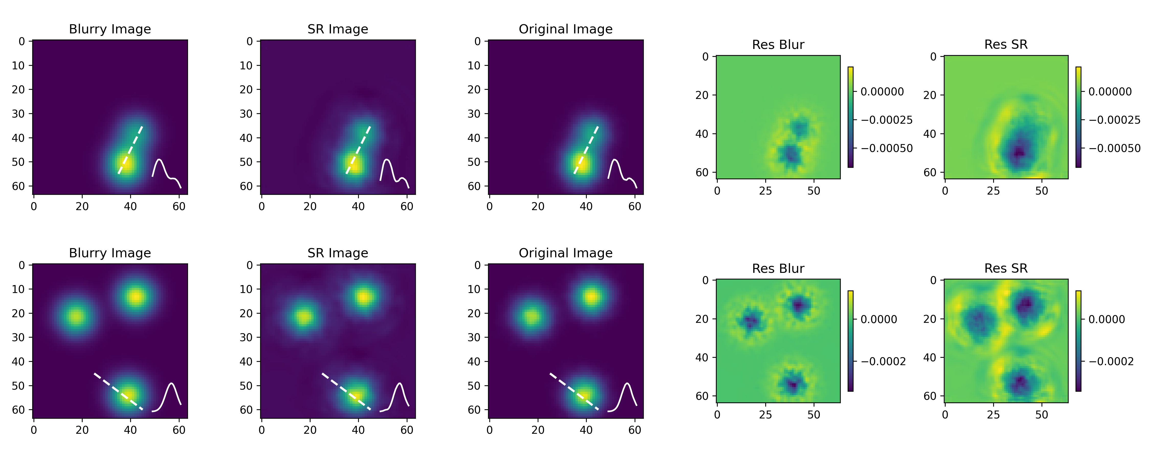
2 TEST - SRC
Reconstruction of SRCNN, tested on Gaussian SRC dataset
Residual map to original map
Notes:
The RES map shows that the reconstructed image is RIGHT, and the JS graph shows that it’s good.

Slide 6
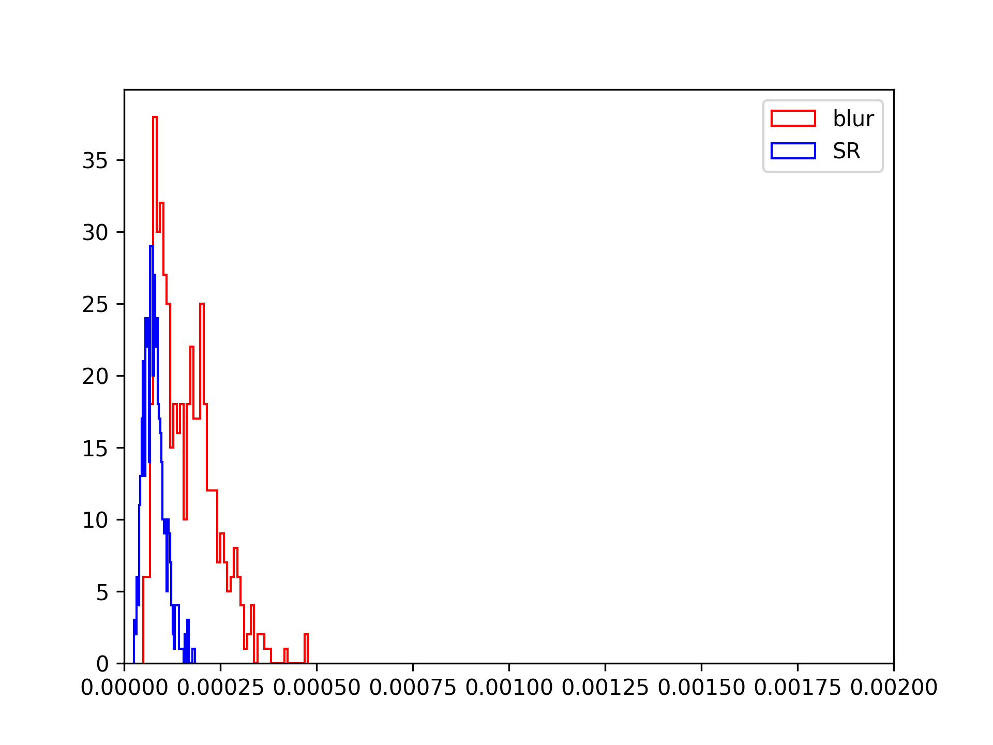
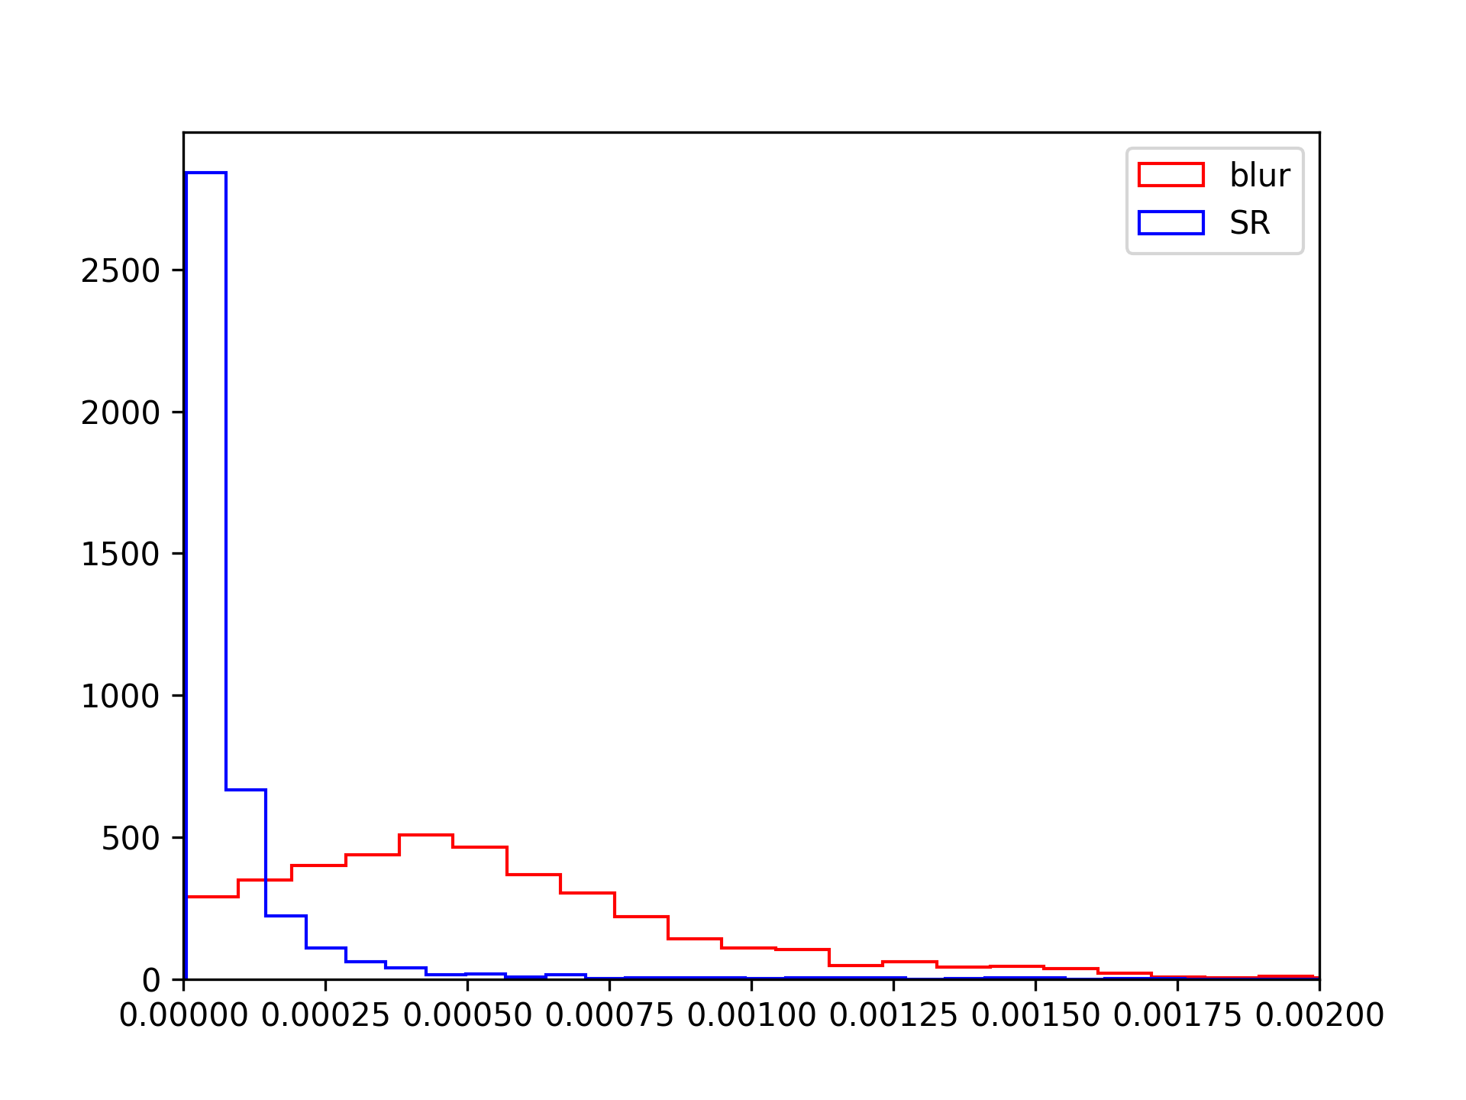
2 TEST
Fig 2. Distribution of Loss Function
Probability Density
J-S Divergence on Background Dataset
J-S Divergence on Source Dataset
Notes:
This is the J-S Divergence graph, which could kindly respond to the PSF distribution. The blue line, our reconstructed image, is better than the red line.
The RES map shows that the reconstructed image is RIGHT, and the JS graph shows that it’s good.

Slide 7
Fig 3. Application to Real LHAASO Observation
3 FURTHER
Reconstructed by SRCNN
Data along dashed white line
Counts Map
(25-40 TeV)
TS Map
Notes:
Furtherly, we put the model into the use of LHAASO observation. This is the counts map of real LHAASO resources, which contains strong Poisson Noise. Thus we re-trained the model by adding noise to the blurred data and applied the model to five selected LHAASO sources. This is the TS map and this is the reconstructed image. The significance map shows that the model works, and we indeed enhanced the angular resolution.

Slide 8
Fig 3. Application to Real LHAASO Observation
3 FURTHER
Reconstructed by SRCNN
Data along dashed white line
Counts Map
(25-40 TeV)
TS Map

Slide 9
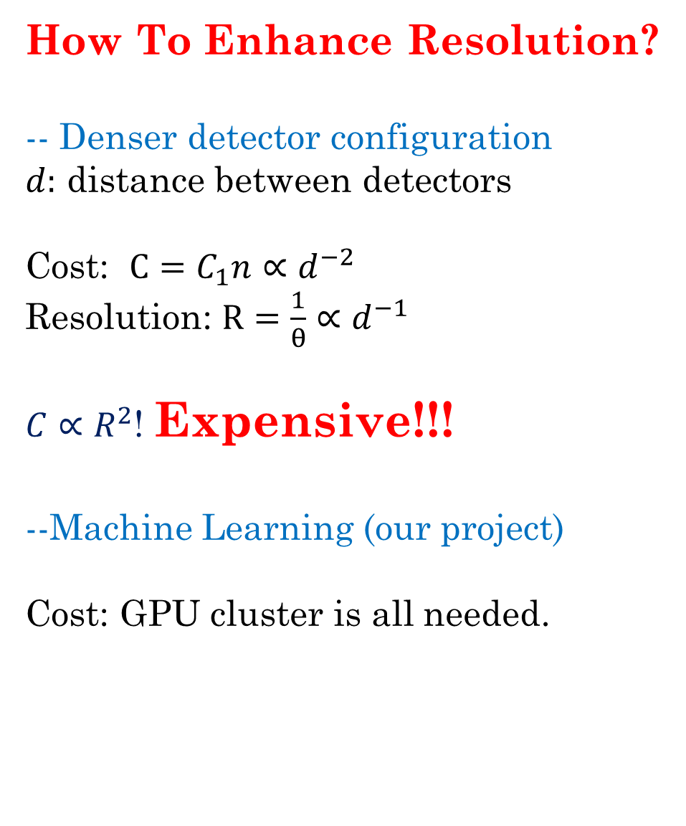
PSF of LHAASO
How To Enhance Resolution?
-- Denser detector configuration
$d:$ distance between detectors
Cost: $C=C_{1}n∝d^{−2}$
Resolution: $R=\frac{1}{θ}∝d^{−1}$
$C∝R^{2}$! Expensive!!!
--Machine Learning (our project)
Cost: GPU cluster is all needed.

Slide 10
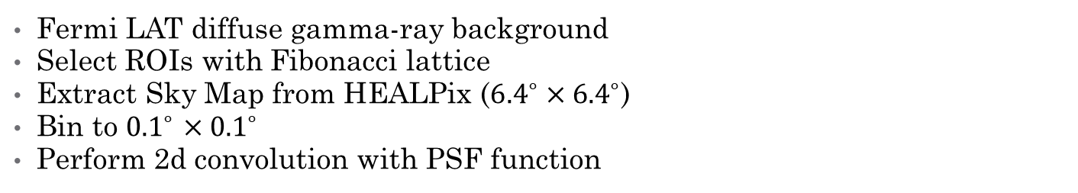
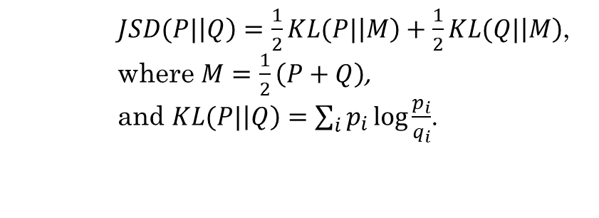
Fermi LAT diffuse gamma-ray background
Select ROIs with Fibonacci lattice
Extract Sky Map from HEALPix (${6.4}^{∘}×{6.4}^{∘}$)
Bin to ${0.1}^{∘}$ ${×0.1}^{∘}$
Perform 2d convolution with PSF function
EXPERIMENTAL PARA.
DETAILS
ENERGY: 25 TeV
BIN: 0.1∘ ×0.1∘.
DATA SIZE: 64*64 2-d array
BKG DATA
NUM_TO_LEARN = 2400
NUM_TO_TEST = 400
EPOCHS = 200
1BATCH_SIZE = 32
LR_MAX = 5e-4LR_MIN = 5e-6
LOSS
TRAIN PARA.
    $JSD(P|\left|Q\right)=\frac{1}{2}KL(P|\left|M\right)+\frac{1}{2}KL(Q|\left|M\right)$,
    where $M=\frac{1}{2}\left(P+Q\right)$,
    and $KL(P|\left|Q\right)=\sum_{i}{p_{i}\log{\frac{p_{i}}{q_{i}}}}$.
--------------------------------------------------------------------------------
Layer (type) Output Shape Param #
============================================
Conv2d-1 [-1, 64, 64, 64] 5,248
Conv2d-2 [-1, 32, 64, 64] 51,232
Conv2d-3 [-1, 1, 64, 64] 801
============================================
Total params: 57,281
Trainable params: 57,281
Non-trainable params: 0
----------------------------------------------------------------
Input size (MB): 0.02
Forward/backward pass size (MB): 3.03
Params size (MB): 0.22
Estimated Total Size (MB): 3.27
----------------------------------------------------------------
CNN PARA.
REFERENCES
1. Wang, et al. "Deep learning enables cross-modality super-resolution in fluorescence microscopy." Nature methods 16.1 (2019): 103-110.
2. Ouyang, et al. "Deep learning massively accelerates super-resolution localization microscopy." Nature biotechnology 36.5 (2018): 460-468.
3. Nehme, et al. "Deep-STORM: super-resolution single-molecule microscopy by deep learning." Optica 5.4 (2018): 458-464.
4. Qiao, et al. "Evaluation and development of deep neural networks for image super-resolution ..." Nature methods 18.2 (2021): 194-202.
Notes:
At last is the technical details. Maybe you’ll be interested in these parameters, the Energy, bin and data size.

Slide 11
Questions are welcome

