Slide 1



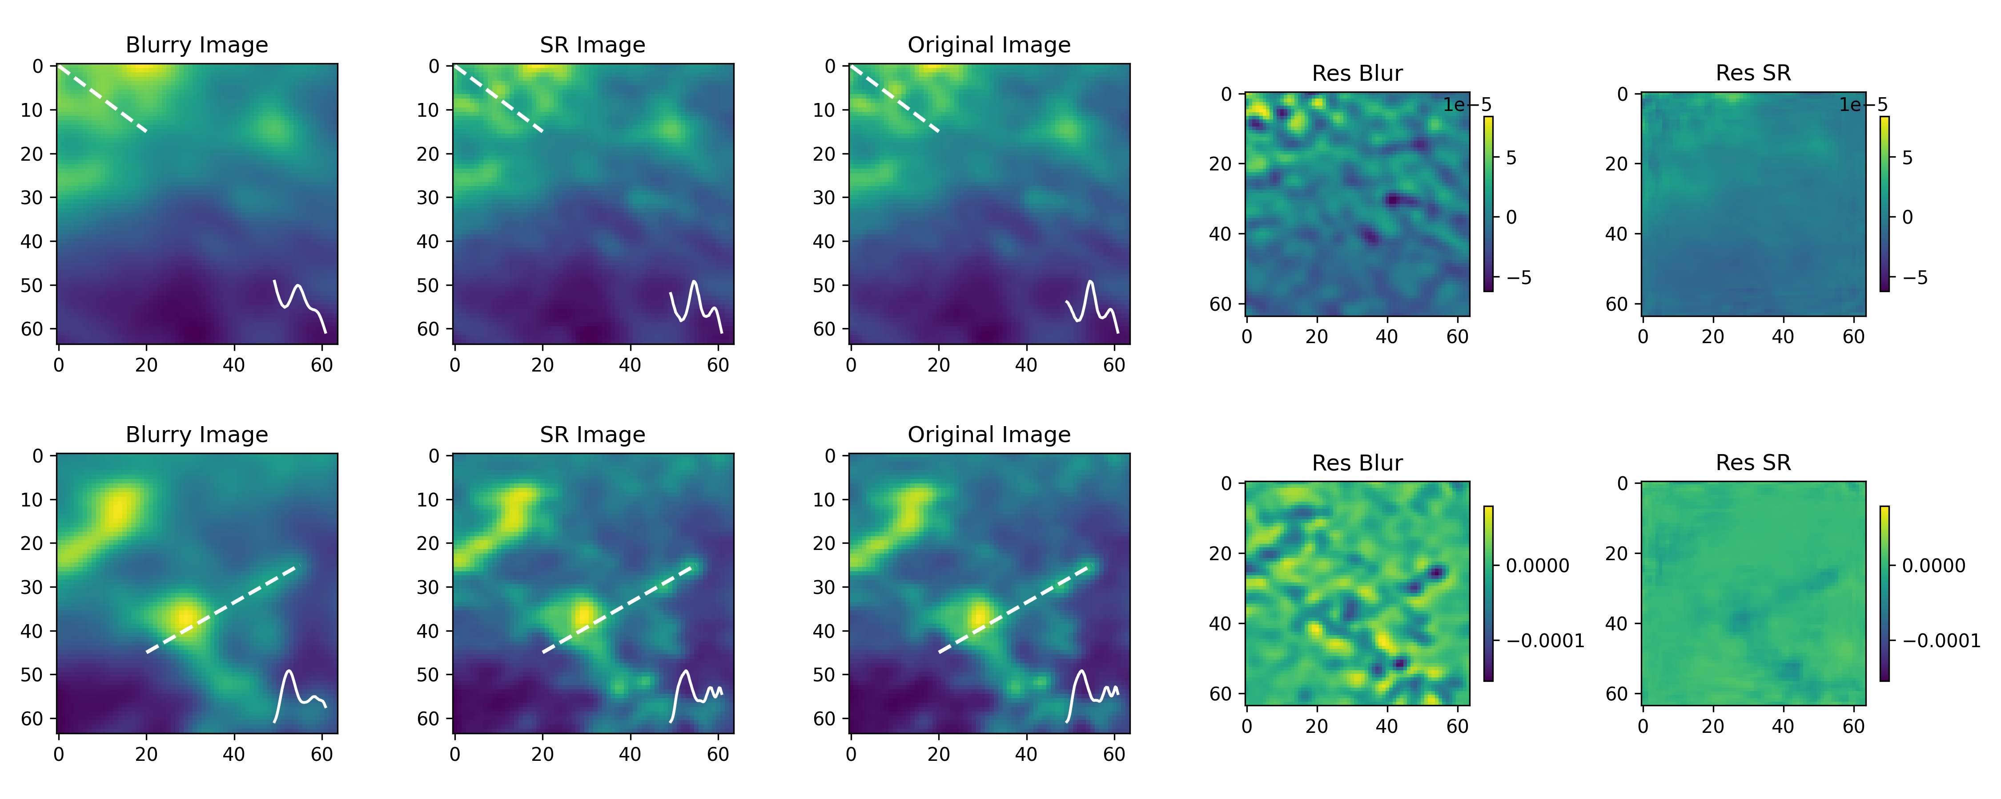
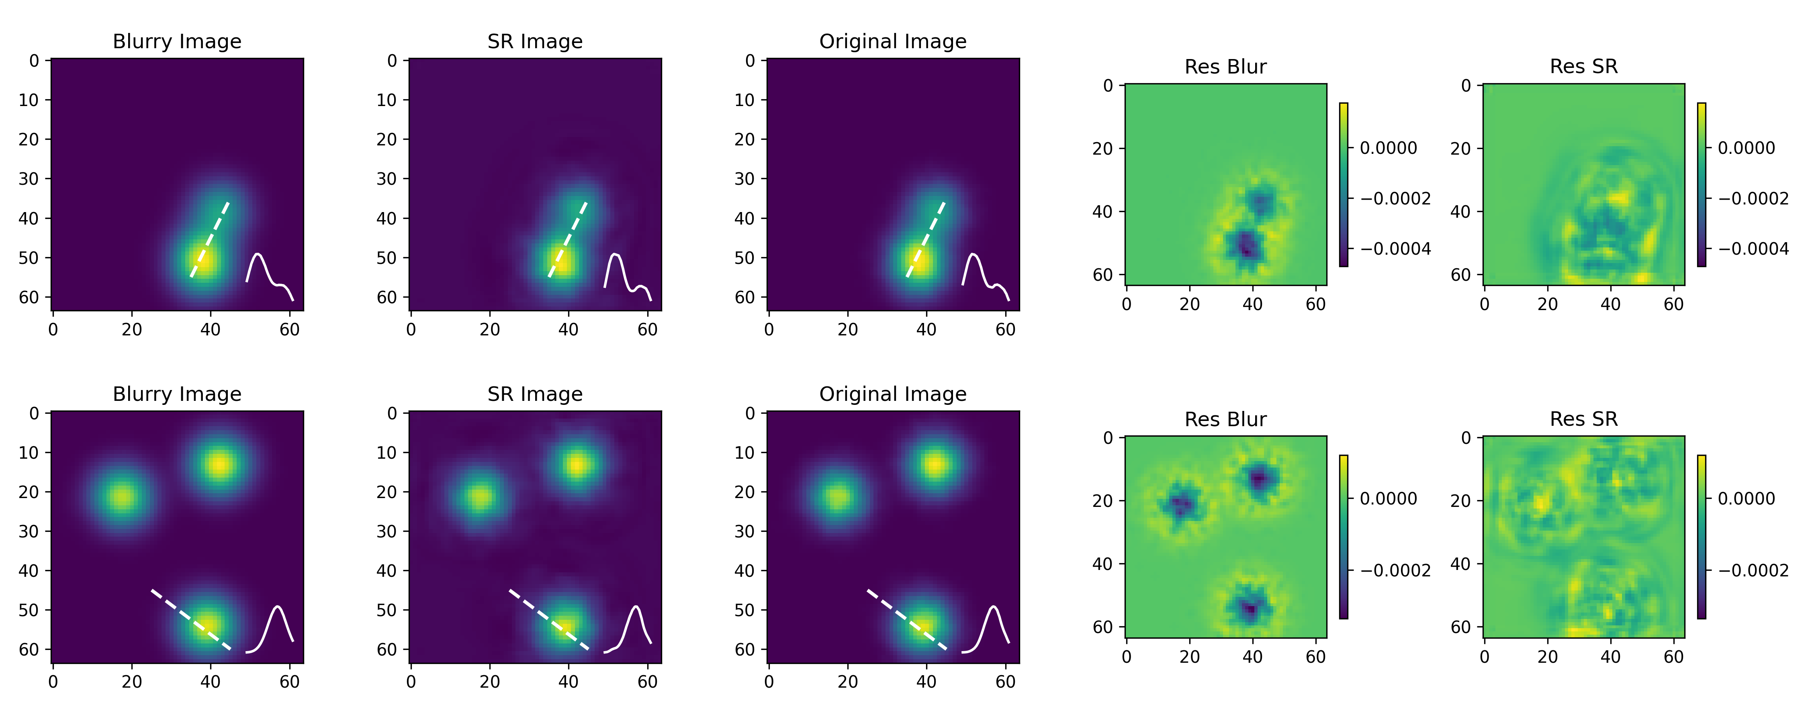
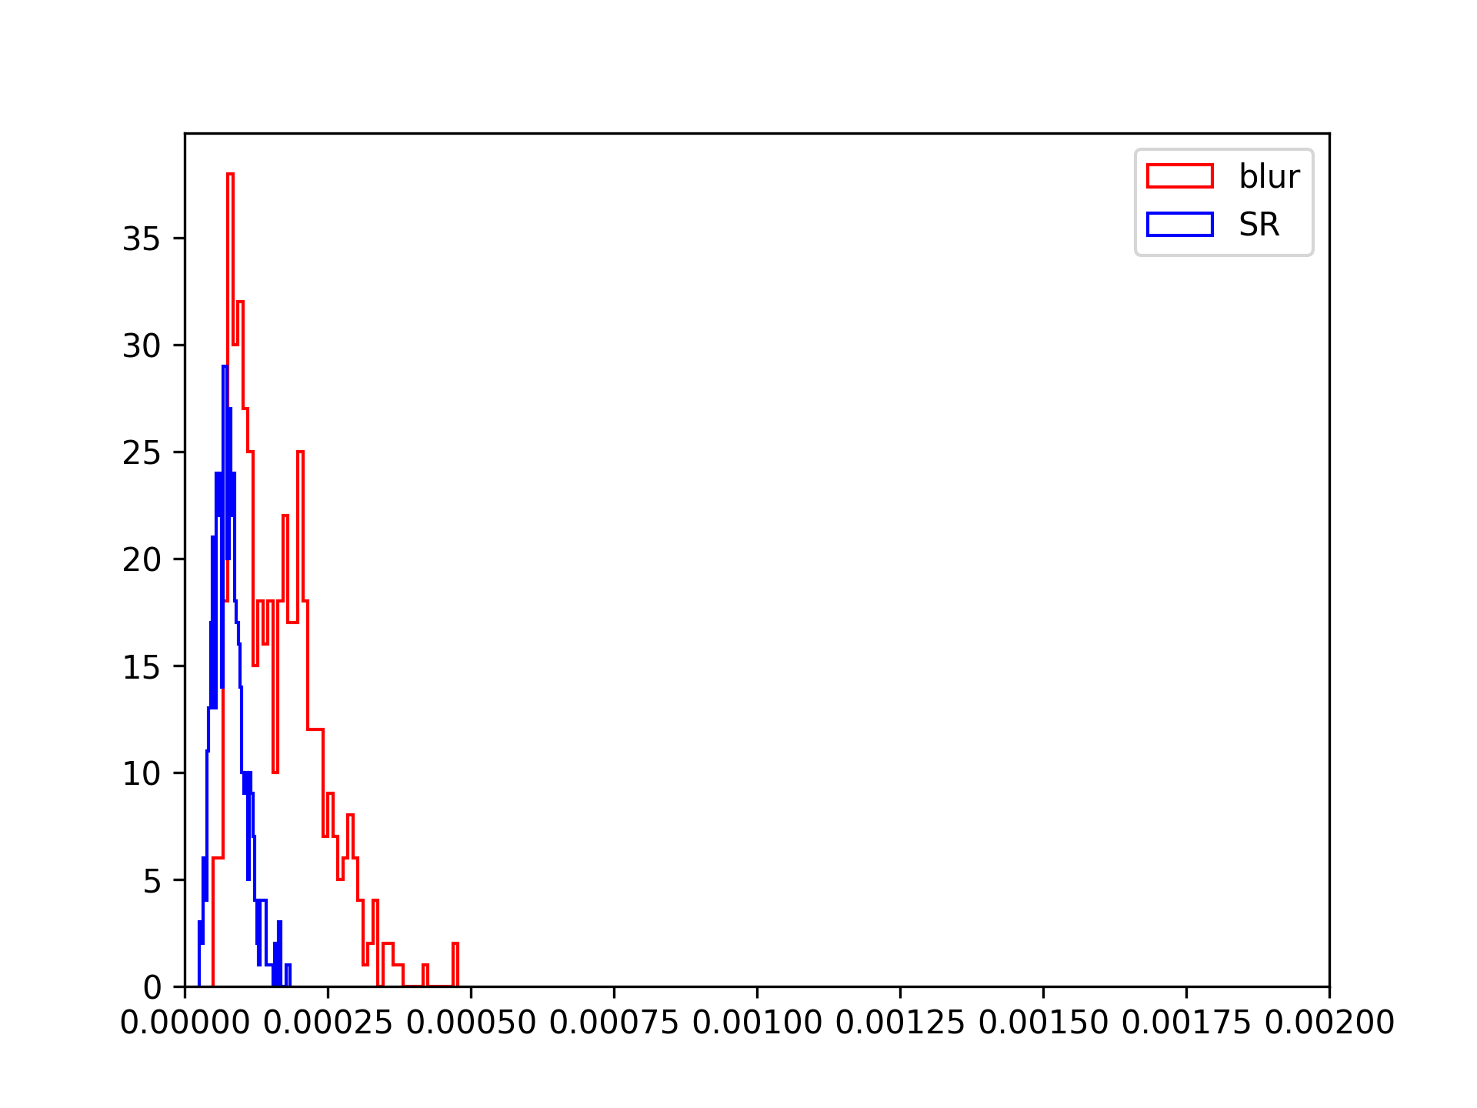
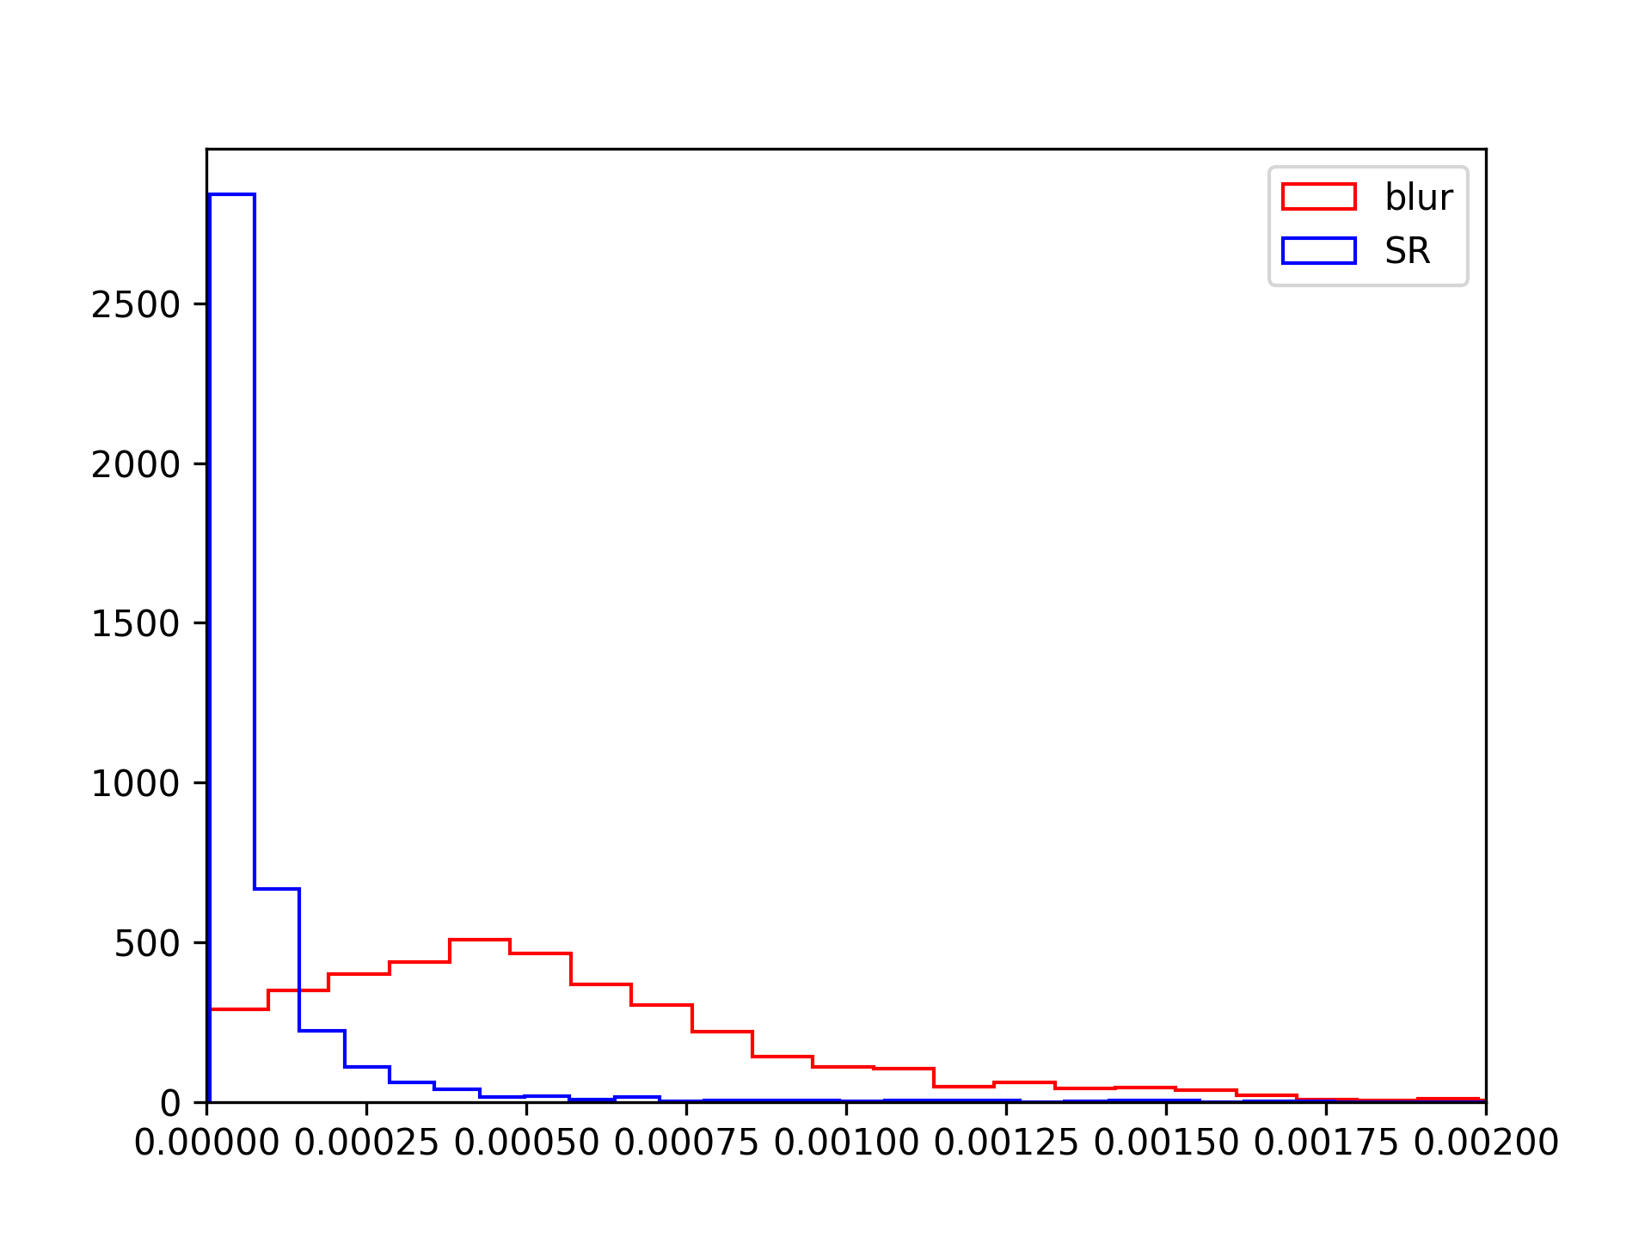
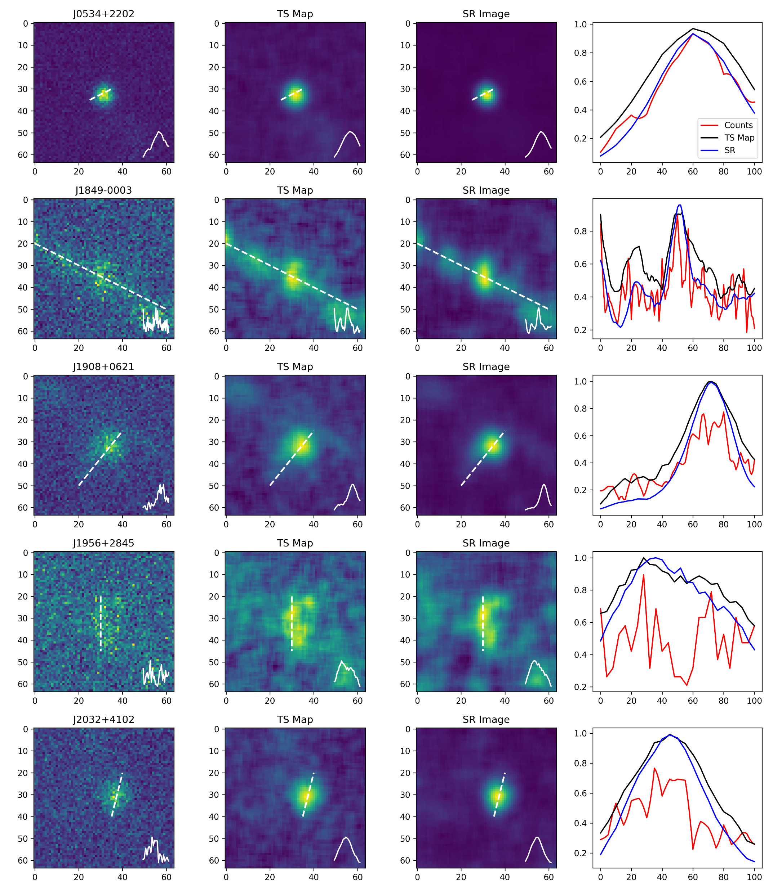
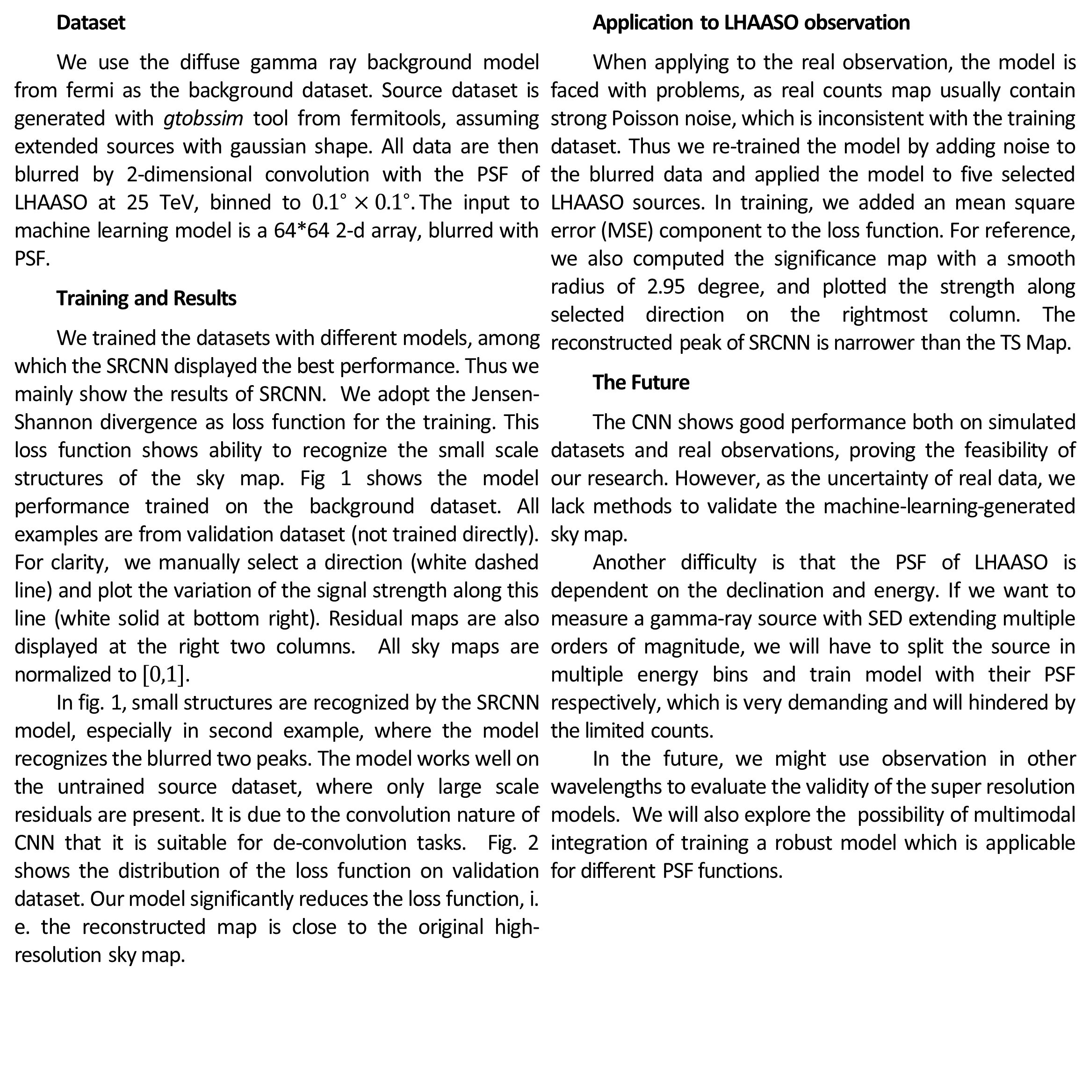
Enhancing the Angular Resolution of LHAASO with Machine Learning
Zi-Hang Liu², Xing-Wei Gong¹, Xiao Tang¹, Lei He¹, Ruo-Yu Liu¹,
¹ School of Astronomy & Space Science, Nanjing University, Nanjing, China
² School of Physics, Nanjing University, Nanjing, China
ABSTRACT RESULTS
The Second LHAASO Collaboration Conference in 2024
We propose a framework specifically designed for super-resolution reconstruction of astronomical observations, particularly for LHAASO images, utilizing three super-resolution network models: Convolutional Neural Networks (CNN), Variational Autoencoders (VAE), and Generative Adversarial Networks (GAN). The CNN model effectively extracts image features through convolution operations, accurately capturing subtle details of celestial bodies; the VAE employs variational inference techniques to generate diverse reconstructed images, thereby restoring features of faint celestial objects; and the GAN model generates high-quality images through adversarial training, successfully simulating realistic astronomical scenes and significantly enhancing the authenticity and detail of image reconstruction.
To validate the effectiveness of the proposed methods, we used four different datasets: a simulated dataset aimed at reproducing astronomical scenes; a real scene dataset containing actual observational data; a Fermi dataset focusing on cosmic background; and a specific dataset concentrating on sources. During data processing, to simulate the real observational scenarios of LHAASO, we fitted the point spread function at 25 TeV as the convolution function.
Training results show significant improvements in image quality across all test datasets, with enhanced clarity for faint stars and sharper contours for bright stars. We believe that applying super-resolution techniques to astronomical imaging is highly feasible. This not only reduces observational costs but also aids scientific judgment. We hope to enhance data processing and analysis speed by combining machine learning with traditional computational methods, providing more efficient tools for astronomical research.
Model Reconstruction of SRCNN
Fig 1. Result on Simulated Data
*
Background Dataset
Source Dataset (Untrained
Blurred by PSF
Reconstructed by SRCNN
Original Map
Residual of Blurred Map
Residual of Reconstructed Map
MATERIALS & METHODS
Fig 2. Distribution of Loss Function
Hidden Layers
Probability Density
Input Layer
a^{[1]}₁
a^{[2]}₁
a^{[3]}₁
Output Layer
a^{[1]}₂
a^{[2]}₂
a^{[3]}₂
J-S Divergence on Source Dataset
J-S Divergence on Background Dataset
X
a^{[1]}₃
a^{[2]}₃
a^{[3]}₃
a^{[4]}
Ŷ
Fig 3. Application to Real LHAASO Observation
a^{[1]}_{n}
a^{[2]}_{n}
a^{[3]}_{n}
X = A^{[0]}
A^{[1]}
A^{[2]}
A^{[3]}
A^{[4]}
DISCUSSION
Dataset
We use the diffuse gamma ray background model from fermi as the background dataset. Source dataset is generated with gtobssim tool from fermitools, assuming extended sources with gaussian shape. All data are then blurred by 2-dimensional convolution with the PSF of LHAASO at 25 TeV, binned to ${0.1}^{∘}×{0.1}^{∘}.$The input to machine learning model is a 64*64 2-d array, blurred with PSF.
Training and Results
We trained the datasets with different models, among which the SRCNN displayed the best performance. Thus we mainly show the results of SRCNN. We adopt the Jensen-Shannon divergence as loss function for the training. This loss function shows ability to recognize the small scale structures of the sky map. Fig 1 shows the model performance trained on the background dataset. All examples are from validation dataset (not trained directly). For clarity, we manually select a direction (white dashed line) and plot the variation of the signal strength along this line (white solid at bottom right). Residual maps are also displayed at the right two columns. All sky maps are normalized to $[0,1]$.
In fig. 1, small structures are recognized by the SRCNN model, especially in second example, where the model recognizes the blurred two peaks. The model works well on the untrained source dataset, where only large scale residuals are present. It is due to the convolution nature of CNN that it is suitable for de-convolution tasks. Fig. 2 shows the distribution of the loss function on validation dataset. Our model significantly reduces the loss function, i. e. the reconstructed map is close to the original high-resolution sky map.
Application to LHAASO observation
When applying to the real observation, the model is faced with problems, as real counts map usually contain strong Poisson noise, which is inconsistent with the training dataset. Thus we re-trained the model by adding noise to the blurred data and applied the model to five selected LHAASO sources. In training, we added an mean square error (MSE) component to the loss function. For reference, we also computed the significance map with a smooth radius of 2.95 degree, and plotted the strength along selected direction on the rightmost column. The reconstructed peak of SRCNN is narrower than the TS Map.
The Future
The CNN shows good performance both on simulated datasets and real observations, proving the feasibility of our research. However, as the uncertainty of real data, we lack methods to validate the machine-learning-generated sky map.
Another difficulty is that the PSF of LHAASO is dependent on the declination and energy. If we want to measure a gamma-ray source with SED extending multiple orders of magnitude, we will have to split the source in multiple energy bins and train model with their PSF respectively, which is very demanding and will hindered by the limited counts.
In the future, we might use observation in other wavelengths to evaluate the validity of the super resolution models. We will also explore the possibility of multimodal integration of training a robust model which is applicable for different PSF functions.
Reconstructed by SRCNN
Data along dashed white line
REFERENCES
1. Wang, et al. "Deep learning enables cross-modality super-resolution in fluorescence microscopy." Nature methods 16.1 (2019): 103-110.
2. Ouyang, et al. "Deep learning massively accelerates super-resolution localization microscopy." Nature biotechnology 36.5 (2018): 460-468.
3. Nehme, et al. "Deep-STORM: super-resolution single-molecule microscopy by deep learning." Optica 5.4 (2018): 458-464.
4. Qiao, et al. "Evaluation and development of deep neural networks for image super-resolution ..." Nature methods 18.2 (2021): 194-202.
Counts Map
(25-40 TeV)
TS Map

