Slide 1
Python & Git Basics

Slide 2
Intro to git
git is a "third generation" source control system
source control is used for:
Keeping track of changes
Allows going back to old versions
Track developers & contributions
Easy collaboration with branching
Distributed development across networks

Slide 3
git
git was created by Linus Torvalds in, like, a weekend. Seriously.
It is very fast, written in pure C
You don't have to be online to make changes, unlike SVN. This will make sense soon.
Lots of tools for visualizing git
gitk (visualize branches and history)
git-cola (GUI for checkins, staging, etc.)

Slide 4
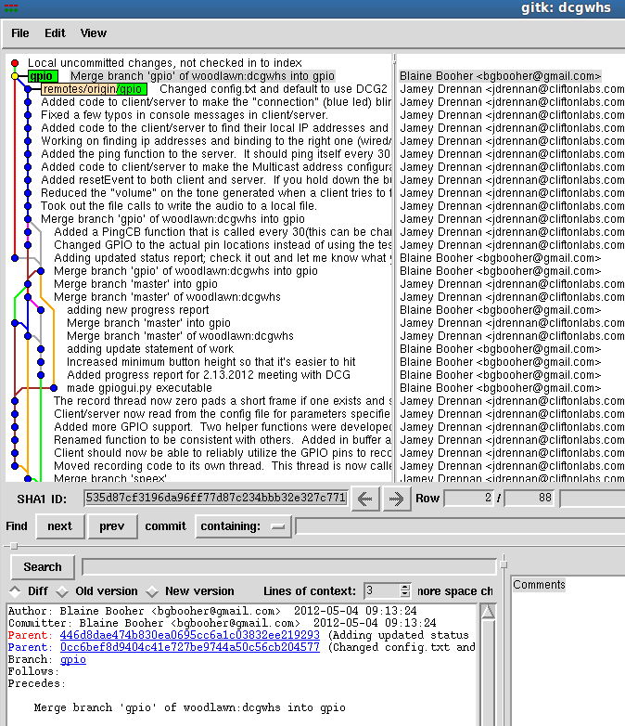
gitk

Slide 5
git basic
git clone: allows you to pull down a new repository
git pull: pulls down latest changes and merges them into your branch
==> 1. Fetch 2. Merge
When you modify a file and want to update it:
git add myfile.py (this stages the file)
git commit -m "Added a new class to myfile.py " (always leave good notes)
==> So at this point it is now committed to your LOCAL repository.
==> See history with: git log
if you have an upstream repo defined, we can see that here:
76$ git remote -v
origin git@woodlawn:dcgwhs (fetch)
origin git@woodlawn:dcgwhs (push)
Finally, to push them to your remote (usually origin is default, master branch)
git push origin master (or just git push)

Slide 6
summary
Other useful commands:
git branch mybranch (creates a new branch to work on in parallel)
git merge mybranch (merges the mybranch branch into your working branch)
git branch (shows all branches on your repo)
git checkout mybranch (switch branches)
git log (shows git log messages)
git diff myfile.py (shows diff between repo and local version of myfile.py)
git checkout <hash> (check out an old version of the repo. every checkin and
file has a hash associated with it. See git log for hash
information.
example hash: 0cc6bef8d9404c41e727be9744a50c56cb204577

Slide 7
Python Classes
A python class is so simple. It's beautiful.
class myclass(object):
def __init__(self, name):
''' Initialization Routine '''
self.name=name
print "my name is %s" % name
def reverse(self):
''' A simple helper function '''
x = self.name
x.reverse()
print "my reversed name is: %s" % x

Slide 8
More information
class myclass(object):
The python object 'object' is the root object that everything inherits from. class myclass() works too, but it's cleaner to always include object.
To inherit another class:
class myclass(XMLWriter):

Slide 9
Classes, continuing
def __init__(self, name):
self.name = name
the __init__ is a special name that represents the constructor of the python class.
self is a pointer to the class itself and *must* be present as the first parameter in every instance function. name, of course, is the only real parameter.
we set the class variable (for this instance) by referencing 'self'.
We initialize our class this way:
m = myclass('blaine')

Slide 10
def reverse(self):
''' A simple helper function '''
x = self.name
x.reverse()
print "my reversed name is: %s" % x
A simple class routine that accesses the 'self' variable to grab our instance variable 'name'. We do a simple reverse on it and print the value. We could just as easily return the value, too.
m = myclass('blaine')
# output: my name is blaine
m.reverse()
# output: my reversed name is enialb

Slide 11
Other special class stuff
__init__(self) is just one special function
__iter__, __next__ are for working with iterators
__call__(), if present, allows you to call an object.
x = myclass('name')
x() # this is calling the class as if it were a function
__repr__ and __str__ allow you to get a human readable name of the class, great for printing
__len__ is meant to return the "length" of the object, useful if you're working with a list object of somekind
__getitem__(x) returns item x. example:
class myclass(object):
def __init__(self)
self.x = (0,1,2,3,4,5,6,7,8,9,10)
def __getitem__(self, i)
return self.x[i]
m = myclass()
print m[5] # prints 4

Slide 12
exceptions
Try / Except clauses are easy. This will catch every single exception thrown:
try:
do_some_stuff
except:
print "error"

Slide 13
exceptions...
One useful exception is for working with dictionaries
x = {'name': 'blaine', 'location': 'cincinnati'}
print x['name']
# prints blaine
x['age'] # throws KeyError Exception
In [17]: x['age']
---------------------------------------------------------------------------
KeyError Traceback (most recent call last)
KeyError: 'age'

Slide 14
exceptions
two easy ways to solve this problem:
if x.has_key('age'):
print x['age']
else:
print 'sorry key not found'
try:
print x['age']
except KeyError:
print 'sorry key not found'
Sometimes it's just easier to do everything in except clauses. when a new exception pops up, you can just account for it and move on without letting the program crash

Slide 15
importing modules, exceptions
numpy = None
try:
import numpy
except ImportError:
print "Can't import numpy, no matrix support"
# then, later:
if numpy:
n = numpy.lots_of_matrix_math()
else:
n = my_slow_matrix_math()

Slide 16
[o for o in range(10)]

Slide 17
easy_install, pip, virtualenv
easy_install and pip are two great programs for installing python modules. Both are available in aptitutde or apt-get with ubuntu.
I use them both interchangeably. I'm starting to prefer pip due to its support for virtualenv.
sudo easy_install package_name
sudo pip install package_name

Slide 18
Working with setup.py
If you download a .zip file for a python package and aren't sure what to do, it's actually quite simple. Always look for setup.py
You may need the package python-setuptools for all variants of setup.py.
$ tar -zxvf mymodule.tar.gz
$ cd mymodule/
$ python setup.py install
OR
$ python setup.py build_ext # means build the python extension
$ sudo python setup.py install # once built, actually install it but needs root permissions
For larger packages, this can take a long time. Behind the scenes python is calling gcc to compile stuff, if necessary, and grabbing all the necessary packages etc.

Slide 19
virtualenv
We'll cover more about virtualenv later, but for now we should be aware of its existence.
Virtualenv allows us to create a "virtual environment" in which we work with python projects. We can install, using pip, all kinds of packages to this virtual environment and they are not accessible outside of this virtual environment to the base system.
This is excellent for managing web projects because you can keep packages with different versions on the machine without conflicting.
You can also deploy easily because pip is aware of which packages it has installed to the virtualenv.
"pip freeze" will list all packages installed.

Slide 20
excel data reading (xlrd module)
[blaine@macbook:/data/cliftonlabs/ken_hill Fri May 04]
85$ sudo easy_install xlrd
[sudo] password for blaine:
Searching for xlrd
Reading http://pypi.python.org/simple/xlrd/
Reading http://www.lexicon.net/sjmachin/xlrd.htm
Best match: xlrd 0.7.7
Downloading http://pypi.python.org/packages/source/x/xlrd/xlrd-0.7.7.tar.gz#md5=ba46c586b4c1df977bf7bdcd711590bf
Processing xlrd-0.7.7.tar.gz
Running xlrd-0.7.7/setup.py -q bdist_egg --dist-dir /tmp/easy_install-jZvt6u/xlrd-0.7.7/egg-dist-tmp-Fz6Fu5
zip_safe flag not set; analyzing archive contents...
Adding xlrd 0.7.7 to easy-install.pth file
Installing runxlrd.py script to /usr/local/bin
Installed /usr/local/lib/python2.6/dist-packages/xlrd-0.7.7-py2.6.egg
Processing dependencies for xlrd
Finished processing dependencies for xlrd

Slide 21
Excel Spreadsheet Reading
Here's a great list of data sets:
http://mathforum.org/workshops/sum96/data.collections/datalibrary/data.set6.html
Let's start out by downloading some data and processing it, all using python.

