Slide 1
Reservoir model
Jan. 2018

Slide 2
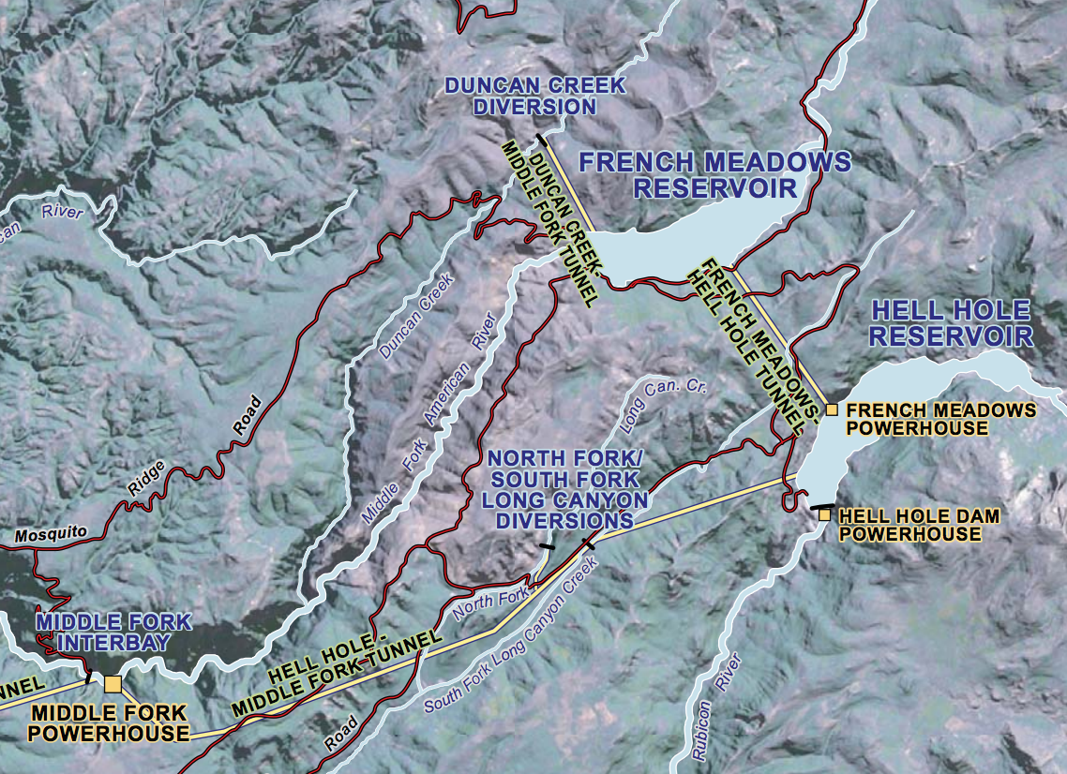
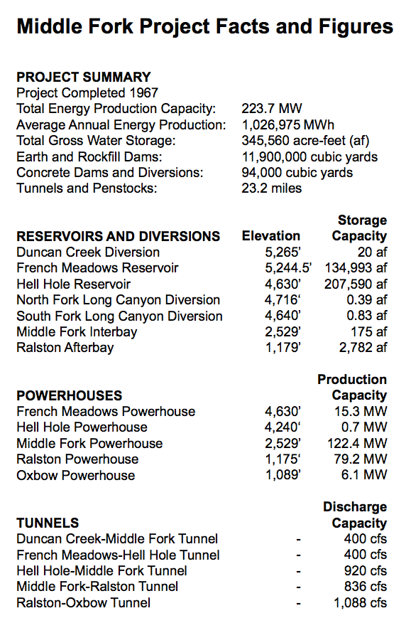
Simplified 2-reservoir model (image/data from PCWA)

Slide 3
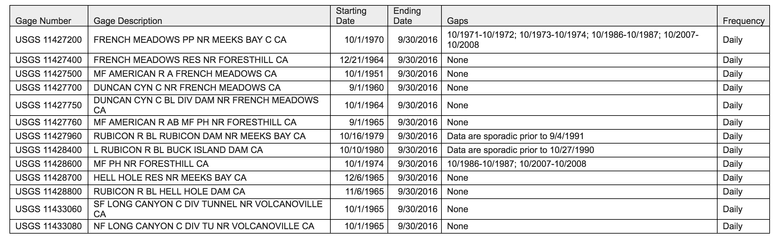
Daily flow data from USGS
Only French Meadows inflow is changed by the hydrologic modeling
Model period 10/1/1980 – 9/30/2015
Model assumes env. flows met first
Then, hydropower production is calculated using a linear storage-elevation curve

Slide 4
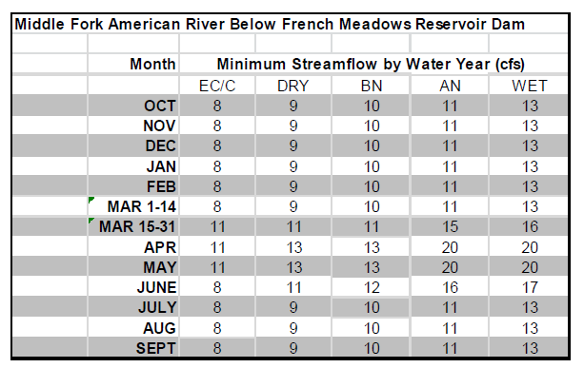
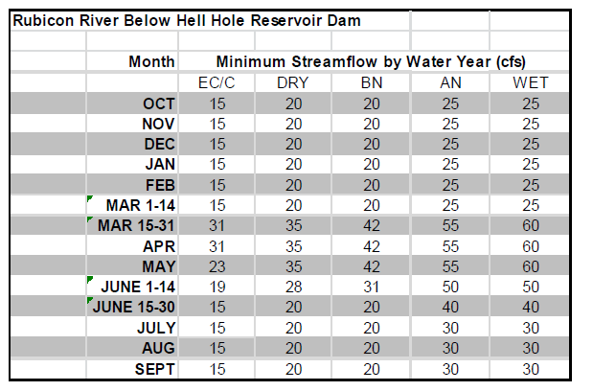
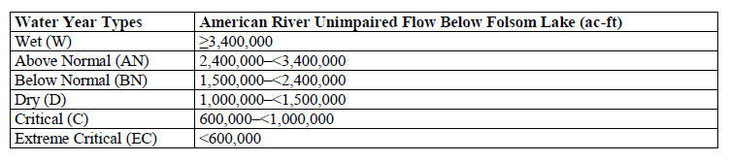
Year-round instream flow requirements

Slide 5
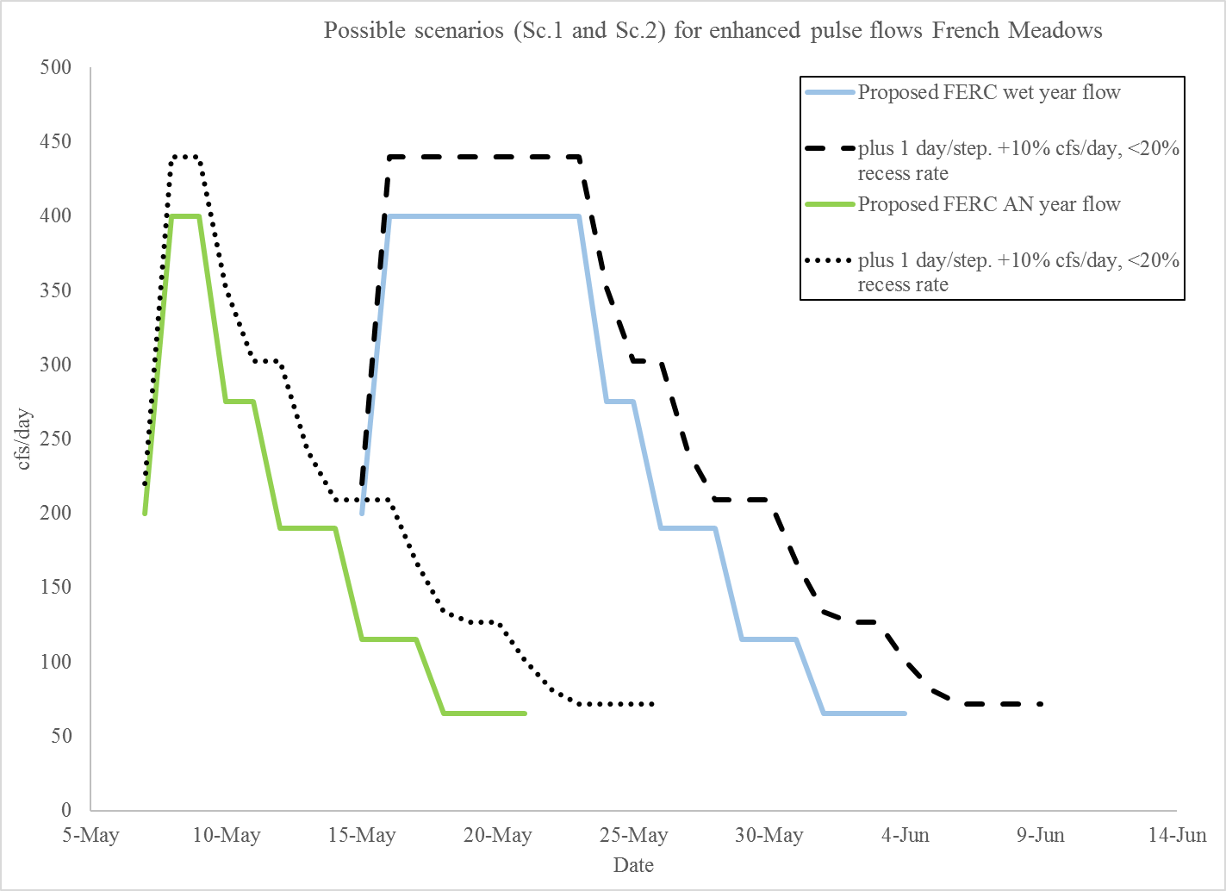
Pulse flow requirements
Second, add pulse flows. 4 scenarios:
No pulse (only instream flows)
FERC proposed (“FERC”)
+1 day/step, +10% cfs/day (“increase”)
Same, plus a <20% restriction on rampdown (“increase_rampdown”)
Only apply to W/AN year types

Slide 6
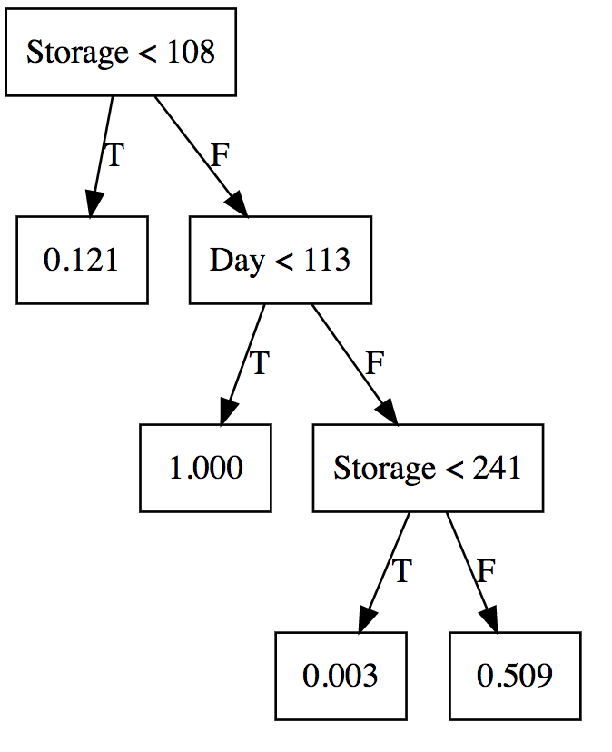
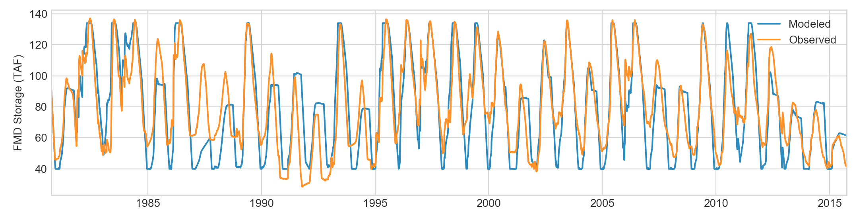
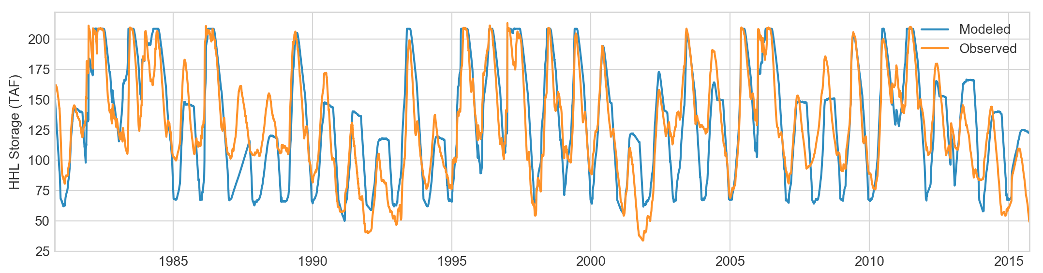
Fitting the historical release policy
To run other scenarios, we first have to represent the hydropower release policy
Approximated from observed historical data, assuming a set of “if-then” rules based on storage and day of the year

Slide 7
Two experiments:
How much hydropower is generated under different hydrologic scenarios, if the release policy stays the same?
What if the release policies are re-optimized to each hydrologic scenario?

Slide 8
