Slide 1
Hybrid Intrusion Detection System.
Project By :
Sahil Sharma 1031210138
Gautami Edara 1031210152
Guided By:
P.Saranya
(Asst. Professor)

Slide 2
OBJECTIVE
Our objective is to develop a Hybrid Intrusion Detection System (HIDS) which can detect a wide range of attacks on host systems using Rule Based and Anomaly Based detection schemes.

Slide 3
PROBLEM DEFINITON
Hosts are susceptible to a range of Network attacks such as Denial of Service (DoS), Flooding, Spoofing, Wormhole etc. which can lead to system failure, information theft, system unavailability, battery drainage.
Firewall is unable to prevent such type of attacks. Hence, Intrusion Detection System provides a second line of defense.

Slide 4
PROPOSED MODEL
Architecture of Hybrid IDS

Slide 5
PROPOSED MODEL
A Hybrid IDS which has a two layer protection scheme the first layer is Rule Based detection and the second layer contains a Supervised Learning model based on support vector machine classifier.
The Rule Based detection scheme uses a database of malicious signatures for checking known attacks. Signature can be an IP Header, Packet with an illegal TCP flag combination, Anonymous FTP attack, DNS buffer overflow attempt, Subject of an Email which contains a virus, etc.

Slide 6
PROPOSED MODEL
Layer two contains an intrusion detection system using a SVM classifier to classify whether the signature is malicious or not. This classifier learns from a training set such as NSL-KDD data set and then classifies the signature using this knowledge.
The cost function for the logistic regression model can be given as

Slide 7
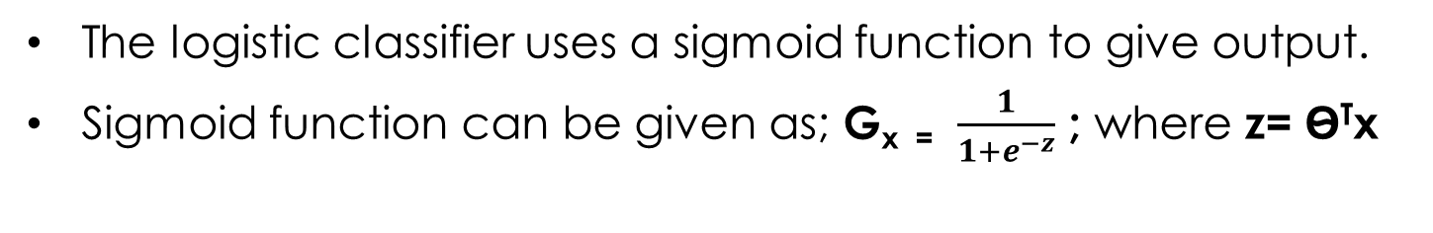
PROPOSED MODEL
The logistic classifier uses a sigmoid function to give output.
Sigmoid function can be given as; G_{x =} $\frac{1}{1+e^{−z}}$ ; where z= Ѳ^{T}x
Graph depicting sigmoid function

Slide 8
PROCESS STEPS
Search for all clients
for each client
Break into IP header and Content
Pass 1 : check if malicious signature //Database lookup
Yes : Alarm the user
No : Pass 2
Pass 2: classify the packet using the SVM model
Yes : Valid Packet
No : Alarm the user // malicious packet
Continue
Refresh Search

Slide 9
MODULE DESCRIPTION
MODULE 1:
Here we capture all the packets coming to the host system.
MODULE 2:
Here we apply rule based filters to find out whether they are malicious or not.
MODULE 3:
Here we apply anomaly based filters to find out whether the packets are malicious or not.

Slide 10
ALGORITHM PHASE - I
PACKET CAPTURING
1: Interface interface[] = check_interfaces();// check for available interfaces
2: if(size_of(interfaces)==0)// size_of returns number of elements in array
3: return error;
4: else
5: interface = choose_inerface(interfaces); /* Recursive method to choose an interface */
6: if(!Interface.availability(interface))
7: return error;
8: else
9: Packet packet[]=interface.capture_packet(interface); /*Captures the packets and returns an array with 2 values*/
10: Header header= packets[0]; // Header is in packets[0]
11: Content content= packets[1]; //Content is on packets[1]

Slide 11
ALGORITHM PHASE - II
SIGNATURE BASED INTRUSION DETECTION
1: do
2: Boolean val = Header.match_Signature(header); /*Boolean method to check if the signature matches or not*/
3: if(val)
4: Intrusion.alarm(USER); //Send an alarm to the user
5: System.send_info(USER, //Send the type of intrusion to the user
6: else
7: continue;
7: while(!checked_all_signatures(header));
Intrusion.type(header));

Slide 12
ALGORITHM PHASE - III
ANOMALY BASED INTRUSION DETECTION
1: cur_Model = System,train_Model(data_set);
2: threshold = System.define_threshold(cur_Model);
3: output = System.predict_output(cur_Model);
4: if(output>threshold)
5: return "anomaly";
6: else
7: return "normal";
8: System.Model.add(cur_Model);

Slide 13
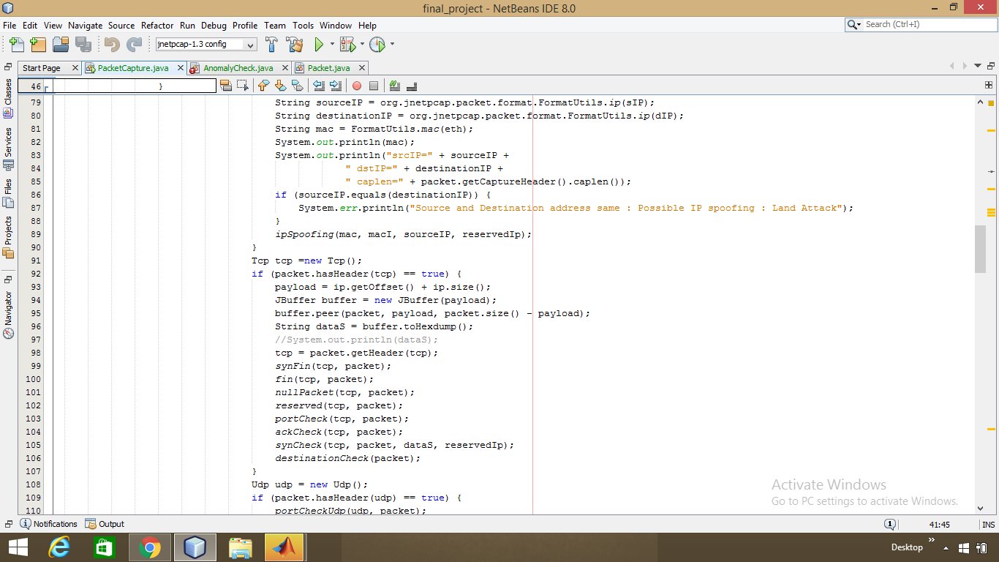
CODE (Module 1-packet capturing)

Slide 14
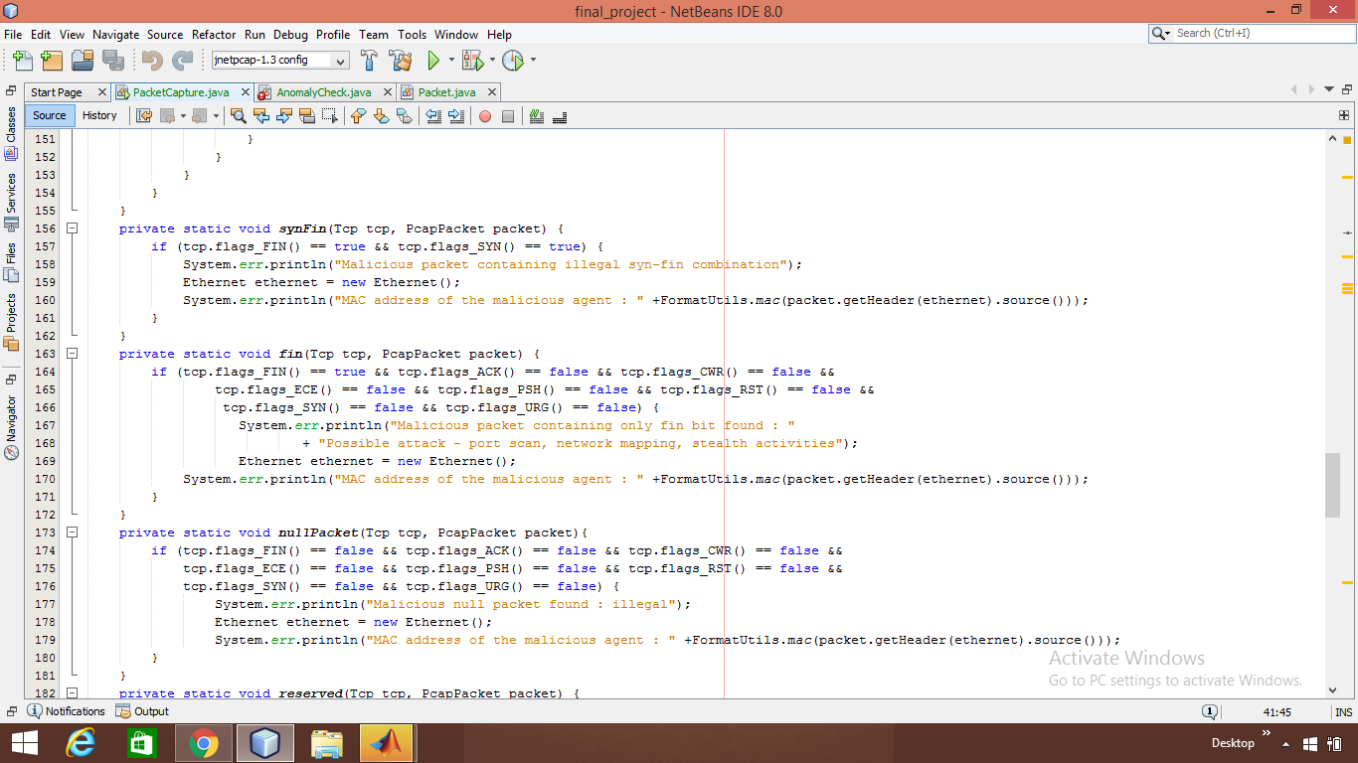
CODE (Module 2-Rule Based)

Slide 15
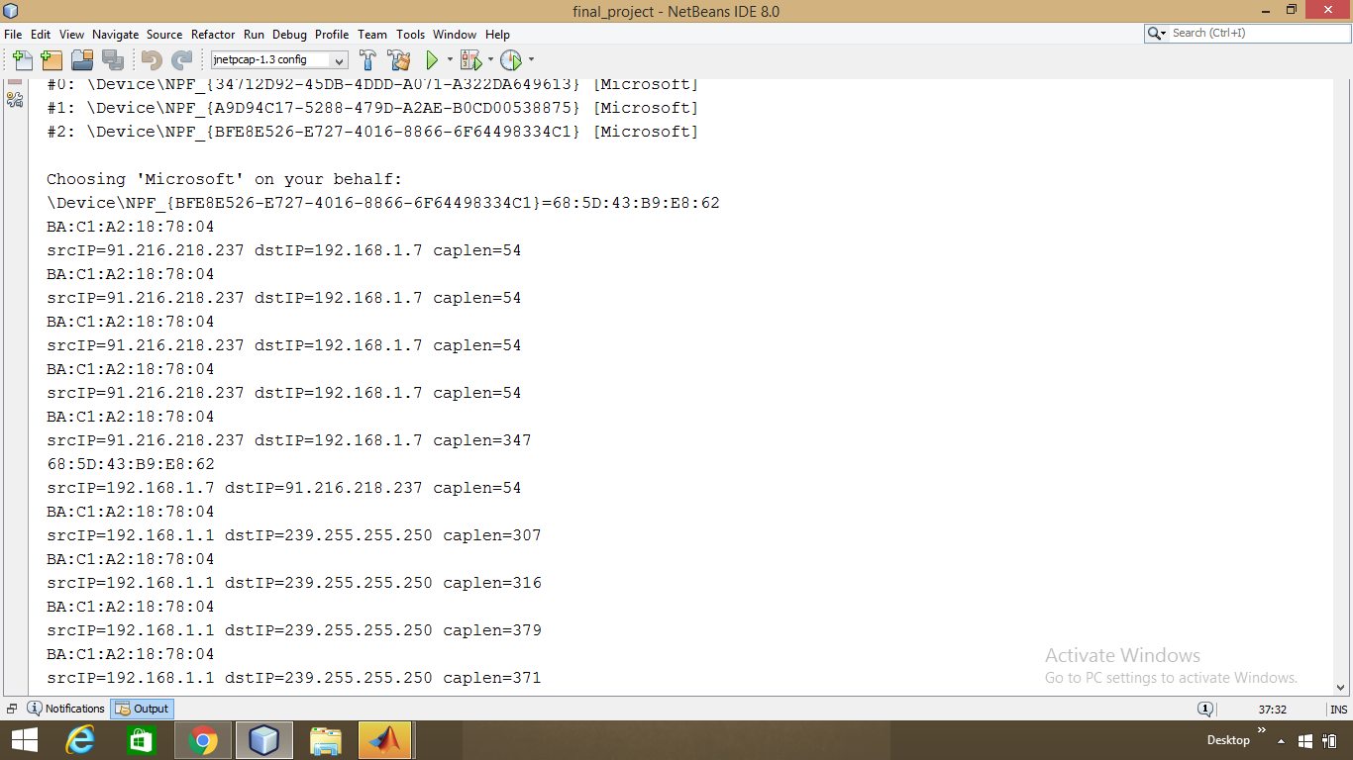
OUTPUT (Module 1 and 2)

Slide 16
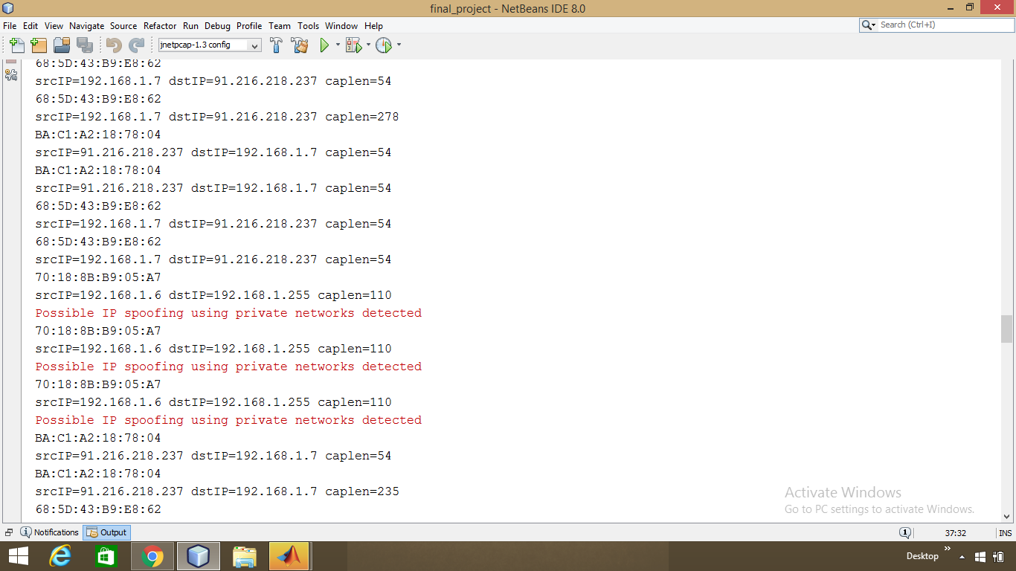
OUTPUT (Module 1 and 2)

Slide 17
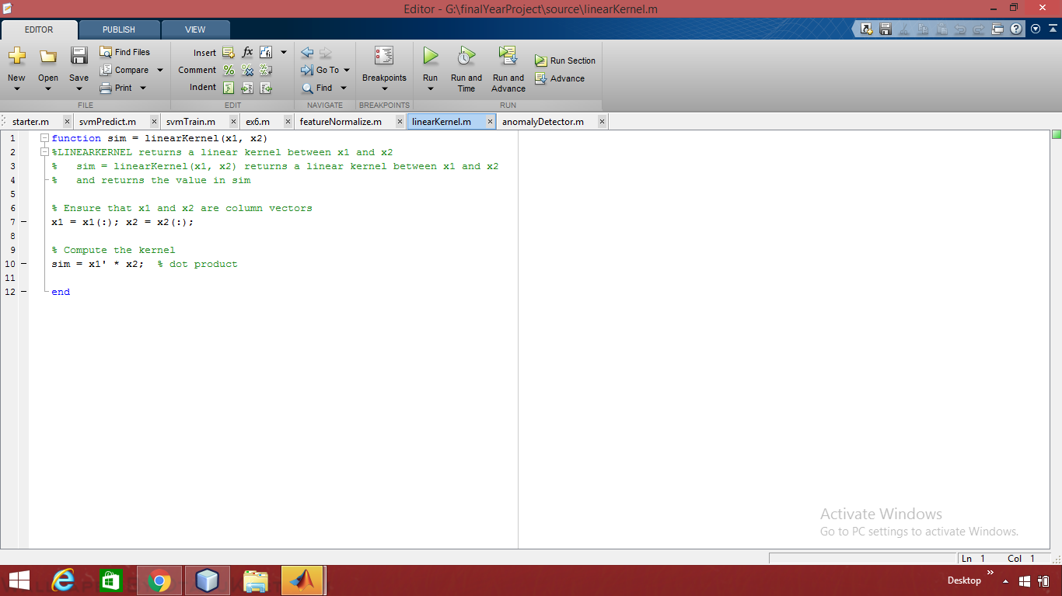
CODE (Module 3- Anomaly Based)

Slide 18
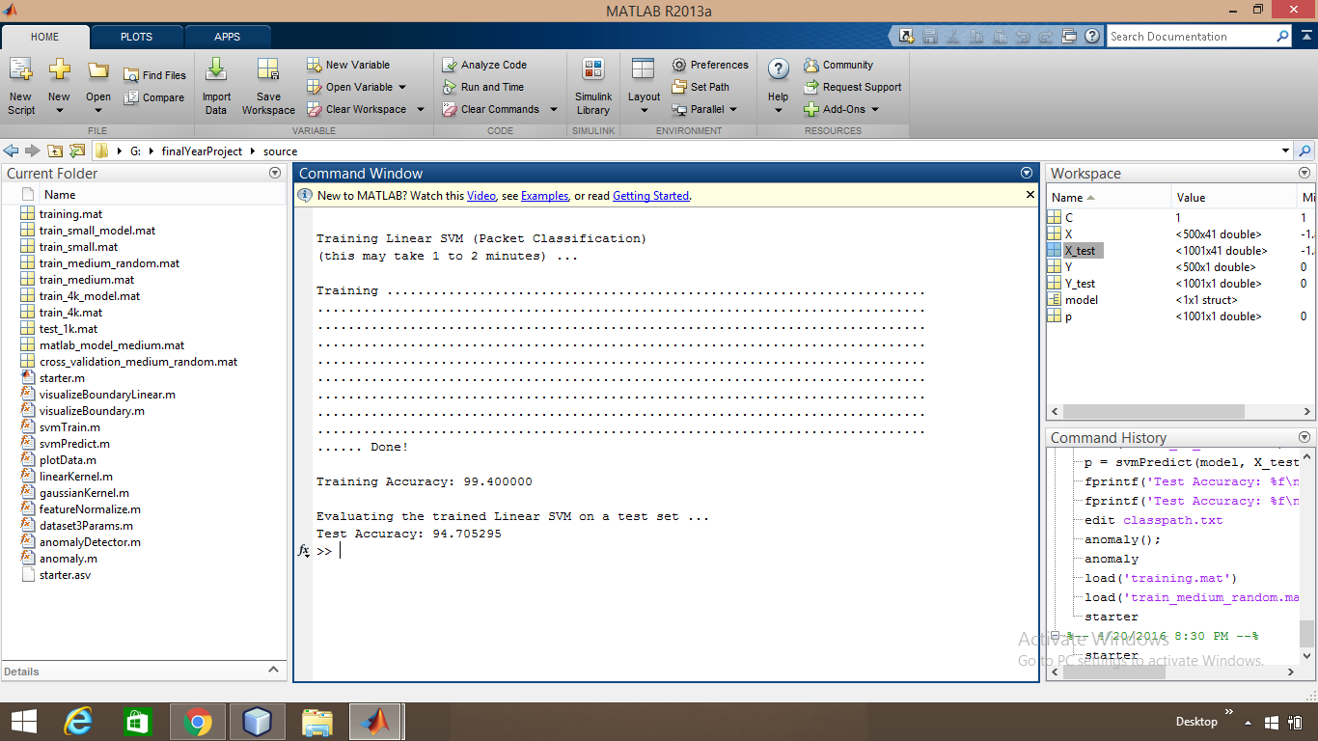
OUTPUT (Module 3)

Slide 19
REFERENCES
J.Antony Jeyanna , E.Indumathi ,Dr.D.Shalini Punithavathani “A Network Intrusion Detection System Using Clustering and Outlier Detection” International Journal of Innovative Research in Computer and Communication Engineering ,Vol. 3, Issue 2, February 2015.
Hichem Sedjelmaci and Mohamed Feham, “Novel hybrid intrusion detection system for clustered wireless sensor network” International Journal of Network Security & Its Applications (IJNSA), Vol.3, No.4, July 2011.
J. Gómez, C. Gil, N. Padilla, R. Baños, and C. Jiménez, “Design of a Snort-Based Hybrid Intrusion Detection System”.
Kayvan Atefi, Saadiah Yahya, Ahmad Yusri Dak , and Arash Atefi, “A hybrid intrusion detection system based on different machine learning algorithms” Proceedings of the 4 th International Conference on Computing and Informatics, ICOCI 2013 28-30 August, 2013 Sarawak, Malaysia. University Utara Malaysia .
Vahid Golmah, “An Efficient Hybrid Intrusion Detection System based on C5.0 and SVM”, International Journal of Database Theory and Application Vol.7, No.2 (2014).

Slide 20
REFERENCES
http://www.holehouse.org/mlclass/06_Logistic_Regression.html
https://zeltser.com/malicious-ip-blocklists/
http://www.selectrealsecurity.com/public-block-lists
http://sanesecurity.com/usage/signatures/
http://www.webopedia.com/TERM/I/intrusion_detection_system.html
https://en.wikipedia.org/wiki/Intrusion_detection_system

Slide 21
THANK YOU

