Slide 1
Name: Booja Sree S NM ID: 962821205017 College Name: University College of Engineering Nagercoil.
Final Project
3/21/2024 Annual Review

Slide 2
PROJECT TITLE
Diabetes Prediction using Convolutional Neural Network (CNN)
3/21/2024 Annual Review

Slide 3


AGENDA
PROBLEM STATEMENT
PROJECT OVERVIEW
WHO ARE THE END USERS?
YOUR SOLUTION AND ITS VALUE PROPOSITION
THE WOW IN YOUR SOLUTION
MODELLING
RESULTS
3/21/2024 Annual Review

Slide 4

PROBLEM STATEMENT
Diabetes is a prevalent health issue affecting millions worldwide. Early detection and management are crucial for preventing complications. However, traditional diagnostic methods can be time-consuming and invasive, leading to delays in treatment.
3/21/2024 Annual Review

Slide 5

PROJECT OVERVIEW
Our project aims to provide a user-friendly solution for diabetes prediction using Convolutional Neural Networks (CNNs).
By leveraging machine learning techniques, we seek to offer a convenient and efficient way for individuals to assess their risk of diabetes based on various health indicators.
3/21/2024 Annual Review

Slide 6

WHO ARE THE END USERS?
Individuals concerned about their diabetes risk.
Healthcare professionals seeking a supplementary tool for early diagnosis.
Researchers interested in exploring innovative approaches to diabetes prediction.
3/21/2024 Annual Review

Slide 7

YOUR SOLUTION AND ITS VALUE PROPOSITION
Our solution involves developing a CNN-based model trained on a dataset containing relevant health parameters. The web application allows users to input their health data and receive an instant prediction regarding their likelihood of having diabetes. This approach offers several key benefits:
Convenience: Users can access the prediction tool from any device with internet connectivity.
Accuracy: The CNN model incorporates advanced machine learning techniques to provide accurate predictions.
3/21/2024 Annual Review

Slide 8

THE WOW IN YOUR SOLUTION
User-Friendly Interface: The intuitive web interface makes it easy for individuals to input their data and receive predictions without any specialized knowledge.
Instantaneous Results: Users receive instant predictions, eliminating the need for lengthy wait times associated with traditional diagnostic methods.
Accessible Anywhere: Our web application is accessible from any device with internet access, ensuring widespread availability and convenience.
3/21/2024 Annual Review
8

Slide 9
MODELLING
Convolutional Neural Network (CNN): We utilize a CNN architecture for its ability to effectively process sequential data and capture patterns within the input features.
Training Data: The model is trained on a dataset containing information such as pregnancies, glucose levels, blood pressure, and other relevant health indicators.
Training Process: The model is trained using the Adam optimizer and binary cross-entropy loss function, with accuracy as the evaluation metric.
3/21/2024 Annual Review
9

Slide 10
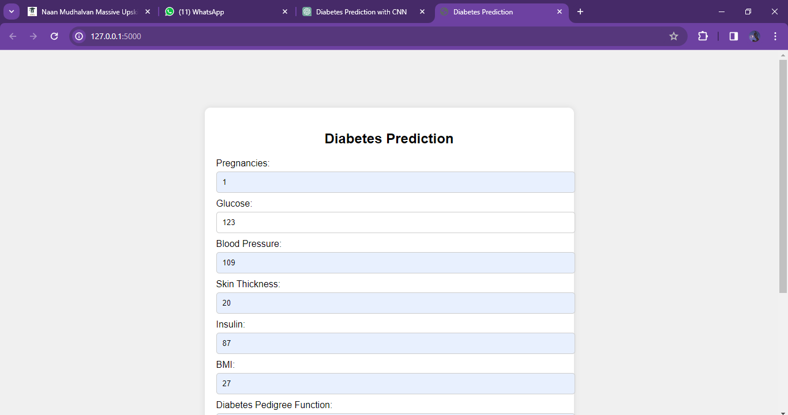
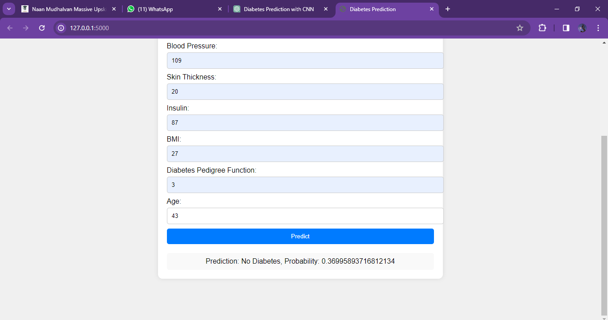
RESULTS
10

Slide 11
Thank You

