Slide 1
Understanding College Placement Scores in 2017
Omar Abdelbadie
General Assembly DSI, CC5

Slide 2
Questions to Answer
What can we learn about the ACT and SAT datasets?
Which States performed well vs. poorly?
How can States ensure BOTH strong participation and high scores?
What more information do we need?

Slide 3
What We Will Look At
Data Munging
Describing the Data
Participation Rates and scores by State
Overall Distributions
Correlations and Insights for Future Improvement

Slide 4

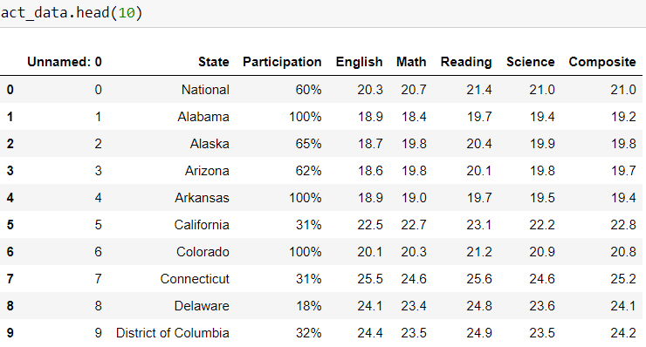
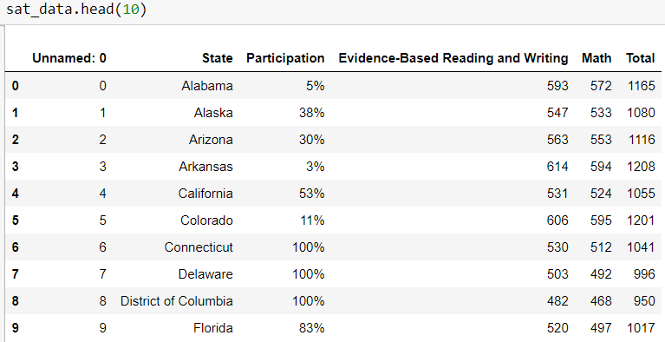
Data Munging
Notes:
This was a relatively clean data set

Slide 5

Data Munging
Notes:
This was a relatively clean data set

Slide 6
2017 in Perspective
The class of 2017 was the largest cohort in SAT history [with] more than 1.8 million students.¹
2.03 million, or 60 percent of the 2017 graduating class, took the ACT. ²
1. [https://reports.collegeboard.org/sat-suite-program-results/overview]
2. [https://www.edweek.org/ew/articles/2017/09/07/us-students-scores-inch-up-on-latest.html]

Slide 7

Data

Slide 8
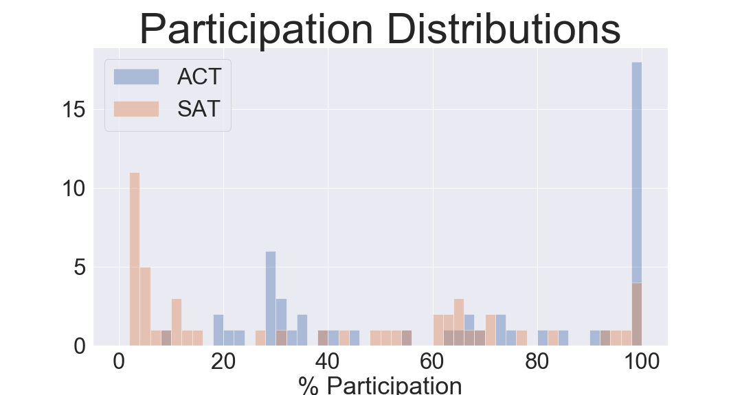
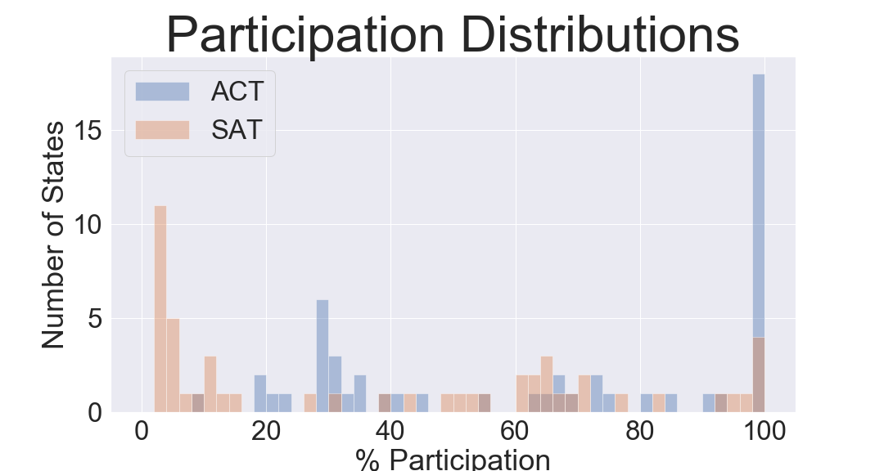
17 States Required ACT;
3 States Required SAT;
ACT Participation: 65% (95% confidence: 56%-74%)
SAT Participation: 40% (95% confidence: 30%-50%)
→ ACT is significantly more popular

Slide 9
100% ACT:
Alabama
Arkansas
Colorado
Kentucky
Louisiana
Minnesota
Mississippi
Missouri
Montana
Nevada
North Carolina
Oklahoma
South Carolina
Tennessee
Utah
Wisconsin
Wyoming
100% SAT:
Connecticut
Delaware
Michigan
ACT Participation: 65% (95% confidence: 56%-74%)
SAT Participation: 40% (95% confidence: 30%-50%)
→ ACT is significantly more popular

Slide 10

The Best!
State | % Participation | SAT Total
Minnesota | 3 | 1295.0
Wisconsin | 3 | 1291.0
Iowa | 2 | 1275.0
Missouri | 3 | 1271.0
Kansas | 4 | 1260.0
State | % Participation | ACT Composite
New Hampshire | 18 | 25.5
Massachusetts | 29 | 25.4
Connecticut | 31 | 25.2
Maine | 8 | 24.3
District of Columbia | 32 | 24.2
Notes:
2 interesting points: The best ACT states are not the best SAT tests. Also, their participation rates are quite low.

Slide 11

And… the rest
State | % Participation | SAT Total
District of Columbia | 100 | 950.0
Delaware | 100 | 996.0
Idaho | 93 | 1005.0
Michigan | 100 | 1005.0
Maine | 95 | 1012.0
State | % Participation | ACT Composite
Nevada | 100 | 17.8
Mississippi | 100 | 18.6
South Carolina | 100 | 18.7
Hawaii | 90 | 19.0
North Carolina | 100 | 19.1

Slide 12
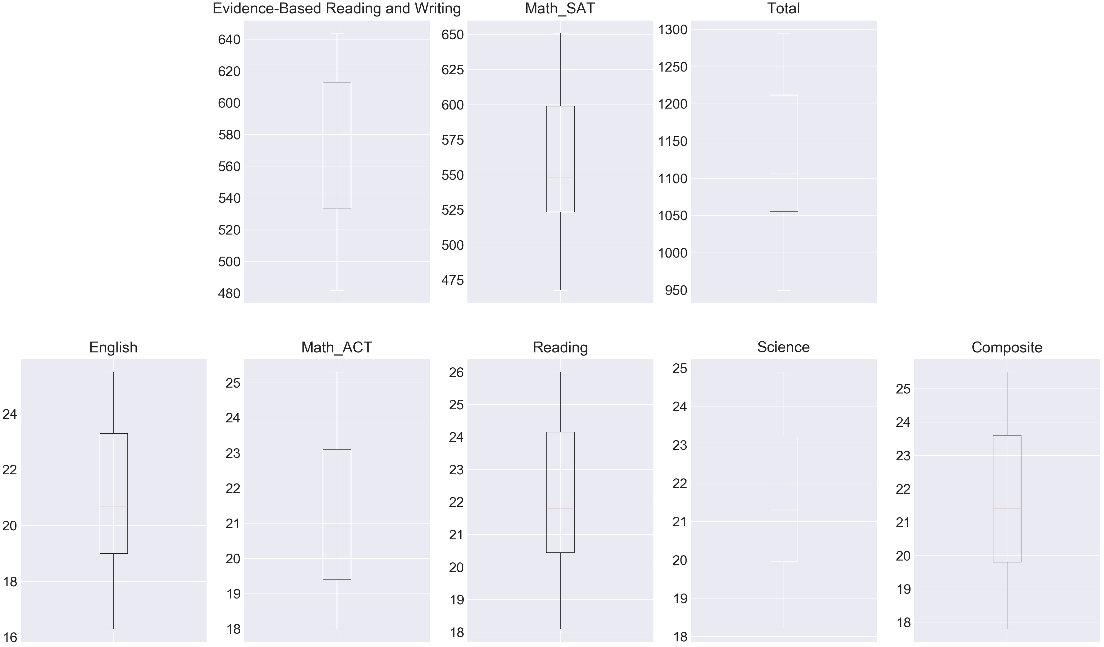
Scores

Slide 13

Tell me MOAAWRRR!

Slide 14
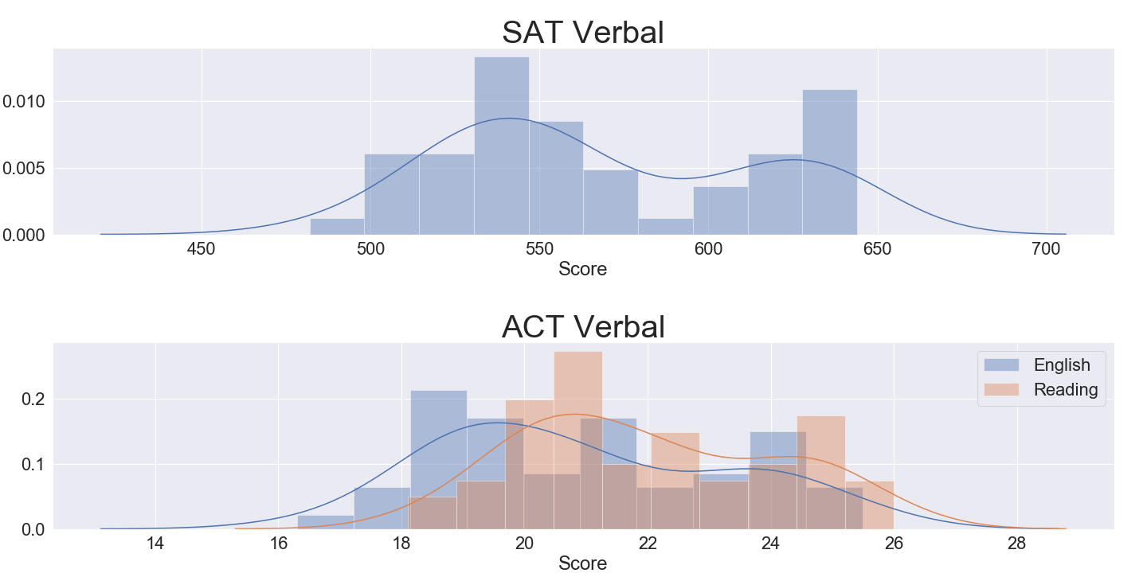
Key Point: Score Distributions are not Normal.

Slide 15
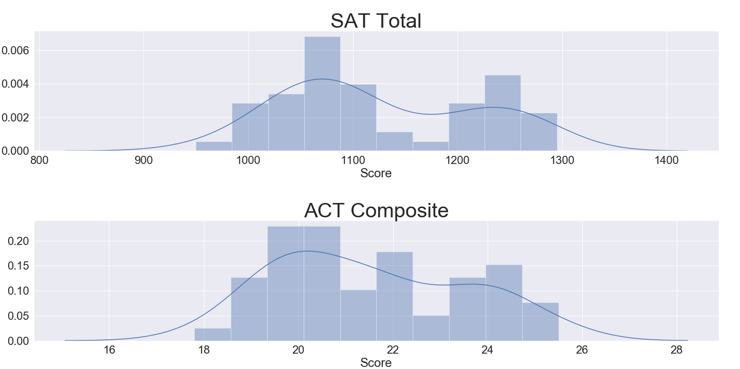
Probability Distribution Functions, cont.
Notes:
These are bi modal, non-normal distributions

Slide 16
Which distributions are normal?
Normal
Weird Non-Normal
SAT Math (p= .056)
ACT English (p= .084)
ACT Science (p= .06)
SAT Participation
Evidence-Based Read & Write
Total
ACT Participation
Math
Reading
Composite
Notes:
Had an alpha of .05

Slide 17
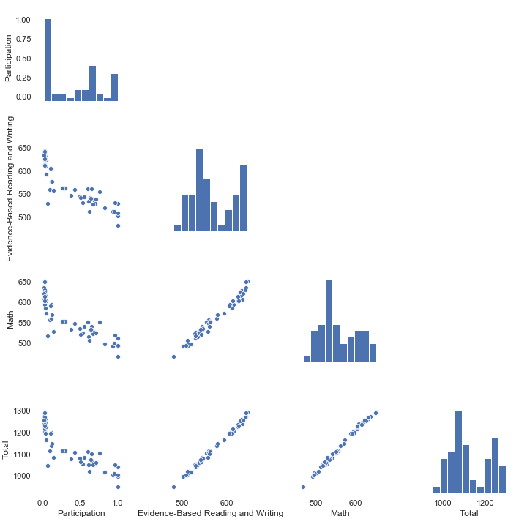
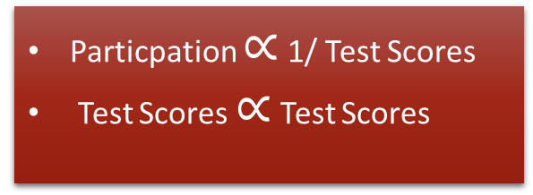
SAT Correlations
Particpation $∝$ 1/ Test Scores
Test Scores $∝$ Test Scores

Slide 18
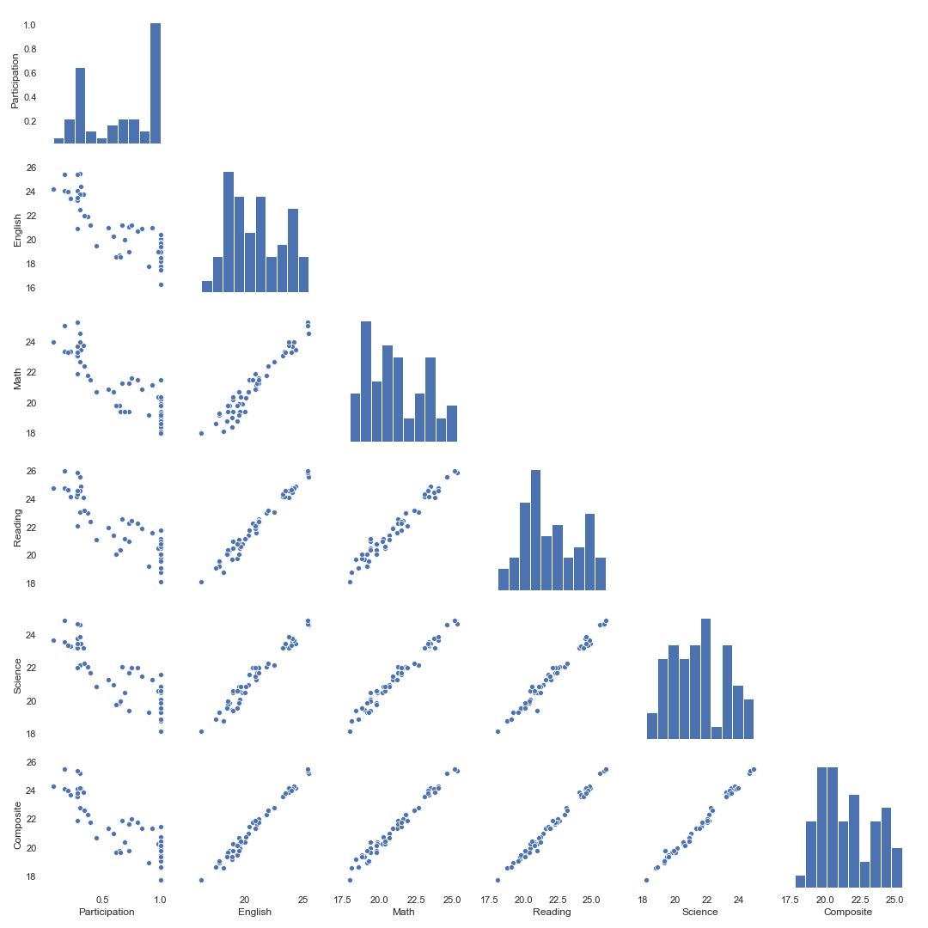

ACT Correlations
Particpation $∝$ 1/Test Scores
Test Scores $∝$ Test Scores

Slide 19
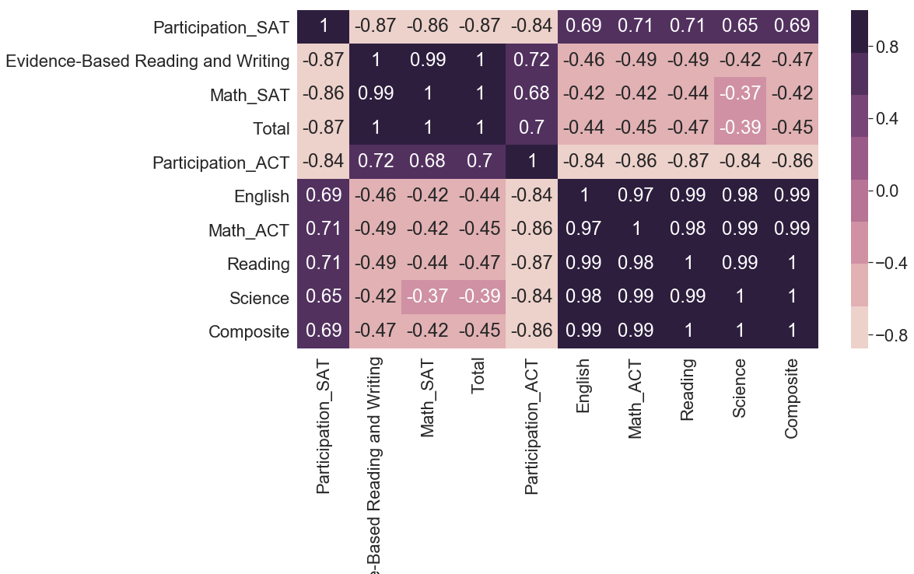
Weak inter-test correlation
Notes:
You'd think that States that perform well on one exam would do so for another...

Slide 20
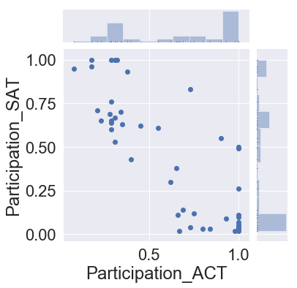
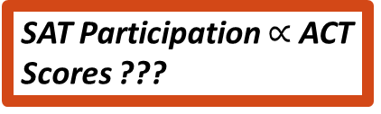
SAT Participation $∝$ ACT Scores ???
Inverse inter-test Participation correlation
Notes:
Students that take one exam are less likely to take the other. Negative participation corr + negative intra part/score corr = positive inter test part/score corr. This Strong effect likely is drowning out any correlation between states’ preparation of their students

Slide 21
Questions to Answer, revisited.
What can we learn about the ACT and SAT datasets?
Which States performed well vs. poorly?
How can States ensure BOTH strong participation and high scores?
What more information do we need?

Slide 22
Insights and considerations
100% participation is a mixed blessing
Nevada’s woes; The truth hurts sometimes
Excellence in one subject → Excellence in all subjects (within a test!)
Unpopular tests (like the SAT) are self selecting
Students are less likely to take one test if they’ve already taken the other

Slide 23
Limitations, or, Further Investigations
We have no historic data.
To make inferences about trends (good or bad), we need different years
We have little information about states’ policies
Other than mandatory testing, which policies/conditions lead to better outcomes.
We could identify states with subject scores that are disproportionately (i.e. buck the correlation of test excellence) to identify specific programs that need improvement.
Geographic/Regional correlations

