Slide 1


BOSCO
THE GYM TRAINER
TEAM MARLBORO
DU HACKS 4.0

Slide 2


QUICK INTRODUCTION
Bosco is an AI that predicts exercises after being trained with machine learning models. The accuracy of exercises can be checked by uploading a video or starting the web camera.

Slide 3
TECH STACK USED
Pandas : to read the csv and manipulate it
Numpy : to perform mathematical operations
OpenCv2 : to access the web camera or video and draw points
Mediapipe : to detect the points over the body or draw mesh over the face
Sklearn : model training and predicting the performed exercise
csv : to write into the csv file

Slide 4
WORKING OF
MEDIAPIPE LIBRABRY
Mediapipe is used to detect the different points over the human body. It’s library developed by google.
There are total of 3 types of detection it provides
Face Mesh
Full Body Skeleton
Full Body Mesh
In backend it works over the c++ script and implementation is based on perception pipline called as Graph

Slide 5
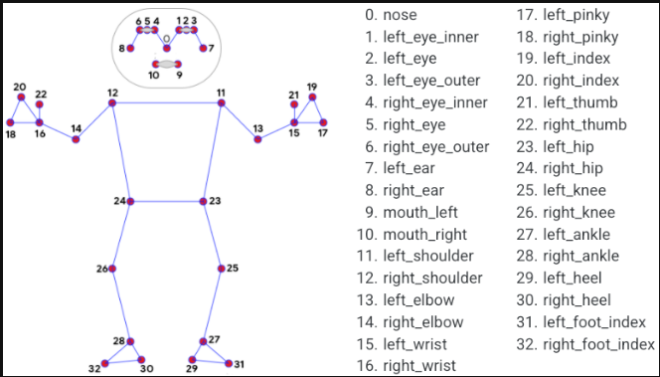
FULL BODY SKELETON
In Our Whole body It detects 32 different point based on the geometry.
After detecting the 32 points it makes 2D and 3D projections wiz [x,y,z] and 3rd invisibility factor

Slide 6
HISTORY
HOW WE GET STARTED
So as we can see there are many small and medium sized traders working around us even in last mile village there is a Dairy or general store available
The biggest problem is all that they all have to manage their stocks and accounting with pen and papers thus makes this task very tidy and can be error prone.
So one day I got a idea of actually creating a planning system and ERP system came into existence

Slide 7
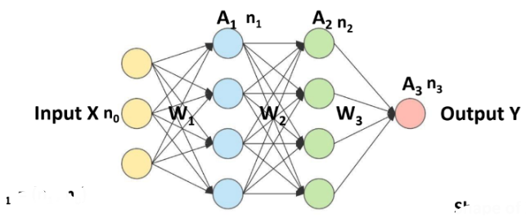
CONSTRUCTION
OF MODEL
Model : Logistic Regression

Slide 8
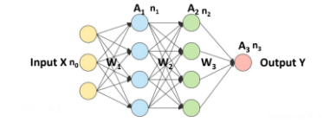

MATHEMATICAL DERIVATIONS
Providing Shape to all Parameters and understanding the cost function
A1 =f1(Z1) A2 =f2(Z2) A3 = Sigmoid (Z3)
Shape of W1 = (n1 , n)
Shape of X = (n0 , m)
Shape of W2 = (n2 , n1)
Zk = Wk Ak-1 + BK
Shape of A1 = (n1 , m)
Shape of W3 = (n3 , n2)
Shape of A2 = (n2 , m)
Shape of B1 = (n1 , 1)
Shape of A3 = (n3 , m)
Shape of B2 = (n2 , 1)
Shape of Y = (n3 , m)
Shape of B3 = (n3 , 1)

Slide 9
CODED DERIVATIONS OF MODEL
2. Forward Propagation
Z_1 = W_1 * X + B_1
A_1 = f ( Z_1 )
Z_2 = W2 * A_1 + B_2
A_2 = Softmax( Z_2 )/Relu(Z_2)
Initialize parameters Randomly
W_1 = np.random.randn(n_1, n_0)
b_1 = np.zeros((n_1, 1))
W_2 = np.random.randn(n_2, n_1)
b_2 = np.zeros((n_2, 1))
3. Softmax
a_i = \frac{e^{z_i}}{\sum_{i=k}^ne^{z_k}}

Slide 10
5. Backward Propagation
dZ_2 = ( A_2 - Y )
dW_2 = \frac{1}{m}. dZ_2 . A_1^T
dB_2 = \frac{1}{m}.sum(dZ_2, 1)
dZ_1 = W_2^T . dZ_2 * f_1^|(Z_1)
dW_1 = \frac{1}{m}.dZ_1.X^T
dB_1 = \frac{1}{m}.sum(dZ_1, 1)
4. Cost Function
Loss = - \sum_{i=k}^{n}[ y_k*log(a_k) ]
Cost = - \frac{1}{m}\sum_{i=1}^{m}\sum_{k=1}^{n}[ y_k*log(a_k) ]

Slide 11
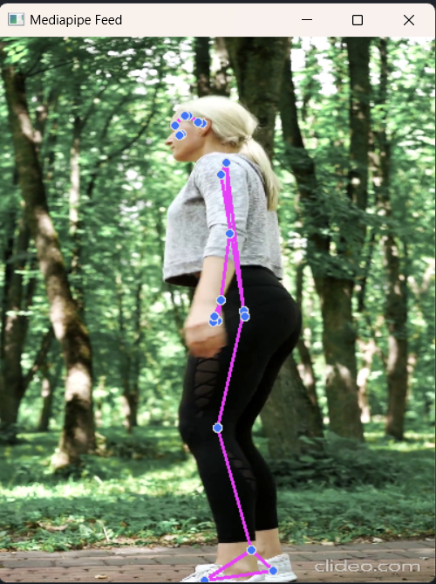
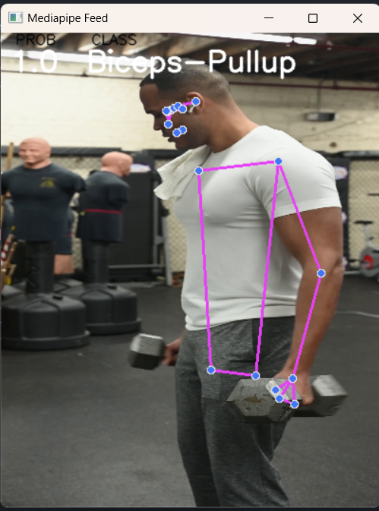
HOW CLASSES GET PREDICTED

Slide 12
THANK YOU

