Slide 1
KNOWIT
BookMyTurf
Online Turf Booking System
Submitted By: Akshata Umesh Shet
Group No: 15
Guided By: SNEHAL SOMVANSHI

Slide 2
1.
Project overview
KNOWIT
BookMyTurf digitizes the turf booking process, replacing manual systems
Addresses challenges like double bookings, poor scheduling, and maintenance delays
Provides online platform for checking availability, booking slots, and payments
Connects three user types: Customers, Turf Owners, and Administrators
Built with React frontend, Spring Boot backend, and MySQL database

Slide 3
2.
Users and Use cases
KNOWIT
User Types: Customers (Players), Turf Owners, and Administrators
Search available turfs by location and amenities
Real-time slot availability checking with calendar view
Online booking and secure payment processing
Booking management, cancellation
Rating and review system for quality assurance

Slide 4
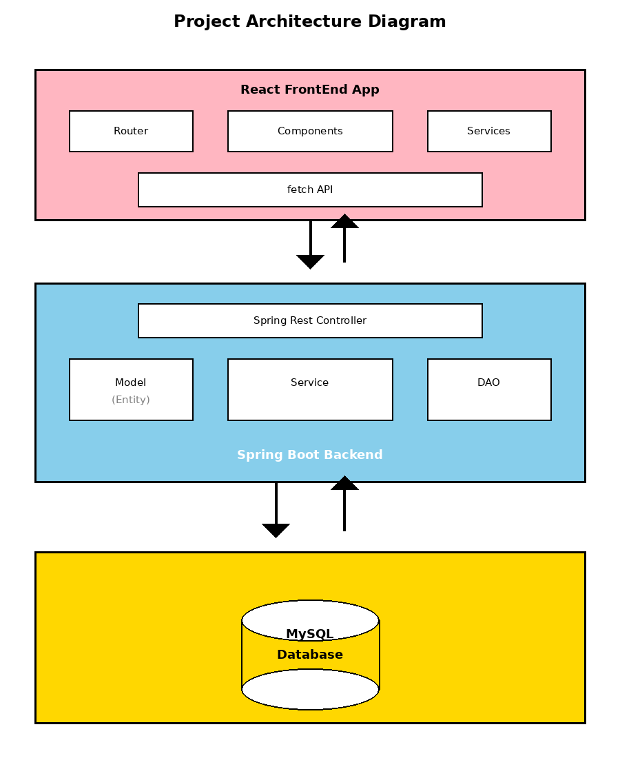
3.
Project Architecture
KNOWIT

Slide 5
4.
My role and contribution
KNOWIT
Full-Stack Development: Developed frontend (7 pages, 4 components) and backend (50+ REST APIs)
Database Design: Created normalized schema with 13 tables ensuring data integrity
Authentication System: Implemented secure user authentication with BCrypt encryption
API Development: Built comprehensive RESTful endpoints for all business operations
Testing: Conducted unit, integration, and end-to-end testing
Documentation: Created technical documentation and setup guides

Slide 6
5.
Project Methodology
KNOWIT
Agile methodology with iterative development cycles
Requirements analysis and detailed planning phase
Database-first design approach for data integrity
Component-based architecture for reusability
Tools: Eclipse IDE, VS Code, Visual Studio Code, MySQL Workbench, Postman, Git
Continuous integration and testing throughout development

Slide 7
6.
Testing approach
KNOWIT
Unit Testing: Tested individual components and service methods
Integration Testing: Verified API endpoints using Postman
Database Testing: Validated CRUD operations and constraints
Frontend Testing: UI components tested across browsers
End-to-End Testing: Complete user workflows validated
Security Testing: Password encryption and data transmission verified

Slide 8
7.
Future extensions
KNOWIT
Mobile applications for iOS and Android platforms
Real-time chat between customers and turf owners
Google Maps integration for location-based search
Dynamic pricing based on demand and peak hours
Loyalty programs and membership plans
AI-powered recommendations and multi-language support

Slide 9
8.
Your experience/ lessons learnt
KNOWIT
Gained hands-on experience with Spring Boot, React, and MySQL integration
Overcame challenges in state management and API integration
Learned importance of clean code and proper documentation
Mastered database normalization and data integrity concepts
Developed responsive design and intuitive UI skills
Implemented security best practices for authentication

