Slide 1
Nomogram Project Update
BP Mulligan, PhD, CPsych
20 August 2024
(updated 16 April 2025)

Slide 2
Nomogram Project Update
BP Mulligan, PhD, CPsych
20 August 2024
(updated 16 April 2025)

Slide 3
Nomogram Project Update
BP Mulligan, PhD, CPsych
12 June 2026

Slide 4
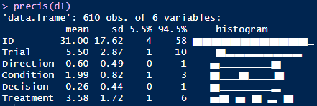
Descriptives

Slide 5
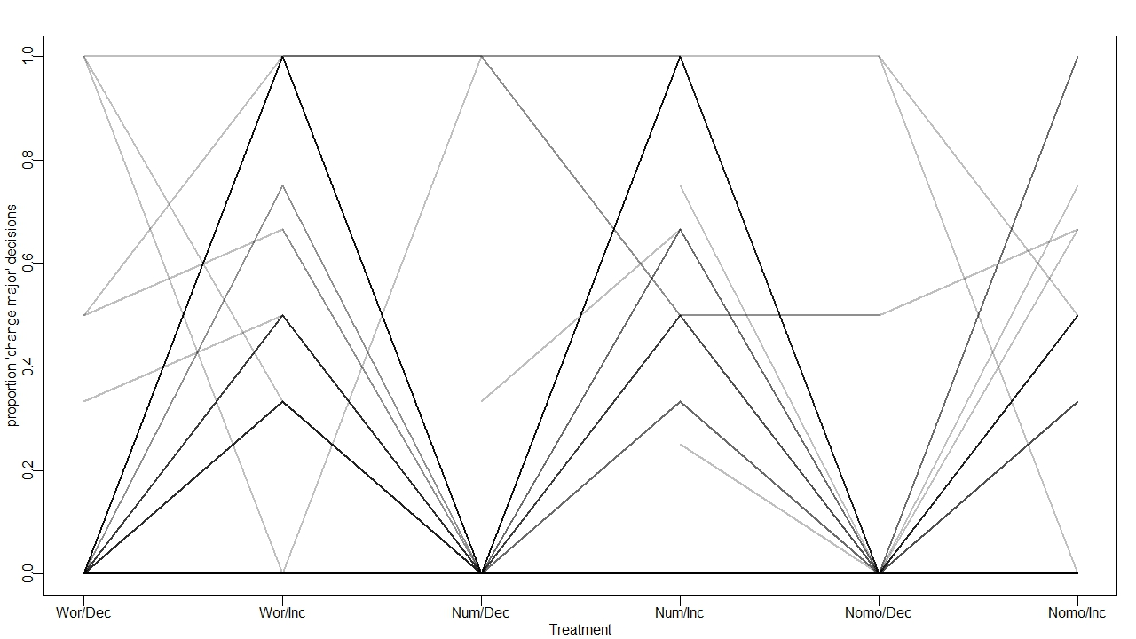

Slide 6
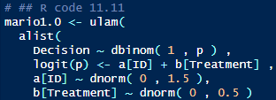
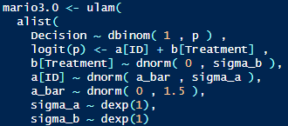
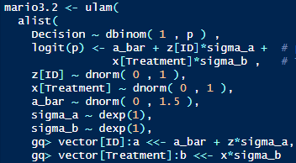
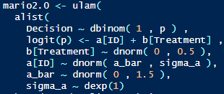
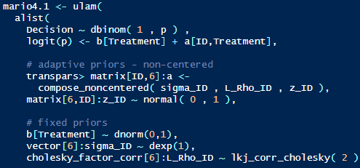

Slide 7
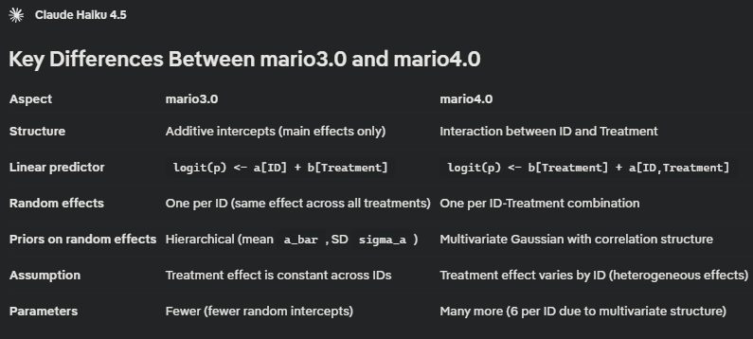

Slide 9
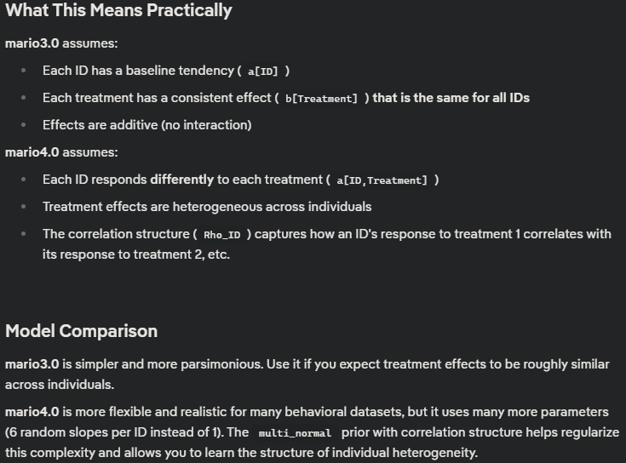

Slide 10
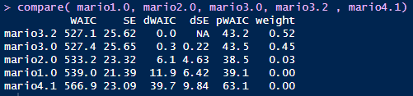


Model Comparison

Slide 11
Model Comparison
137 pars
816 pars

Slide 12
Covarying Effects
Real data often has covarying effects
Estimating (co)variance parameters in the model can improve the fit and the accuracy of prediction
What if we compare a model that estimates covariance with one that does not?

Slide 13
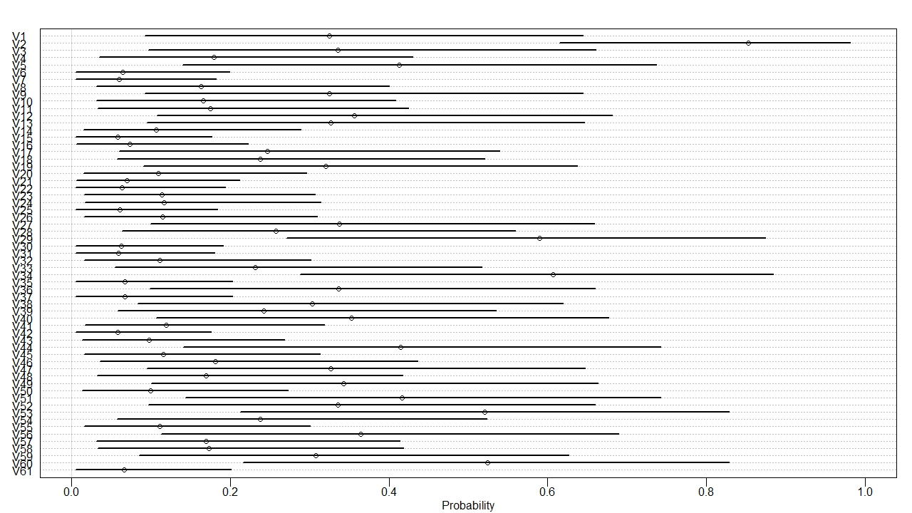
mario3.2

Slide 14
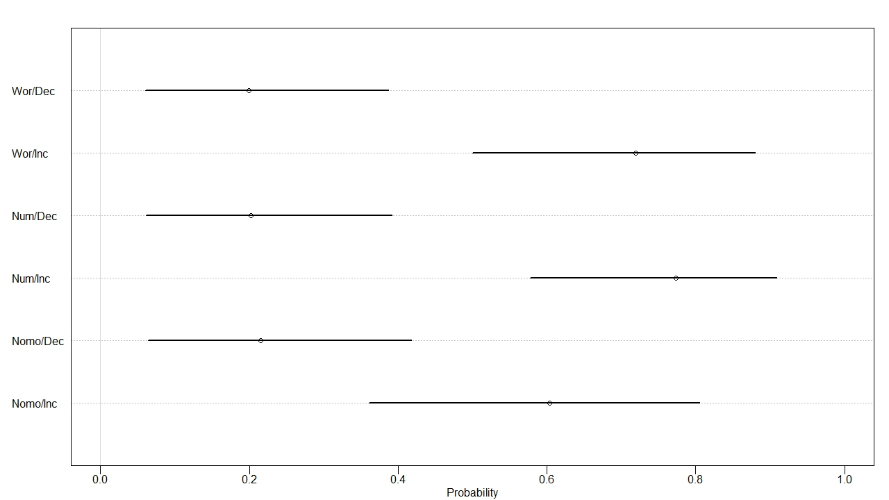
mario3.2

Slide 15
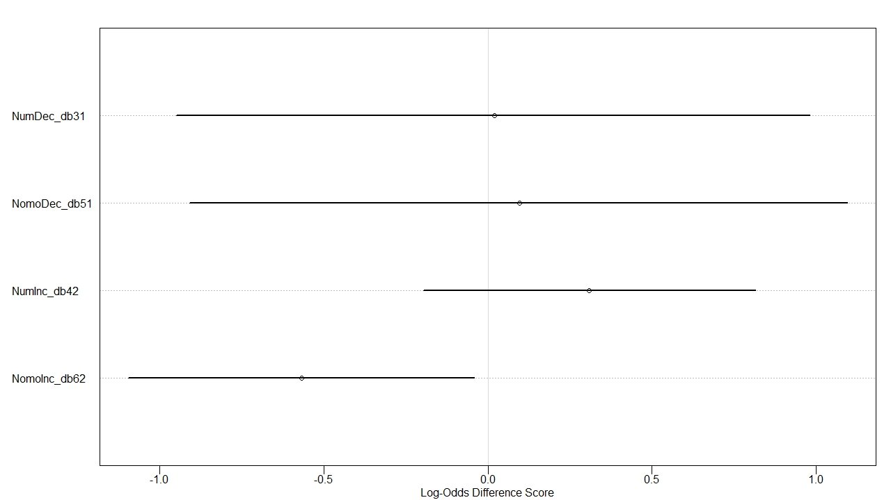
mario3.2

Slide 16
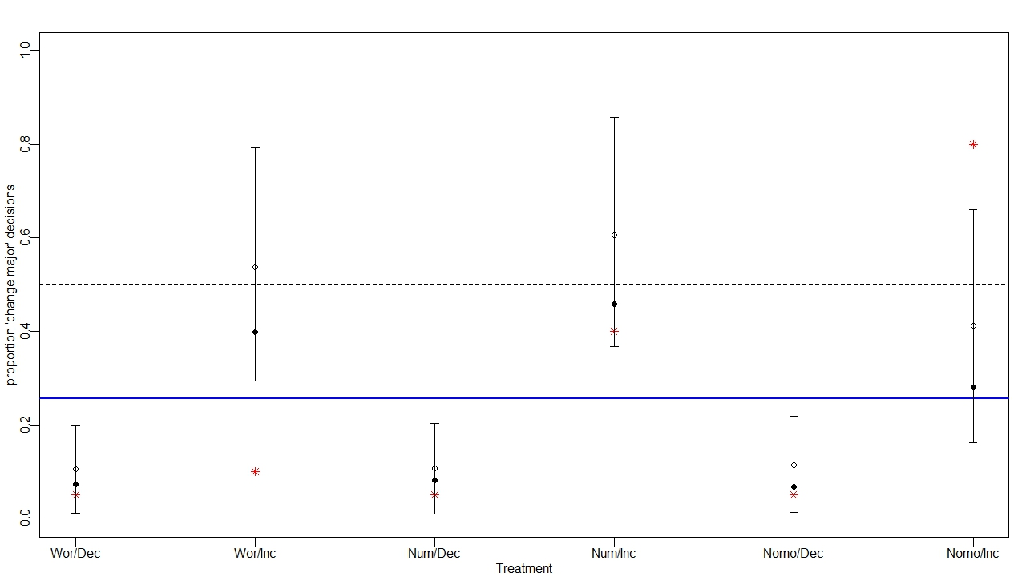
mario3.2

Slide 17
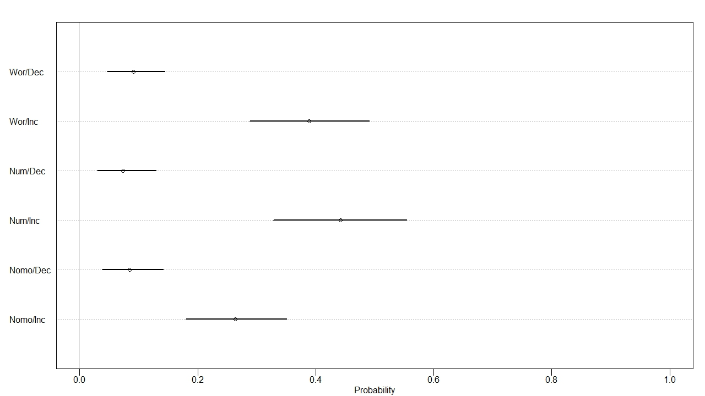
mario4.1

Slide 18
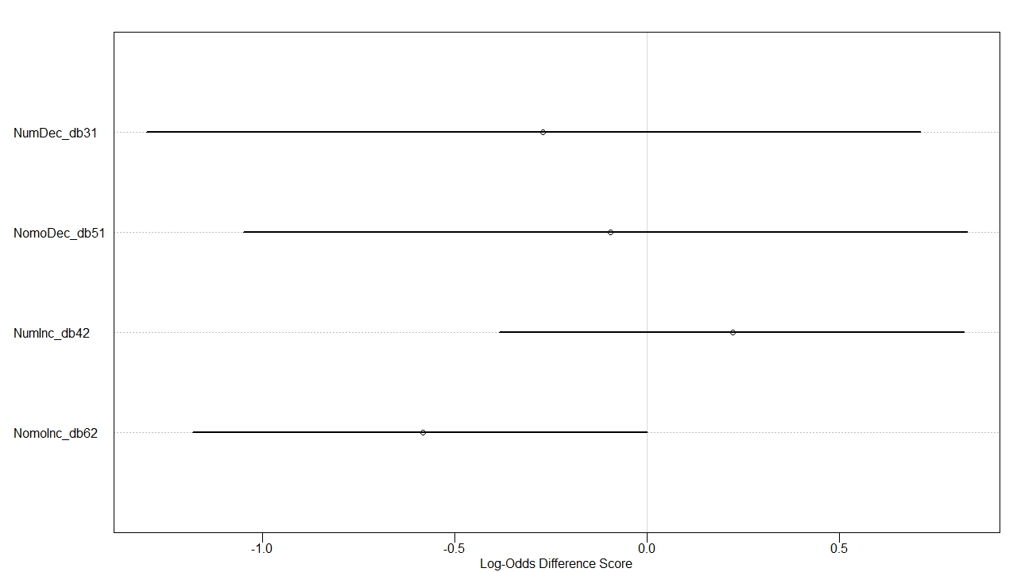
mario4.1

Slide 19
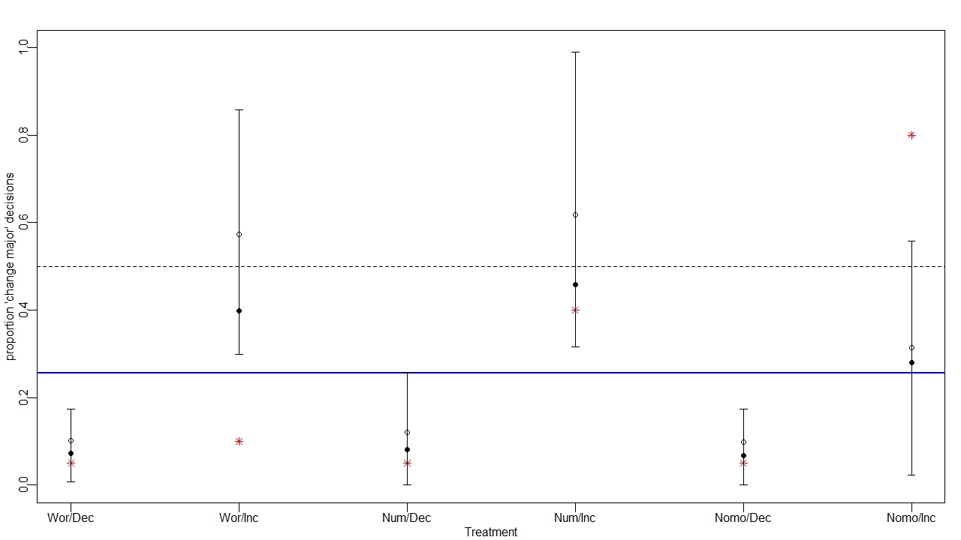
mario4.1

Slide 20
Next Steps
Publication?
Where?
Iterate and collect more data?
Add an intervention group that receives some instruction about nomogram interpretation?

Slide 21
Discussion
Increase comprehensibility of model comparison
Study 2?
nomogram education treatment condition
covariates (experience with graphs, comfort with math, etc)
how quickly they make an initial click vs how long they take to submit the page (also did person change their response)
Exploratory analysis – time, individual diffs
Demand characteristics in a within-person design (i.e. introducing training partway through the vignettes)

Slide 22
Post-meeting Thoughts
Study 1 limitations – it ignores the magnitude of difference (considering only the direction); we assume that the “best decision” is to change majors when there is data suggesting that outcomes are better, but this ignores the real-world implications of a making a major life decision; also implies (erroneously) that there is no error in the posterior estimate (i.e. consider the probability of a good outcome after a change to be 51% vs 99%.... The latter is more convincing)
Study 2: systematically vary direction, magnitude, and format
Study 3: consider adding a component of randomized assignment to an educational intervention for data/nomogram literacy vs. control condition

