Slide 1

BOOKSMART PRODUCT DEMO
The contractor engine turns financial activity into action
A live walkthrough of trusted financial intelligence, job monitoring, owner tasks, and CPA escalation.
Jobber knows the work. Accounting knows the books. BookSmart explains what needs attention.

Slide 2
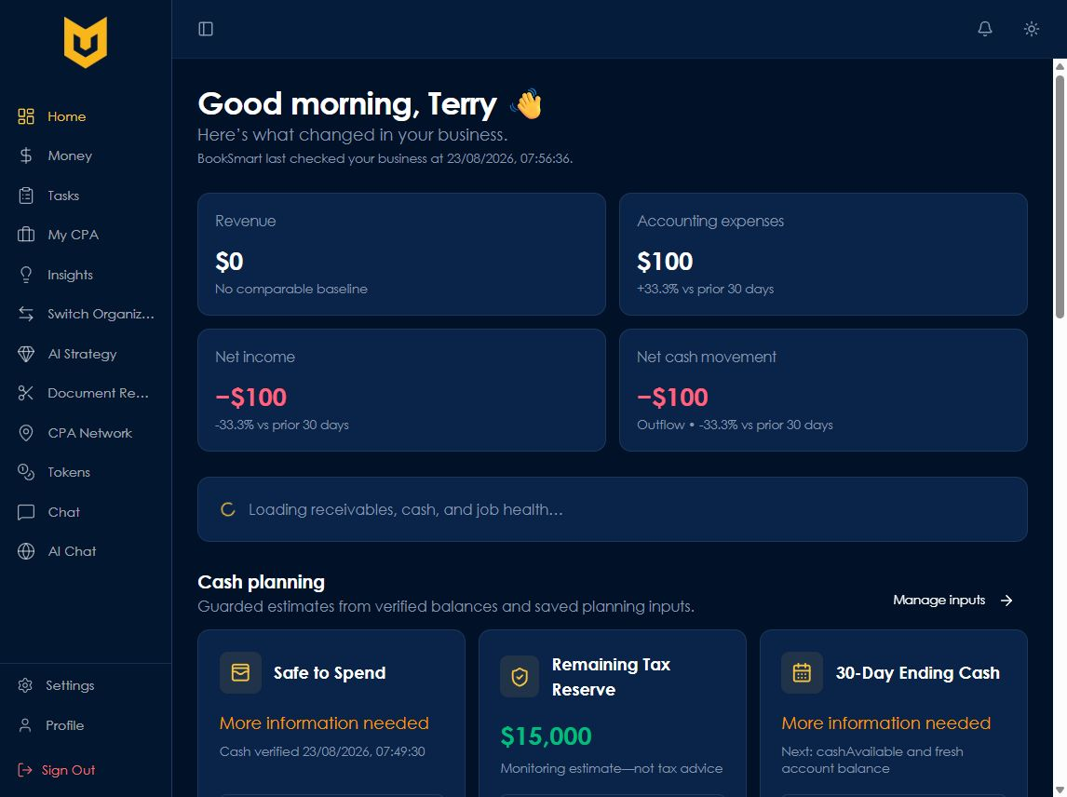
BOOKSMART CONTRACTOR ENGINE / 01
The morning brief starts with trusted numbers
BookSmart summarizes what changed, highlights risk, and labels missing inputs instead of guessing.

Slide 3
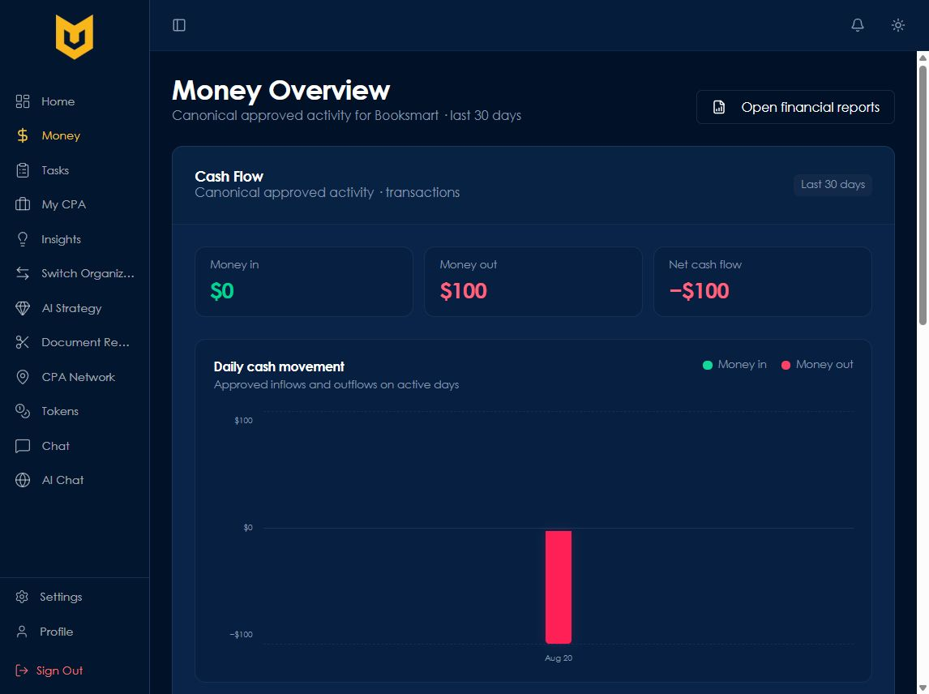
BOOKSMART CONTRACTOR ENGINE / 02
One accounting truth prevents double counting
Canonical approved activity drives revenue, expenses, net income, and cash movement; connected sources add context.

Slide 4
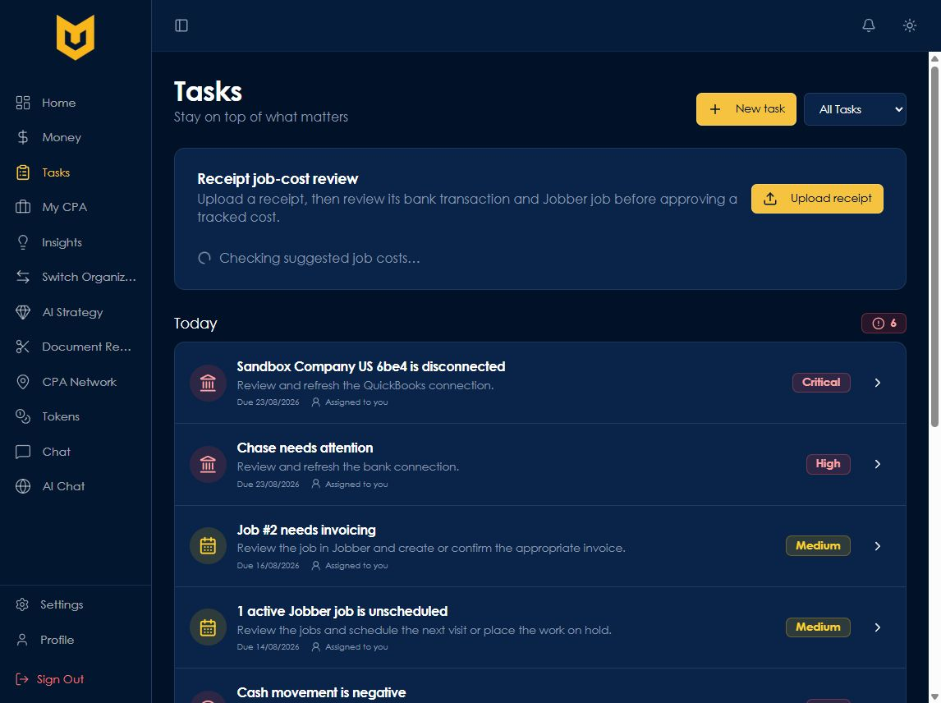
BOOKSMART CONTRACTOR ENGINE / 03
Signals become concrete, owned work
Every supported issue creates a persistent task with an owner, priority, due date, and deterministic lifecycle.

Slide 5
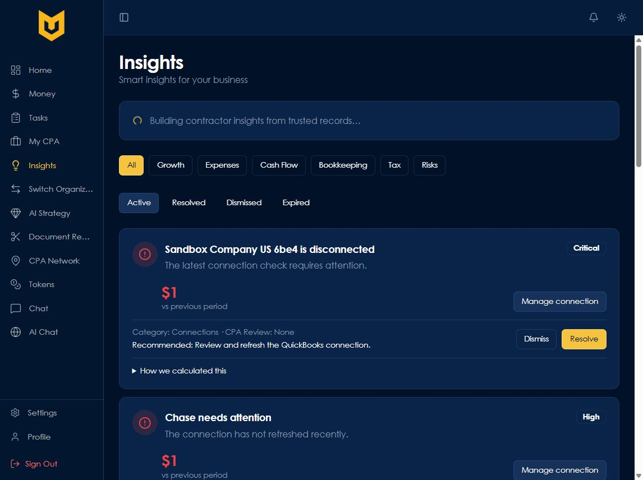
BOOKSMART CONTRACTOR ENGINE / 04
Every insight is explainable and reviewable
The engine shows the condition, evidence, recommendation, source path, and whether CPA review is appropriate.

Slide 6
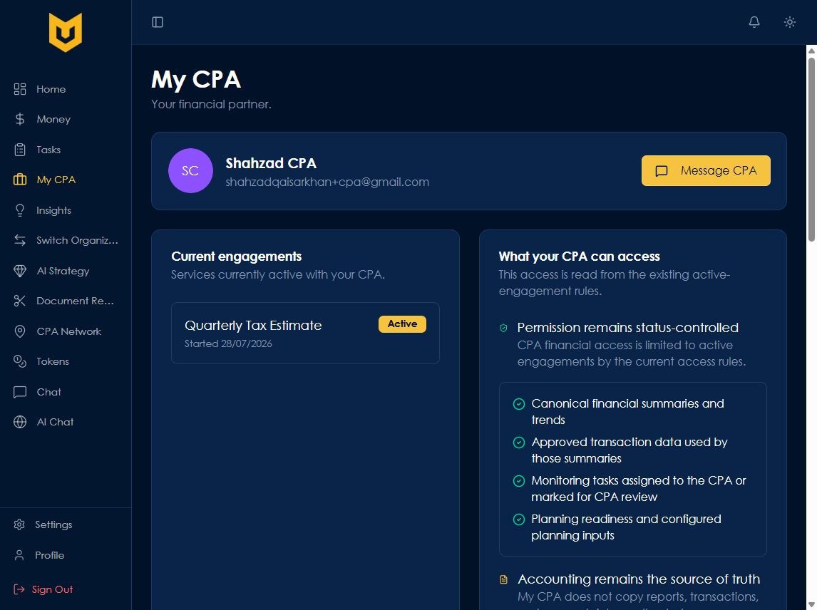
BOOKSMART CONTRACTOR ENGINE / 05
The CPA sees only what the owner authorizes
Status-controlled access and supported escalation keep professional review useful without creating another ledger.

Slide 7
THE BOOKSMART MAGIC
Here’s what happened. Here’s what needs attention next.
The first contractor engine already connects trusted accounting activity, operational Jobber context, monitoring signals, persistent tasks, and CPA review. The remaining work is production validation and deeper provider coverage.
Core implementation: 90% • Overall readiness: 82%

