Slide 1
Julian Lüken
Avid lover of all things Computer Science and Math.

Slide 2
About me
M. Sc. Applied Computer Science
Areas of specialization: Scientific Computing, Digital Signal Processing
Currently working at the German Aerospace Center (since 2021)
Institute of Propulsion Technology, Turbine Department in Göttingen (DE)
Thesis project CoolingGen
Knowledge and interest in math and programming, especially w.r.t. Digital Signal Processing

Slide 3
CoolingGen
State-of-the-art tool for parametric modelling of 3D turbine blade/vane geometries at the German Aerospace Center
Based on custom CAD kernel
Uses NURBS for object representation
Uses streamsurface coordinate transformation coupled with custom algorithms (fillet creation, ray marching, …) for fast geometry modification

Slide 4
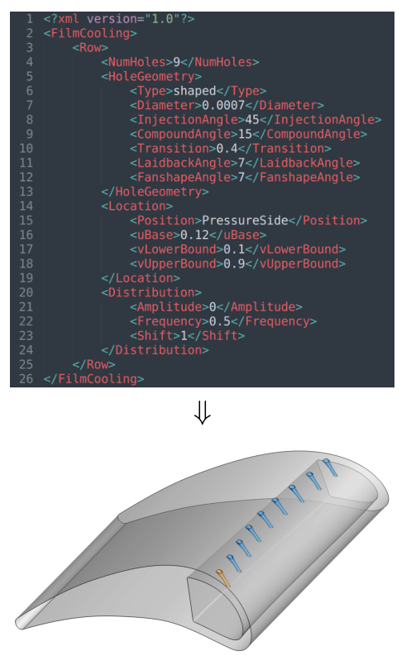
CoolingGen
Problem: Aviation cooling structures are hard to model with conventional CAD tools. Once they are created, they are hard to modify
Solution: Make own CAD tool that has its own primitives based on (relatively) simple parameter representations. We can then simply modify the input and re-create the geometry

Slide 5
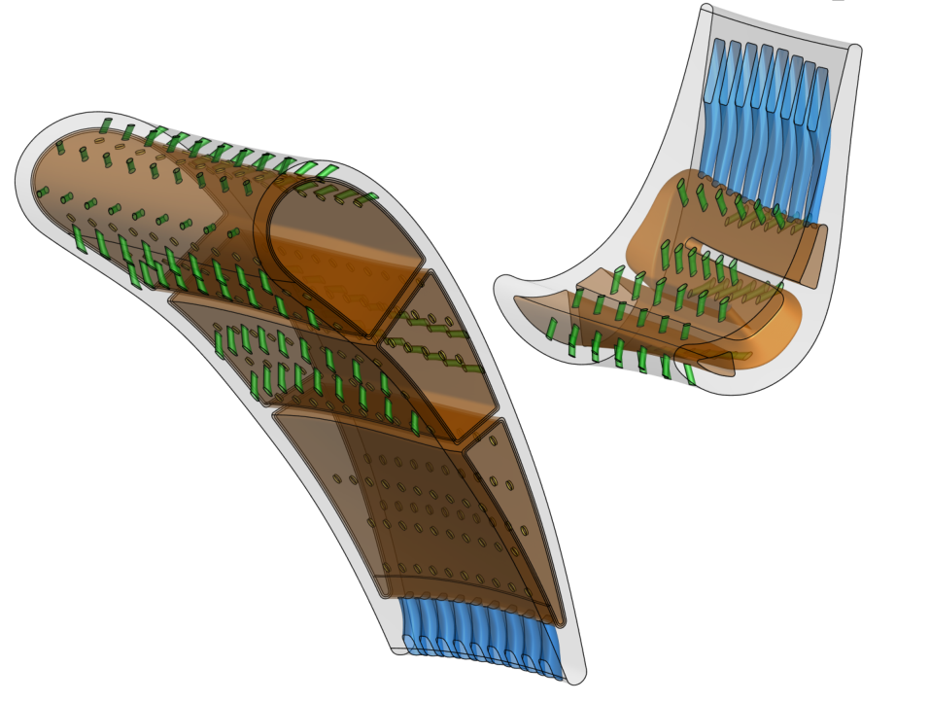
CoolingGen
Problem 2: Resulting shapes are intersection-heavy. Using Boolean operators, this will take ages to generate. No can do!
Solution 2: Use more simple representations of the shapes and find a way to intersect these.

Slide 6
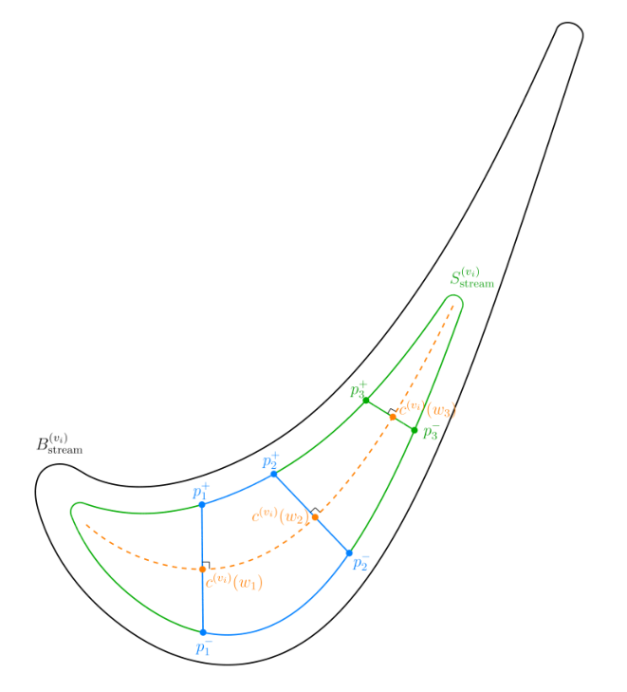
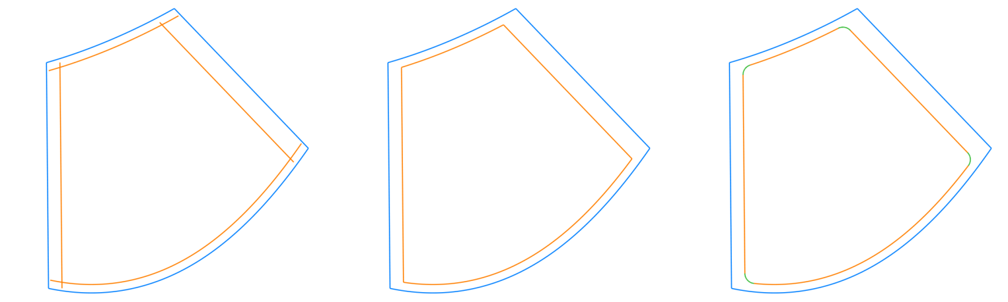
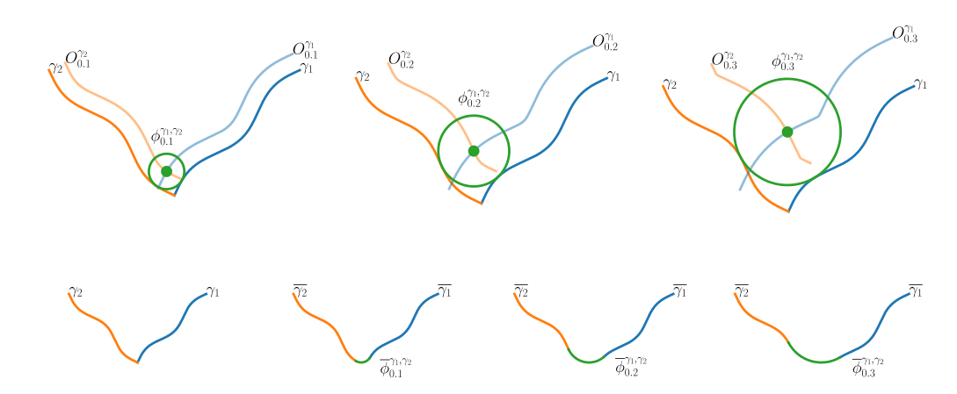
Offset delimiting curves
Trim at intersections
Add fillets
Transform to streamsurface
coordinate system
Fillet creation process

Slide 7
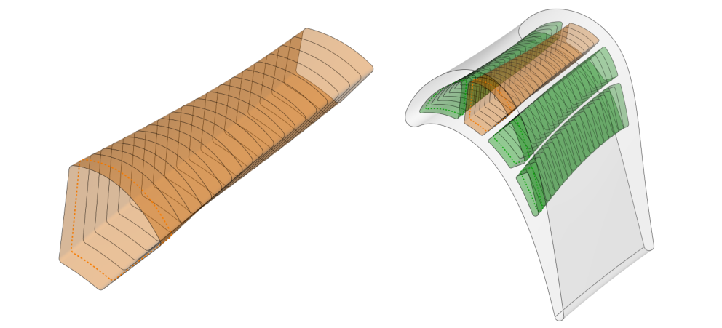
Inverse transform (black curves) and surface lifting (orange surface)

Slide 8
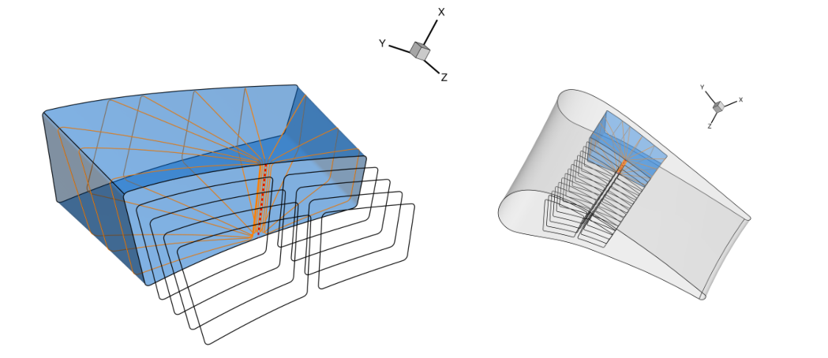
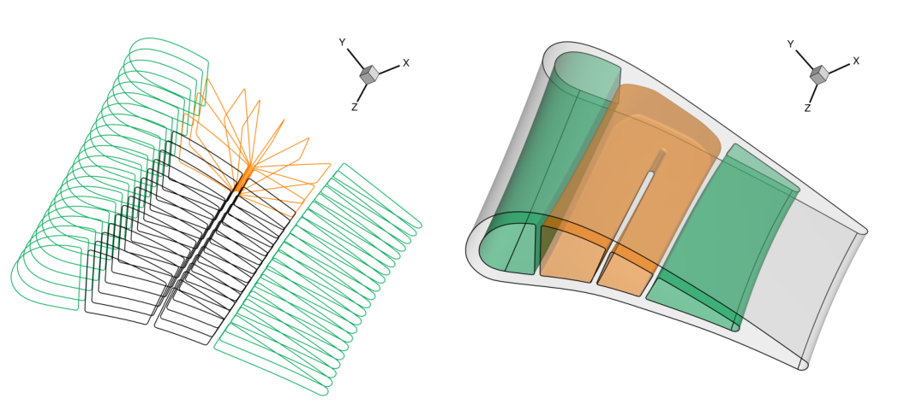
Creating turns between the resulting channels
Once again, surface lifting
Fuse channels, find plane intersections

Slide 9
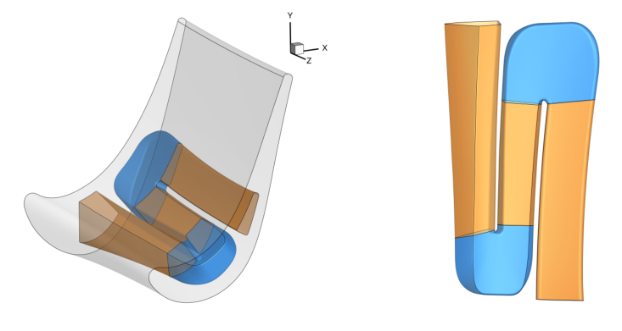
Multiple turns

Slide 10
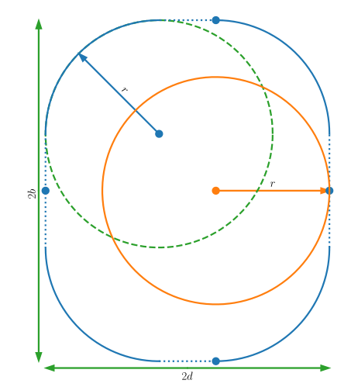
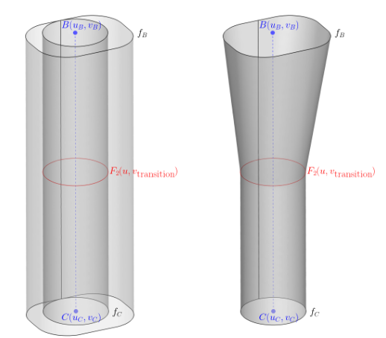
Hole creation
Embed in 3D space using line segment
Find special linearly interpolated surface
Basic 2D curves
In this case: circle, rounded rectangle

Slide 11
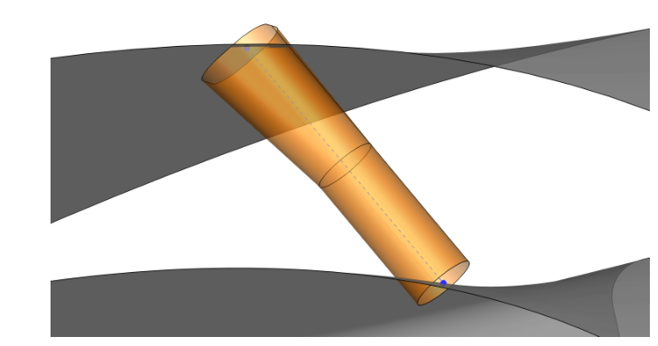

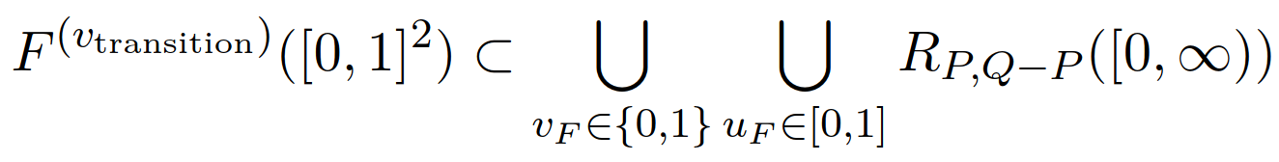
Hole intersection
Notice:
The orange shape consists of rays, which are much easier to intersect with surface than surfaces

Slide 12
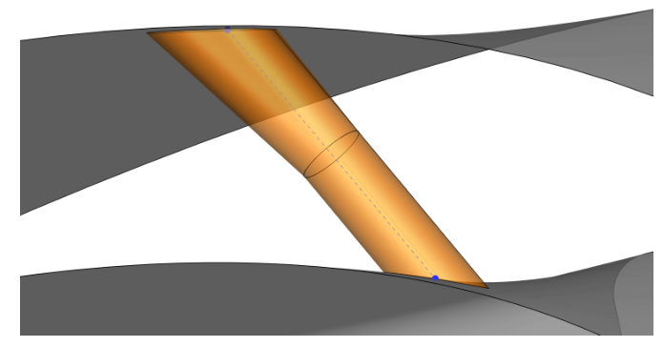
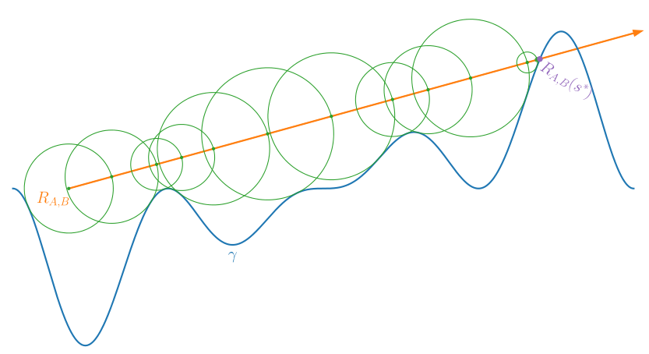
Hole intersection with ray marching
Intersected shape
Original shape
Ray marching

Slide 13
Result

Slide 14
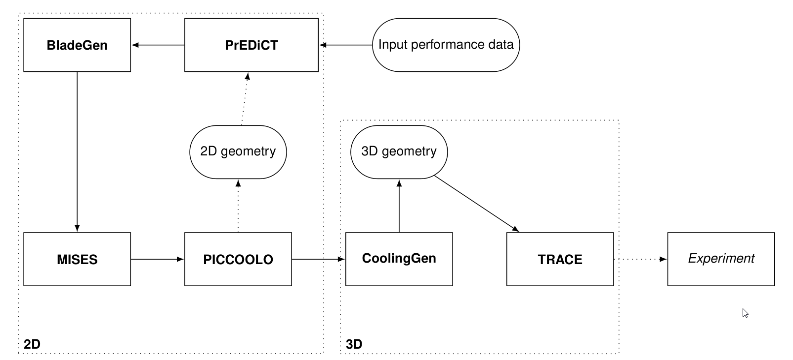
Cooling Design Process Chain

Slide 15
Also about me
From Northern Germany (East Frisia)
Cooking, hiking, video games
Playing the guitar for 15 years now
Loves Jazz and Progressive Metal

