Slide 1
Julian Lüken
Avid lover of all things Computer Science and Math.
🌐 | https://boolean-julian.github.io/
✉ | julian-lueken@t-online.de

Slide 2
Contents
About me ☺
Scientific project and current occupation: CoolingGen
My interest in Computer Tomography

Slide 3
Contents
About me ☺
Scientific project and current occupation: CoolingGen
My interest in Computer Tomography

Slide 4
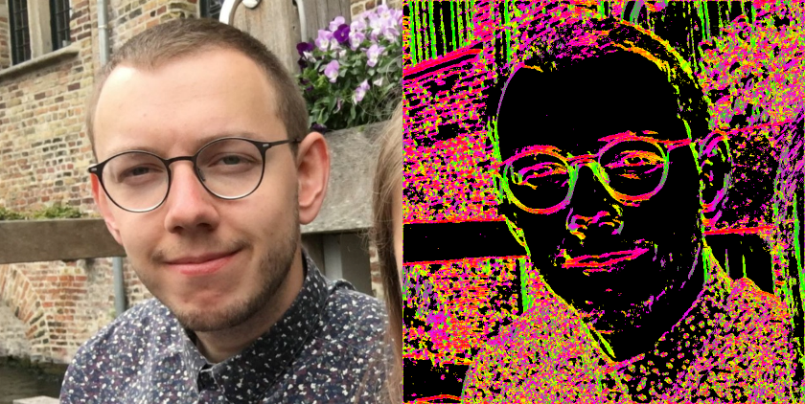

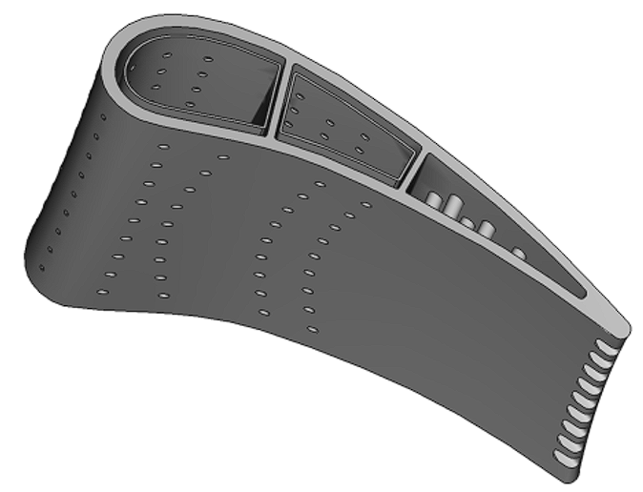
About me
B. Sc. and M. Sc. in Applied Computer Science
Areas of specialization: Scientific Computing, Digital Signal Processing
Proficiency in math and programming, especially Computer-Aided Design (CAD) and Computer Tomography
Currently working at the German Aerospace Center (since 2021)
Institute of Propulsion Technology, Turbine Department in Göttingen (DE)
Thesis project CoolingGen
Notes:
I enjoy cooking, hiking and video games
I like Jazz and Progressive Metal
And I‘v been playing the guitar for ~15 years, hit me up for lessons

Slide 5
Contents
About me ☺
Scientific project and current occupation: CoolingGen
My interest in Computer Tomography

Slide 6
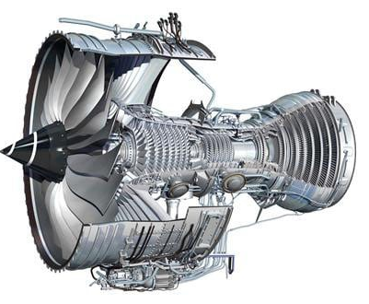
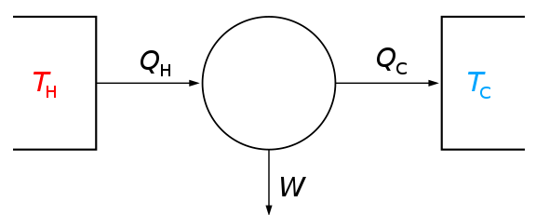
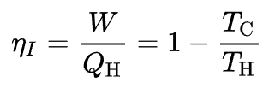
CoolingGen
State-of-the-art tool for parametric modelling of 3D turbine blade/vane geometries at the German Aerospace Center
Based on custom CAD kernel
Uses NURBS for object representation
Uses streamsurface coordinate transformation coupled with custom algorithms (fillet creation, ray marching, …) for fast geometry modification
Notes:
Jet engine: Turbine can be seen in the red box
Motivation for cooling:
To have optimal efficiency, we need really hot gas (T_H big!)
But: Hot fluid melts material
Thus: Provide structural elements which provide cooling

Slide 7
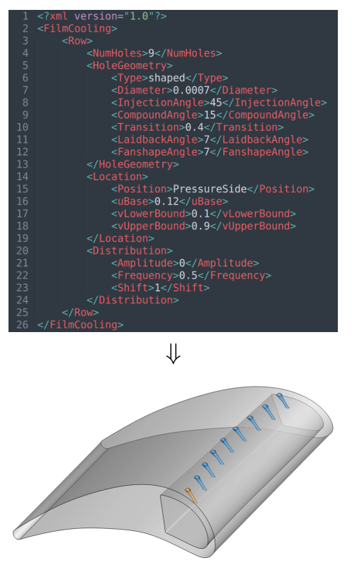
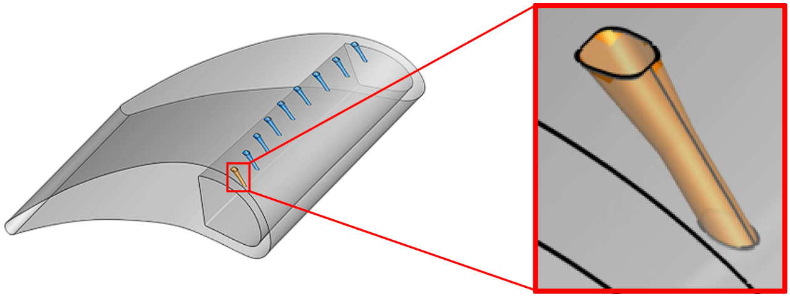
CoolingGen
Problem 1: Aviation cooling structures are complex geometries
Hard to model with conventional CAD tools
Hard to modify once created
Solution 1: Create own CAD tool that has its‘ own primitives based on (relatively) simple parametric representations
→ Simple input modification yields modified geometry

Slide 8
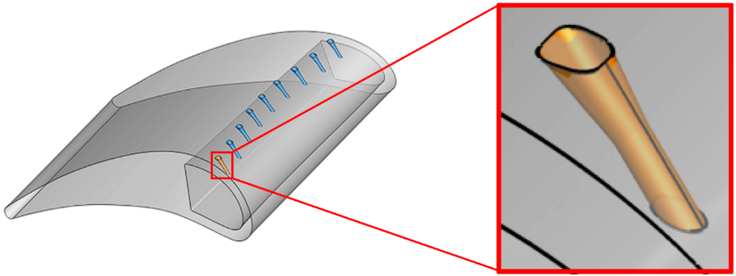
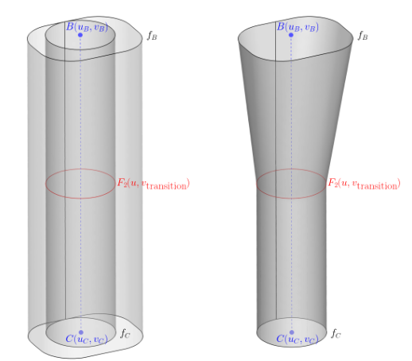
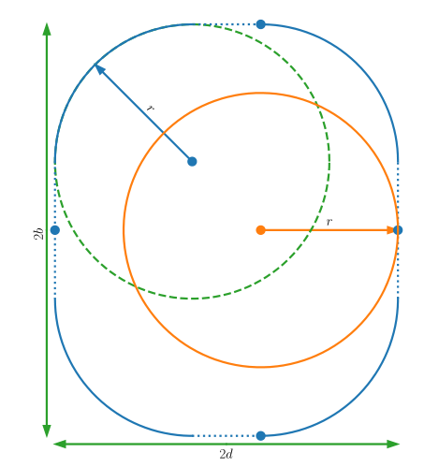
Example Problem 1: Film hole creation
Embed in 3D space using line segment
Find special linearly interpolated surface
Basic 2D curves, in this case:
circle, rounded rectangle

Slide 9
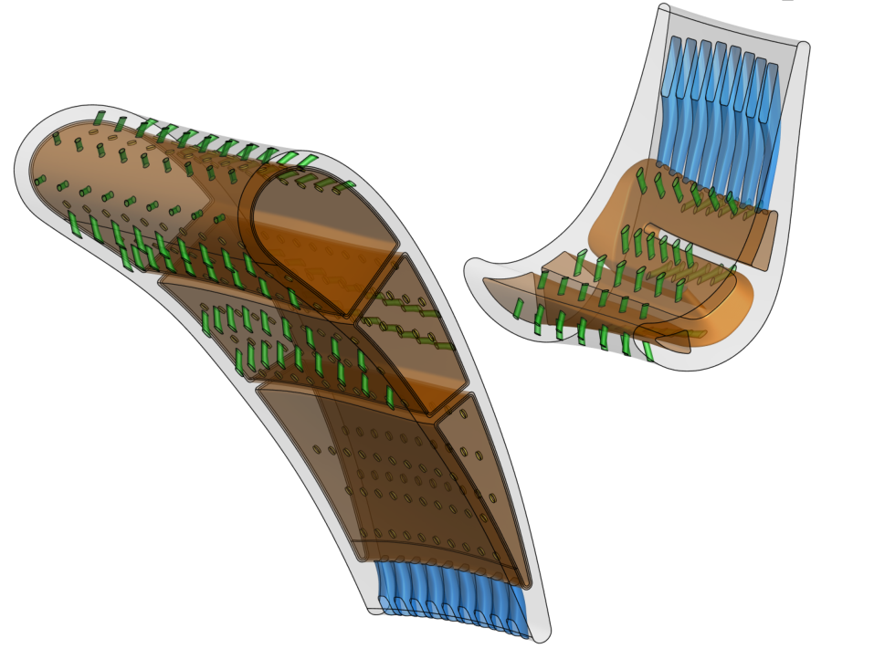
CoolingGen
Film cooling holes
Problem 2: Resulting shapes are intersection-heavy. Using Boolean operators, this will take ages to generate. No can do!
Solution 2: Use more simple representations of the shapes and find a way to intersect these.
Notes:
End of slide: Two examples: channels and film cooling

Slide 10
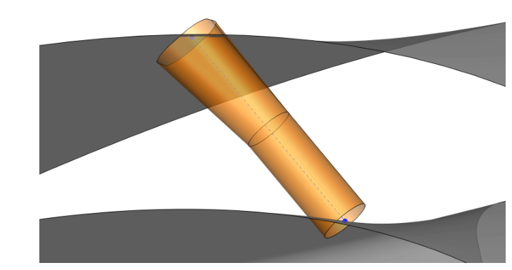
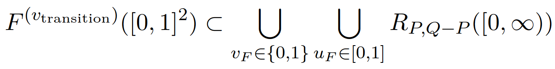
Example Problem 2: Film cooling hole intersection
But luckily we notice:
In other words,
Each film cooling hole is a subset of rays originating in mid circle
Fortunately, ray/surface intersection is simpler than surface/surface intersection
Problem: We have to intersect the film cooling hole surface with the neighboring surfaces
→ Difficult

Slide 11
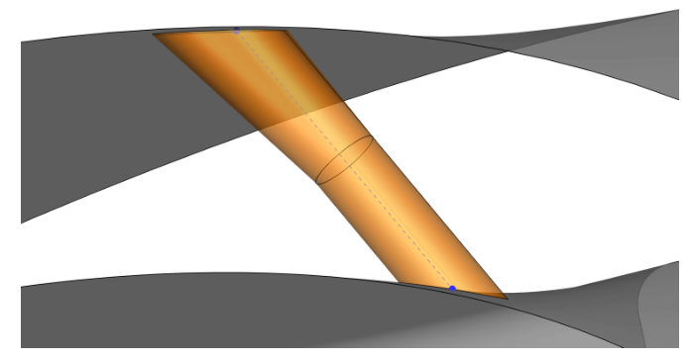
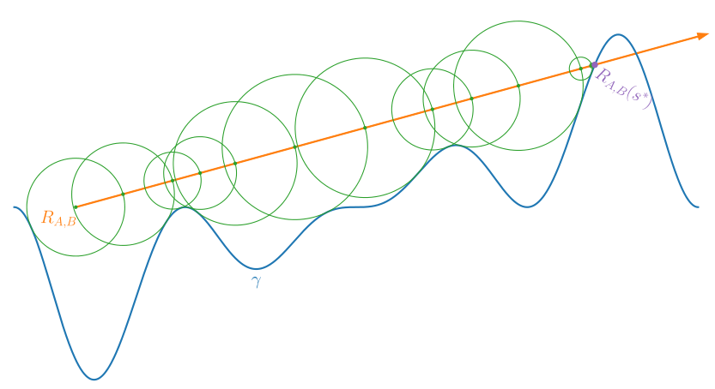
Example Problem 2: Film cooling hole intersection
Intersected shape
Original shape
Ray marching

Slide 12
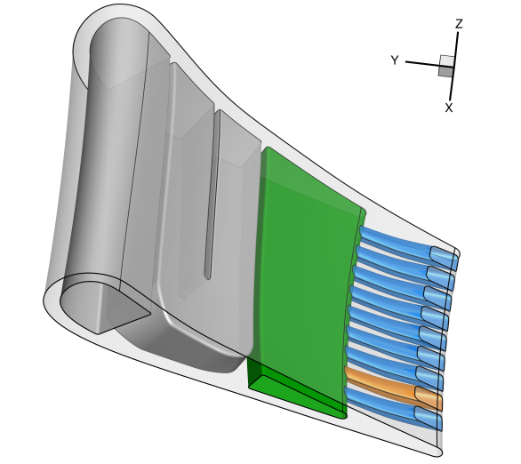
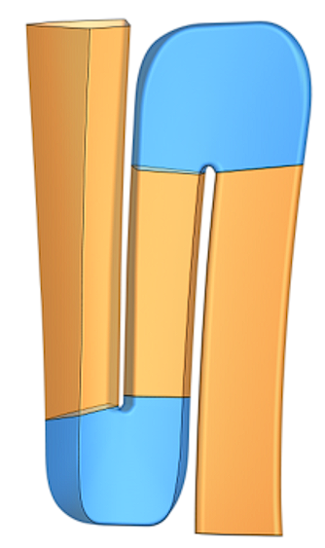
Resulting surfaces
CoolingGen provides the tools to create many different such geometries
Notes:
Bendy cooling channels
Trailing edge ejection slots
Impingement inserts
Impingement inter-channel cooling
Pin-fin arrays

Slide 13
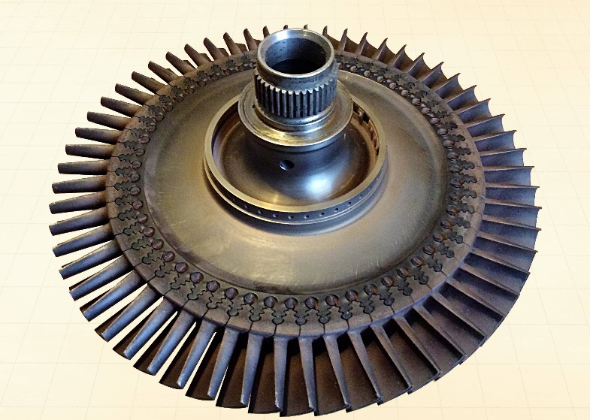
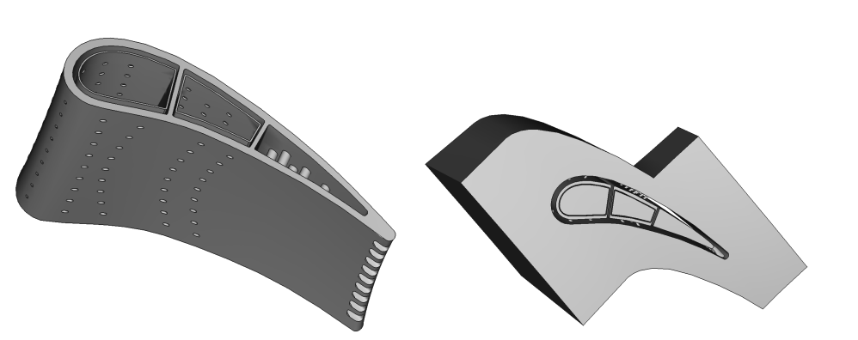
Resulting solids
Turbine stage
Solid volume
Fluid volume
Notes:
Fluid is the negative of the solid
Bounded symmetrically to produce tiling of turbine stage
SHOW 3D PRINT!!!

Slide 14
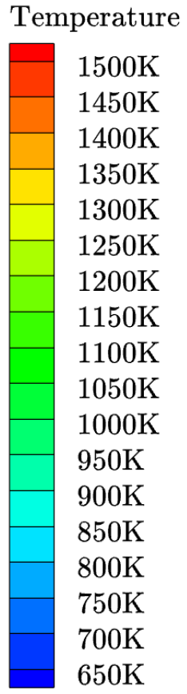
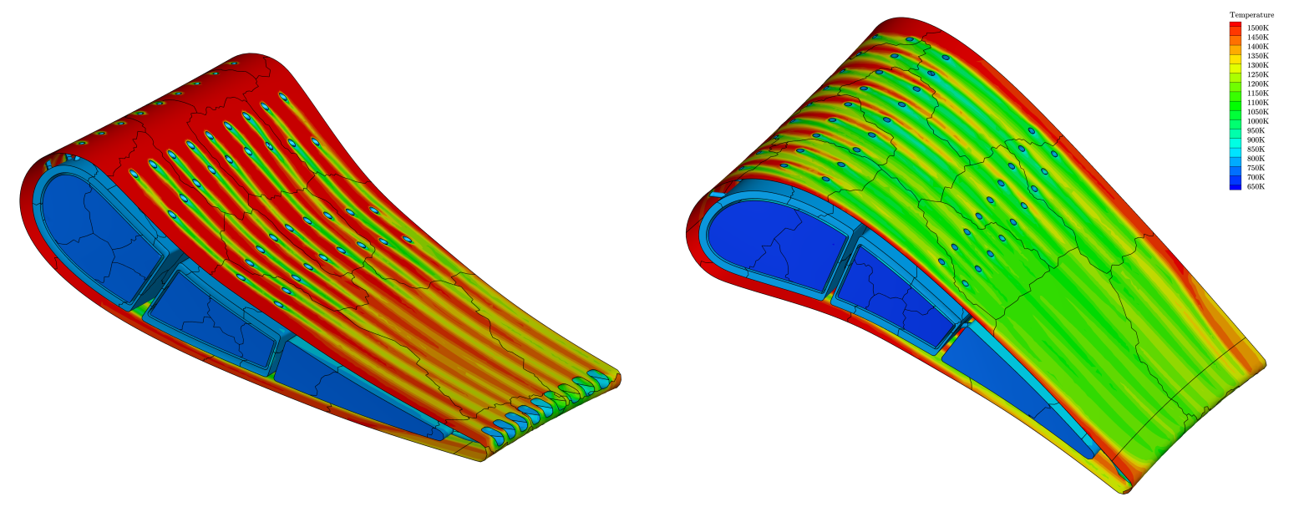
Resulting CFD Simulation
Notes:
Evaluate design using CFD

Slide 15
Contents
About me ☺
Scientific project and current occupation: CoolingGen
My interest in Computer Tomography

Slide 16
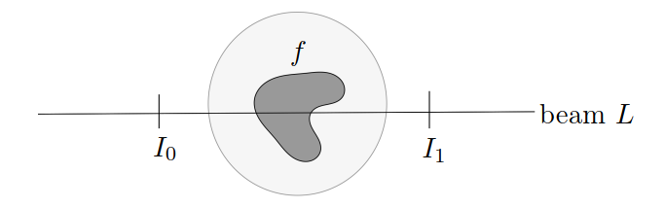



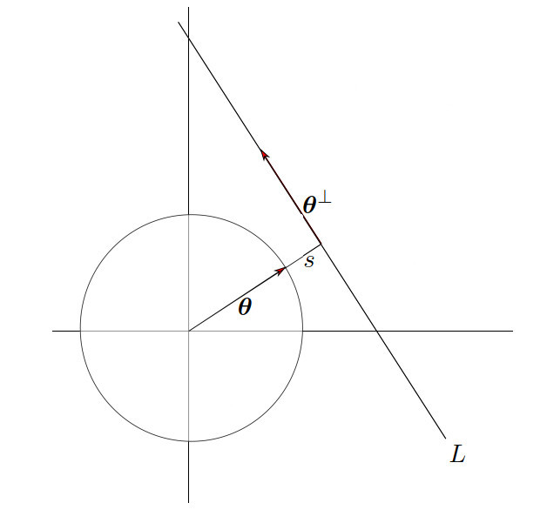
Computer Tomography
X-rays traversing a small distance suffer a relative intensity loss:
Beam is strongly focused → Assume line:
Set up differential equation:
Integrate along line to find:
Which is where we get the Radon transform R

Slide 17
Essential task in CT
We want to reconstruct the density function from its‘ Radon transform (or in n-dimensional space, the John transform) → Inverse problem
But: Analytic inversion not feasible (ill-posed), many different factors
Finitely many measurements → No uniqueness of solution
Non-locality of solution
...
Fascinating and challenging: Many quite different approaches to solve inverse problem
Algebraic reconstruction technique (Overdetermined linear system → Kaczmarz)
Cormack inversion formula
Filtered back projection
Fourier reconstruction
…
Notes:
My motivation:
Highly DSP related: To my knowledge, all known solutions use some kind of Wavelet/Fourier transform, which I always found interesting

Slide 18
Thank you ☺
Dr. rer. nat. habil. Gerlind Plonka-Hoch for sparking my interest in Fourier Analysis, Image Reconstruction and especially CT
Robin Schöffler for teaching me about jet engines
Nina Brose for the nice CFD imagery

Slide 19
Thank you for your attention
Questions?

