Slide 1
Julian Lüken
Avid lover of all things Computer Science and Math.

Slide 2
About me
M. Sc. Applied Computer Science
Areas of specialization: Scientific Computing, Digital Signal Processing
Currently working at the German Aerospace Center (since 2021)
Institute of Propulsion Technology, Turbine Department in Göttingen (DE)
Thesis project CoolingGen
Knowledge and interest in math and programming, especially w.r.t. Digital Signal Processing
Lucky enough to throroughly enjoy math courses dedicated to Computer Tomography

Slide 3
CoolingGen
State-of-the-art tool for parametric modelling of 3D turbine blade/vane geometries at the German Aerospace Center
Based on custom CAD kernel
Uses NURBS for object representation
Uses streamsurface coordinate transformation coupled with custom algorithms (fillet creation, ray marching, …) for fast geometry modification

Slide 4
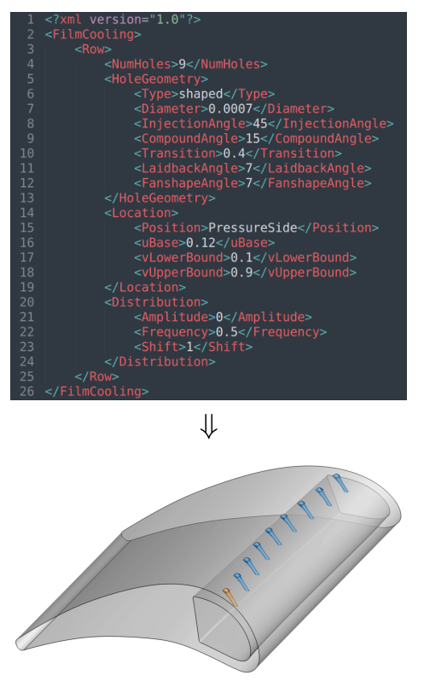
CoolingGen
Problem: Aviation cooling structures are hard to model with conventional CAD tools. Once they are created, they are hard to modify
Solution: Make own CAD tool that has its own primitives based on (relatively) simple parameter representations. We can then simply modify the input and re-create the geometry

Slide 5
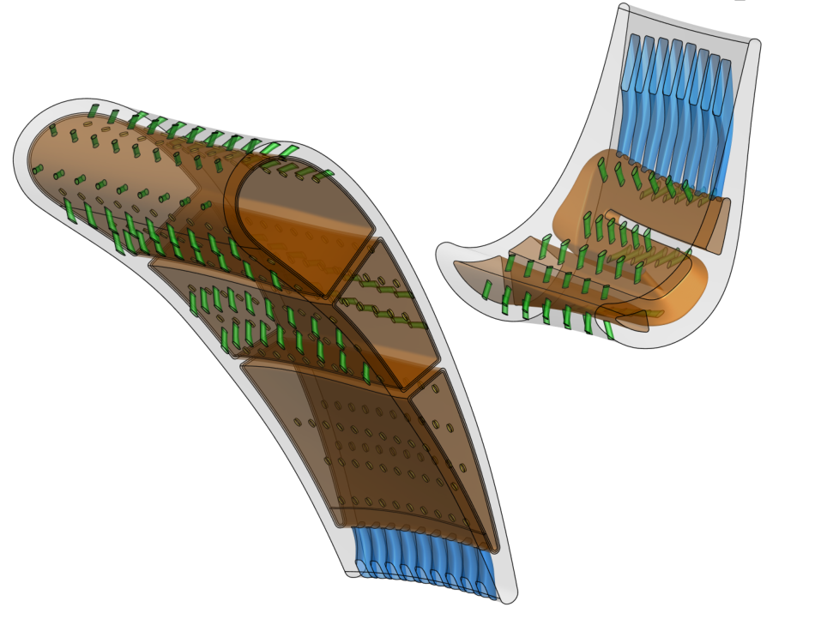
CoolingGen
Problem 2: Resulting shapes are intersection-heavy. Using Boolean operators, this will take ages to generate. No can do!
Solution 2: Use more simple representations of the shapes and find a way to intersect these.

Slide 6
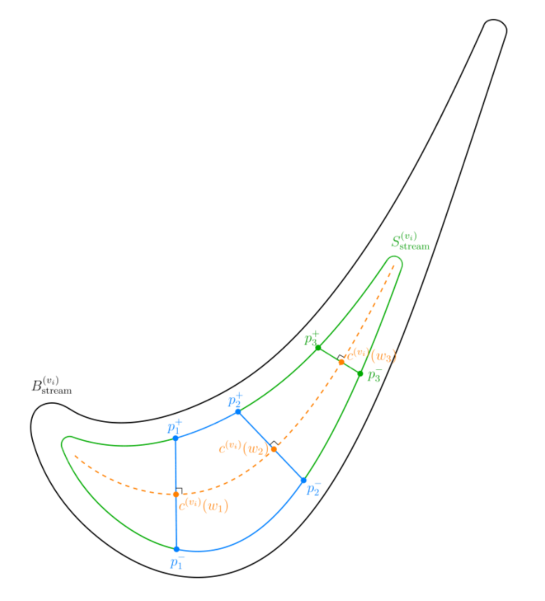
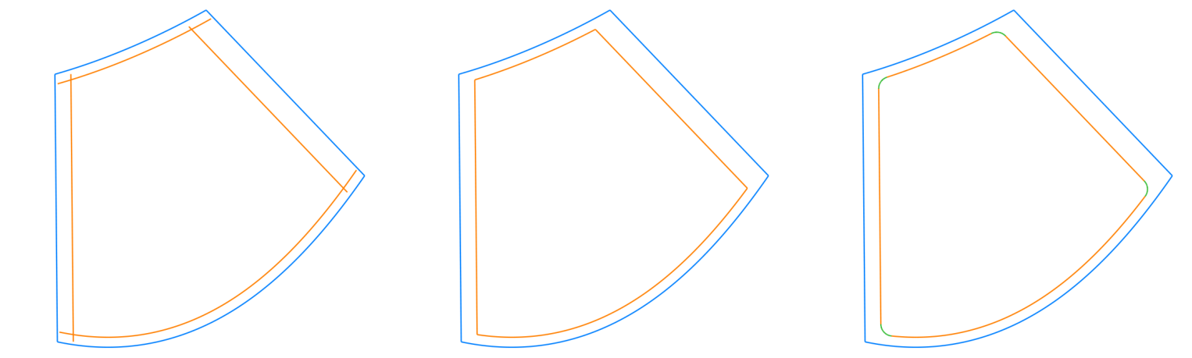
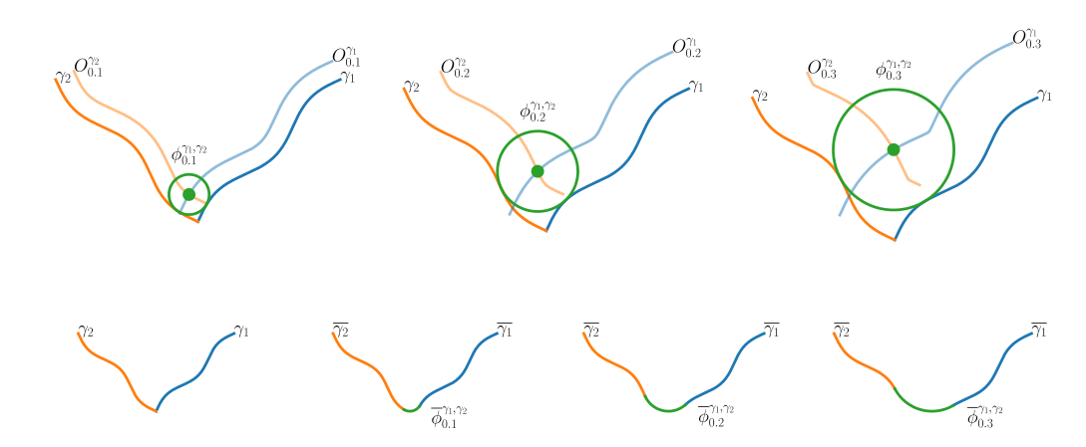
Offset delimiting curves
Trim at intersections
Add fillets
Transform to streamsurface
coordinate system
Fillet creation process

Slide 7
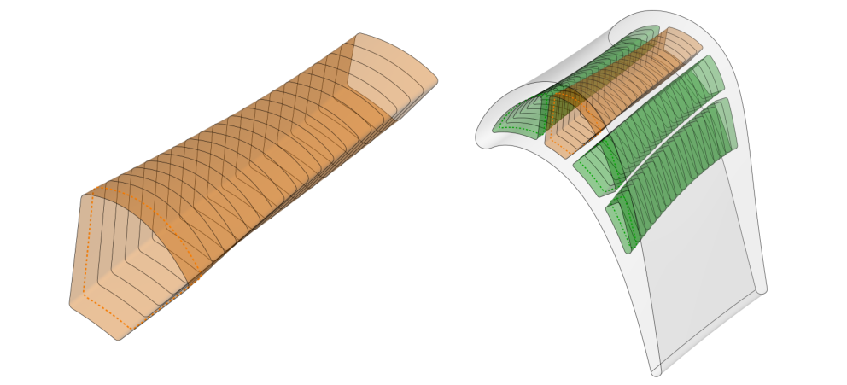
Inverse transform (black curves) and surface lifting (orange surface)

Slide 8
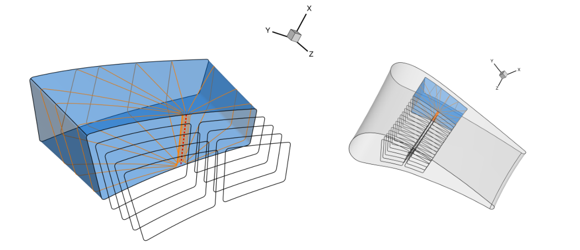
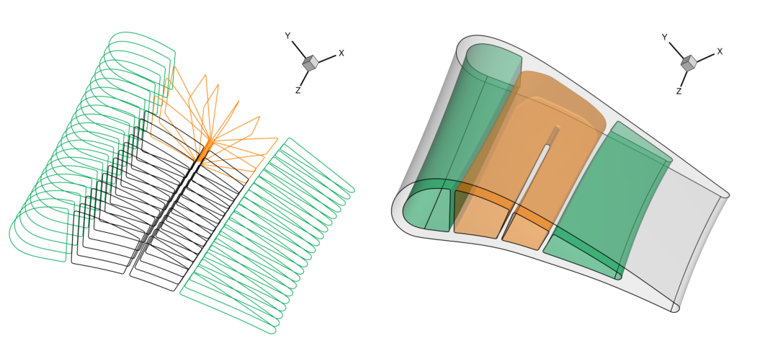
Creating turns between the resulting channels
Once again, surface lifting
Fuse channels, find plane intersections

Slide 9
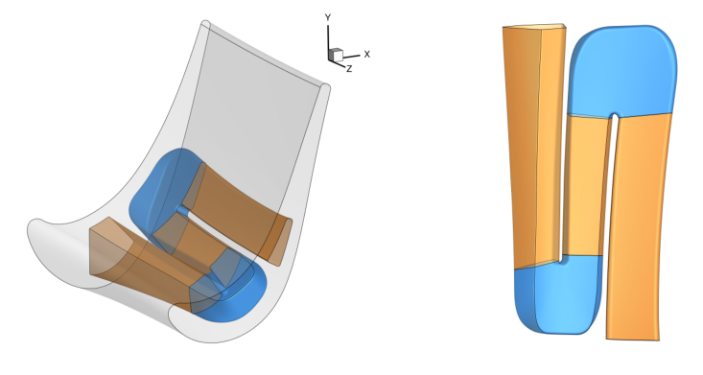
Multiple turns

Slide 10
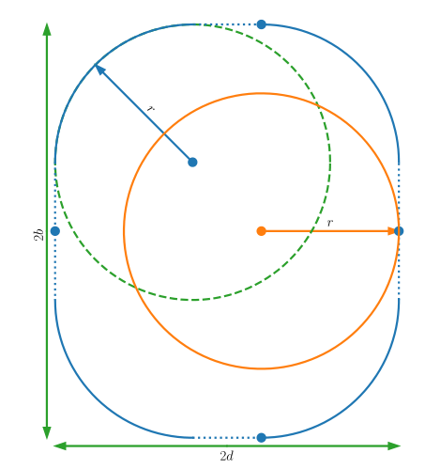
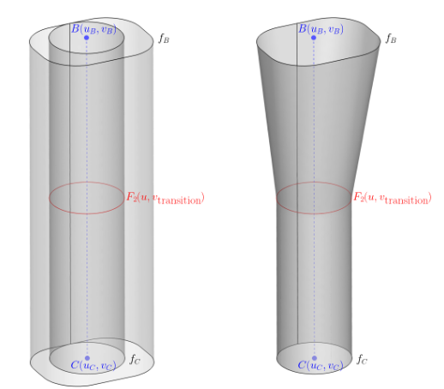
Hole creation
Embed in 3D space using line segment
Find special linearly interpolated surface
Basic 2D curves
In this case: circle, rounded rectangle

Slide 11
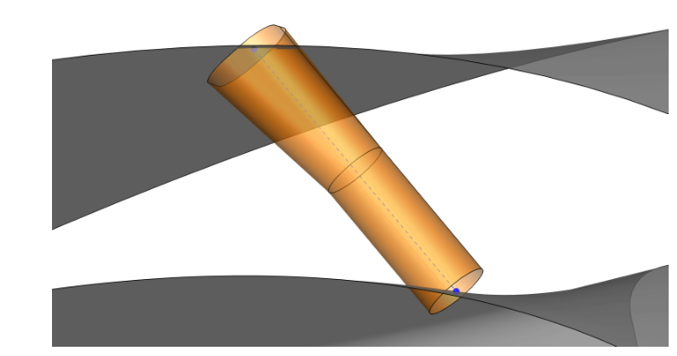
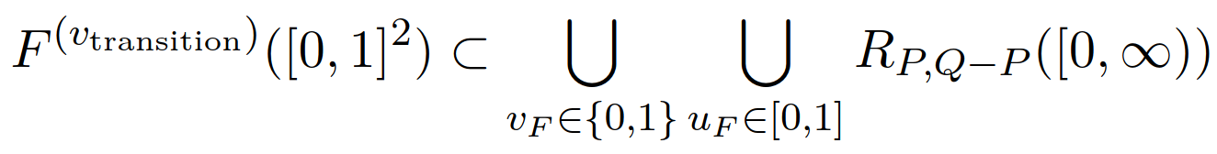
Hole intersection
Notice:
The orange shape consists of rays, which are much easier to intersect with surface than surfaces

Slide 12
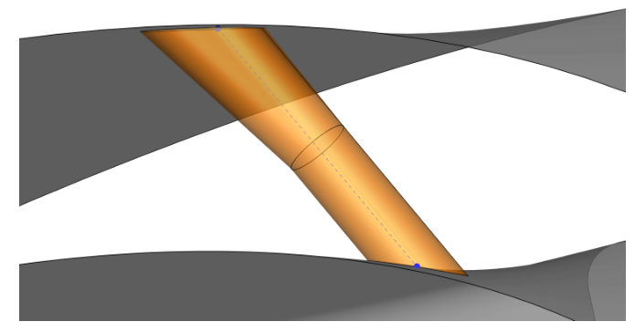
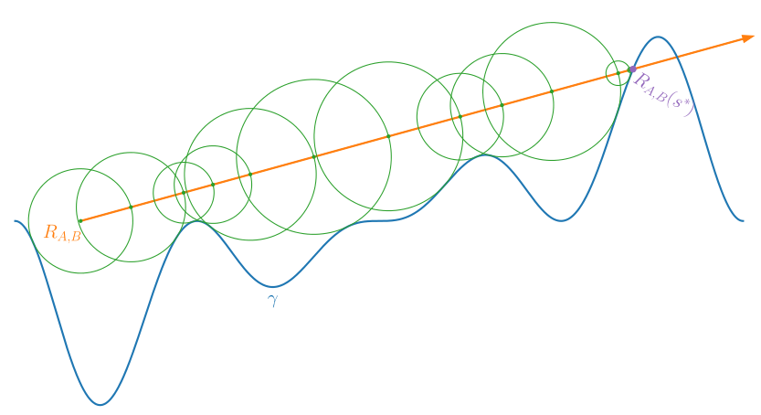
Hole intersection with ray marching
Intersected shape
Original shape
Ray marching

Slide 13
Resulting surfaces

Slide 14
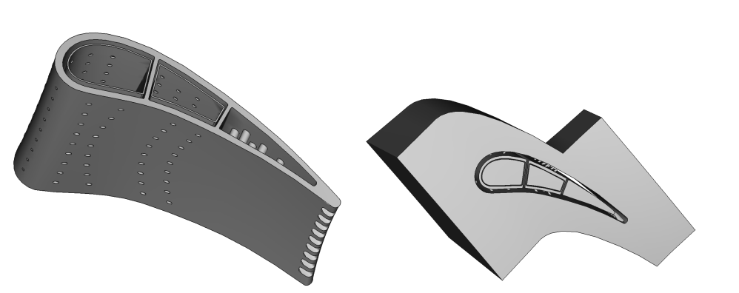
Resulting solids

Slide 15
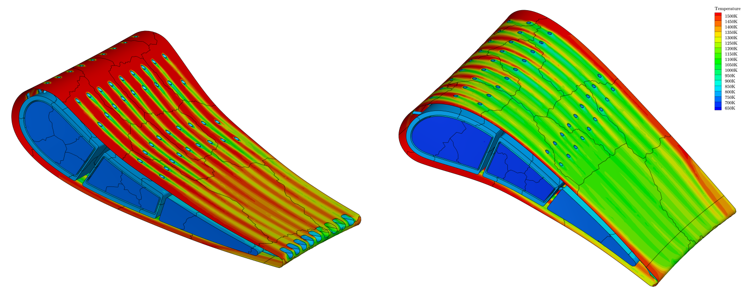
Resulting CFD Simulation

Slide 16



Computer Tomography in 2D – The Radon transform
X-rays traversing a small distance suffer a relative intensity loss:
Beam is strongly focused → Assume line:
Set up differential equation:
Integrate along line to find:
Which is where we get the Radon transform R from:

Slide 17
Essential task in CT
We want to reconstruct the density function from its‘ Radon transform (or in n-dimensional space, the John transform)
But: Analytic inversion not feasible, many different factors:
Only sometimes actually invertible
Non-locality of solution
…
Many approaches to approximate solution…
Algebraic reconstruction technique
Cormack inversion formula
Filtered back projection
Fourier reconstruction
…

Slide 18
Also about me
I enjoy cooking, hiking and video games
Playing the guitar for 15 years now
Loves Jazz and Progressive Metal

