Slide 1


ΕΘΝΙΚΟ ΜΕΤΣΟΒΙΟ ΠΟΛΥΤΕΧΝΕΙΟ
ΣΧΟΛΗ ΗΛΕΚΤΡΟΛΟΓΩΝ ΜΗΧΑΝΙΚΩΝ & ΜΗΧΑΝΙΚΩΝ ΥΠΟΛΟΓΙΣΤΩΝ
ΤΟΜΕΑΣ ΤΕΧΝΟΛΟΓΙΑΣ ΠΛΗΡΟΦΟΡΙΚΗΣ & ΥΠΟΛΟΓΙΣΤΩΝ
Βελτιστοποίηση Επίδοσης Εγγραφών στο Κατανεμημένο
Σύστημα Αποθήκευσης Κλειδιού-Τιμής etcd μέσω
Ενσωμάτωσης του Αποθηκευτικού Μηχανισμού RocksDB
Γεωργία Μ. Κοκκίνου
Επιβλέπων Καθηγητής: Νεκτάριος Κοζύρης
Εργαστήριο Υπολογιστικών Συστημάτων

Slide 2

Outline
Basic Concepts
Current Design
Our Approach
Experimental Evaluation

Slide 3

Outline
Basic Concepts
Current Design
Our Approach
Experimental Evaluation

Slide 4



etcd
a = 5
put (a, 5)
Key-value
store
Raft
put / get / delete
a = 5
a = 5
a = 5
Distributed key-value store
Replicated, Consistent, Highly-available
Open-source, Go

Slide 5

etcd
2
query
3
use
register
1
Common usecases:
Service A
Service B
Service C
    Service discovery
Widely used in production: Kubernetes, CoreOS, etc.
    Shared configuration
10.4.3.7:8756
10.4.3.11:4545
10.4.3.20:333
    Distributed locking

Slide 6






Motivation
RocksDB
BoltDB
Client Tier
Application Tier
Data Tier
Write-intensive applications:
    Data collection systems
    Mail servers
    Online backup solutions
    Social media websites
    Interactive games
    Transaction processing systems

Slide 7
Existing Approaches
Systems similar to etcd:
    ZooKeeper
    Consul
    unstable reads/writes under heavy load, complex
    cannot scale well with number of clients, limited API
Distributed storage systems using RocksDB:
    CockroachDB
    SQL layer & sharding introduce extra latency

Slide 8
Outline
Basic Concepts
Current Design
Our Approach
Experimental Evaluation

Slide 9
BoltDB
Database
            Key-value store
            Memory-mapped file
            Copy-on-write B+ tree
            ACID transactions
Storage Engine

Slide 10
B+ trees
7
16
1
5
6
9
12
18
21
v1
v5
v6
v9
v12
v18
v21
B-tree
B+ tree
search/insertion/deletion
Keys reside in the leaves
sequential access
2. Leaves are linked

Slide 11
Copy-on-write B+trees
Only sequential writes
root 9
root 12
No linked leaves
node 1
node 4
node 6
node 10
High write amplification
leaf 2
leaf 3
leaf 5
leaf 7
leaf 8
leaf 11

Slide 12
Outline
Basic Concepts
Current Design
Our Approach
Experimental Evaluation

Slide 13

Why RocksDB?
Key-value store
C++ library
LSM-tree design
Developed by Facebook, fork of LevelDB
High-performance
Widely used in production: MongoDB, MySQL, Ceph, Facebook, etc.
Open-source
Considered by etcd developers

Slide 14
LSM-trees
Write
Memtable
(in-memory
write buffer)
Memory
Disk
SST file
(immutable)
L0
a - z
a - z
a - z
Read
L1
a - d
e - h
i - m
n - z
t - z
1GB
n - s
L2
a - f
g - j
k - l
m - p
q - u
v - z
10GB
L3
100GB
WAL
Sequential, batched writes
Flushes
Compactions

Slide 15
RocksDB vs BoltDB
More suitable for write-heavy applications
Handles datasets larger than the available memory better
Efficient disk space usage: compression, no fragmentation
High memory consumption
Lower read performance
Large values may cause successive flushes & compactions
Complexity

Slide 16
Expectations
Improvement of write performance
Slight deterioration of read performance, within acceptable bounds
Preservation of consistency & high-availability guarantees of etcd

Slide 17
Architecture
put (a, 5)
etcdctl
etcd
Raft
Translate BoltDB API calls to their RocksDB equivalent
Minimize changes in etcd code
BoltDB to RocksDB
Wrapper
gorocksdb
Storage Backend
RocksDB C API
BoltDB
a = 5
RocksDB

Slide 18
Cgo
Cgo enables the creation of Go packages that call C code
      import “C”
      C.size_t, C.stdout, C.malloc
C compiler is called
A cgo call introduces an overhead:
      Different calling convention
      Treated by Go runtime as a blocking system call
Stack switch
Recommended when:
      Duration of called function renders overhead negligible
      Performance is considerably better in C

Slide 19
Mapping of Concepts
BoltDB
RocksDB
DB
DB
Buckets
Prefixes
Put, Get, Delete
Put, Get, Delete
Cursor
Iterator
Transactions
Transactions
Snapshot
Checkpoint
Defragmentation

Slide 20
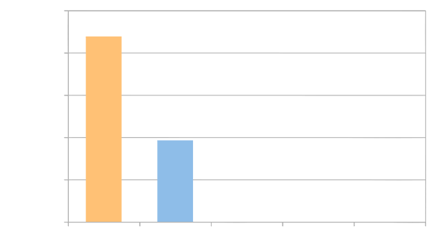
Optimizations
Bucket access:
fewer cgo calls per operation
25000
+4.4%
0%
+3.4%
20000
-21%
15000
WriteBatch & Snapshot:
no concurrency control →
less overhead
Write Throughput (requests/sec)
-56.1%
10000
5000
0
Tuning RocksDB
      Parallelism
      Flushing & compaction options
original
base
bucket
wb
final

Slide 21
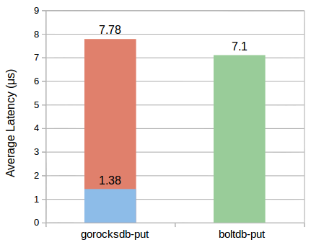
Cgo Overhead
rocksdb-c-api-put
cgo overhead

Slide 22
Storage Quota Removal
Configurable backend size ranging from 2GB to 8GB
Not enough for a general-purpose key-value store
Reasons:
    Disk space exhaustion
    Performance degradation
    MTTR
Modern systems have large storage capacity
LSM-tree handles well datasets larger than memory

Slide 23
Outline
Basic Concepts
Current Design
Our Approach
Experimental Evaluation

Slide 24
Methodology & Environment
client
Built-in CLI benchmark tool of etcd
Key size 8 bytes
Value size 256 bytes
etcd 3.2.0
RocksDB 5.5.1
EC2, m3.xlarge
4 cores
15GB RAM
40GB SSD

Slide 25
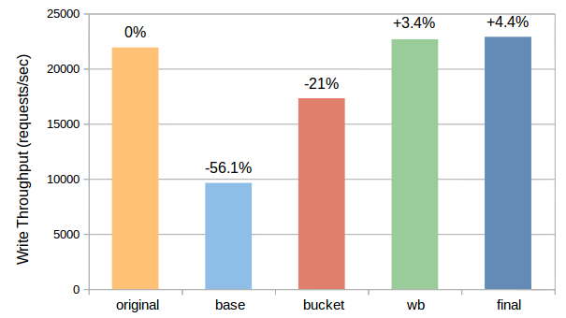
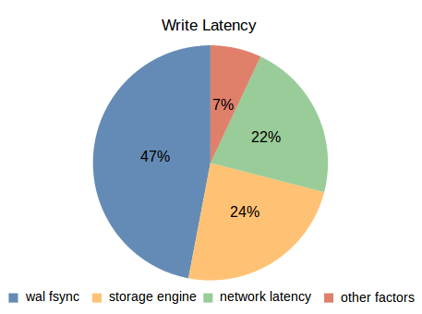
Write Performance

Slide 26
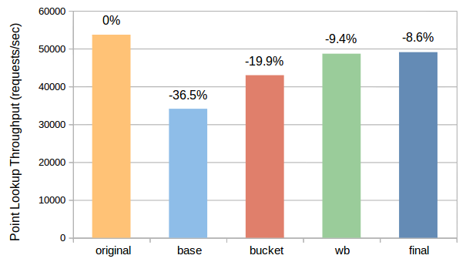
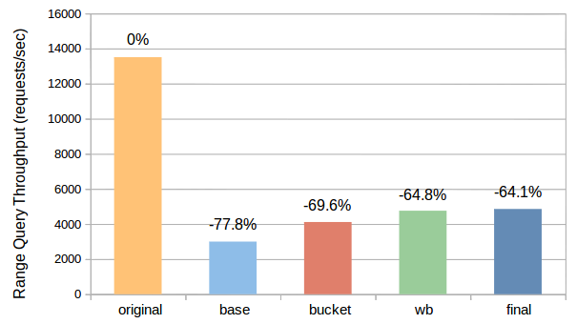
Read Performance
All LSM-tree levels must be checked
Bloom filters do not help

Slide 27
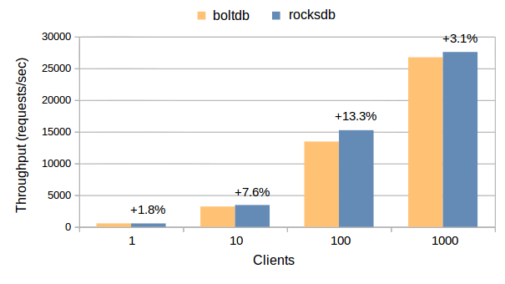
Client Concurrency

Slide 28
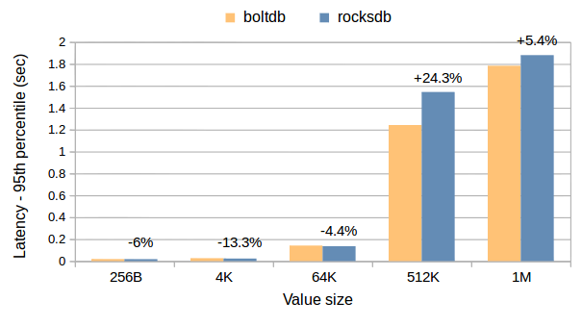
Value Size

Slide 29
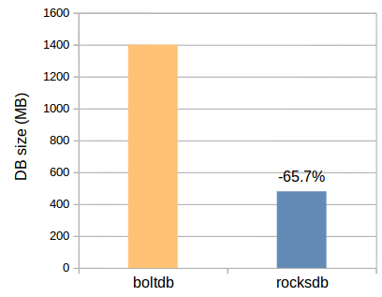
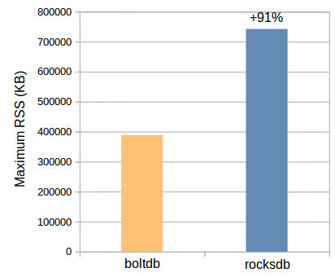
Disk & Memory Consumption
Compression
Large memtables
No fragmentation

Slide 30
Concluding Remarks
Write performance improved (1.8% - 13.3%)
Read performance deteriorated
Disk space consumption was halved
Memory consumption doubled
Positive side effects:
      No need for defragmentation
      Storage quota removal
Cgo overshadows the advantage of the LSM-tree

Slide 31

Future Work
LSM-tree-based storage engine written in Go
Badger
Benchmark with dataset larger than memory
Automate RocksDB tuning

Slide 32


Thank you!
Questions?

Slide 33
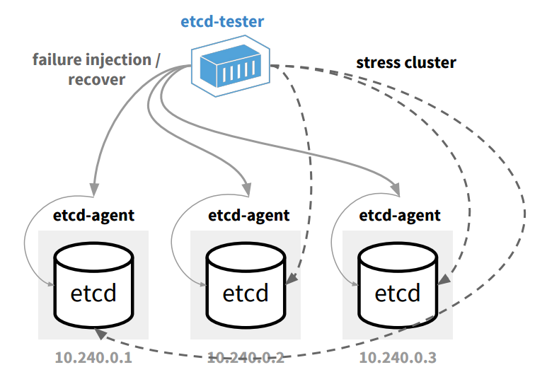
Testing
Unit tests
Functional test suite
    Sets up an etcd cluster and makes continuous write requests to it
    Injects a failure (kill leader, kill majority, network partition, etc.)
    Repairs the failure and expects cluster to recover within 1 minute
Testing Distributed Systems in Go, G. Lee, CoreOS blog

Slide 34
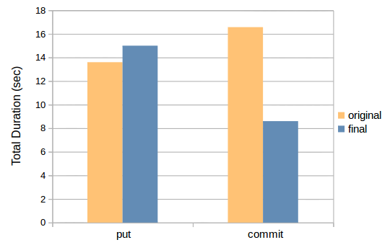
Put & Commit Duration

Slide 35
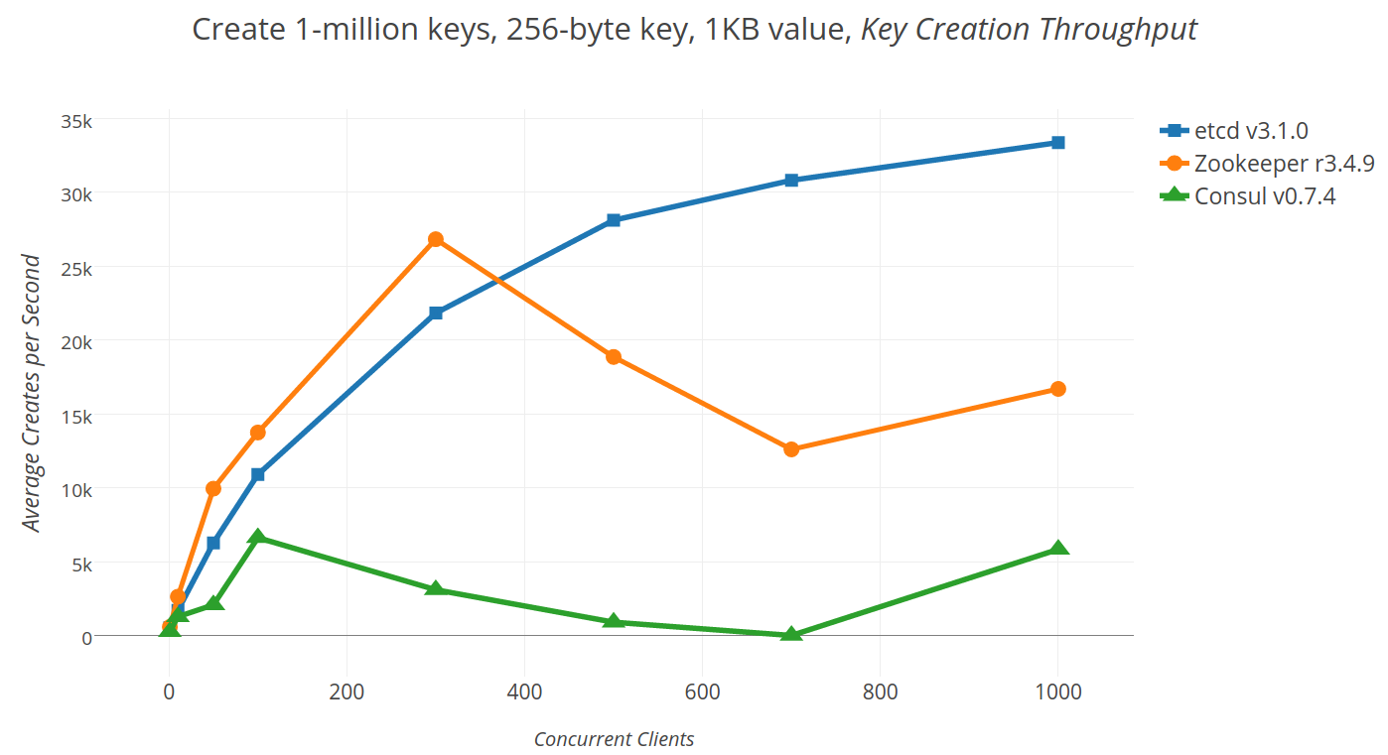
etcd vs ZooKeeper vs Consul

