Slide 1
ENGR 361: A Machine Learning Approach to Automatic Closed Captioning
Lionel Quintanilla, Andrew De La Rosa, Pouya Tavakoli, Brian Tran, Matthew Zaldana

Slide 2
Introduction: Hypothesis & Research Question
Purpose: Develop and test an application that can automatically generate closed captions using machine learning techniques

Slide 3
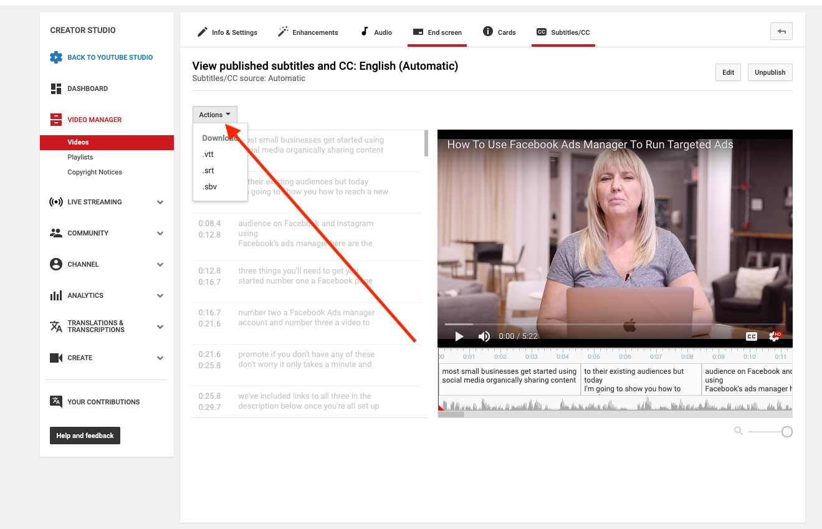
Introduction: Background & Significance
Certain content requires closed captions (FCC, 2021).
Many providers create captions automatically with Automatic Speech Recognition (Google Cloud, 2021).
ASR does not produce particularly accurate closed captions, only 60% to 70% accurate (Bond, 2014).

Slide 4
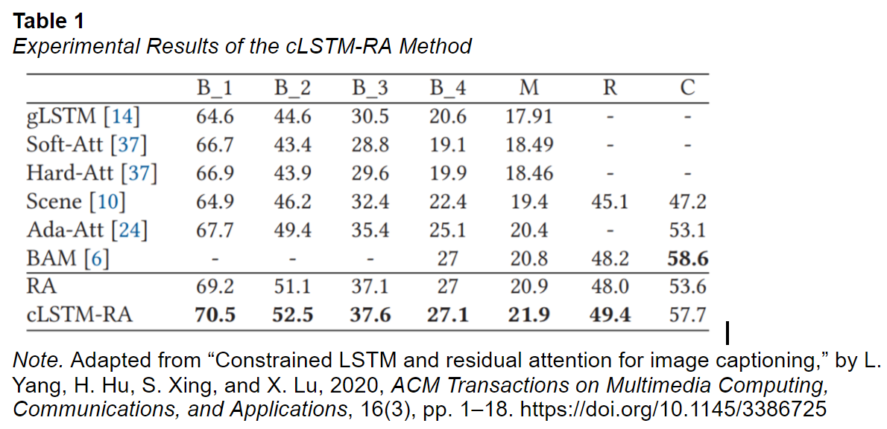
Introduction: Background & Significance
Inaccurate captions carry legal liability; NAD sued Harvard and MIT in 2015 for inaccurate captions (Rosenblum, 2015).
Providing accurate captions protects from liability and fines.
Neural networks in captioning show promising results. (Yang et al., 2020).

Slide 5
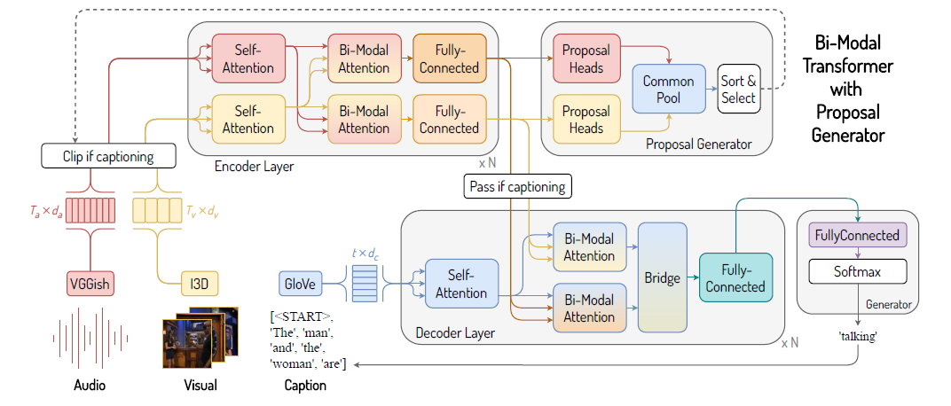
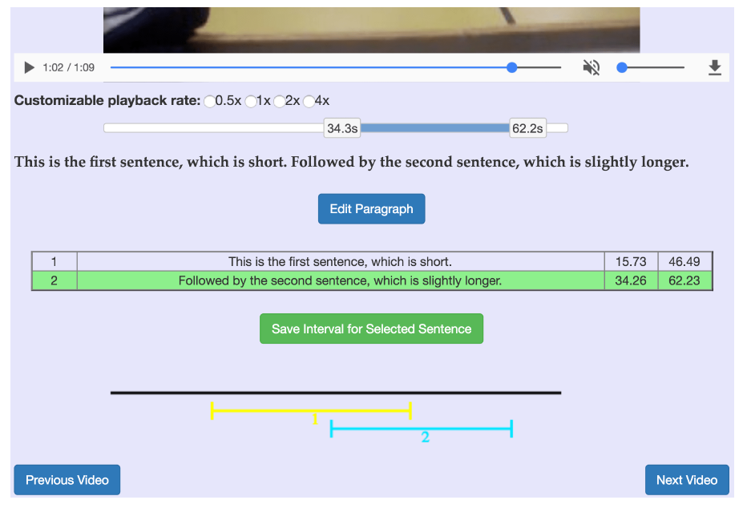
Introduction: Specific Aims
Aim 1: Devise a machine learning technique that can create captions with a reasonable degree of accuracy
Aim 2: Create an application that can take in videos and display captions on top of the videos

Slide 6
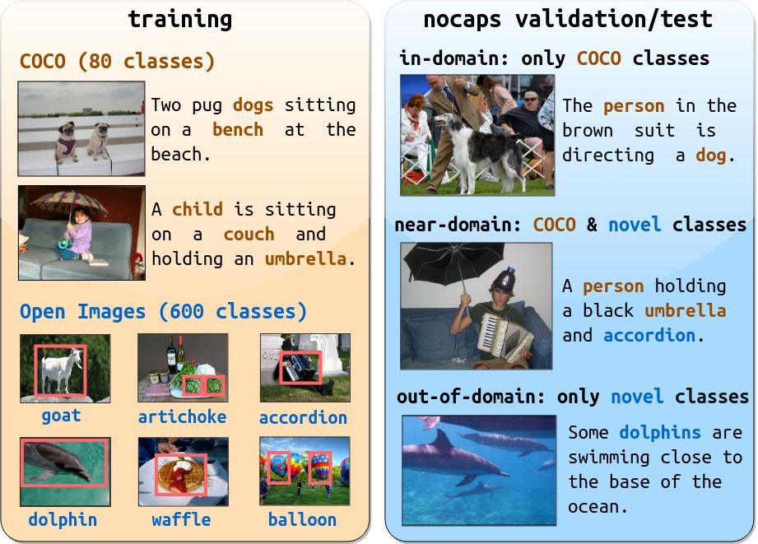
Methods & Research Plan I Design and Samples
Four Algorithms
GAN
NMT
RNN
3-module encoder-decoder
Algorithm Training
Uses industry approved data sets for training live captioning AI
~1000s of media per dataset
User Survey
15 mins of view time per tester
Both open and closed response questions

Slide 7
Methods & Research Plan II Setting and Protocol
Setting
Un-interruptible computer laboratory and multimedia room for viewing
Each participant views video on multiple devices
Participants then complete a QA survey
Protocol
Algorithms run and train on separate computers for 24 hours
Test results are collected onto an external drive
Survey takers will watch 15 minutes of captioned footage then complete a survey

Slide 8
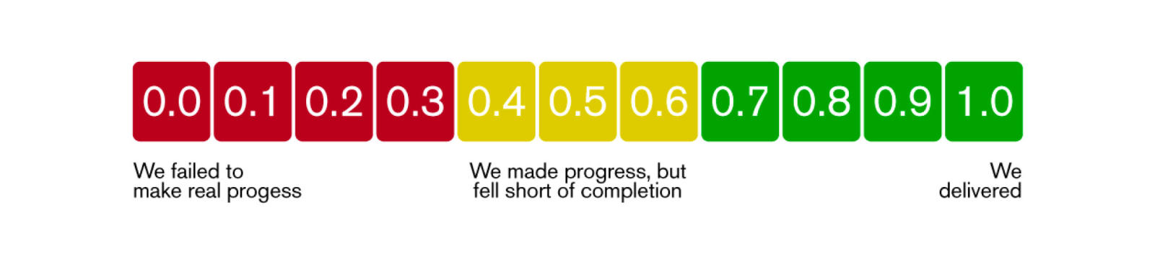

Methods and Research Plan III Analysis Plan
Three Metrics
Accuracy of Text (AT)
Visual Quality of Text (VQ)
Quality of Descriptive Language (QL)
Open Ended Questions
Users will have three sections to list qualitative observations about AT, VQ, and QL.

Slide 9
Outcomes & Expectations
Aim 1:
Compare results of each technique using the three common ML tests to determine accuracy
Accuracy of produced text (AT)
Visual quality of the text on-screen (VQ)
Quality of descriptive language (QL)
When calculating the averages of these scores, we must acknowledge that
Must be a score of on a scale from 0 to 1
We can decipher the data given from these experiments using several natural language tests:
BLEU – measures the accuracy of machine-generated text at a sentence level
METEOR – measures the accuracy of text at a word level
ROGUE – measures accuracy of machine-generated text with substrings
We would like to improve, accuracy of the words, grammar and vocabulary

Slide 10
Outcomes & Expectations
Aim 2:
Measure the visual appeal of the text generated on screen as well as the quality of descriptive text for HoH/deaf people
Visual Quality is average of scores from the survey
Quality of descriptive Language average of text scores which is around 0.5
Excellent score is 0.8 to 0.9
Survey contains open response sections that gauge to overall experience
Use Dr. Burgstahler methods for eye-catching captions
Use one or two lines of text
Combine with our technique enables comprehension and understanding

Slide 11
Project Timeline & Budget
Key:
S = Required Time
X = Checkpoint
X = Expected Finish
= Debug time/Finish
 | Month 1 (Week 1 --- 4) | Month 2 (Week 5 --- 8) | Month 3 (Week 9 --- 12) | Month 4 (Week 13 --- 16)
Aim 1: Algorithm Development - Programming - Training - Analysis/Finish | - - - -x | - -x- -x | - - - -x
Aim 2: Extension Development - Video intake - Caption Display - Combine w/ Algorithm/ Finish | - -x- -x | - - - -x | - - - -x
Volunteer Testing |  |  | -x-x-x- | x-x

Slide 12
Project Timeline & Budget
Budget Reasoning
Aim 1:
Each workstation computer is used in order to test each possible technique for developing the algorithm
Training the algorithm will require data that can be obtained for free or at a negligent price
Aim 2:
The workstation computers that are bought for Aim 1 can be reused for Aim 2 therefore nullifying potential cost for Aim 2
Volunteer Expenses
The conference room rental is required in order to have a potential place for testing volunteer
Testing computers are used to host the extension that is developed so that volunteers are able to test the extension's capabilities
Volunteer should be compensated for their participation in testing the extension to ensure that the project goal is properly fulfilled
 | Cost | Amounts needed
Aim 1
Workstation Computers (per computer) | $500 - $1,000 | 6 computers
Aim 2
Workstation Computers (per computer) | $500 - $1,000 | Aim 1 Computers can be used
Volunteer Expenses
Conference Room Rent (per hour) | $70 - $160 | 1 hour needed
Testing Computers (per computer) | $150 | 7 – 10 people
Compensation (per volunteer) | $25 - $50 | 7 – 10 people
TOTAL | $4295 - $8160 | General Avg: $6550

Slide 13
References
Benton, B. (2021, October 21). Workstation vs desktop computer: Which do you need? Redshift by Autodesk. Retrieved December 11, 2021, from https://redshift.autodesk.com/pc-versus-workstation/.
Bond, L. (2019, June 3). Are Automatically Generated Captions and Transcripts Detrimental to Video SEO? 3Play Media. Retrieved November 15, 2021, from https://www.3playmedia.com/blog/are-automatically-generated-captionstranscripts-detrimental-video-seo/.
Burgstahler, S. (2018). Creating Video and Multimedia Products That Are Accessible to People with Sensory Impairments. Creating Video and Multimedia Products That Are Accessible to People with Sensory Impairments | DO-IT. Retrieved December 11, 2021, from https://www.washington.edu/doit/creating-video-and-multimediaproducts-are-accessible-people-sensory-impairments.
Federal Communications Commission. (2021, January 27). Closed Captioning on Television. Federal Communications Commission. Retrieved November 14, 2021, from https://www.fcc.gov/consumers/guides/closed-captioning-television.
Google Cloud. (2021). Speech-to-Text Basics. Google. Retrieved December 11, 2021, from https://cloud.google.com/speech-to-text/docs/basics.
IBM Cloud Education. (2020, August 17). What Are Neural Networks? IBM. Retrieved December 11, 2021, from https://www.ibm.com/cloud/learn/neural-networks. Machine Learning Approach | 7 December 2021 14
Lavie, A., & Agarwal, A. (2007). Meteor: an automatic metric for MT evaluation with high levels of correlation with human judgments. Proceedings of the Second Workshop on Statistical Machine Translation - StatMT '07, 228–231. https://doi.org/10.3115/1626355.1626389
Lin, C.-Y. (2004). ROUGE: A package for automatic evaluation of summaries. Text Summarization Branches Out, 74–81. https://doi.org/https://aclanthology.org/W04- 1013
Microsoft. (2021). Common Objects in Context. COCO. Retrieved December 11, 2021, from https://cocodataset.org/#home.
Nam, S., Fels, D. I., & Chignell, M. H. (2020). Modeling closed captioning subjective quality assessment by deaf and hard of hearing viewers. IEEE Transactions on Computational Social Systems, 7(3), 621–631. https://doi.org/10.1109/tcss.2020.2972399
National Institute of Deafness and Other Communication Disorders. (2021, March 25). Quick Statistics About Hearing. Retrieved November 14, 2021, from https://www.nidcd.nih.gov/health/statistics/quick-statistics-hearing.
Papineni, K., Roukos, S., Ward, T., & Zhu, W.-J. (2001). BLEU: A method for automatic evaluation of machine translation. Proceedings of the 40th Annual Meeting on Association for Computational Linguistics - ACL '02, 311–318. https://doi.org/10.3115/1073083.1073135
Pavic, F., & Brkic, L. (2021). Methods of improving and optimizing react webapplications. 2021 44th International Convention on Information, Communication and Electronic Technology (MIPRO). https://doi.org/10.23919/mipro52101.2021.9596762
Peerspace. (2021, October 23). How Much Does It Cost to Rent a Hotel Conference Room? Peerspace. Retrieved December 11, 2021, from https://www.peerspace.com/resources/rent-hotel-conference-room/.
Pickard, J. (2021, November 11). The Best Cheap Chromebook Prices and deals in December 2021. TechRadar. Retrieved December 11, 2021, from https://www.techradar.com/news/cheap-chromebook-deals.
Plummer, B. A., Wang, L., Cervantes, C. M., Caicedo, J. C., Hockenmaier, J., & Lazebnik, S. (2015). Flickr30k entities: Collecting region-to-phrase correspondences for richer image-to-sentence models. 2015 IEEE International Conference on Computer Vision (ICCV), 1–22. https://doi.org/10.1109/iccv.2015.303
Rosenblum, H. A. (2015, February 12). NAD Sues Harvard and MIT for Discrimination in Public Online Content. National Association of the Deaf. Retrieved December 11, 2021, from https://www.nad.org/2015/02/17/nad-sues-harvard-and-mit-fordiscrimination-in-public-online-content/.
Yang, L., Hu, H., Xing, S., & Lu, X. (2020). Constrained LSTM and residual attention for image captioning. ACM Transactions on Multimedia Computing, Communications, and Applications, 16(3), 1–18. https://doi.org/10.1145/3386725

