Slide 1
Not Great Not Terrible JavaScript
@boolfalse
April 2023

Slide 2
Notes, Q&As
***

Slide 3
Table of Contents
Browsers history, ECMAScript
Browser Engines, Engine basics
Execution Context, EC phases, Call Stack usage examples
function vs. var vs. let/const, hoisting
JS entities (primitives & referenced types)
LibUV needs, event-loop initials, different visuals
Real life analog for thread pool, terminology, CPU
event-loop with examples
Node.js runtime with libUV, big picture
Q&As

Slide 4
Browsers History
...
1990: WorldWideWeb (Nexus) - Tim Berners-Lee
1993: “Mosaic” browser
1994: Netscape - “Netscape Navigator”
1995: Netscape - JavaScript (Brendan Eich)
1996: Microsoft – Jscript interpreter
1996: ECMA standards

Slide 5
ECMA-262 spec
1997 - ECMAScript 1
1998 - ECMAScript 2
1999- ECMAScript 3
*** ECMAScript 4 չի թողարկվել
2009 - ECMAScript 5
2015 - ECMAScript 2015 (ES6)
2016 - ECMAScript 2016
… այսպես ամեն տարի մի թողարկում 2015֊ից սկսած

Slide 6




Browser Engines
SpiderMonkey (Netscape, Mozilla Firefox)
V8 (Google Chrome)
Chakra (Microsoft Edge)
JavaScriptCore (Apple Safari, WebKit engines)

Slide 7
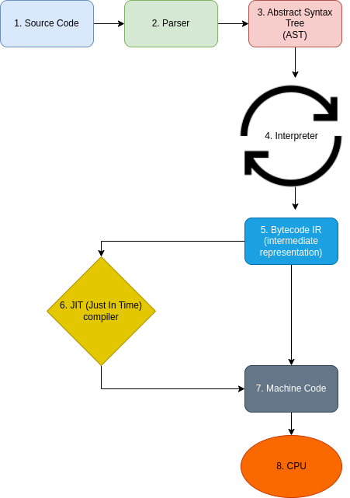
JavaScript Engine basics

Slide 8
Execution Context phases
Functions in JS – first class-citizens
Memory creation phase
1. global object (Chrome - windows, Node.js – global)
2. this (link to global object)
3. variables/functions hoisting (in memory stack/heap)
Execution phase
1. code execution line by line
2. EC for each function

Slide 9
EC phases experiment
var x = 2;
var y = 3;
function multiply(a, b) {
var m = a * b;
return m;
}
var z = multiply(x, y)

Slide 10
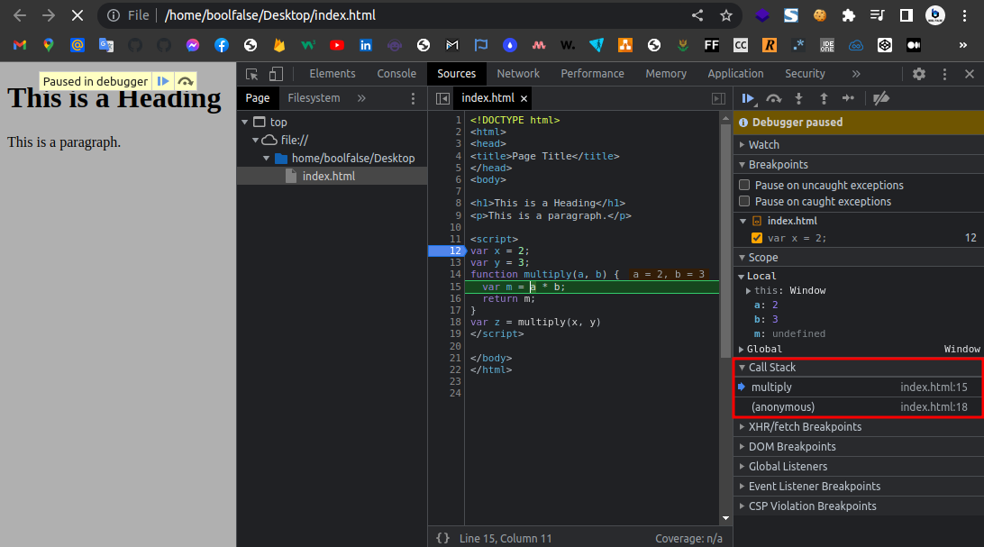
Call Stack: initials

Slide 11
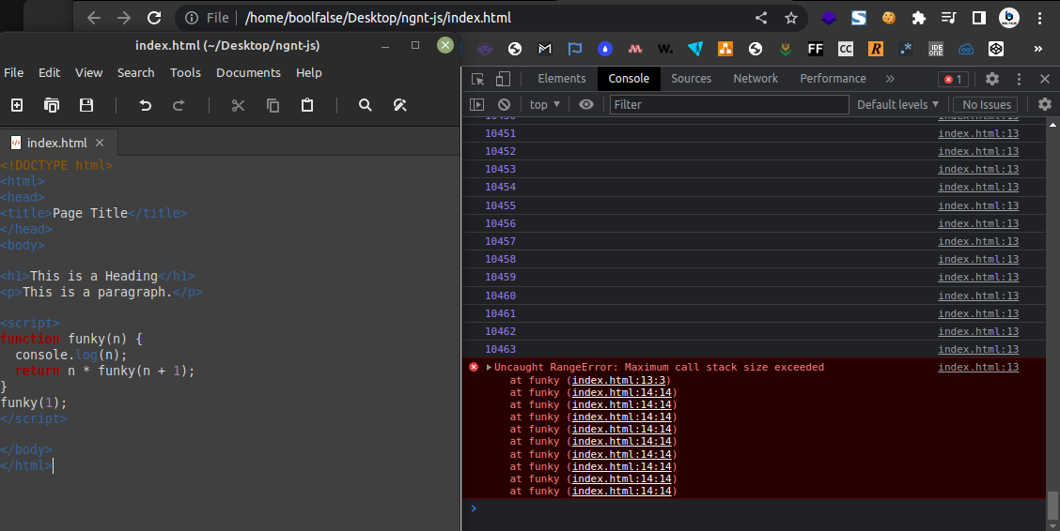
Call Stack: max size

Slide 12
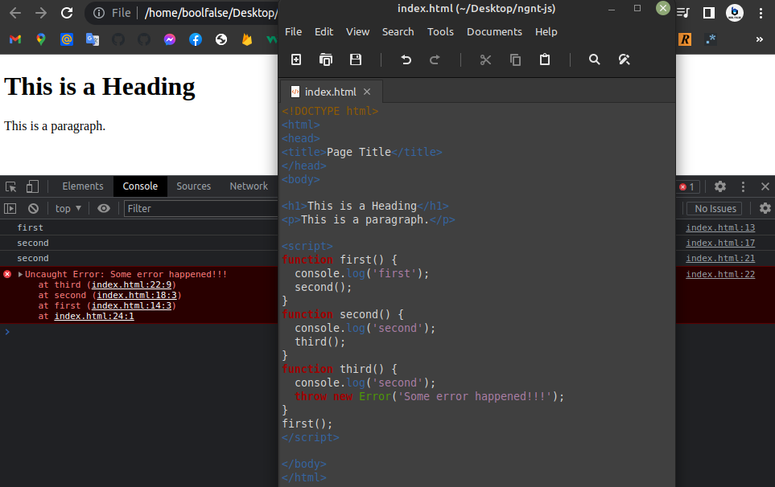
Call Stack: error

Slide 13
functions vs. var vs. let/const
console.log(multiply);
console.log(x, y);
let x = 2;
let y = 3;
var z = multiply(x, y)
function multiply(a, b) {
var m = a * b;
return m;
}

Slide 14
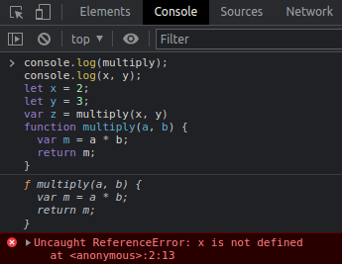
functions vs. var vs. let/const

Slide 15
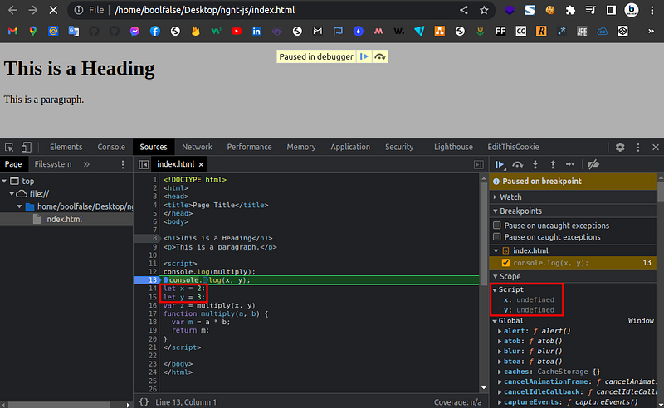
JavaScript hoisting

Slide 16
Entities in Javascript (since ES6)
Primitives (stored in stack)
String
Boolean
Number
Undefined
Symbol
BigInt
Reference Types (stored in heap)
Array
function
Object

Slide 17
How JS stores data
// objects case
let car = {
maxSpeed: 200,
wheelsInch: 17
};
let anotherCar = car;
car.maxSpeed = 240;
console.log(anotherCar.maxSpeed); // ---- 240
anotherCar.wheelsInch = 18;
console.log(car.wheelsInch); // --------- 18

Slide 18
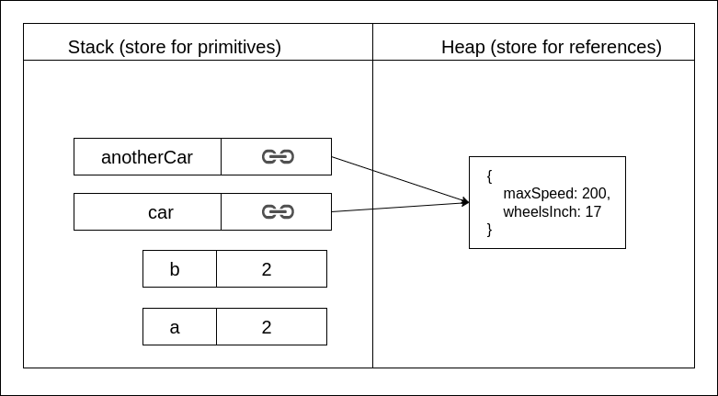
How JS stores data

Slide 19

Douglas Crockford (crockford.com)
Fun with Functions

Slide 20
LibUV & event-loop initials
UV = Unicorn Velociraptor
Web APIs:
setTimeout() և setInterval() XMLHttpRequest (XHR) fetch()
RequestAnimationFrame() addEventListener() geolocation API
WebSockets Web Workers IndexedDB
FileReader API WebRTC Web Audio API
Service Worker API Notification API MediaDevices.getUserMedia()
Intersection Observer API Resize Observer API Mutation Observer API

Slide 21
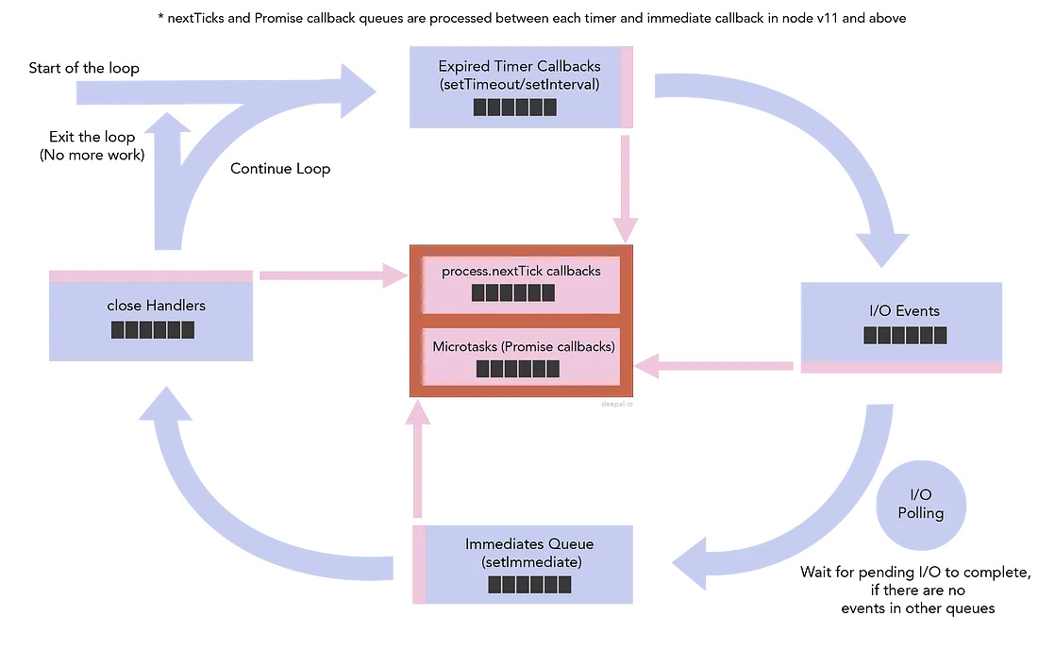
event-loop (visualization 1)

Slide 22
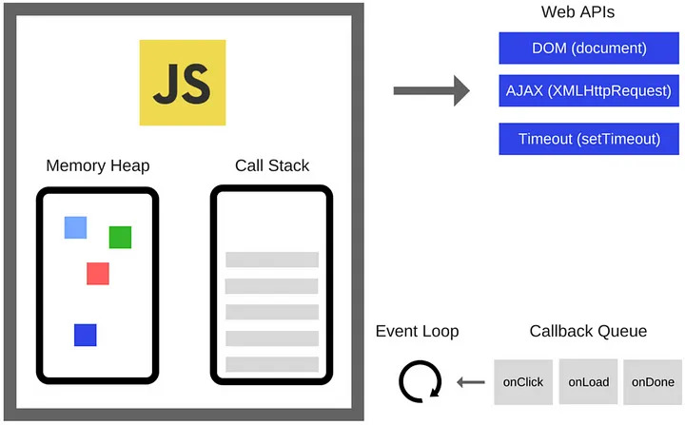
event-loop (visualization 2)

Slide 23
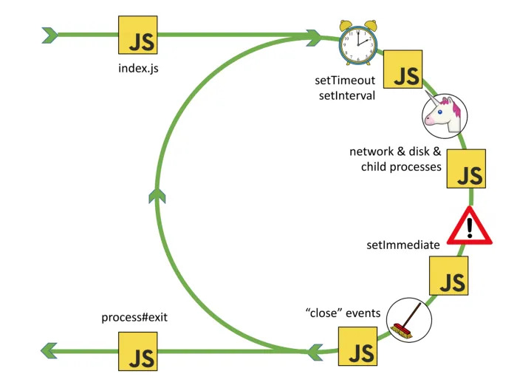
event-loop (visualization 3)

Slide 24
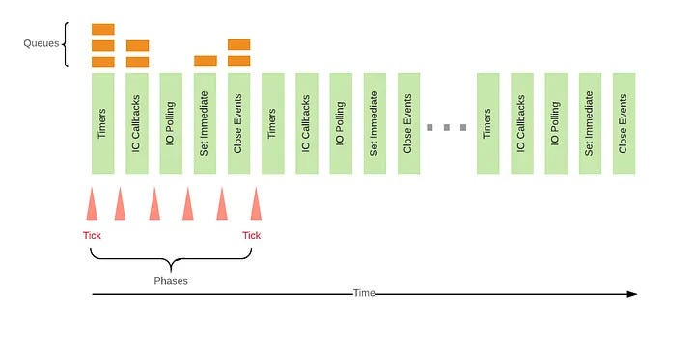
event-loop (visualization 4)

Slide 25
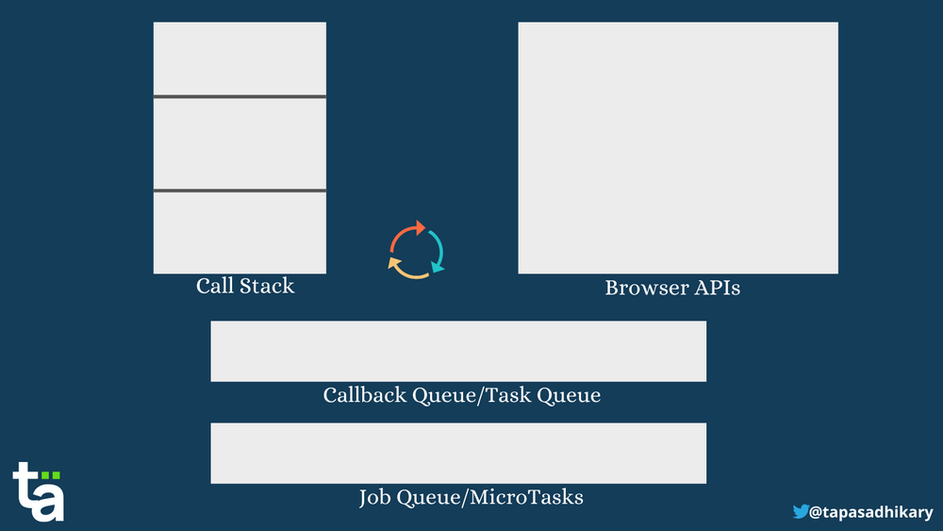
event-loop (visualization 5)

Slide 26
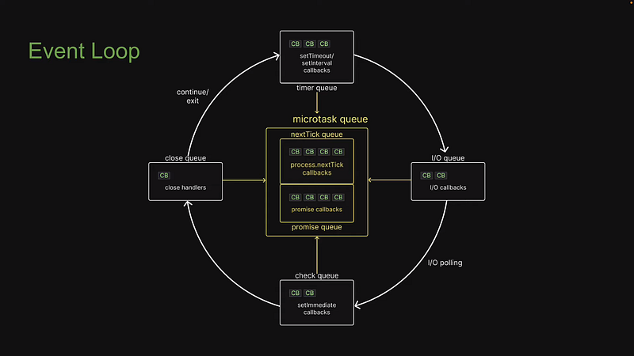
event-loop (visualization 5)

Slide 27
async blocking operations
fs
fs.createReadStream()
fs.chown()
fs.copyFile()
crypto
crypto.scrypt()
crypto.sign()
crypto.verify())
dns
dns.lookup()
dns.resolveCname()

Slide 28
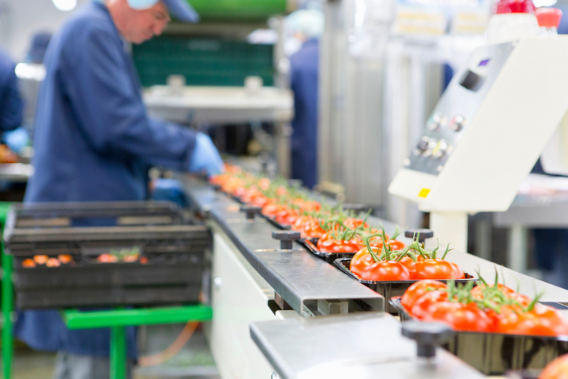
Real life analog
(thread pool initials)

Slide 29
Analogy comparision
master thread - ավագ աշխատակից
thread pool - դիմում օգնական աշխատակիցներին
thread - ամեն մի (օգնական) աշխատակիցը
UV_THREADPOOL_SIZE = 4- օգնական աշխատակիցների by default քանակը (սա նաև կախված է OS֊ից)
Node.js runtime - գործարանի տնօրեն
CPU-intensive async tasks - ծանր բեռեր
sync / async non-blocking operations - բեռեր, որոնք կարող է անցակացնել ավագ աշխատակիցը
async blocking CPU-intensive operations - բեռեր, որոնք ավագ աշխատակիցը հանձնարարում է օգնական աշխատակիցներին՝ կատարելու և զեկուցելու արդյունքը

Slide 30
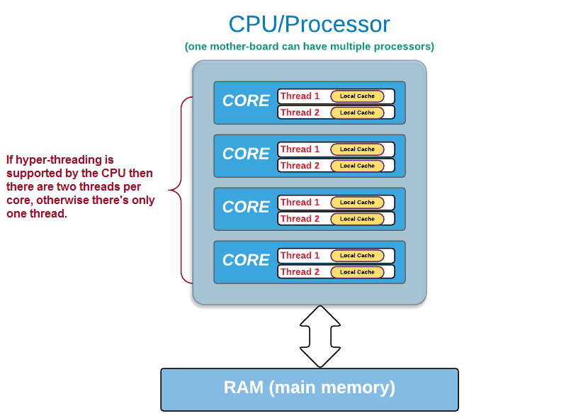
CPU – core - thread

Slide 31

LibUV’s event-loop feature

Slide 32
Example 01 (event-loop)
// example 01: microtask and timer queues
setTimeout(() => console.log("setTimeout 1"), 0);
setTimeout(() => {
console.log("setTimeout 2");
process.nextTick(() => console.log("setTimeout 2 nextTick"))
}, 0);
setTimeout(() => console.log("setTimeout 3"), 0);
process.nextTick(() => console.log("nextTick 1"));
process.nextTick(() => {
console.log("nextTick 2");
process.nextTick(() => console.log("nextTick 2 nextTick"));
});
process.nextTick(() => console.log("nextTick 3"));
Promise.resolve().then(() => console.log("Promise 1"));
Promise.resolve().then(() => {
console.log("Promise 2");
process.nextTick(() => console.log("Promise 2 nextTick"));
});
Promise.resolve().then(() => console.log("Promise 3"));

Slide 33
Example 01 - result
nextTick 1
nextTick 2
nextTick 3
nextTick 2 nextTick
Promise 1
Promise 2
Promise 3
Promise 2 nextTick
setTimeout 1
setTimeout 2
setTimeout 3
setTimeout 2 nextTick

Slide 34
Example 02 (event-loop)
// example 02: I/O queue and timer queue anomaly
const fs = require("fs");
setTimeout(() => console.log("setTimeout"), 0);
fs.readFile(__filename, () => console.log("readFile"));
// for (let i = 0; i < 1000000000; i++) {}

Slide 35
Example 02 - result
setTimeout
readFile
// anomaly
readFile
setTimeout

Slide 36
Example 03 (event-loop)
// example 03: I/O queue and I/O polling
const fs = require("fs");
fs.readFile(__filename, () => {
console.log("readFile");
});
process.nextTick(() => console.log("nextTick"));
Promise.resolve().then(() => console.log("Promise"));
setTimeout(() => console.log("setTimeout"), 0);
setImmediate(() => console.log("setImmediate"));
for (let i = 0; i < 1000000000; i++) {}

Slide 37
Example 03 - result
nextTick
Promise
setTimeout
setImmediate
readFile

Slide 38
Example 04 (event-loop)
// example 04: check queue & timer queue anomaly
setTimeout(() => console.log("setTimeout"));
setImmediate(() => console.log("setImmediate"));

Slide 39
Example 04 - result
setTimeout
setImmediate
// anomaly
setImmediate
setTimeout

Slide 40
Example 05 (event-loop)
// example 05: Close queue in the end
const fs = require("fs");
const readableStream = fs.createReadStream(__filename);
readableStream.on("close", () => {
console.log("readableStream");
});
readableStream.close();
setImmediate(() => console.log("setImmediate"));
setTimeout(() => console.log("setTimeout"), 0);
Promise.resolve().then(() => console.log("Promise"));
process.nextTick(() => console.log("nextTick"));

Slide 41
Example 05 - result
nextTick
Promise
setTimeout
setImmediate
readableStream

Slide 42
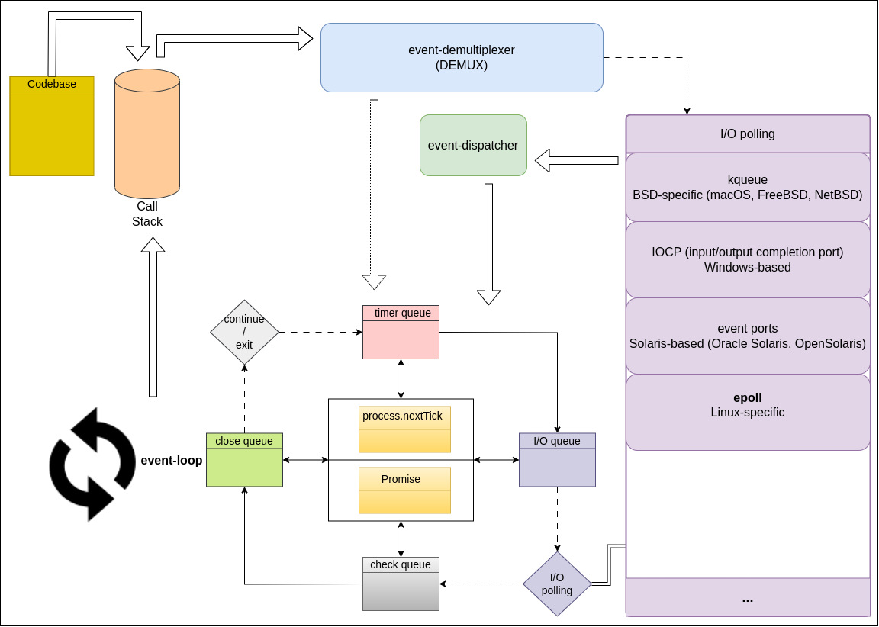
Node.js Runtime libUV
Reactor Pattern

Slide 43
Q&As
***

Slide 44


