Slide 1
The Problem
How do we predict the price of a home in Ames, Iowa?
The Issue in Context
Don’t want to pay rent every month for the rest of your life? Buy your own home!
Tired of living in a small town? Sell your home!
But…how do you put a price tag on it?
The Approach
Explore large set of data on over 2000 homes in Ames, IA
Construct predictive linear regression model
Evaluate model on unseen data
Notes:
45 seconds

Slide 2
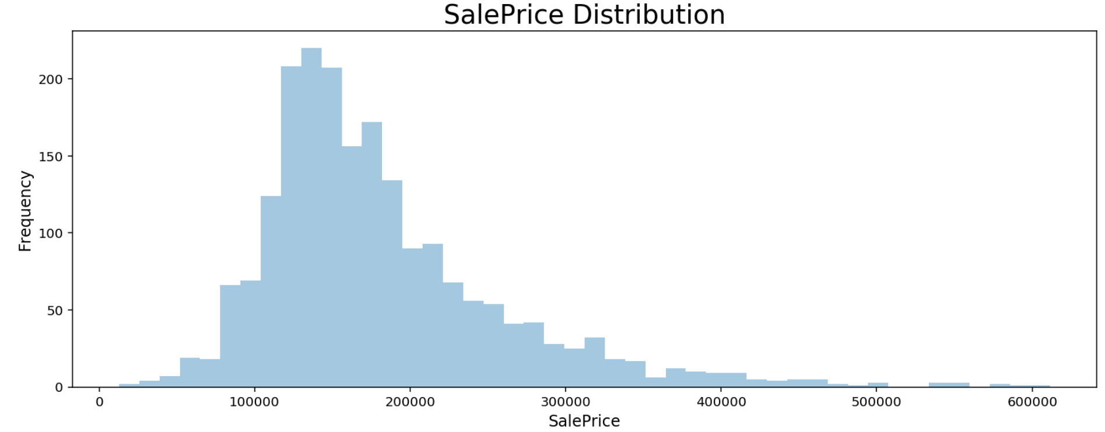
Methodology: Exploratory Data Analysis
Examining the Distribution of Target Variable – SalePrice
Notes:
(10 seconds)

Slide 3
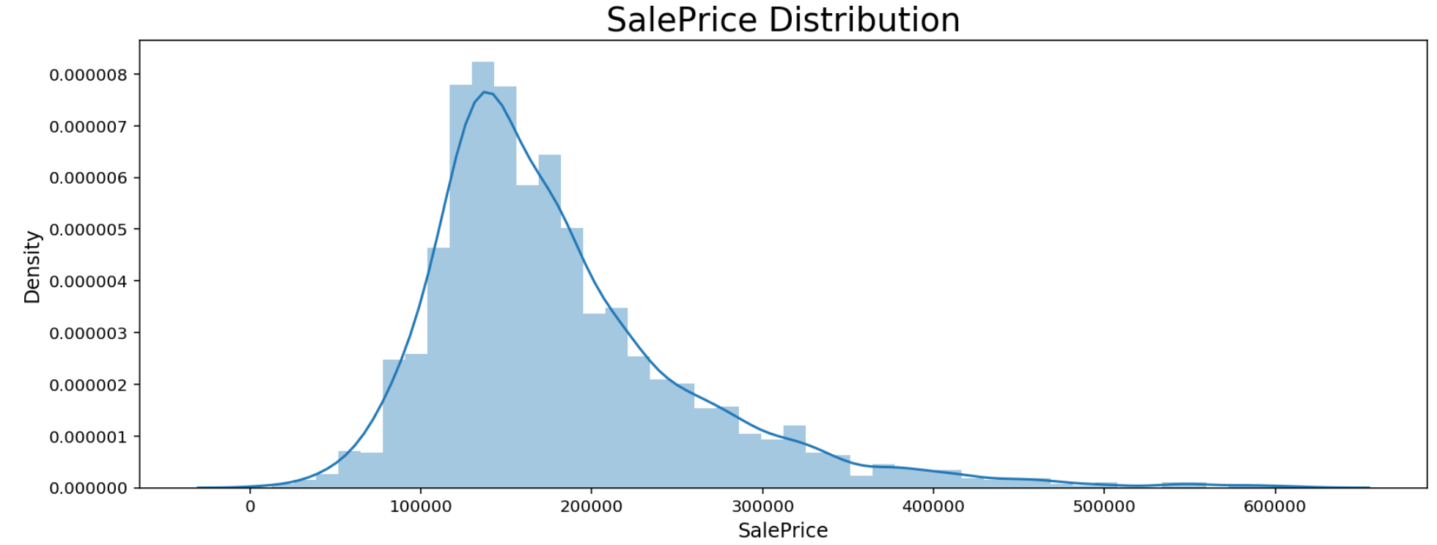
Methodology: Exploratory Data Analysis
Examining the Distribution of Target Variable – SalePrice
Notes:
(10 seconds)

Slide 4
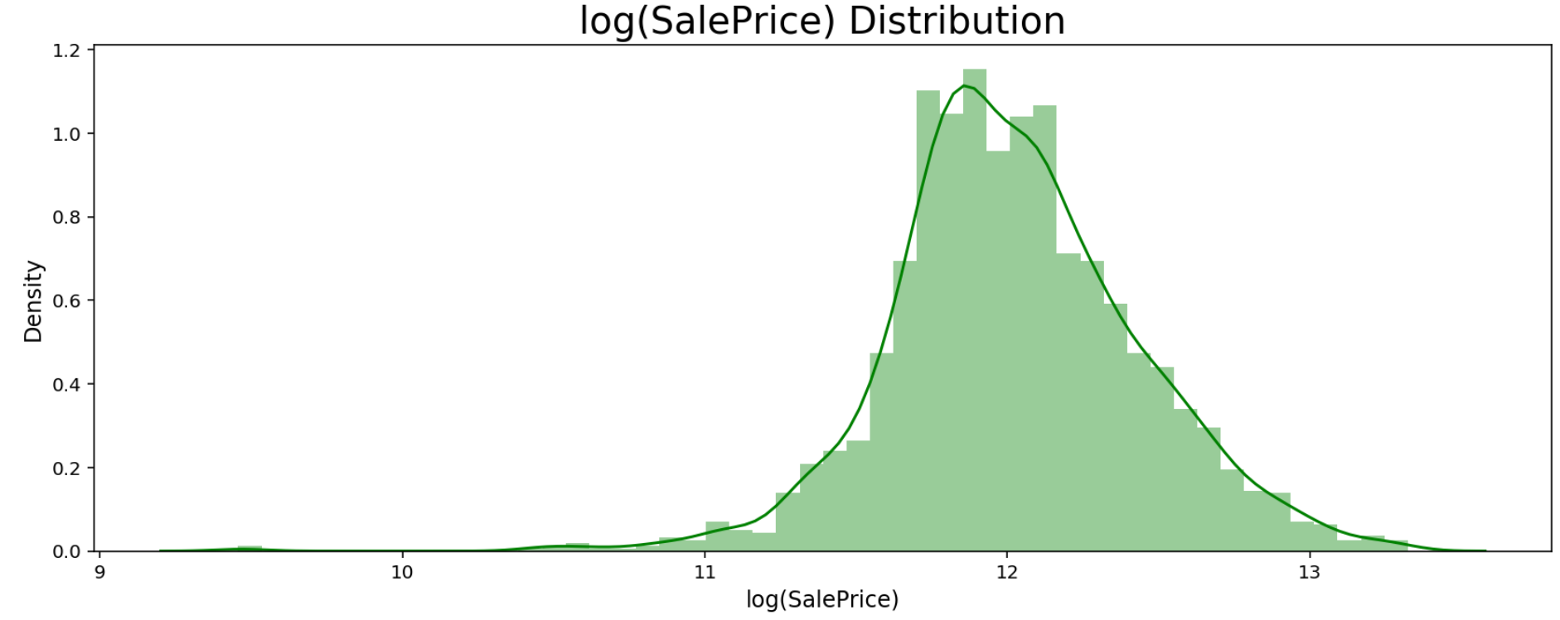
Methodology: Exploratory Data Analysis
Examining the Distribution of Target Variable - log( SalePrice )
Notes:
(10 seconds) = 1:15

Slide 5
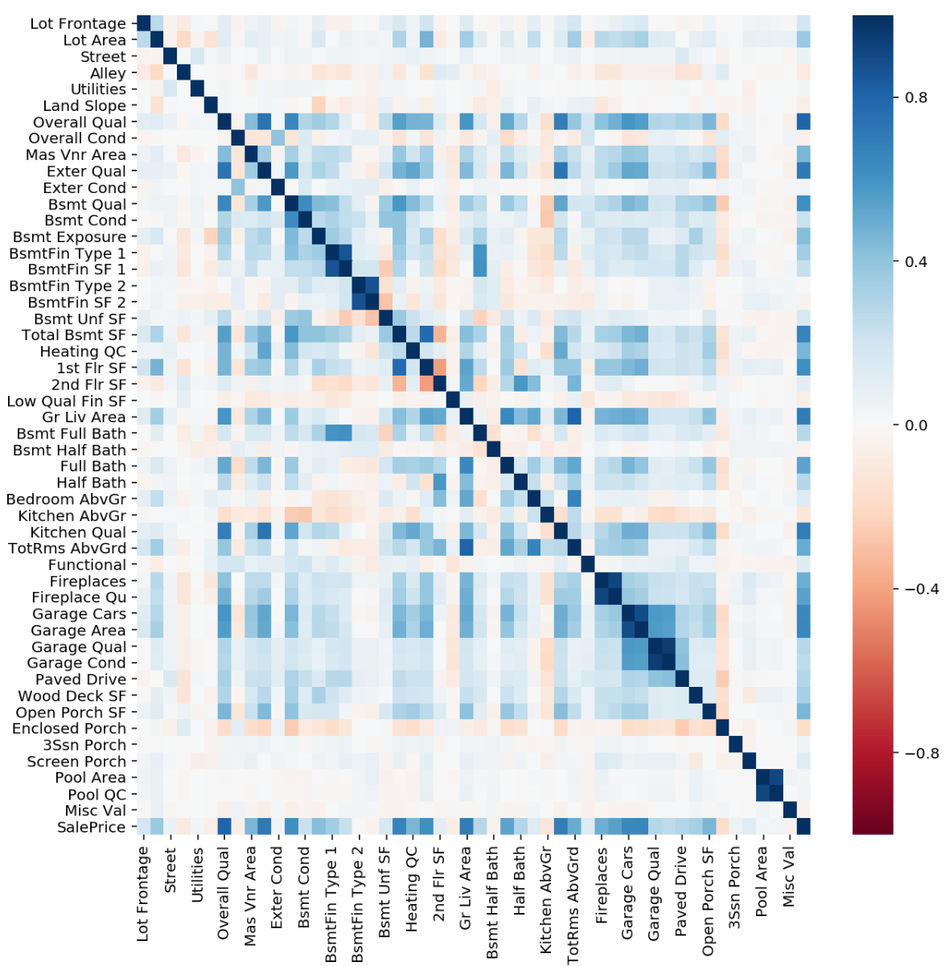
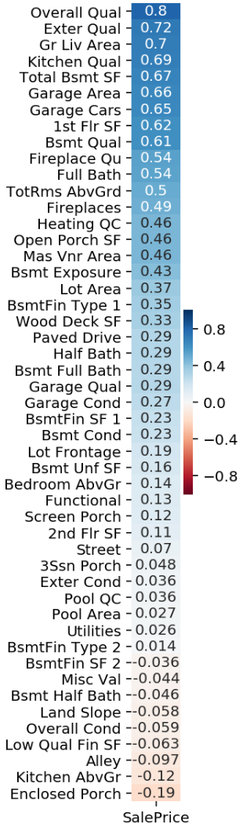
Methodology: Exploratory Data Analysis
Some multicollinearity in features, but focus on correl. vs SalePrice
Notes:
45 seconds = 2:15

Slide 6
Methodology: Data Cleaning & Feature Engineering
Handling Features by Data Type
Data
Categorical
Nominal
(BldgType)
Ordinal
(PoolQC)
Numeric
Floats
(LotFrontage)
Int
(LotArea)
missing? → 0
missing? → string “NA”
One-Hot Encode: Dummy Variable
Mapping: Rating/Ranking System

Slide 7
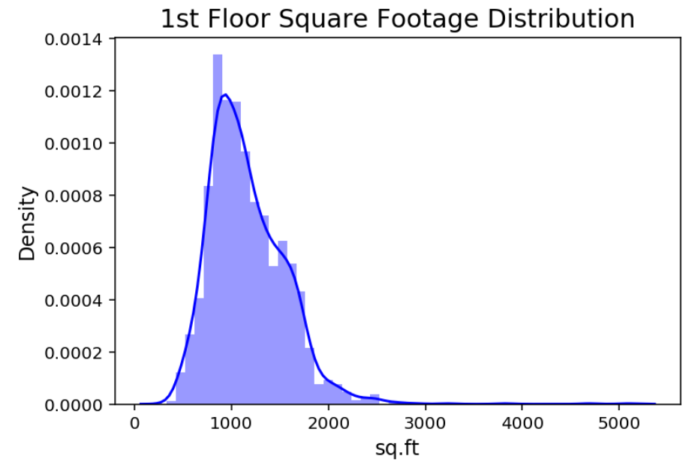
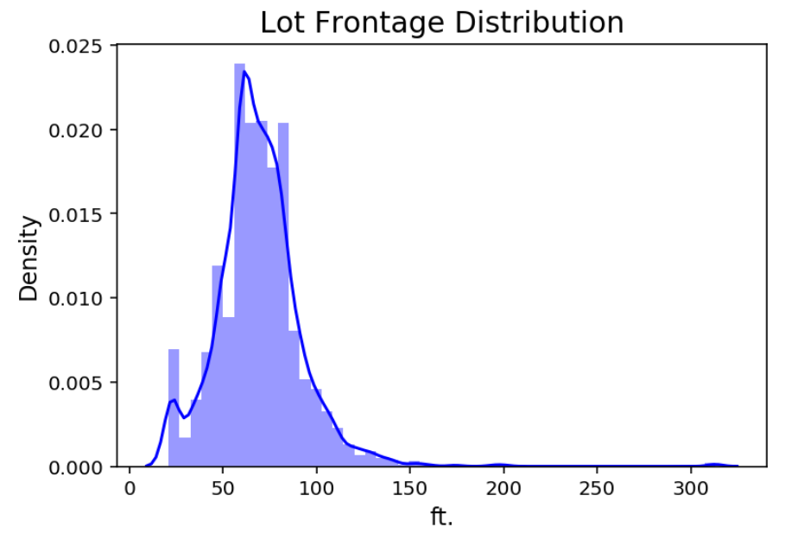
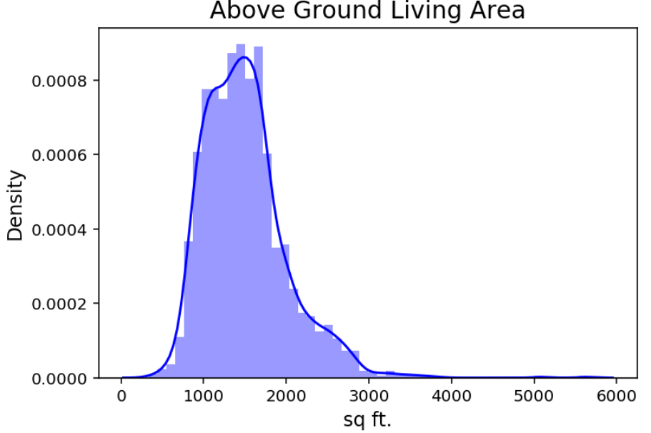
Methodology: Feature Engineering
Distributions Some of Noteworthy Numeric Features
There are also features that are “almost normal” but skewed in the same way that SalePrice is!
Our threshold: a feature is moderately skewed if Skew(X) > 0.5
Not convinced? See next slide for evidence to support replacing such features with their logs.
Notes:
1 minute = 4:15

Slide 8
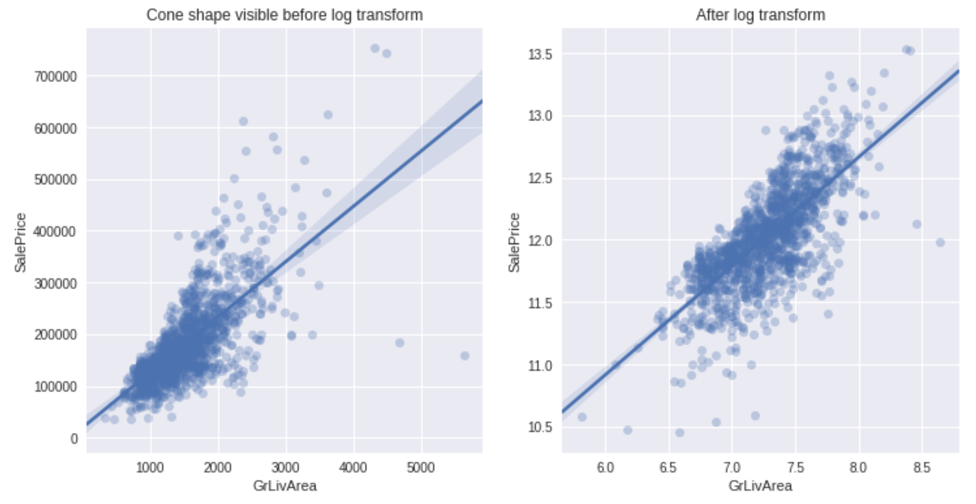
Methodology: Feature Engineering & Modeling
Benefits of the Log Transform
Original
Logged
Notes:
5 seconds = 4:20

Slide 9
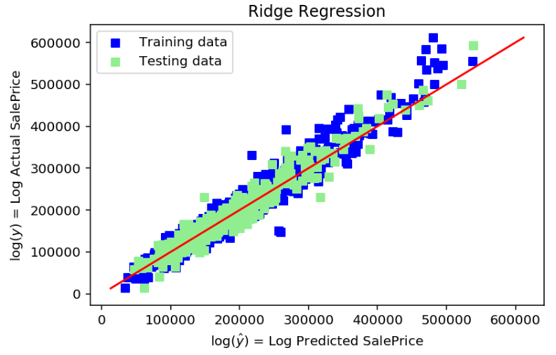
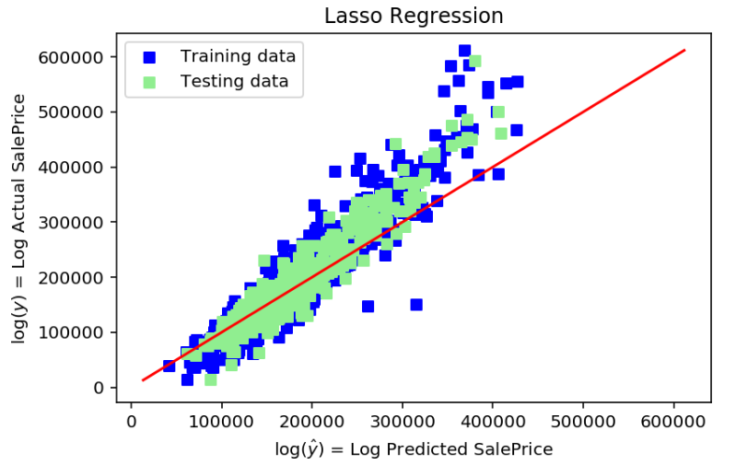
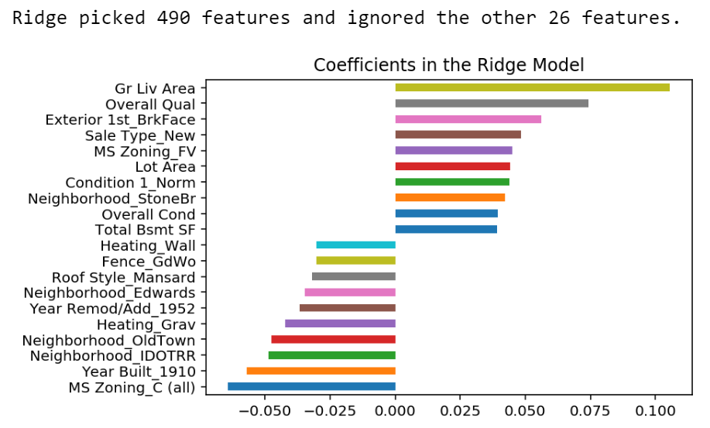
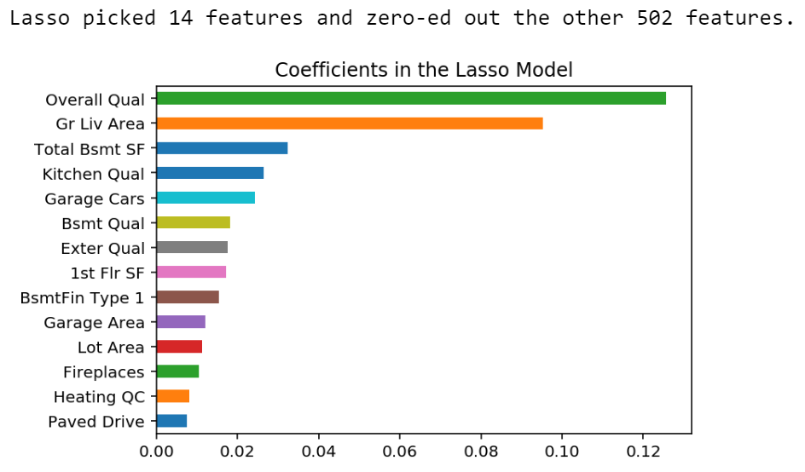
Modeling: Results
OLS useless with 516 regressors, but Ridge and Lasso came through
Notes:
20 seconds = 4:40

Slide 10
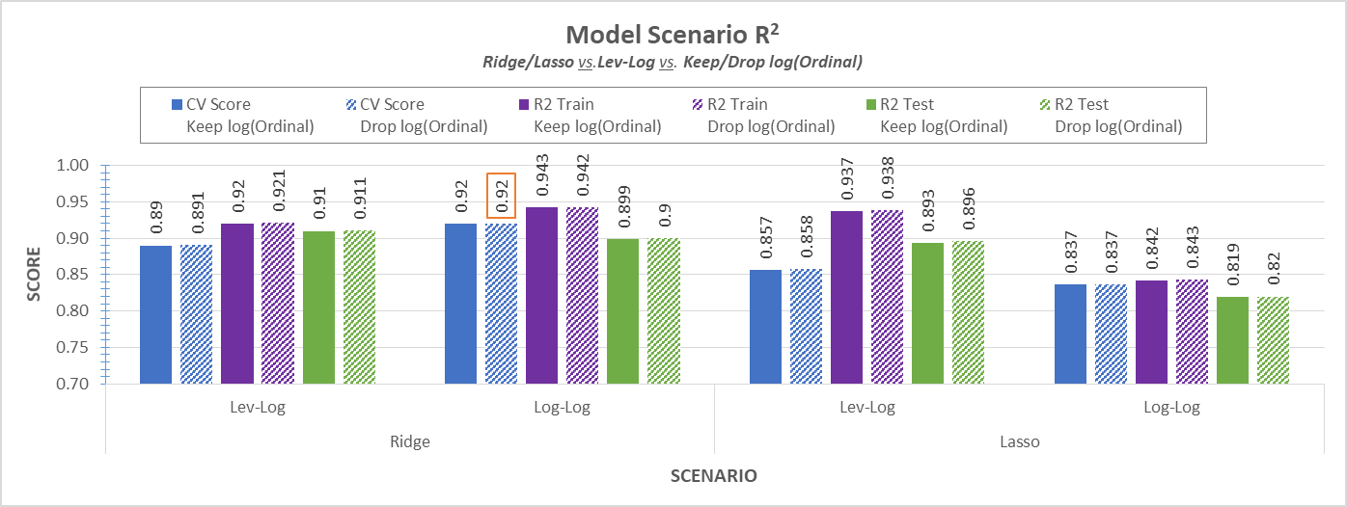
Modeling: Evaluation
Scenario Analysis of Models
Log-Log Ridge Regression outperformed other scenarios in terms of both CV Score and Training Set R².
Dropping log(ordinals) typically did better than keeping them in all scenarios.
Notes:
40 seconds = 5:20

Slide 11
Wrapping-Up
Verdict on our Log-Log Ridge Regression model
Able to handle unseen data decently well
R² Test score, Kaggle RMSE score
Suffers from slight overfitting (5% diff in R² Train vs. Test),
Still performs well on a consistent basis judging by 5-Fold Cross Validation Score
Overall, model can be used to predict prices of homes in Ames, IA within a ballpark of true value.
Further Enquiry
Manually select interaction terms to include in the model and examine if RMSE falls further
Introduce polynomial versions of the top 10 highly correlated features with SalePrice into the model to see if it improves model predictability
Implement Gradient Boosting and Random Forests to improve model predictability
Using the surviving features from Lasso, how well would OLS perform? What ends up being the threshold at which OLS fails?
Notes:
40 seconds = 6:00

