Slide 1

A Heading
Pokémon as mysterious creatures with many secrets living alongside humans or in the wild. They can be caught using a Poké Ball for carrying around. The exact number of Pokémon species is unknown, with over 1000 confirmed and potentially more to be discovered in the future.

Slide 2

A Heading
The TV Anime series and movies based on Pokémon offer new storytelling while staying true to the original video game. They bring the Pokémon characters to life through adventures and emotions, appealing to both kids and adults. The series started in 1997 and continues to be popular worldwide, with the movies touching on themes like family and the environment.

Slide 3
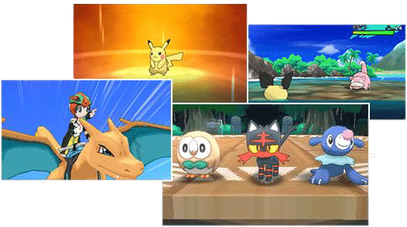
A Heading
The Pokémon video games were unique because players could exchange Pokémon between different versions, aiming to complete the Pokédex. Some Pokémon are challenging to catch, and rare ones only appear in specific game versions, encouraging players to cooperate with others to catch them. This cooperation grows from small trading rings to larger ones as more people play together, increasing the fun of the game.

