Slide 1
DIGI-SOLES
Submitted by
SHUBHAM GUPTA - 16BCE0232
SHAGNIK GHOSH - 16BCE0224

Slide 2
OBJECTIVE
To create a safety shoe for people (especially women and elderly) which will ensure protection by notifying the user’s associates of any kind of danger the user is in.

Slide 3
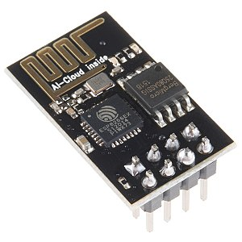
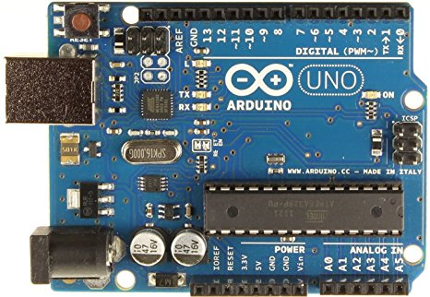
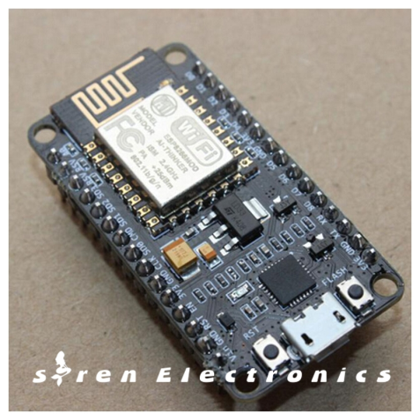
In place of Arduino interfacing with ESP8266 we are using Node MCU.
Arduino
ESP8266
Node MCU

Slide 4
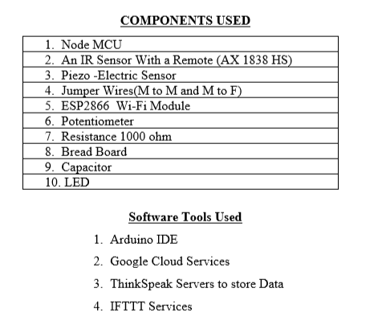

Slide 5
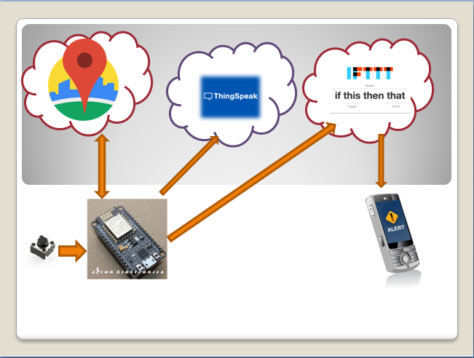
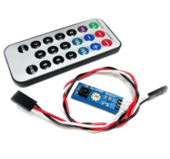
DESIGN
IR SENSOR

Slide 6
METHODOLOGY
On pressing the button, LED glows and the location data is extracted from the Google cloud using Geolocation API.
The data collected from the Google cloud on the Node MCU, is then transferred to ThingSpeak for further analysis.
The location data is now packed in form of a message which is send to the victim’s associates using IFTTT API.

Slide 7
THINGSPEAK CHARTS

Slide 8
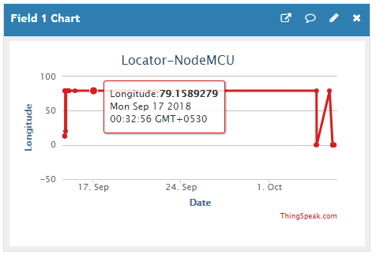
Longitude Values:

Slide 9
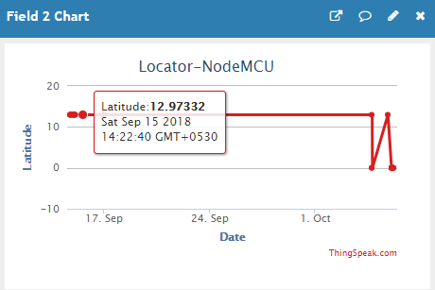
LATitude Values:

Slide 10
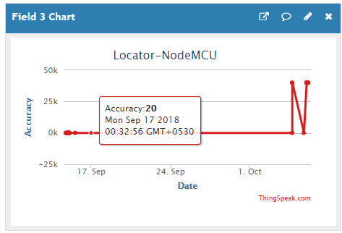
Accuracy:

Slide 11
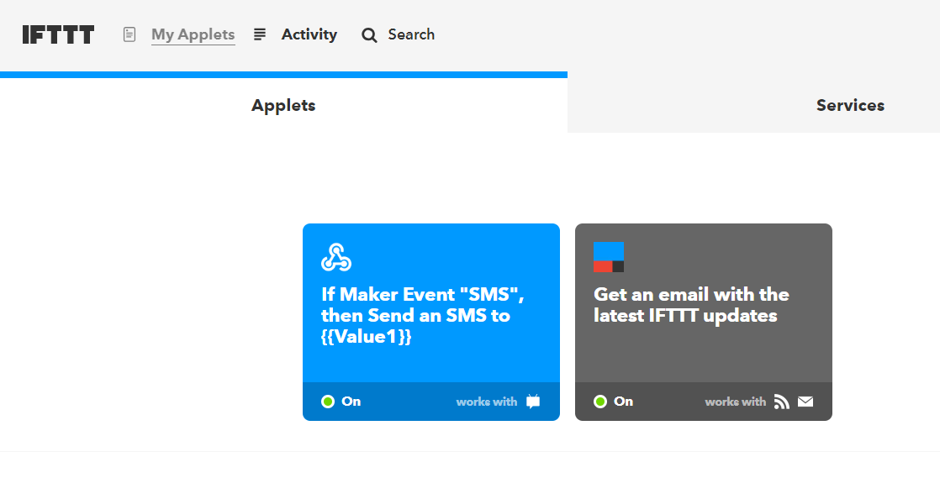
IFTTT APPLET

Slide 12
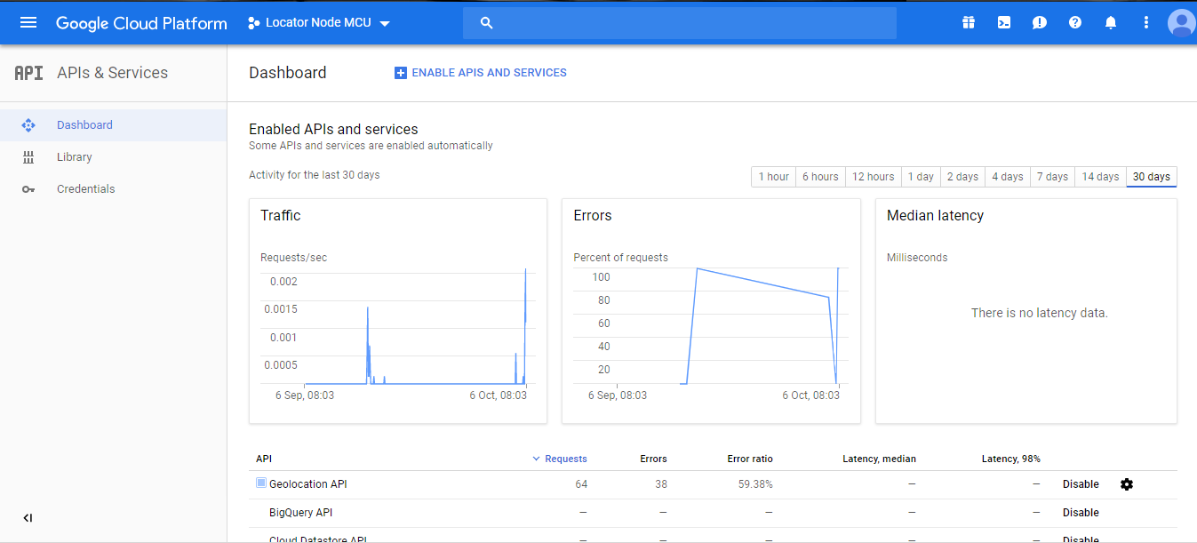
Google Cloud Console

Slide 13
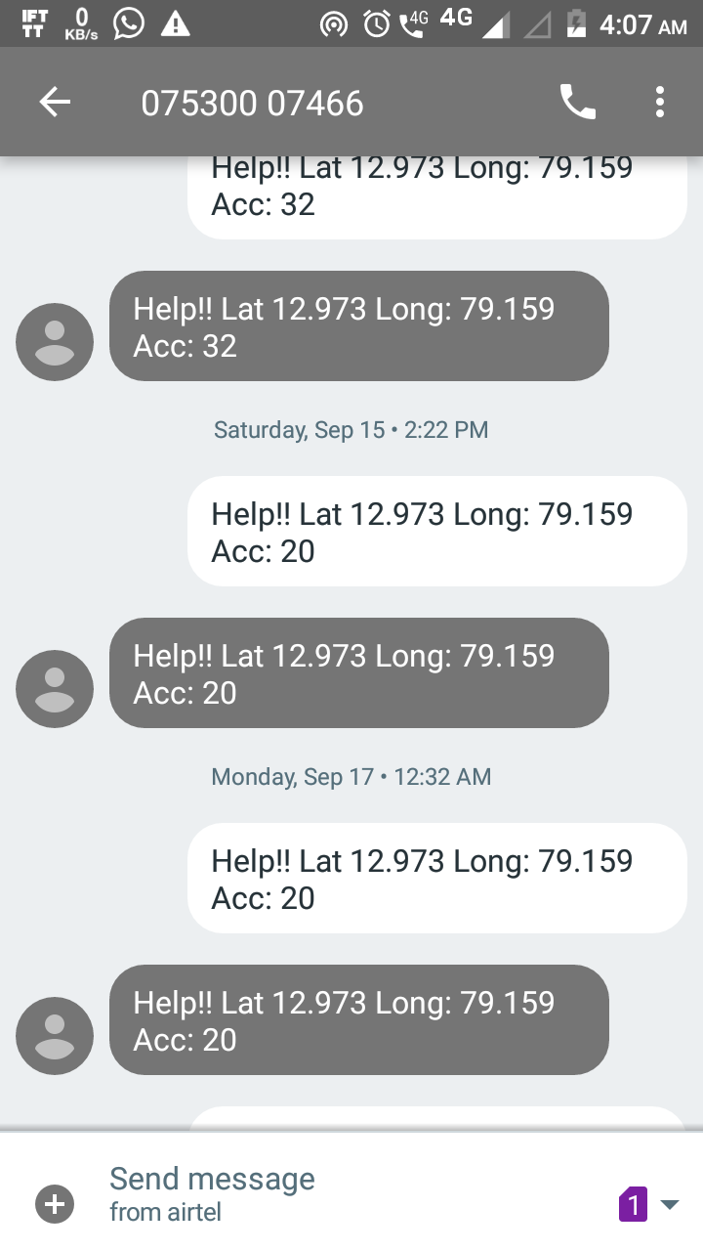
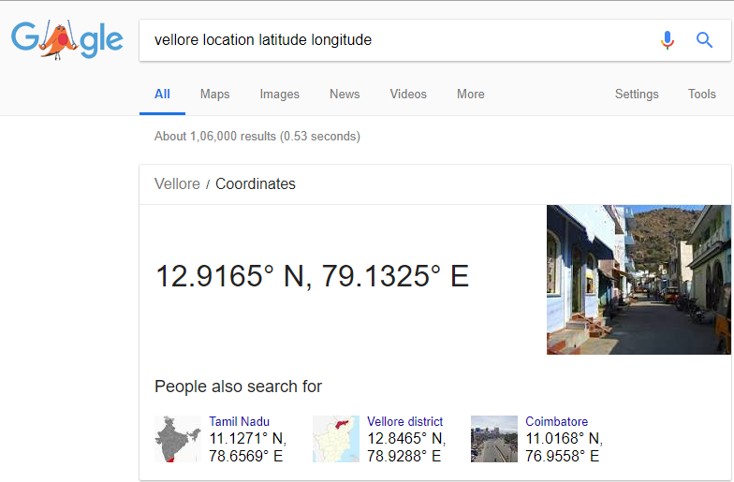
Vellore Location Coordinates(DD):

Slide 14
FUTURE WORK
Analysis of the data stored in the ThingSpeak server for categorizing the area according to their security levels.
Real time monitoring
Providing shortest path to the associates using Google Maps so as to reach the victim earliest.

