Slide 1

Reliance stock analysis
Data analysis with python
ANIRUDH M - 1RVU23CSE060
BHUVAN MADHUSUDHAN - 1RVU23CSE116
BHUMIKA G -1RVU23CSE111
ANIKETH C.S -1RVU23CSE057

Slide 2
TABLE OF CONTENT
INTRODUCTION
METHODOLOGY
01
02
inference
graphs
03
04
Data ANALYSIS
WITH PYTHON

Slide 3
TABLE OF CONTENT
result
conclusion
05
06
references
07
Data ANALYSIS
WITH PYTHON

Slide 4
introduction
01
Data ANALYSIS
With python

Slide 5
INTRODUCTION
Data ANALYSIS
With python
Our project contains a detailed analysis of Reliance stocks from the time period 2000 to 2021
The stock data can be obtained from financial markets, stock exchanges, or financial data providers. Common sources include NSE (National Stock Exchange) or BSE (Bombay Stock Exchange) for Indian stocks.

Slide 6
INTRODUCTION
Data ANALYSIS
With python
Historical stock data typically includes daily or intraday information on Open, High, Low, Close (OHLC) prices, trading volume, and adjusted closing prices.
we have used python and its inbuilt libraries to do the statistical analysis , our aim is to visualize the data using graphs and Statistical formulae for better analytics

Slide 7
Statistical tools used
mean
median
Mode
Standard deviation
skewness
Kurtosis
Data ANALYSIS
The mean is the average of a set of numbers.
The median is the middle value in a set of numbers
the mode is the value that appears most frequently
The standard deviation is a measure of the amount of variation or dispersion of a set of values
Skewness is a measure of the asymmetry of a probability distribution
is a measure of the “peakedness” of a probability distribution

Slide 8

methodology
02
Data ANALYSIS
With python

Slide 9
methodology
Data ANALYSIS
With python
Our first step was to identify a dataset ,which is complete and did not have any missing values or duplicate values or other errors
• We decided on this dataset keeping the result in our mind
• We have used python and its libraries(modules) for generation of graphs and other statistical data
• We have used a jupyter notebook to incorporate the data which we generated using python .

Slide 10
methodology
Data ANALYSIS
With python
• We have used in built libraries of python like Pandas ,matplotlib, seaborn, scipy, sklearn, NumPy
• Outlining the data points which are related to each other so we can understand the correlation between each other
• We have chosen appropriate graphs for the corresponding data
• Identifying the datapoints which stand out to generate a conclusion
• Using the appropriate tools we have identified if investing in this company is profitable or not

Slide 11

inference
03
Data ANALYSIS
With python

Slide 12
inference
Data ANALYSIS
With python
Our basic aim is to understand the behavior of the reliance stocks throughout the year based on a time period of 21 years ,also our aim is to learn how the stock market works through this analysis
We look into how the stock behaves everyday by looking into the opening prices on the beginning of the day .By looking at the maximum and minimum value the stock has attained in that particular day .
Also ,we compare the closing price of the previous day and opening price of the current day To see if the stock value is increased or decreased.

Slide 13
inference
Data ANALYSIS
With python
Another datapoint which we refer to is the last price
(i.e which is the last price at which the stock is that particular day) and the closing price (i.e which is the value of the stock at the end of the day)
Examination of volatility patterns provides insights into the stock's price fluctuations.
Identification of periods of high and low volatility, which may influence trading strategies

Slide 14

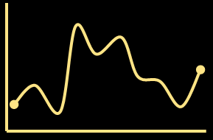

graphs
04
Data ANALYSIS
With python

Slide 15
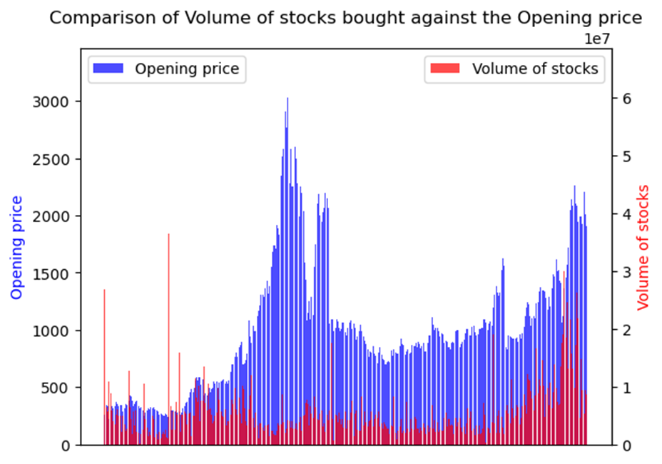
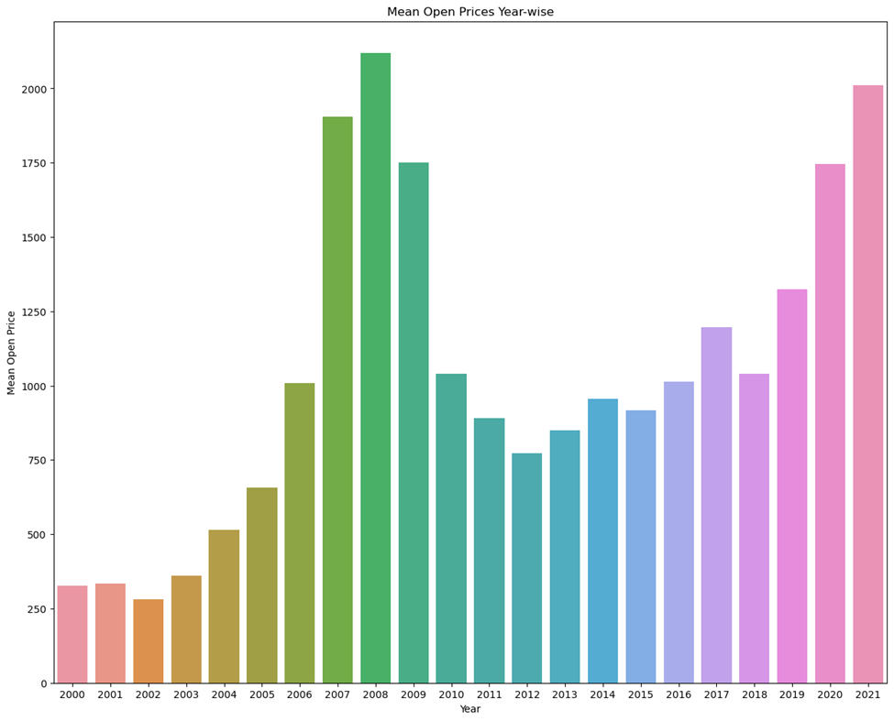
graphs
Data ANALYSIS
With python

Slide 16
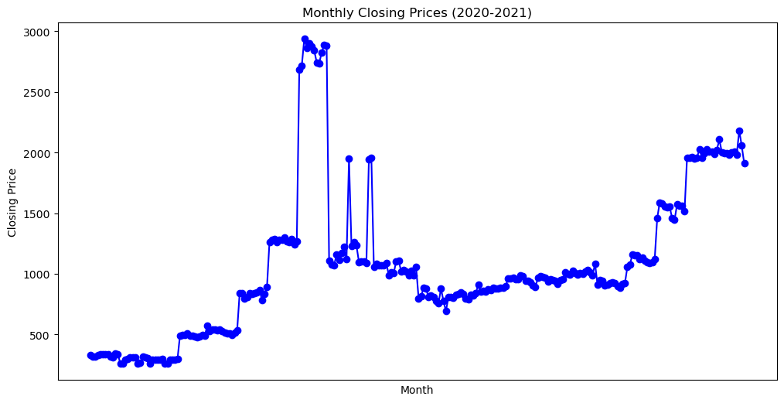
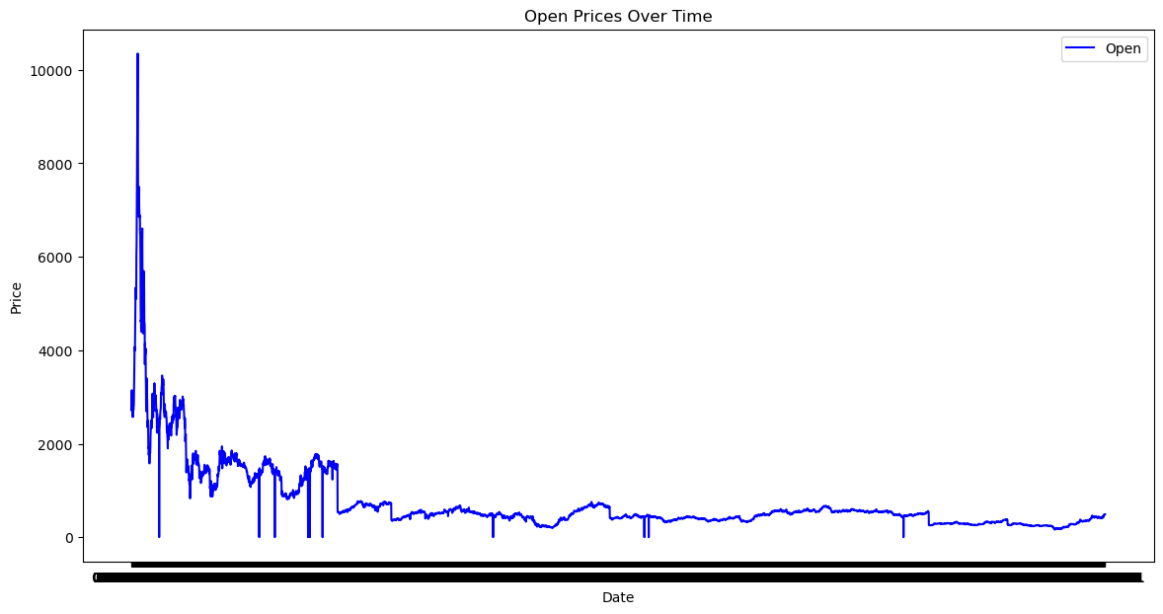
graphs
Data ANALYSIS
With python

Slide 17
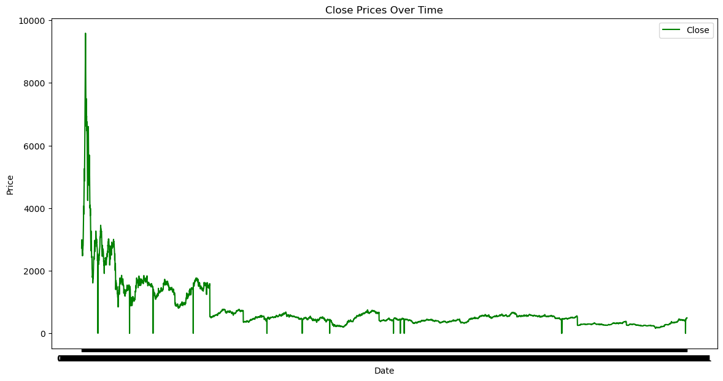
graphs
Data ANALYSIS
With python

Slide 18
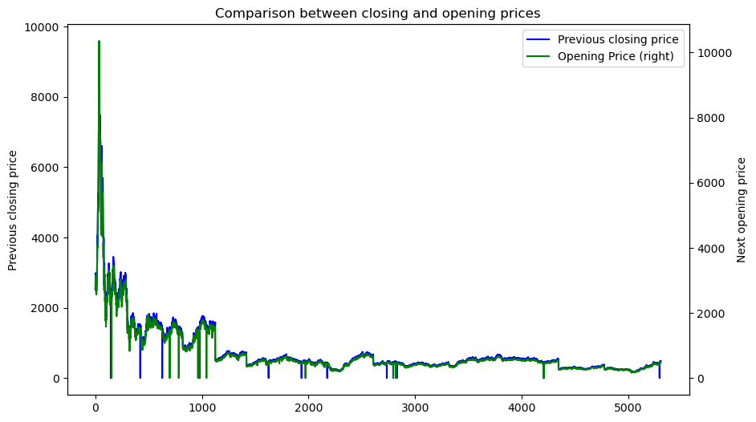
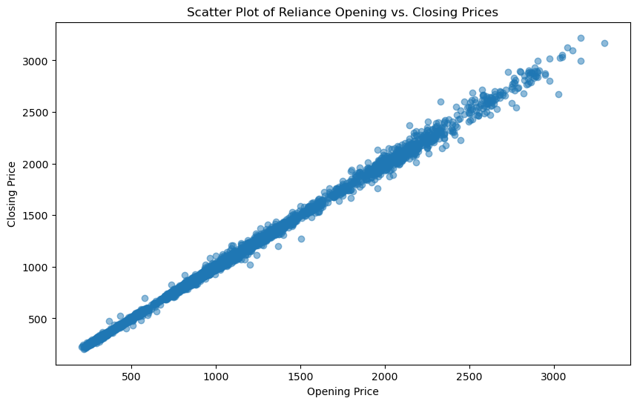
graphs
Data ANALYSIS
With python

Slide 19
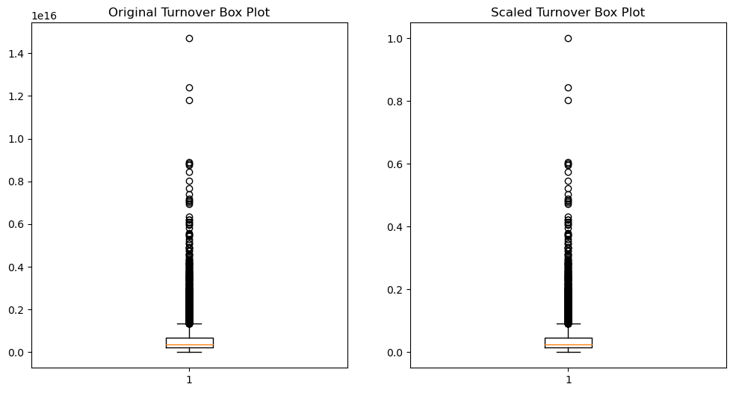
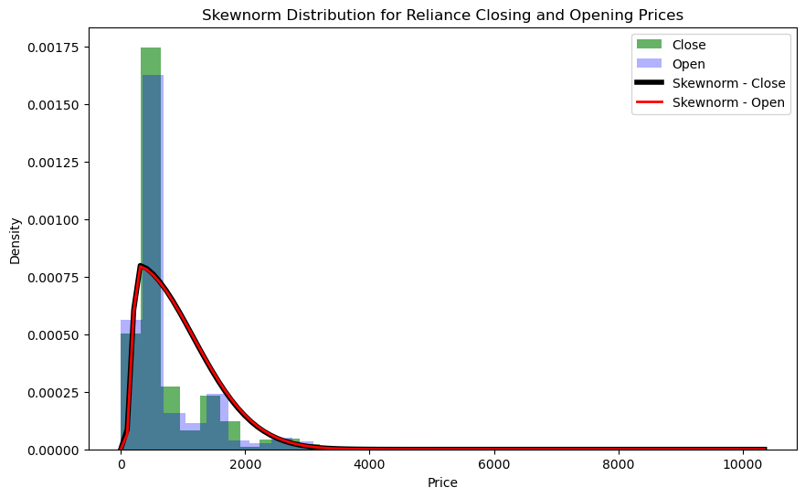
graphs
Data ANALYSIS
With python

Slide 20
Result and discussions
05
Data ANALYSIS
With python

Slide 21
Result and discussions
Data ANALYSIS
With python
Through the analysis of the RIL's turnovers, the standard deviation of the turnover was relatively high compared to its mean turnover which are signs of positive large fluctuations which might lead to high profit considering all circumstances. The large deviation of std from mean could potentially be a sign of increased risk of investment.
This contradicting situation made us inspire to make a more detailed analysis.
To be able to conclude the final statement on the stock analysis of RIL, we looked into the comparison graphs of the opening and closing prices and also the skewness distribution of the stock prices.
These key elements lead us to be able to make a more defining conclusion on the company.

Slide 22




Conclusions
06
Data ANALYSIS
With python

Slide 23
conclusions
Data ANALYSIS
With python
By this analysis we are trying to understand how the reliance stock has been behaving over the years , and what factors might have be affecting the valuation of the stock ,also we can observe that the stock value of RIL has been consistently profitable.
To conclude the overall aim of our project, we have plot a skew norm distribution which gives a proper overall insight on the stock fluctuations of RIL.
At first, the closing prices has more higher leap than the opening prices which is a good sign of big returns.
Second, we have the skewness distribution curve of the opening and closing prices. The curve has a longer right tail indicating frequent rise in prices more than its average price and the curve being highly positively skewed which means that there is positive sentiment of the company stocks in the market. Since the closing and opening prices are following a similar skewness distribution, there could be less risks of depreciation leading to heavy losses.

Slide 24
conclusions
Data ANALYSIS
With python
Overall, Reliance is a good company to invest which has many positive signs of appreciation. Even though, there might chances of drop in prices But looking at our analysis there is a slight promising situation of not losing your principal amount. A good investment could be a small investment at the start and slowing increasing our investment stocks as the prices take a gradual increase. Taking patience and waiting when the prices drop would be advisable. In the art of waiting, there lies moments filled with happiness so definitely there will be huge profits despite the ups and downs in the market sentiment.

Slide 25
references
07
Data ANALYSIS
With python

Slide 26
references
Data ANALYSIS
With python
dataset-https://www.kaggle.com/datasets/rohanrao/nifty50-stock-market-data
https://chat.openai.com/

Slide 27
THANK YOU!!
Data ANALYSIS
WITH PYTHON
TEAM MEMBERS
BhuMIKA G
ANIRUDH M
ANIKETH CHAKRAVARTHY
BHUVAN MADHUSUDAN

