Slide 1
Car Rental - Vintage Vogue
Presented by:
BHUMIKA G
SUJAY S VEERSHETTE
Submitted for the partial fulfillment
of
BTECH HONS
in
RV UNIVERSITY

Slide 2
Table of contents
01
02
03
04
05
06
Abstract
Theory and
Fundamentals
Introduction
Objectives
07
Related
work
Methodology
Tools and
Technologies

Slide 3
Table of contents
08
09
10
11
12
13
Testing and
Implementation
Data Collection
Findings and
Results
Applications
14
Conclusion
Future Scope
References

Slide 4
01
Abstract

Slide 5

Vintage Vogue is a cutting-edge car rental website with 6 webpages designed to provide users with a seamless and convenient way to rent vehicles. The platform aims to revolutionize the traditional car rental process by offering a user-friendly interface, a diverse fleet of vehicles, and advanced features to enhance the overall rental experience.
It boasts an intuitive and easy-to-navigate interface, ensuring a smooth experience for users of all levels of technological proficiency. The platform focuses on simplicity, allowing users to effortlessly browse available vehicles and complete the rental process with just a few clicks.

Slide 6
02
Introduction

Slide 7

Explore the liberty of uncharted territory alongside Vintage Vogue. We provide a smooth and dependable automobile rental experience that is customized to meet your needs, redefining convenience.
Variety of Vehicles: Choose from our large selection of cars, which includes roomy SUVs and fuel-efficient compacts.
Simple Reservation: With only a few clicks on our intuitive web platform, you may reserve the perfect vehicle. With ease, decide on your pick-up location and dates, then go on the road.

Slide 8
03
Theory and Fundamentals

Slide 9
It is a simple interactive user-friendly website with navigation bar which makes it easy-to-navigate. We have included grid frames to align the products, and various blogs to provide the user hassle - free renting with 3 step process. The website is animated for aesthetics and to attract users and cheap rental cars.

Slide 10
04
Objectives

Slide 11
Users can easily browse through available cars, compare prices, and make reservations from the comfort of their homes or on the go. This is much more convenient than physically visiting multiple rental agencies.
Variety of Vehicles: A car rental website typically offers a range of vehicles, from compact cars to SUVs or even luxury cars. This gives users the flexibility to choose a vehicle that suits their specific needs.
Cost Comparison: Users can compare prices and features of different rental agencies, helping them find the best deal. This transparency is beneficial for both customers and the rental agencies.
Booking Flexibility: Customers can book a vehicle for a specific duration and location, providing them with flexibility for their travel plans.

Slide 12
05
Related Work

Slide 13
https://www.sciencegate.app/keyword/1858321
https://www.researchgate.net/publication/353174644_Car_Rental_System

Slide 14
07
Tools and Technologies

Slide 15
HTML – 50%
CSS – 48%
JAVASCRIPT – 2%

Slide 16
08
Testing and Implementation

Slide 17
Animations to attract users
Blogs to help first-time users for easy renting process
Grid frames to align the content for a sophisticated display
Hyperlinks for easy navigation
CSS variables to reuse the codes

Slide 18
09
Data Collection

Slide 19
https://www.cardekho.com/
https://www.carwale.com/

Slide 20
10
Findings and Result

Slide 21
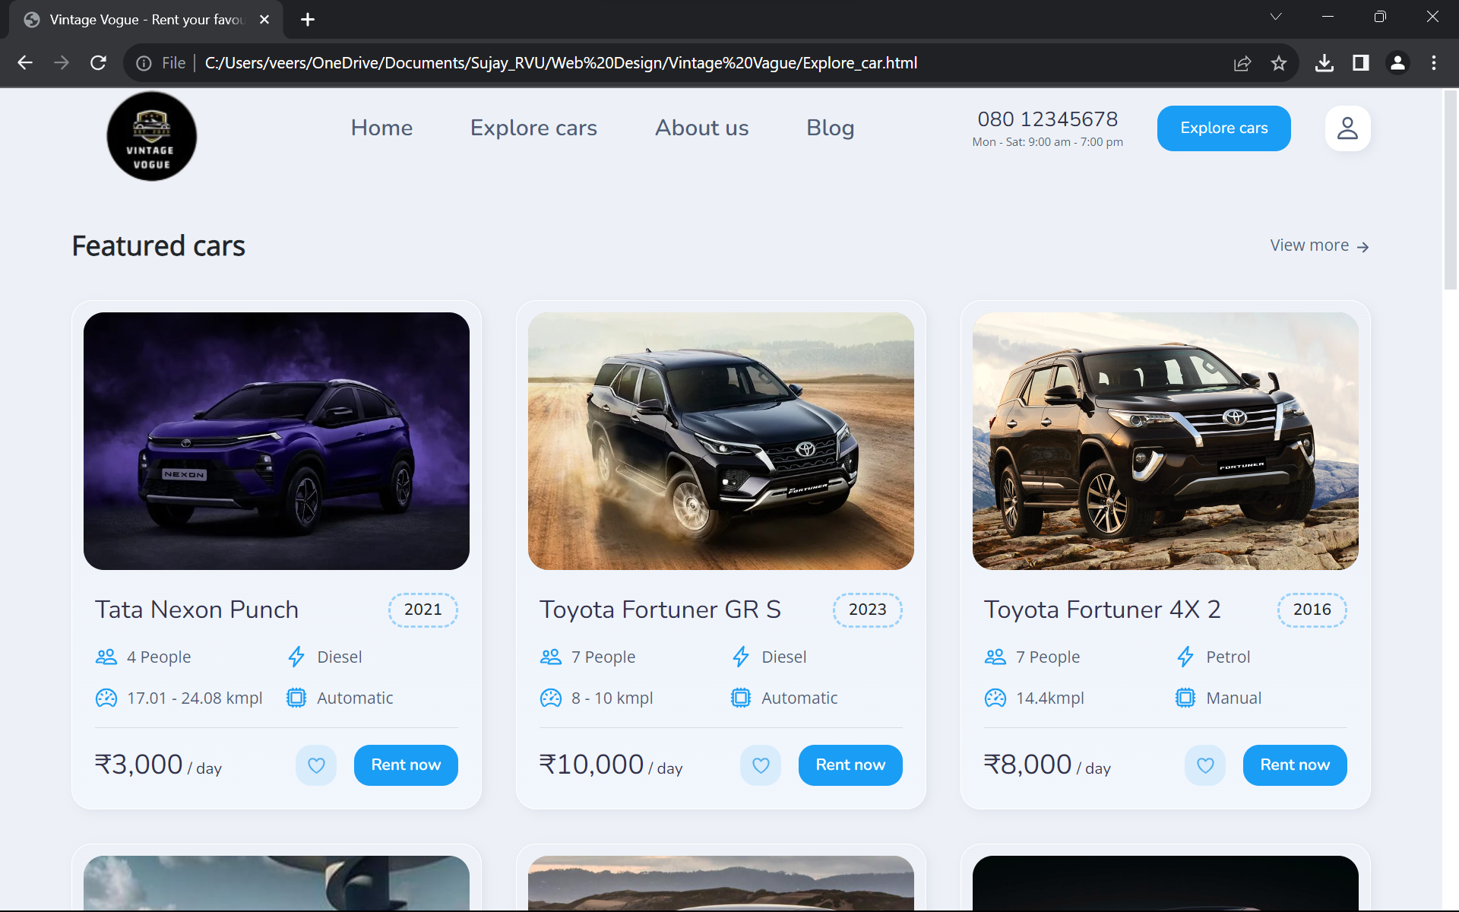
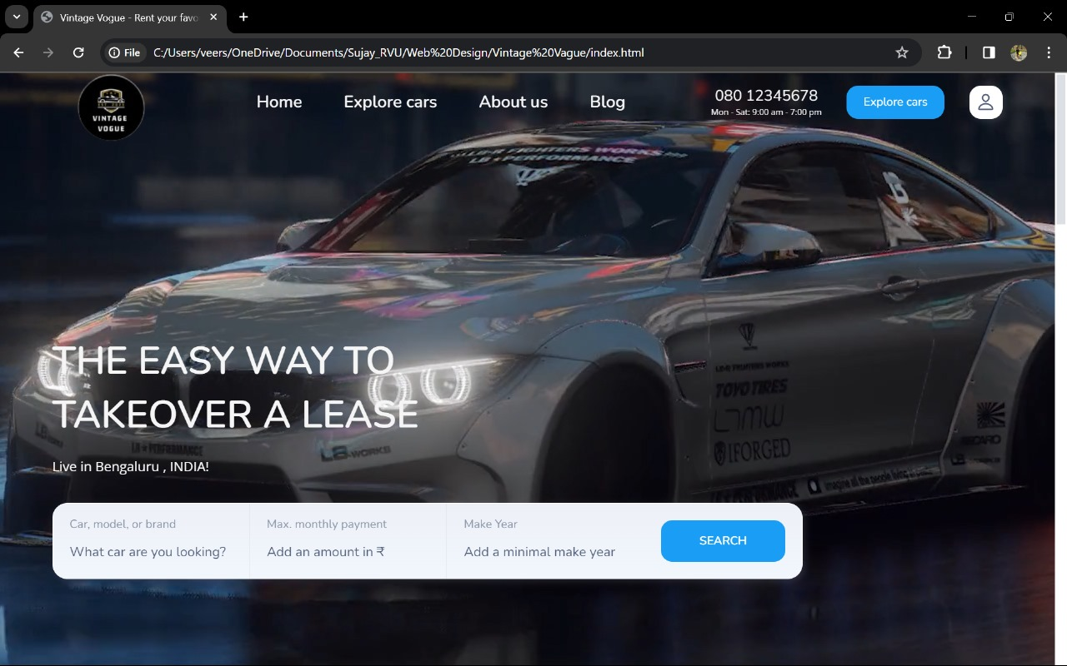

Slide 22
11
Applications

Slide 23
Vehicle Rentals for Travelers: Travelers can use the website to rent vehicles for vacations, business trips, or other travel needs. They can choose from a variety of vehicles based on their preferences and requirements.
Airport Car Rentals: Car rental websites near airports provide a convenient option for travelers arriving by air. Customers can book a vehicle online and pick it up or drop it off at the airport location.
Local Transportation: Residents or visitors in a city can use the website for local transportation needs, such as commuting, running errands, or attending events.
Special Occasions: People can rent vehicles for special occasions like weddings, anniversaries, or other events where they need a specific type of vehicle for a short duration.

Slide 24
12
Conclusion

Slide 25
In conclusion, the development of the car rental website has been a comprehensive and rewarding endeavor. The primary objective of providing users with a seamless and efficient platform for renting cars has been successfully achieved. The project incorporated various essential features, including user authentication, a user-friendly interface, a robust booking system, and integration with payment gateways to facilitate secure transactions.
The website design focuses on enhancing the user experience, with an intuitive navigation system and responsive layouts that ensure accessibility across different devices. The inclusion of a dynamic search functionality, detailed car listings, and clear pricing information contributes to a positive user journey.
The implementation of a secure authentication system ensures that user data is handled with the utmost confidentiality, while the booking system incorporates real-time availability and reservation tracking. Payment integration has been seamlessly embedded, allowing users to complete transactions effortlessly.
Throughout the development process, rigorous testing and optimization were carried out to identify and address potential issues, resulting in a reliable and stable website. Additionally, efforts were made to adhere to industry best practices, ensuring that the website complies with relevant security standards and regulations.
Future enhancements and scalability have been considered in the project, allowing for the incorporation of additional features such as user reviews, loyalty programs, and integration with navigation services.
In conclusion, the car rental website project represents a successful collaboration of design, functionality, and security, providing users with a convenient and trustworthy platform for renting vehicles. The implementation aligns with industry standards, and ongoing maintenance will ensure the website's continued efficiency and relevance in the dynamic car rental market.

Slide 26
13
Future Scope

Slide 27
Integrate it with app
Chat bot for answering of questions
More versatile varieties of car brands

Slide 28
14
References

Slide 29
https://www.researchgate.net/publication/353174644_Car_Rental_System
https://www.sciencegate.app/keyword/1858321

Slide 30
Thank You!

Slide 31
06
Methodology

Slide 32
Table
 | BMW | Audi | Hyundai | Toyota | Tata | Porsche
Sedan | 500 | 300 | 265 | 165 | 450 | 765
Hatchback | 125 | 450 | 765 | 500 | 335 | 335
SUV | 165 | 900 | 500 | 450 | 165 | 165
Venus | 200 | 125 | 165 | 600 | 300 | 500
Compact | 500 | 335 | 450 | 500 | 500 | 265
MUV | 450 | 265 | 600 | 265 | 450 | 450

