Slide 1


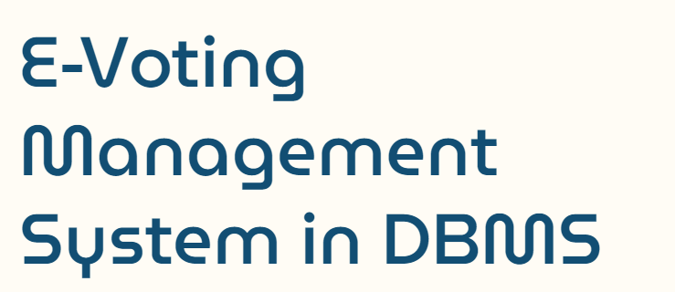
Course Instructor:
Prof. Abidha Vadakkini Purakkal,
SOCSE, RV University, Bangalore
By:
3rd Semester Mini Project
Aniketh Chakravarthy S (1RVU23CSE057)
Anoushka Pandey(1RVU23CSE065)
BHUMIKA G(1RVU23CSE111)
BHUVANA S (1RVU23CSE118)

Slide 2

In a world where technology has become a fundamental part of daily life, traditional election methods are being challenged by inefficiencies, security concerns, and accessibility difficulties. Current election systems frequently require voters to be physically present at voting booths, rely on manual record-keeping, and are susceptible to human error and security breaches. This traditional strategy restricts accessibility and may discourage voter participation, particularly among those in distant areas.
The E-Voting platform aims to develop a safe, transparent, and efficient system that modernises the voting process by utilising digital technology. This technology should allow voters to cast their votes electronically from any place. It must prioritise security and authenticity by enabling only eligible voters to register and vote once, as well as preventing tampering with recorded ballots. Furthermore, it provides real-time election results, increasing transparency and trust in the electoral process.

Slide 3

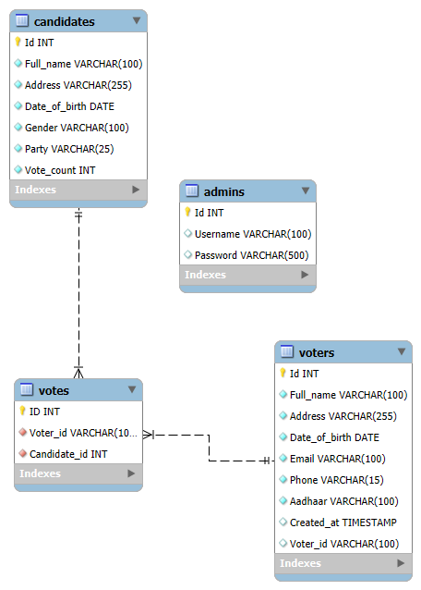

Slide 4
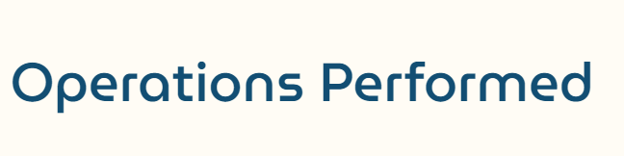

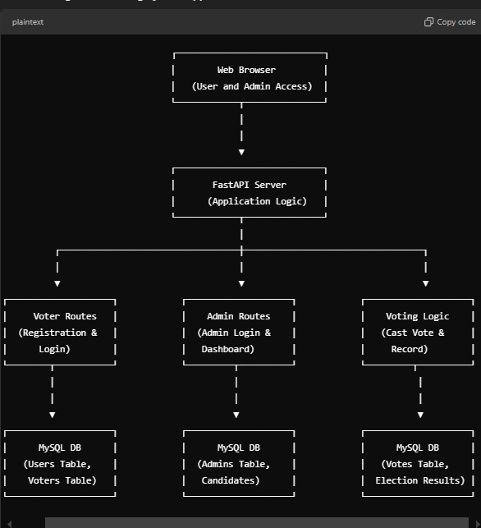


Page routing
Data verification
Data Collection
Website - Frontend
Data Display
Alerting errors
Data Storage
Server –
FastAPI
Data Retrieval
Database

Slide 5

Web Browser (User and Admin Access):
The top-most box represents the interface through which users and administrators interact with the application.
Users and admins can access different routes for specific functionalities, such as voting and admin dashboard management
.
FastAPI Server (Application Logic):
The FastAPI server sits between the web browser and the databases, handling application logic.
It manages the routes (URLs) and handles requests from both users and admins. This server is responsible for processing requests, interacting with the database, and returning responses.
Voter Routes (Registration & Login):
This section contains routes related to voter activities, such as registration and login.
Voters can register themselves in the system, log in, and access functionalities related to voting.
It interacts with MySQL DB (Users Table, Voters Table), where user and voter information is stored
.
Admin Routes (Admin Login & Dashboard):
This section manages routes for administrators, including admin login and dashboard functions.
Admins can log in to the system to manage candidates, view voter information, and oversee the election process.
This section interacts with MySQL DB (Admins Table, Candidates), which stores data related to admins and candidates.
Voting Logic (Cast Vote & Record):
This part of the system handles the core voting functionality, such as casting votes and recording them.
Once a voter logs in and selects a candidate, this module processes the vote and saves it in the database.
It interacts with MySQL DB (Votes Table, Election Results), which records the votes cast by each voter and calculates election results.
MySQL Databases:
Each part of the application interacts with a dedicated MySQL database table(s) for storing data:
  Users Table and Voters Table: Store voter and user information.
  Admins Table and Candidates Table: Store data for administrators and candidates.
  Votes Table and Election Results: Track votes cast and store the results of the election.

Slide 6


