Slide 1
Final project : NBA Who is champion?
2018/6/11
徐翊展 黃軍儒 張育瑄

Slide 2
Introduction
Crawler for NBA
Predict total score by 1st
Find who is champion-like

Slide 3





Flowchart

Slide 4
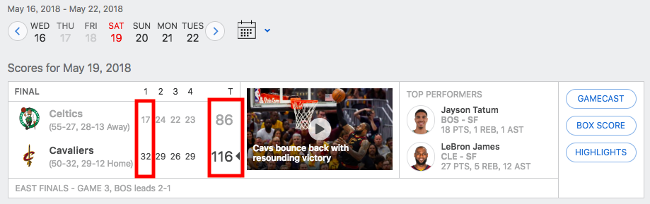
Crawler for NBA
Crawler
BeautifulSoup with Selenium
Focus on postseason
Use recent 3 years history to predict (total 397 samples)

Slide 5
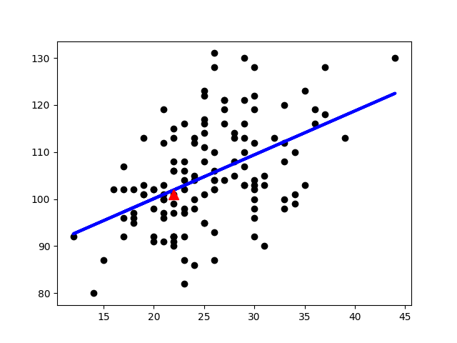
Predict the total score
Regression
Y = 81.41984056687336 + 0.9331266607617353X
when 1st score increase 1 unit, total score will increase 0.9331 units.
Example : f(22) = 101, f(31) = 110
RMSE = 9.5271
There are 9.5721 error in average
compare to real score with this
regression model.

Slide 6
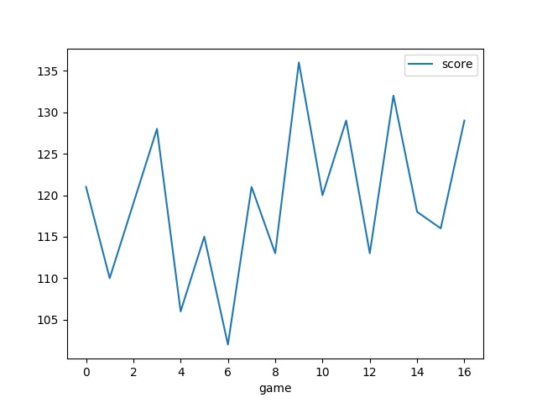
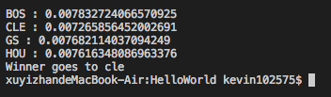
Who is champion ?
Similarity
Find who is most similar to GS in 2017 postseason
by total score time-series plot
Use HOG as feature
Champion is who has the min MSE
GS 2017

Slide 7
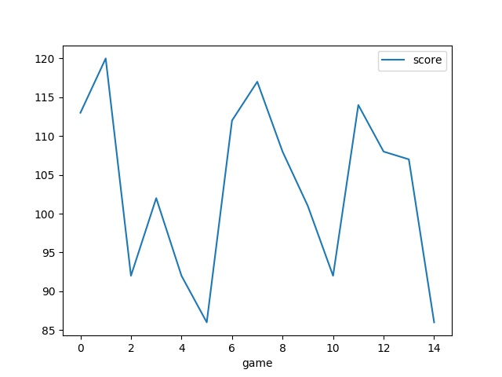
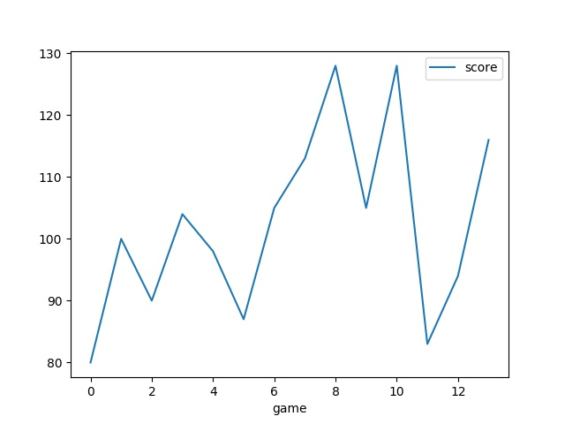
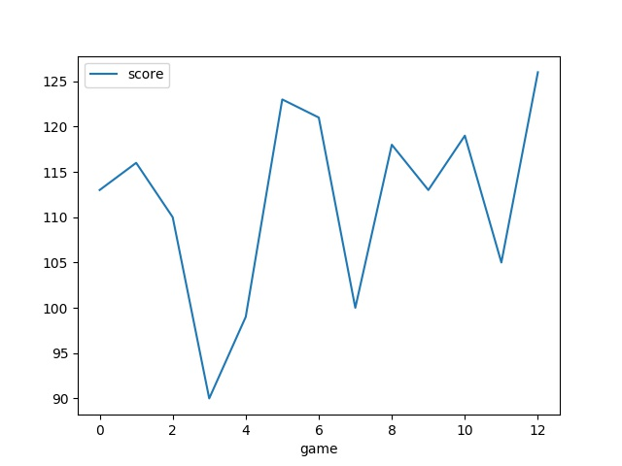
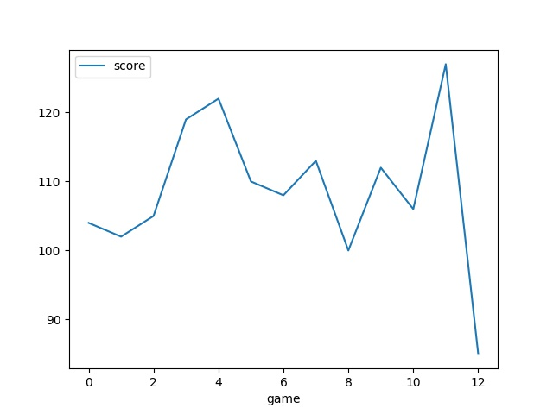
Similarity
BOS
CLE
GS
HOU

Slide 8
Furthermore
Conclusion
This model may use on sport lottery to earn money
Should be add more features to accurate the model.
https://github.com/boom85423/FinalProject

