Slide 1
Working with XML Data
Module 13

Slide 2
Understanding how PowerShell Uses XML
Lesson 1

Slide 3
XML Documents
Examine the example:
Like all XML documents, this one starts with a single top-level node, <computers>. In this example, it contains two child nodes, each named <computer>.
Both <computer> nodes have an attribute, “name,” and each of those attributes has a value.
The <computer> nodes each have two child nodes, <biosserial> and <osversion>.
XML nodes, or tags, come in pairs. There will be an opening tag, like <computer>, and a corresponding closing tag, like </computer>. Tags with no content may be presented as singleton or self-closing tags, like <biosserial />.
The contents of a node are nested entirely between its opening and closing tag; nodes do not overlap. For example, <computers><computer></computers></computer> would be incorrect, because the tags do not close in the proper order.

Slide 4

Reading XML
Windows PowerShell has its own Import-CliXML and Export-CLiXML cmdlets, which read and write a specific kind of XML. We want to work with our own XML format (technically called an XML application), so we need something other than the –CliXML cmdlets.
[xml]$xml = Get-Content C:\computers.xml
Cast the $xml variable as the [xml] data type.

Slide 5
Creating an XML reading tool
Examine the example.
This function will either accept text in the pipeline, or a filename. So, you can run it using either of these two commands:
Get-Content c:\computers.xml |
Get-ComputerNamesFromXML
Get-ComputerNamesFromXML –FileName c:\computers.xml

Slide 6
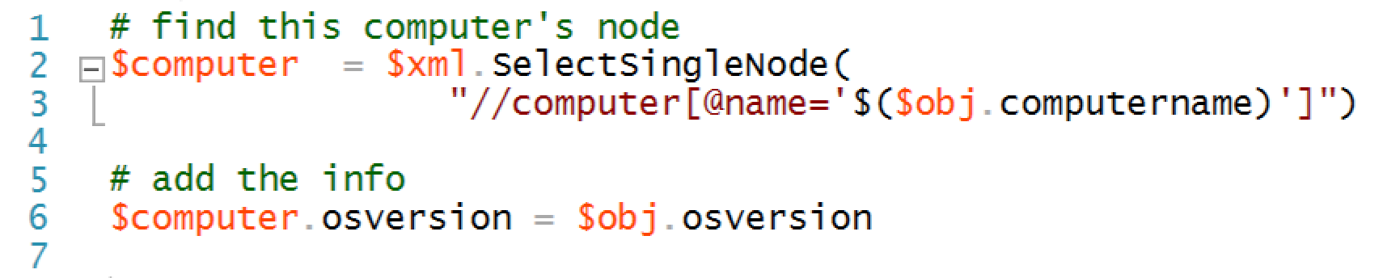
Modifying XML Nodes
Examine the example.
The magic is in these two lines:

Slide 7
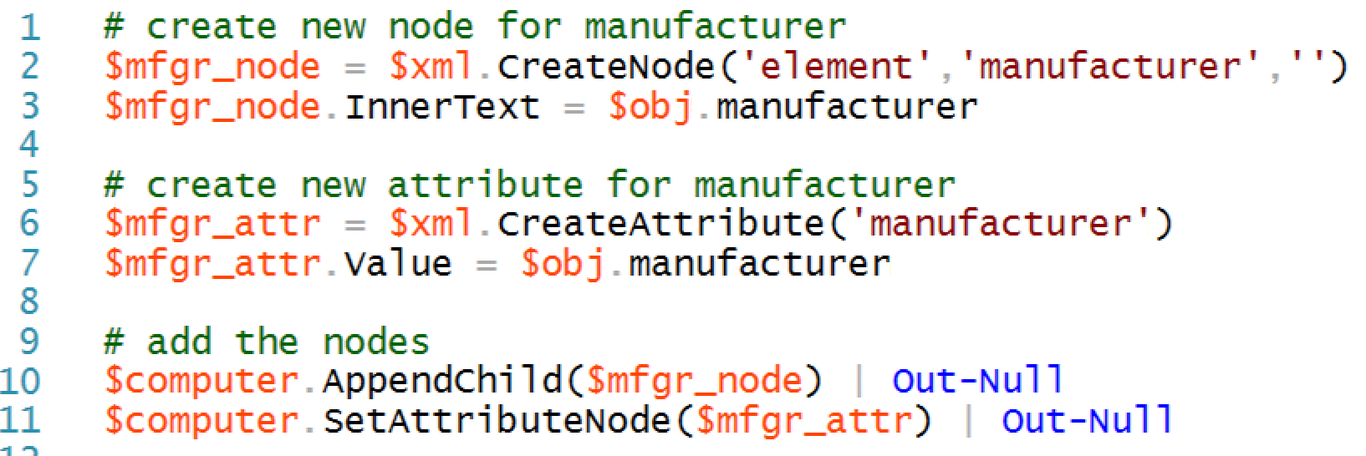
Adding XML Attributes and Nodes

Slide 8


Lab A
45 Minutes
CLIENT
MEMBER
DC
Administrator P@ssw0rd

Slide 9
Conclusion
You’ve just seen yet another way that reusable tools are flexible, valuable assets in an organization. Because your tools don’t care here their input comes from, they can be extended to accept input from nearly anyplace, and to have their output utilized in almost any fashion.
You created additional tools to consume and create XML in this module, and paired them with your existing tools to create an effective management system.

