Slide 1
Windows PowerShell Scripting & Toolmaking
Byron Hynes
byron.hynes@globalknowledge.com byron@hynes.ca https://www.linkedin.com/in/byronhynes/

Slide 2
Student Introduction
Get ready to tell us a bit about you, your job role and your experience is with PowerShell
Most importantly, share what you hope to gain this week
When I call on you, you can speak on mic, or you can past a message in the chat window.
Notes:
Ask students to introduce themselves and provide their backgrounds, product experience, and expectations of the course.
Record student expectations on a whiteboard or flip chart that you can reference during class.
10961B
00: Introduction

Slide 3
About This Course
Audience
Course Prerequisites
Course Objectives
What You Can Expect
Notes:
10961B
00: Introduction

Slide 4
What about me?
Microsoft Certified Trainer (MCT) for 25 years
Worked lots of places, including five years at Microsoft in Windows Server and EPG.
Now, spend my time doing:
Teaching like this
Design and support for real-world clients
Content creation (writing, videos)
Occasional development projects (usually data)
Other projects in a “blended career” in entertainment, events and management coaching.

Slide 5
Facilities
Class hours
8:30 to 4:30 Eastern Time (Instructor is in Mountain, students from all over)
Breaks
Around 10:15 am for 15 minutes
Around 12:00 pm for an hour “lunch” break
Around 3:00 pm for 15 minutes
Notes:
Add any local information specific to your classroom, such as emergency situations.
10961B
00: Introduction

Slide 6
Course Material
Retrieve your unique course material code from the Training Materials tile in your MyGK logon for this course
Register your code on Skillpipe.com
We will be using the “A” version of this course, NOT the “B” version
Do NOT use the lab steps in the Skillpipe course material. The lab steps have been customized to our lab environment.
A custom lab manual is located under the “Content” tab of your lab interface. The file is: 55039AC-GK-Custom-LabManual.pdf
Notes:
10961B
00: Introduction

Slide 7
Zoom, Skillpipe and Learn-On-Demand
Introducing our Student Advocate
Zoom refresher
Courseware Access
Lab Access
How to get help
Global Knowledge / SkillPipe
Learn-On-Demand
Chat with one of us (note that I may not notice chat immediately… mic use allowed! Encouraged even!)
I am happy to “go to bat” to get help for you – but often just as effective for you to open a ticket.

Slide 8
Outline
Module 1: Preparing for Scripting
The Scripting Environment
Review of the Powershell Language
Module 2: Parameterizing a Command
Making Scripts “generic” with parameters
Module 3: Script and Manifest Modules
Module 4: Handling Errors
Module 5: Using Pipeline Input and Output
Module 6: Creating Hierarchical Command Output
Complex Output and Object Hierarchies
Module 7: Debugging
Module 8: Customizing Default Formatting
Notes:
Welcome students to the course and introduce yourself. Provide a brief overview of your background to establish credibility. Use the next slide for students to introduce themselves.
10961B
00: Introduction

Slide 9
Outline (cont.)
Module 9: Advanced Parameters and Documentation
Module 10: Creating Controller Scripts
Module 11: Creating HTML Reports
Module 12: PowerShell Workflow
Module 13: Working with (XML) Data
XML, with a splash of CSV, and JSON
Module 14: Proxy Functions
Module 15: PowerShell Toolmaking
Open Lab – Create a tool from a “functional spec”
Notes:
Welcome students to the course and introduce yourself. Provide a brief overview of your background to establish credibility. Use the next slide for students to introduce themselves.
10961B
00: Introduction

Slide 10
Outline (cont.)
Optional Topics for Friday
Reading and writing SQL
Working with passwords for scripts
“Better” Editors and debuggers
Unit Testing
Compiling scripts into executables
Semi-Automatically translating C# to PowerShell and back
Profiles and automatic loading
Using UI Elements like Winforms/WPF
Notes:
Welcome students to the course and introduce yourself. Provide a brief overview of your background to establish credibility. Use the next slide for students to introduce themselves.
10961B
00: Introduction

Slide 11
Student Intro’s
Please, tell us your name (Correct any errors, typos or mis-pronounciations)
What do you do for work?
How do you use or want to use PowerShell?
What do you need or want from this course?
Fun bits of trivia about you (inside or outside of work) are also welcome (but optional).

Slide 12
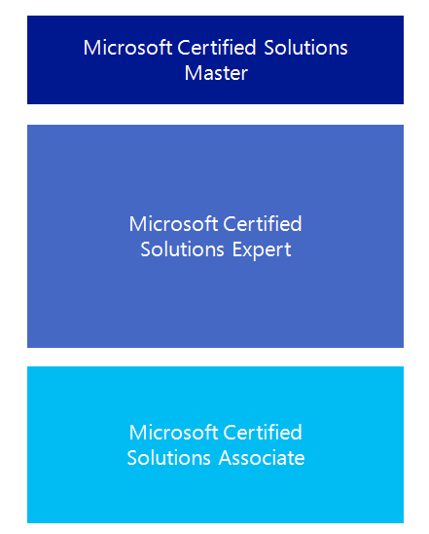

Microsoft Certification Program
Get trained. Get certified.
Get ahead.
There is no specific PowerShell certification available from Microsoft. However, many of the certification exams do have PowerShell related questions that you will need to answer.
Visit the following site for more detail on certifications:
http://www.microsoft.com/learning/
certification
Notes:
This course does not have a direct mapping to any exam. However, while there is not a standalone Windows PowerShell exam the topics are covered across all the individual Microsoft Certified Solutions Associate (MCSA) and Microsoft Certified Certified Solutions Expert (MCSE) exams. This course will help prepare the student for Windows PowerShell related concepts and processes within those exams.
10961B
00: Introduction

Slide 13
Virtual Machine Environment
Virtual Machine Name: | Use as:
Alpha | Windows Server 2016 full edition domain controller and DHCP server for the hq.local domain.
Bravo | Windows Server 2012 R2 full edition member server in the hq.local domain.
Echo | Windows 10 client computer and in the hq.local domain with Remote Server Administratin Tools (RSAT) installed. (You should perform ALL of your lab steps from Echo, unless otherwise instructed.)
Lab Manual | Once you launch the lab instance, You will find the lab manual under the “Content” tab in the upper right corner of the screen. The file is: 55039AC-GK-Custom-LabManual.pdf (Do NOT use the lab steps in the Skillpipe course material. Our lab steps have been customized to our lab environment.)
Notes:
10961B
00: Introduction

Slide 14
Additional Lab Notes
Follow the lab manual in the lab machine, not the books! It’s a PDF. Download it and put it on a tablet, laptop or second screen for easiest use.
The lab machines run older versions of Windows. The labs work fine, but to go outside the lab, you may need to update Windows. YMMV.
You have lab access for a year.
You can run the lab scripts on any PowerShell computer, changing computer names.
The instructor (me) can see your lab screen, and may share it with the class during Q&A.

