Slide 1
Script and Manifest Modules
Module 03

Slide 2
Creating a Manifest Module
Lesson 1

Slide 3
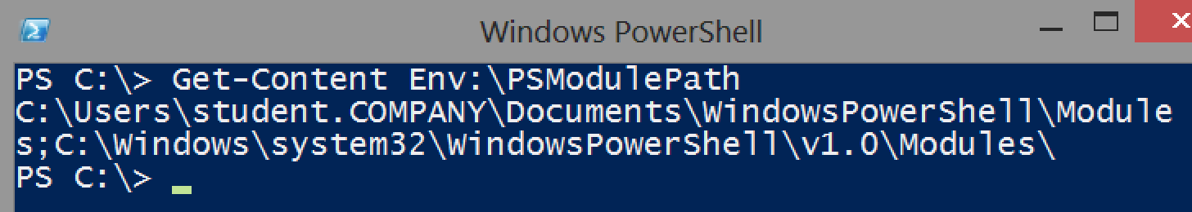
Module location
In order for PowerShell to fully utilize them, modules must live in a specific location.
PSModulePath environment variable defines those permitted locations.

Slide 4
Module name
Module names should consist of letters, numbers, and underscores, although Microsoft-provided modules tend to be named only with letters.
Don’t use module names that contain spaces.
The folder must be created in one of the paths listed in PSModulePath.

Slide 5
Module contents
When you run Import-Module, or when PowerShell attempts to automatically load a module, the shell looks in your module folder for one of these items:
A module manifest, such as MyTools.psd1. Note that the filename must match the name of the module’s folder, MyTools.
A binary module, which in our example would be MyTools.dll, if we were using a compiled binary.
A script module, such as MyTools.psm1. The filename must be the complete module name, exactly as the module’s folder is named, plus the .psm1 filename extension.
Note: References to “MOL” or “MolTools” are leftovers from the original course name “Month of Lunches”

Slide 6
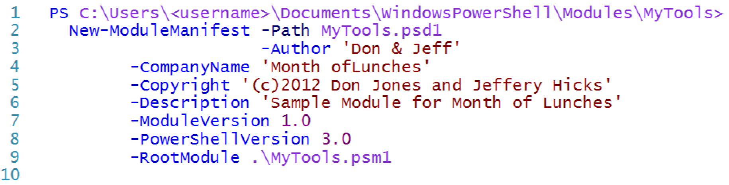
Creating a module manifest
Create a module manifest using New-ModuleManifest and providing the information needed using the command’s parameters.

Slide 7
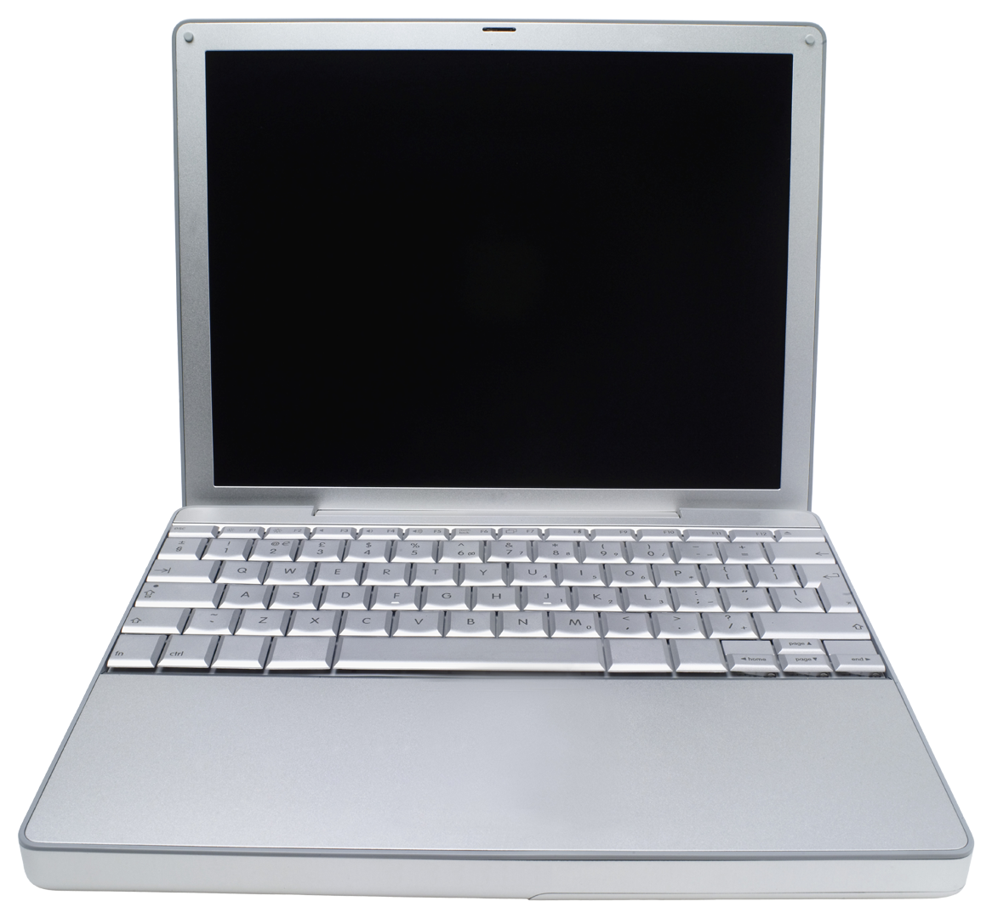

Lab A
30 Minutes
CLIENT
MEMBER
DC
Administrator P@ssw0rd

Slide 8
Conclusion
You’ve turned your script into a manifest module, which will provide us with the framework for expansion, easier testing, and packaged distribution.
Next, you’ll begin working with error handling.

