Slide 1
Preparing for scripting
Module 01

Slide 2
overview
Lesson 1

Slide 3
What is toolmaking?
A word borrowed from the machining industry, meaning “someone who makes tools used by others.”
Tools don’t necessarily know the context in which they are being used
A hammer can build a house, fix a wooden boat, or even smash in a window.
Tools are often “black boxes,” requiring little knowledge about their inner workings if you want to use them

Slide 4
Is this course for you?
You should be a skilled and confident IT administrator – this class will not teach you those skills.
You should have a strong background as a Windows PowerShell tool user – running commands in the console.
A background in a scripting or programming language will be very helpful.

Slide 5
Prerequisites
PowerShell v3
Execution policy allowing script execution
Admin privileges on your computer
Ideally, multiple computers to test tools against
Lab environment:
CLIENT – Windows 8 in the COMPANY domain
DC – Windows Server 2012 domain controller
MEMBER – Windows Server 2012 member server
Administrator password is P@ssw0rd on all computers

Slide 6
Preparing the scripting environment
Lesson 2

Slide 7

PowerShell’s execution policy
Designed to…
Slow down…
An uninformed user…
From accidentally…
Running an untrusted script
RemoteSigned or Unrestricted is recommended
Read about_signing in the shell for more information on script signing

Slide 8
Running Scripts
Click the green “play” icon (or press F5) to run scripts in the ISE
When running a script, you must provide a path, either absolute or relative.
Note: PS1 is used in PowerShell 1.0, 2.0, and 3.0; the 1 refers to the language engine version.

Slide 9
Editing Scripts
Don’t use Notepad!
PowerShell v3 comes with the Integrated Scripting Environment (ISE)
Offers IntelliSense parameter and command completion
Live syntax checking
Color coding
Brace matching
There are also commercial (paid and free) editors you can choose

Slide 10
Understanding variables and operators
Lesson 3

Slide 11


What are variables?
X
$X
The variable name is X
$X refers to the variable contents

Slide 12
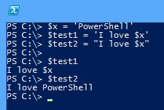
Quotation marks

Slide 13
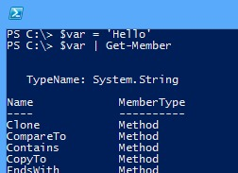
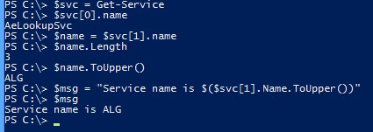
Object members and variables

Slide 14

Parentheses

Slide 15
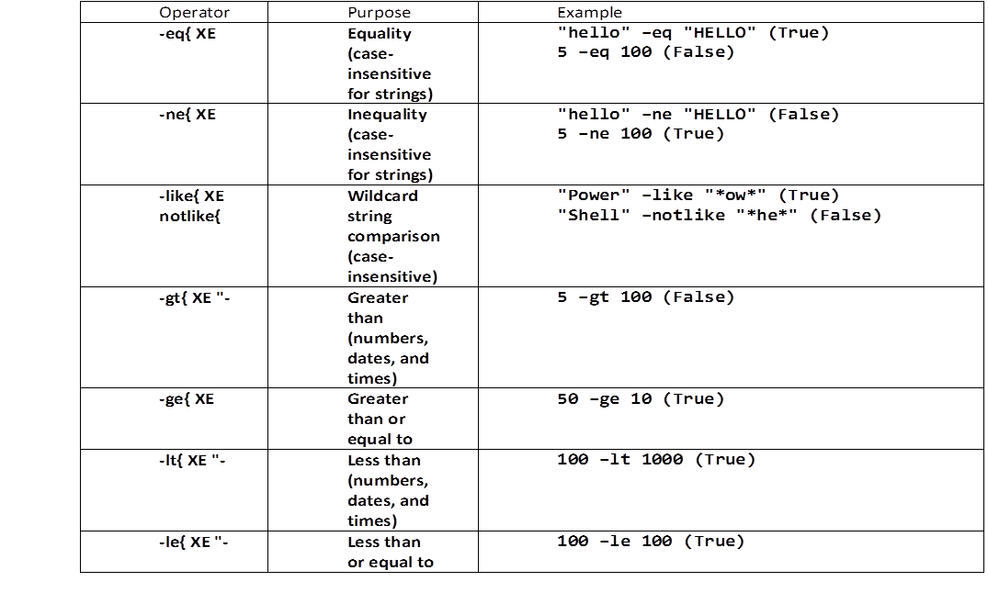
Comparison operators

Slide 16
Understanding scripting constructs and scope
Lesson 4

Slide 17
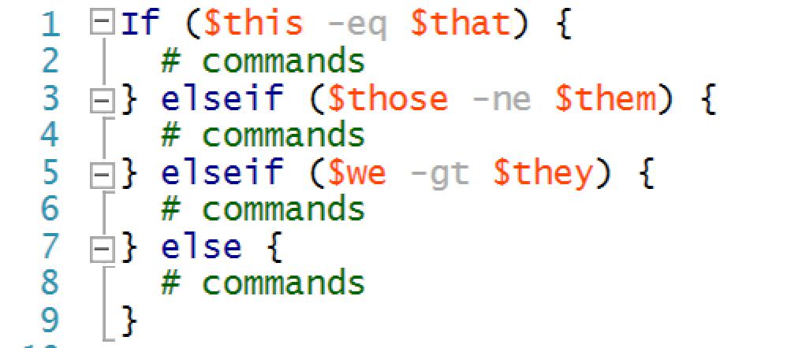
If…ElseIf…Else
Logical constructs are used to make decisions and to execute different commands based on the outcome of that decision.

Slide 18
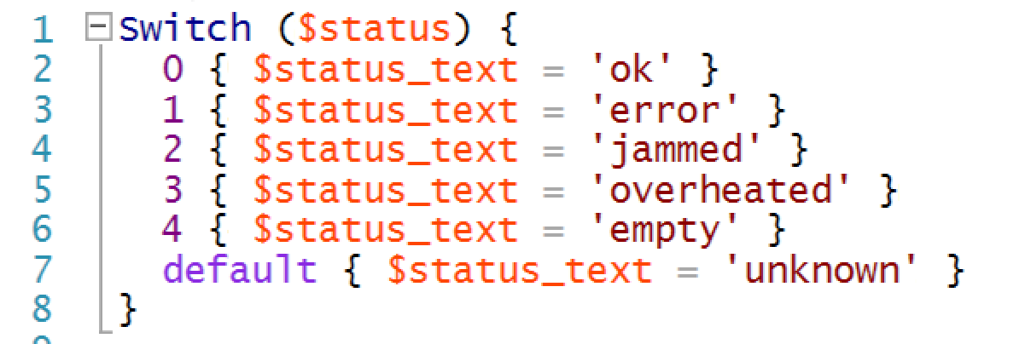
Switch construct
The Switch construct examines a single object, often contained in a variable, and compares it to a number of possible values.

Slide 19
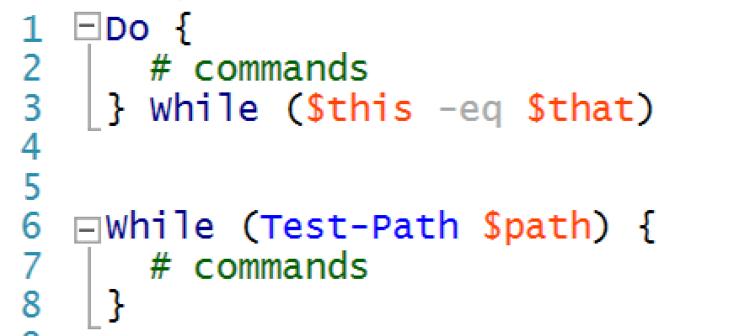
Do…While
This is a primary looping construct in PowerShell. It’s designed to repeat a block of commands so long as some condition is True or until a condition becomes True.

Slide 20
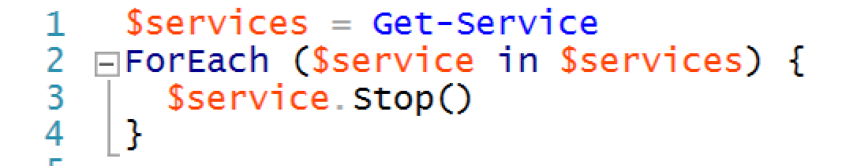
ForEach construct
This construct is similar in operation to the ForEach-Object cmdlet and differs only in its syntax.

Slide 21
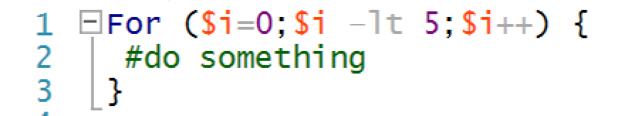
For construct
The For construct is designed to execute the construct’s contents a specific number of times.

Slide 22
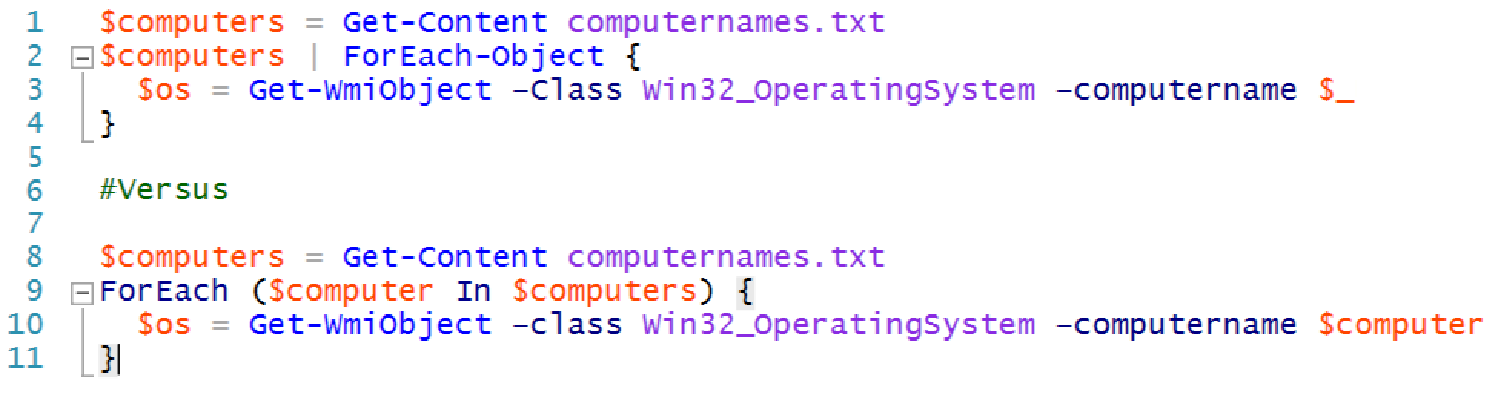
Pipelines vs. Script constructs
PowerShell often gives you several different ways to accomplish the same thing. That does not, however, mean that all ways are exactly the same.
Once you start building a complete script you should really commit fully to the scripting language.

Slide 23
What is scope?
Scope is a system of containerization. In some senses, it’s designed to help keep things in PowerShell from conflicting with one another.
Scope is a way of building walls between and around different scripts and functions, so that each one has its own little sandbox to play in without fear of messing up something else.
There are several elements within PowerShell that are affected by scope:
Variables
Functions
Aliases
PSDrives
PSSnapins

Slide 24
Conclusion
This module was intended to provide a brief overview of key scripting language elements and the shell’s scripting environment.
Variables
Operators
Scripting constructs
Scope

