Slide 1
Parameterizing A Command
Module 02

Slide 2
Designing Parameters
Lesson 1

Slide 3
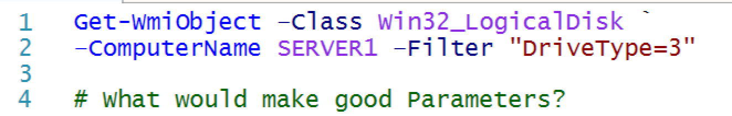
Changeable information
Parameters usually represent changeable information – that is, items that will be different each time a script is run.

Slide 4
Creating a Parameterized Script
Lesson 2

Slide 5

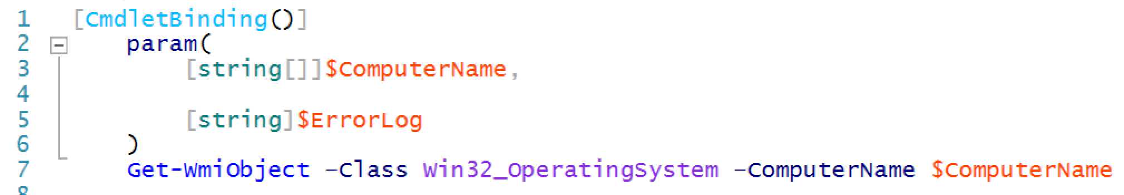
Best practices
Param() block is preceded by [CmdletBinding()].
Declare a data type for each parameter.
The parameters are a comma-separated list.
Notice that we indented the contents of the Param() block.

Slide 6
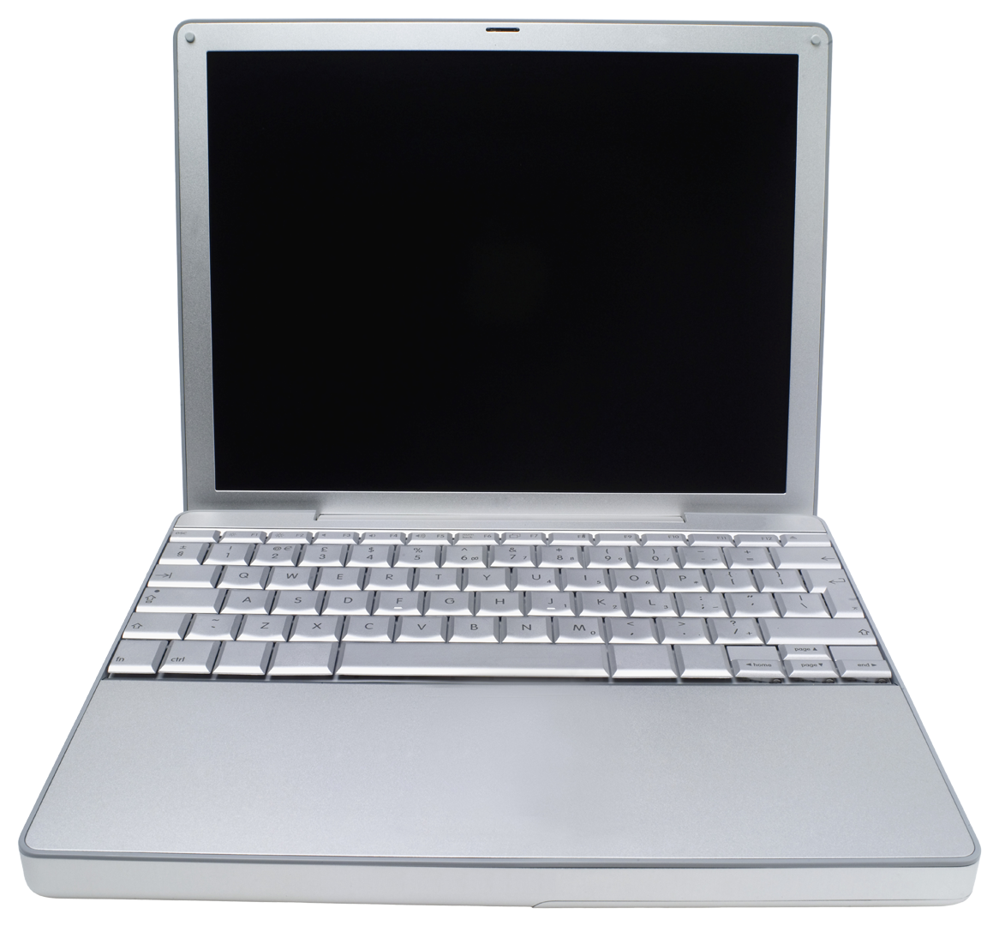

Lab A
30 Minutes
CLIENT
MEMBER
DC
Administrator P@ssw0rd

Slide 7
Creating a Parameterized Function
Lesson 3

Slide 8
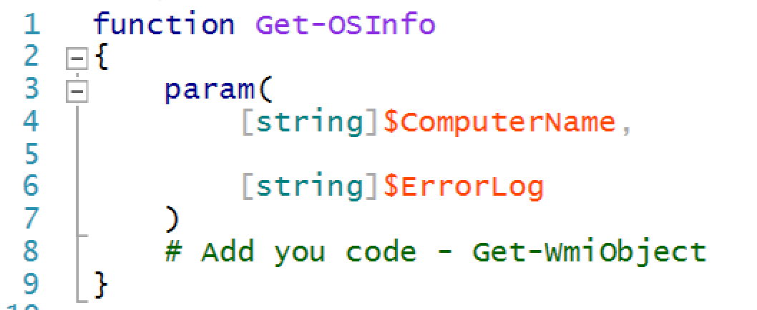
Parameterizing a function
Give the function itself a cmdlet-style, verb-noun name.
Dot source to test - . .\tools.ps1
Call within the script - Get-OSInfo –computername SERVER2

Slide 9
Lab B
15 Minutes
CLIENT
MEMBER
DC
Administrator P@ssw0rd

Slide 10
Conclusion
You’ve learned to take a working command and turn it into a parameterized function, which is the basic building block for all script-based tools.
In the next module, we’ll start formalizing that script’s structure into something that will be more easily distributed, tested, and expanded.

