Slide 1
Creating Controller Scripts
Module 10

Slide 2
Designing Controller Scripts
Lesson 1

Slide 3

Controller Scripts for Processes
A controller script does all the things that a tool does not.
A controller script may well display user interface elements, like dialog boxes or menus.
Controller scripts will not often use cmdlet-style, verb-noun file names. Instead, their filenames should clearly reflect what they do, such as “Provision New User.ps1.”
Controller scripts should clearly document their dependencies, and should explicitly import whatever modules they require.
See example for simple controller script.

Slide 4
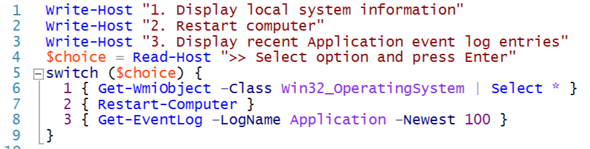
Controller Scripts for User Interface
Other controller scripts may be primarily intended to present a user interface to less technical users, who might not be comfortable running tools directly.

Slide 5
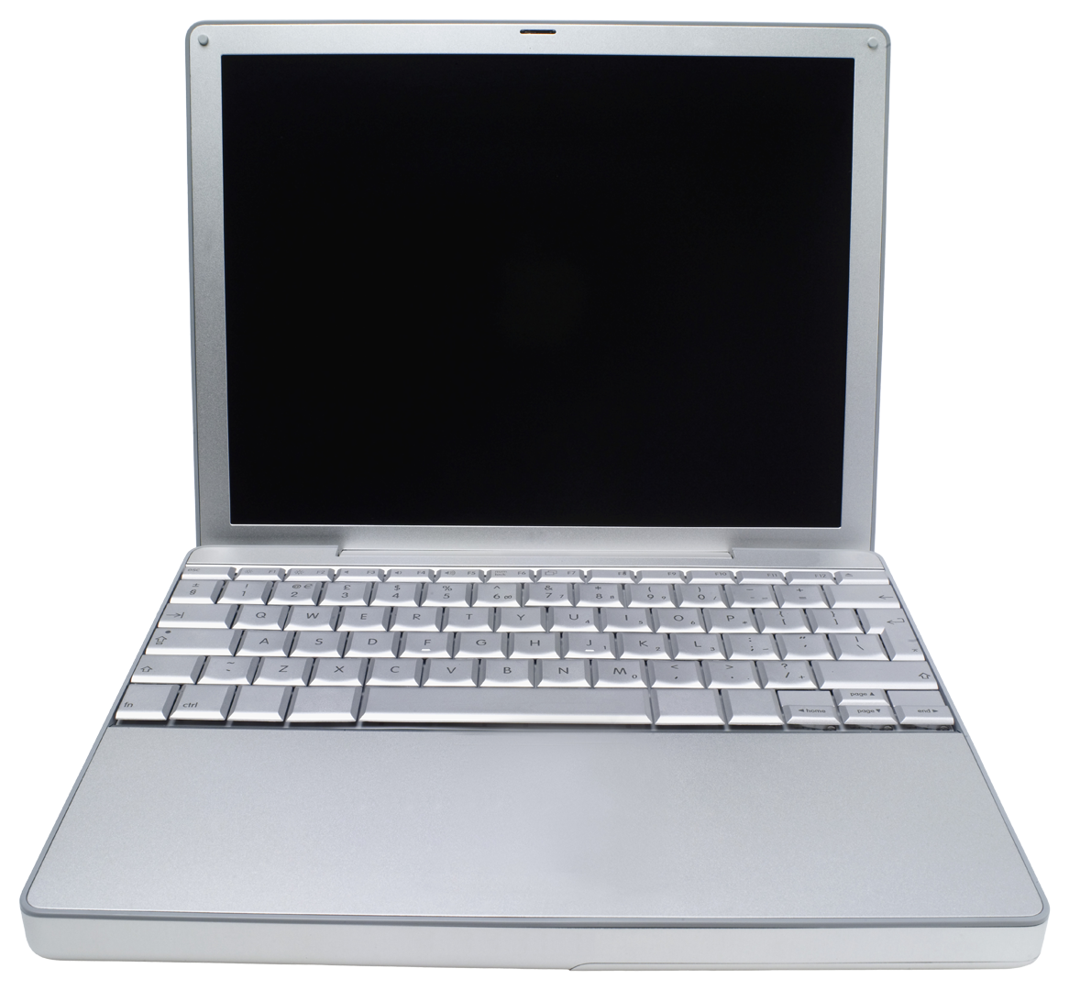

Lab A
30 Minutes
CLIENT
MEMBER
DC
Administrator P@ssw0rd

Slide 6
Conclusion
Controller scripts help complete your arsenal of automation capabilities. They let you leverage the reusable, parameterized tools that you’ve already learned to create.
Controller scripts can be used to provide an appropriate user interface for your tools, or to sequence multiple tools in a complex business process.
In the next module, you’ll learn about a specialized kind of controller script used to create management reports.

