Slide 1
Handling Errors
Module 04

Slide 2
Designing Error Handling
Lesson 1

Slide 3

$ErrorActionPreference
Whenever a PowerShell command encounters a non-terminating error, it checks a built-in variable $ErrorActionPreference.
Continue - This is the default. Displays the error and keeps running.
SilentlyContinue – Keeps running however does not display an error.
Stop – Displays an error and stops executing.
Inquire – Prompts you what action to take.

Slide 4
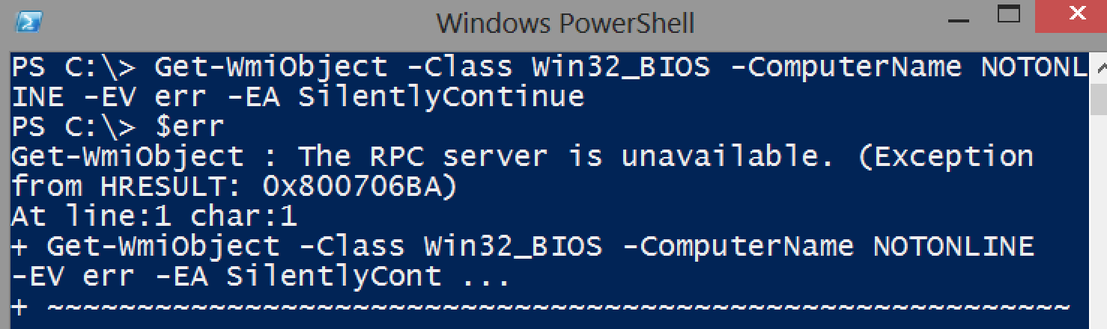
Setting the error action & variable
–ErrorAction, which can be abbreviated as –EA.
–ErrorVariable, which can be abbreviated as –EV.

Slide 5
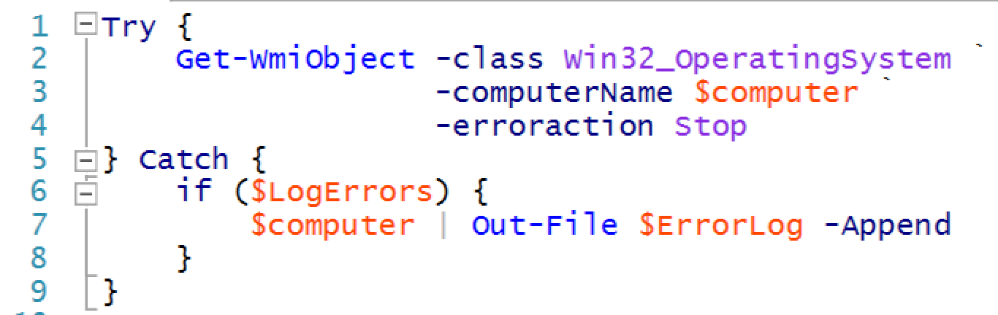
Try…Catch…Finally
Introduced in PowerShell v2, this is the real way to do error handling.

Slide 6
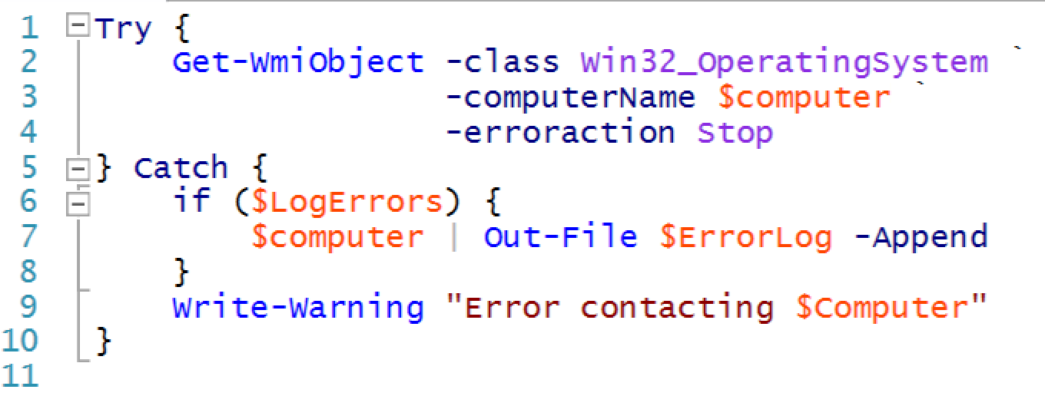
Providing some visuals
Your error handling should display a user readable error message as in line 9.

Slide 7


Lab A
60 Minutes
CLIENT
MEMBER
DC
Administrator P@ssw0rd

Slide 8
Conclusion
You’ve learned functions to deal with anticipated errors, using standard PowerShell patterns and practices.
Next it will be time to implement even more standardized patterns and practices, by having your commands fully participate in the PowerShell pipeline.

