Slide 1
Customizing Default Formatting
Module 08

Slide 2
Designing Formatting
Lesson 1

Slide 3

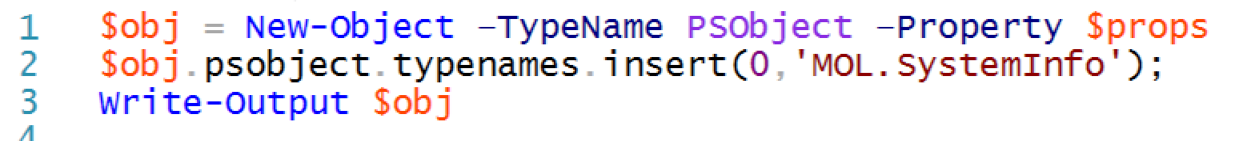
Adding a type name to output objects
Views are triggered by the type name of the object they display.

Slide 4
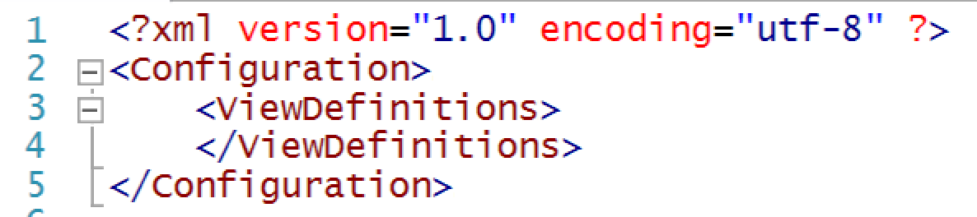
Making a view
Every view file must start out with this information, and within the <ViewDefinitions></ViewDefinitions> section.
Save the file with a .ps1xml extension.
Add additional required tags.

Slide 5
Loading and debugging the view
View files have to be loaded into memory within each new shell session using Update-FormatData.
Column headers must match column properties:
PS C:\> Update-FormatData -PrependPath C:\test.format.ps1xml
Update-FormatData : There were errors in loading the format data file:
C:\test.format.ps1xml, Error at XPath
/Configuration/ViewDefinitions/View[1]/TableControl in file
C:\test.format.ps1xml: Header item count = 6 does not match default row item count = 5.

Slide 6
Adding a view to a module
Views can automatically load as part of a module.
Copy the view file to the module’s folder.
Re-create the module’s manifest (.psd1 file) and include the -FormatsToProcess parameter of New-ModuleManifest.
This parameter accepts the filename of your view file, and will cause the view file to load along with the module.

Slide 7
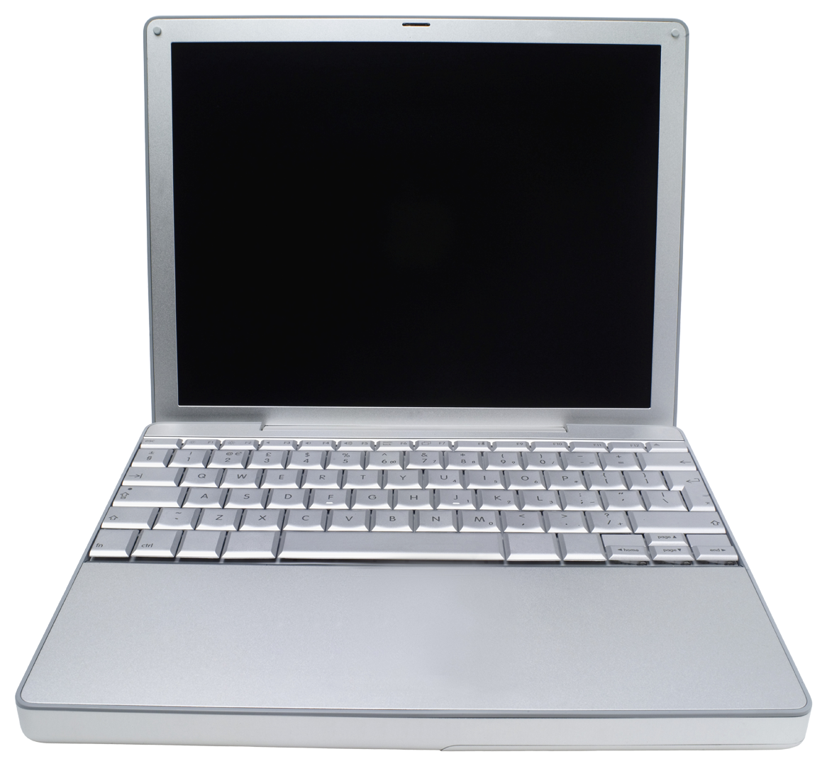

Lab A
60 Minutes
CLIENT
MEMBER
DC
Administrator P@ssw0rd

Slide 8
Conclusion
Custom formatting adds a true level of professionalism to the tools you write, but still gives your tools’ users the ability to convert, filter, export, sort, and even to override your formatting when needed. You’re truly working like a “real” cmdlet!

