Slide 1
PowerShell Workflow
Module 12

Slide 2
Understanding Workflow
Lesson 1

Slide 3
Common parameters for workflows
The workflow keyword adds a large set of built-in common parameters. Here are some:
-PSComputerName—A list of computers to execute the workflow on
-PSParameterCollection—A list of hash tables that specify different parameter values for each target computer, enabling the workflow to have variable behavior on a per-machine basis
-PSCredential—The credential to be used to execute the workflow
-PSPersist—Force the workflow to save (checkpoint) the workflow data and state after executing each step (we’ll show you how you can also do this manually)

Slide 4

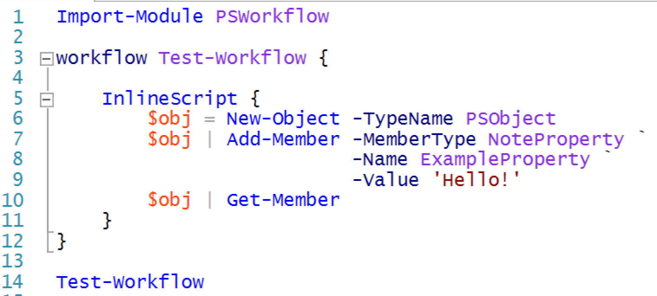
Activities and stateless execution
Workflow is built around the concept of activities.
See examples

Slide 5
Persisting state
The state of a workflow consists of its current output, the task that it’s currently executing.
It’s important that you help workflow maintain this state.
Run the Checkpoint-Workflow command.

Slide 6
Inherently remotable
Workflows are designed from the ground up to be remoted.
All workflow commands get a –PSComputerName parameter automatically.
PowerShell connects to the remote computers via Remoting (which must be enabled).
Remote computers run the workflow using their local resources.
Remote computers must also be running PowerShell 3.0.

Slide 7
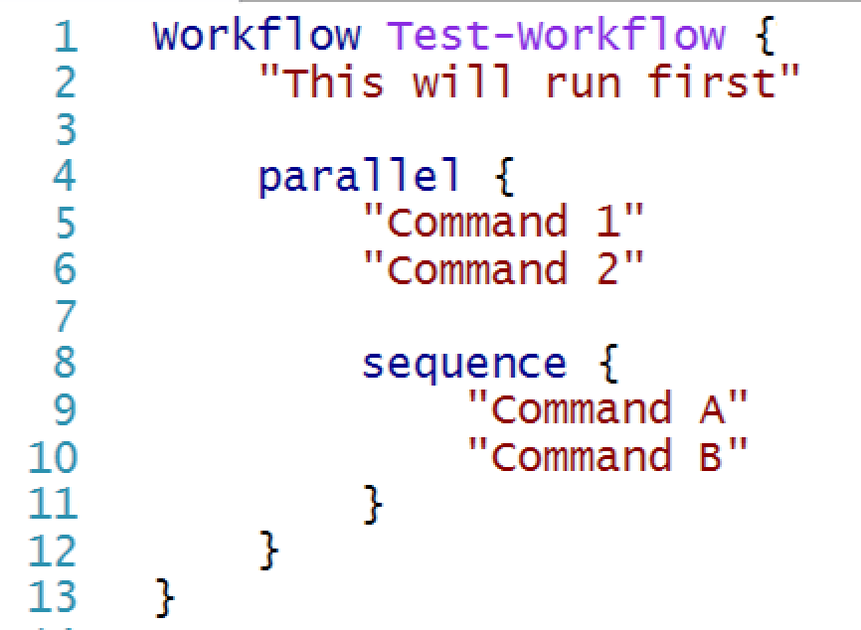
Parallelism
Windows workflow is designed to execute tasks in parallel.

Slide 8
General workflow design strategy
It’s important to understand that the entire contents of the workflow get translated into WF’s own language, which only understands activities.
Most of PowerShell’s built-in commands—the ones available before any modules have been imported—work fine.
That isn’t the case with add-in modules.
The solution is to think of a workflow as a high-level task coordination mechanism.

Slide 9
Example workflow scenario
Examine – Writing the workflow
Examine – Workflows vs. functions

Slide 10
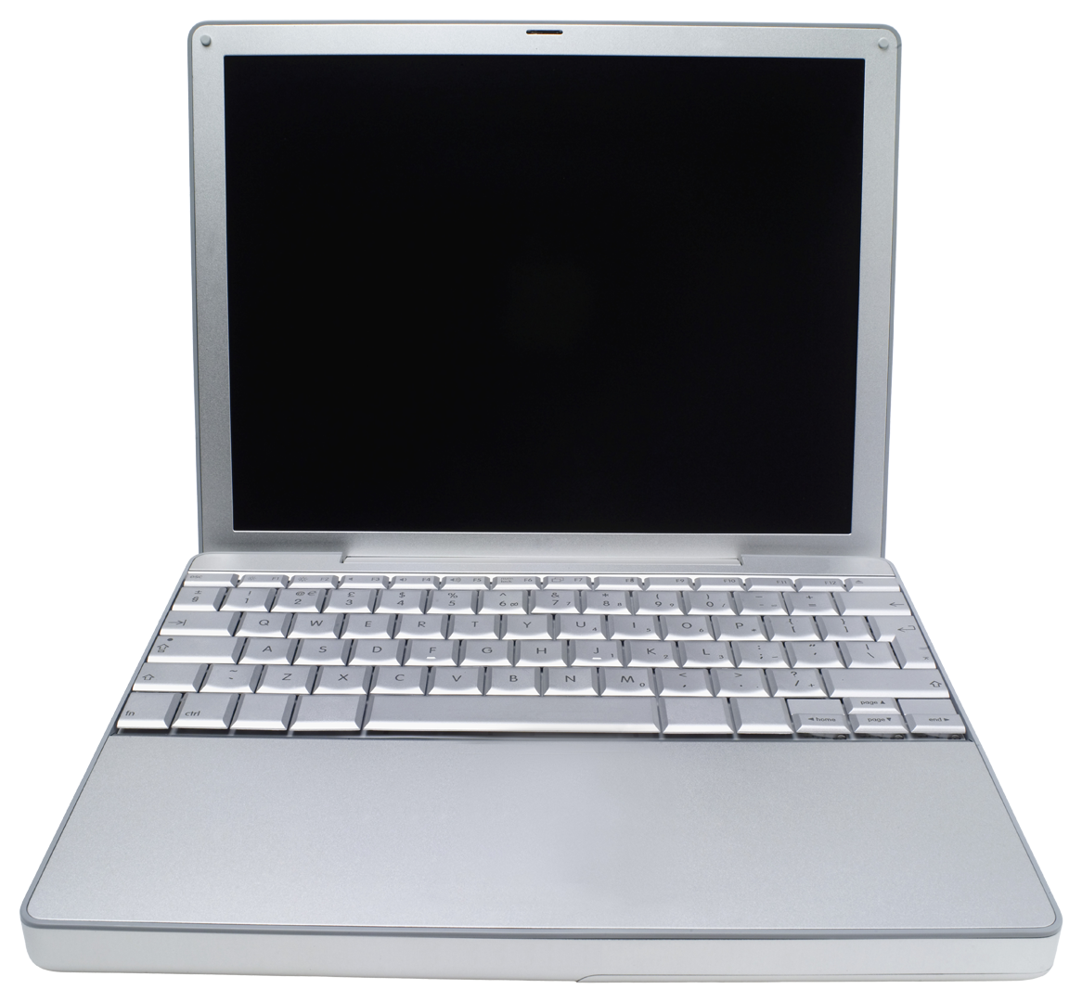

Lab A
45 Minutes
CLIENT
MEMBER
DC
Administrator P@ssw0rd

Slide 11
Conclusion
Workflow is a complex topic. Keep in mind that workflow isn’t the same as PowerShell; PowerShell simply provides a script-like way of writing workflows, and what you type in PowerShell is translated under the hood to workflow.
That means workflows are pretty different, and it takes a lot of time and practice to really use them effectively.

