Slide 1
Windows PowerShell Scripting and Toolmaking

Slide 2
Student Introduction
In the chat window, prepare a message about your job role and what your experience is with Windows and PowerShell or other programming
Be ready to post the message when I call on you
Notes:
Ask students to introduce themselves and provide their backgrounds, product experience, and expectations of the course.
Record student expectations on a whiteboard or flip chart that you can reference during class.
10961B
00: Introduction

Slide 3
Facilities
Class hours
8:30 to 4:30
Breaks
Around 9:45 am for 15 min.
Around 12:00 pm for a 1 hour lunch
Around 2:00 pm for 15 min.
Notes:
Add any local information specific to your classroom, such as emergency situations.
10961B
00: Introduction

Slide 4
About This Course
Audience
Course Prerequisites
Course Objectives
What You Can Expect
Notes:
10961B
00: Introduction

Slide 5
Course Material
Retrieve your unique course material code from the Training Materials tile in your MyGK logon for this course
Register your code on Skillpipe.com
We will be using the “A” version of this course, NOT the “B” version
Do NOT use the lab steps in the Skillpipe course material. The lab steps have been customized to our lab environment.
A custom lab manual is located under the “Content” tab of your lab interface. The file is: 55039AC-GK-Custom-LabManual.pdf
Notes:
10961B
00: Introduction

Slide 6
Outline
Module 1: Preparing for Scripting
Securing the Scripting Environment
Understanding Variables and Operators
Understanding Scripting Constructs and Scope
Module 2: Parameterizing a Command
Designing Parameters
Implementing Parameters
Module 3: Script and Manifest Modules
Designing Script Modules
Implementing Script Modules
Module 4: Handling Errors
Designing Error Handling
Implementing Error Handling
Notes:
Welcome students to the course and introduce yourself. Provide a brief overview of your background to establish credibility. Use the next slide for students to introduce themselves.
10961B
00: Introduction

Slide 7
Outline (cont.)
Module 5: Writing Commands that Use Pipeline Input and Output
Understanding Pipeline Parameter Binding
Implementing Pipeline Parameter Input
Implementing Pipeline Parameter Output
Module 6: Creating Hierarchical Command Output
Designing Complex Command Output
Implementing Complex Command Output
Using Object Hierarchies
Module 7: Script Debugging
Designing Scripts for Debugging
Implementing Script Debugging
Module 8: Customizing Default Formatting
Designing Formatting
Implementing Custom Formatting
Notes:
Welcome students to the course and introduce yourself. Provide a brief overview of your background to establish credibility. Use the next slide for students to introduce themselves.
10961B
00: Introduction

Slide 8
Outline (cont.)
Module 9: Adding Advanced Parameter Attributes and Command Documentation
Implementing Help Documentation
Implementing Advanced Parameter Attributes
Module 10: Creating Controller Scripts
Designing Script Execution
Implementing a Controller Script
Module 11: Creating HTML Reports
Creating Basic HTML Reports
Creating Enhanced HTML Reports
Module 12: PowerShell Workflow
Understanding Workflows
Implementing Workflows
Notes:
Welcome students to the course and introduce yourself. Provide a brief overview of your background to establish credibility. Use the next slide for students to introduce themselves.
10961B
00: Introduction

Slide 9
Outline (cont.)
Module 13: Working with XML Data
Understanding XML
Implementing XML Manipulation
Module 14: Creating Proxy Functions
Designing Proxy Functions
Implementing Proxy Functions
Module 15: PowerShell Toolmaking
Designing the Tool
Implementing the Tool
Testing the Tool
Notes:
Welcome students to the course and introduce yourself. Provide a brief overview of your background to establish credibility. Use the next slide for students to introduce themselves.
10961B
00: Introduction

Slide 10
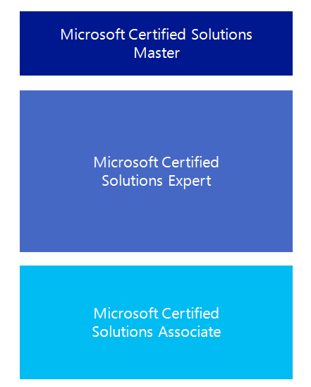

Microsoft Certification Program
Get trained. Get certified.
Get ahead.
There is no specific PowerShell certification available from Microsoft. However, many of the certification exams do have PowerShell related questions that you will need to answer.
Visit the following site for more detail on certifications:
http://www.microsoft.com/learning/
certification
Notes:
This course does not have a direct mapping to any exam. However, while there is not a standalone Windows PowerShell exam the topics are covered across all the individual Microsoft Certified Solutions Associate (MCSA) and Microsoft Certified Certified Solutions Expert (MCSE) exams. This course will help prepare the student for Windows PowerShell related concepts and processes within those exams.
10961B
00: Introduction

Slide 11
Virtual Machine Environment
Virtual Machine Name: | Use as:
Alpha | Windows Server 2016 full edition domain controller and DHCP server for the hq.local domain.
Bravo | Windows Server 2012 R2 full edition member server in the hq.local domain.
Echo | Windows 10 client computer and in the hq.local domain with Remote Server Administratin Tools (RSAT) installed. (You should perform ALL of your lab steps from Echo, unless otherwise instructed.)
Lab Manual | Once you launch the lab instance, You will find the lab manual under the “Content” tab in the upper right corner of the screen. The file is: 55039AC-GK-Custom-LabManual.pdf (Do NOT use the lab steps in the Skillpipe course material. Our lab steps have been customized to our lab environment.)
Notes:
10961B
00: Introduction

