Slide 1
Applied Data Science Capstone Project
https://github.com/nakaaki-jp
Jan. 1, 2020

Slide 2
Introduction/Business Problem
Kyoto is one of the oldest city in Japan and there are quite a lot of historical structures. It attracts many foreign tourists every year.
In this report, we explore Kyoto city and recommend places for opening a travel agency with local guide service for those tourists.

Slide 3
Data
Japan postal code
https://www.post.japanpost.jp/zipcode/dl/roman/ken_all_rome.zip?190712
Distributed from Japan Post Corporation
Get addresses in Kyoto city
1. zip code
2. prefecture (Japanese)
3. borough (Japanese)
4. neighborhood (Japanese)
5. prefecture (English)
6. borough (English)
7. neighborhood (English)
Geopy
https://geopy.readthedocs.io/
Get coordinates (latitude, longitude) for locations
Folium location data
https://python-visualization.github.io/folium/
Get map to visualize location data
Foursquare API
https://api.foursquare.com
Get the characteristics of neighborhoods from venues information near by them.

Slide 4
Methodology
The steps
1. Group venues by neighborhood and by taking the mean of the frequency of occurrence of each category
2. Get the top 10 venues for each neighborhood
3. Cluster neighborhoods by venues and get the top 10 venues for each neighborhood. The venues information do not have hierarchical structures. So `k-means clustering` is suitable for the purpose.
4. Visualize the clusters on map
5. Examine the clusters to see their characteristics. Plot common venues of each cluster.

Slide 5
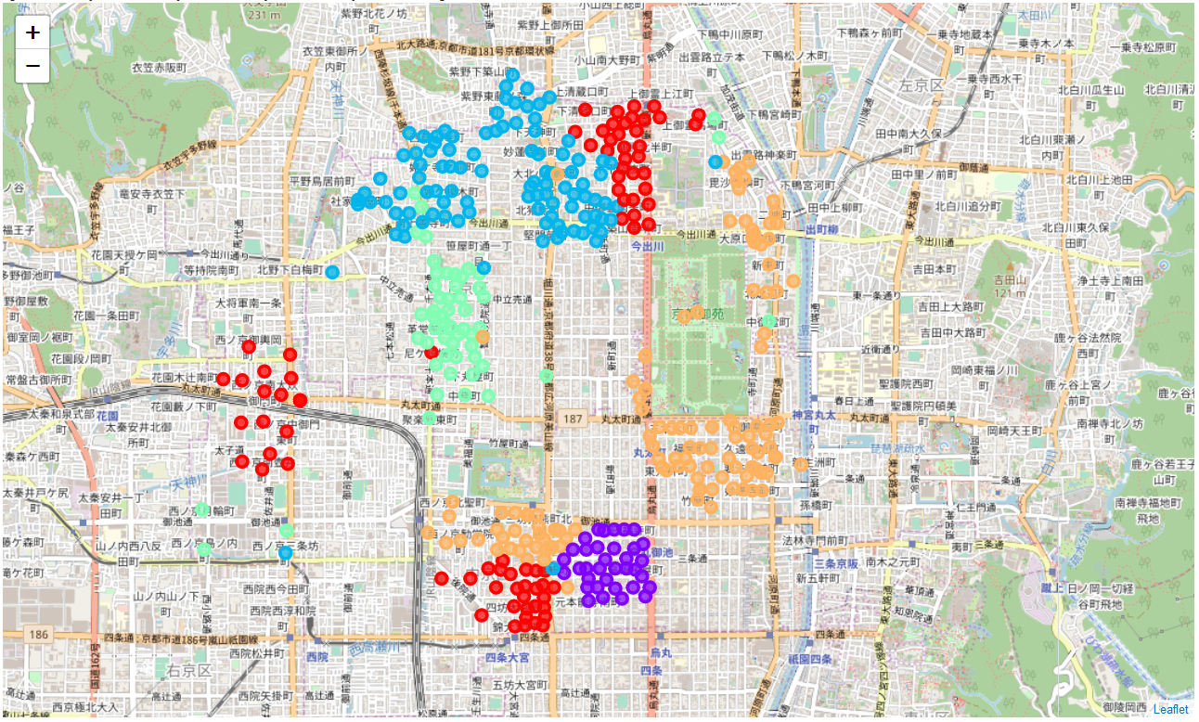
Results
1
Cluster1
Cluster2
Cluster3
Cluster4
Cluster5
2
3
4
5

Slide 6
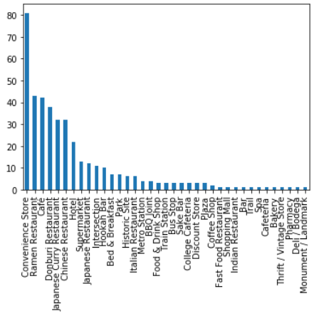
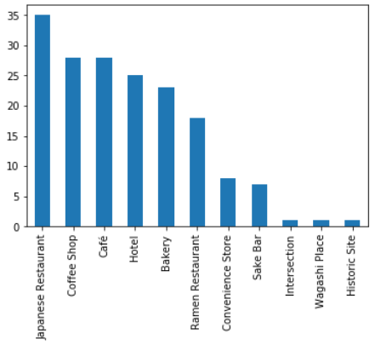
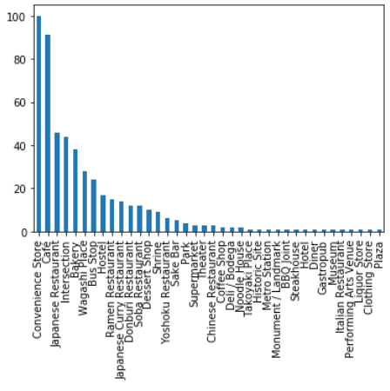
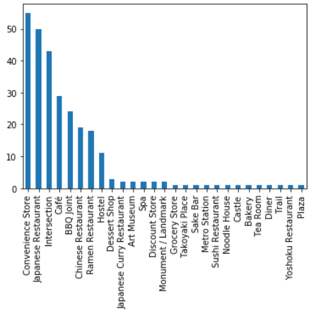
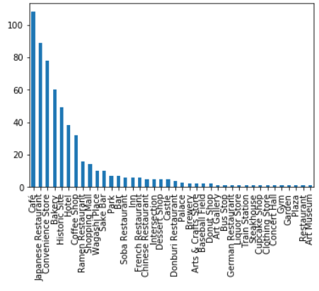
Common Venues of Each Cluster
Cluster1
Cluster2
Cluster3
Cluster4
Cluster5

Slide 7
Discussion
The office of travel agency should be located in an area where many tourists come and stay for long hours
Such areas should have hotels (including hostel, bed & breakfast), cafe, and convenient stores.
The cluster 1, 2, 3, and 4 have them. Among them,
The cluster 1, 3, and 4 are easier to access
The cluster 1 and 4 has metro stations
The cluster 3 has bus stops
The cluster 1 is close to an attractive world heritage site Nojo-jo Castle (http://nijo-jocastle.city.kyoto.lg.jp/?lang=en)

Slide 8
Conclusion
We recommend to open the office in the area of cluster 1. To nominate a few neighborhoods in that:
AMAGASAKIYOKOCHO
UCHIGAMAECHO
URATSUKIJICHO
URAFUROCHOOKAMATSUCHO

