Slide 1
Credit Card Transaction
Presented by Cing San Lun

Slide 2
Table of contents
01
02
03
04
05
06
Background
Project Intro
Method
Result
Previous education, employment
Background information about the topic
All of the details regarding the data
Exploratory findings and answers to evaluation questions
06
Summary
Conclusion
Question?
Summary of the entire result section
What is important?
Big picture information
Answer questions ask by the audience

Slide 3
01
Background

Slide 4

Education & Employment
Palm Beach Atlantic University
B.S. Computer Science’ 21
Career Development
Handshake Database Coordinator
15th Judicial Circuit Court
Technology Assistant Intern
Senior Intern

Slide 5
02
Project Intro

Slide 6
Project Background
Wells Fargo Bank
Personal Credit Card
Bank Statement
CSV/Excel File Columns
Master Category
Subcategory
Date
Location
Payee
Description
Payment Method
Amount

Slide 7
03
Method

Slide 8
Data Analysis/Wrangling
Python/Jupyter Notebook
Load in Data
Remove ‘Payment Method’ column
Split ‘Date’ column
Convert column to correct format
Calculate total amount
Calculate summary statistic on numerical column
Calculate statistic on non-numerical column
Inflation rate = -87.56%

Slide 9
Summary Statistics
 | Amount | Year
count | 394.000000 | 394.0
mean | 47.104162 | 2022.0
std | 53.181035 | 0.0
min | 1.070000 | 2022.0
25% | 13.977500 | 2022.0
50% | 31.025000 | 2022.0
75% | 57.617500 | 2022.0
max | 388.760000 | 2022.0

Slide 10
ANOVA (Analysis of Variance)
Python/Jupyter Notebook
Determine null hypothesis
Determine the level of significance
Collect data
Calculate sum of squares
Calculate degrees of freedom
Calculate mean square
Calculate F-statistic
Determine p-value
Compare p-value to level of significance
Interpret the results

Slide 11
ARIMA
Python/Jupyter Notebook
Data Preparation
Determine the parameters
Fit the ARIMA model
Compare model selection
Forecasting
Model evaluation
Model refinement
Re-forecasting
Model deployment

Slide 12
04
Result

Slide 13
Evaluation Questions
What is the total number of credit card transactions in the given period?
What is the average transaction amount?
What is the average number of transactions per day/week/month?
What is the geographical distribution of transactions?
What is the most common type of transaction (e.g., online, in-store, recurring)?

Slide 14
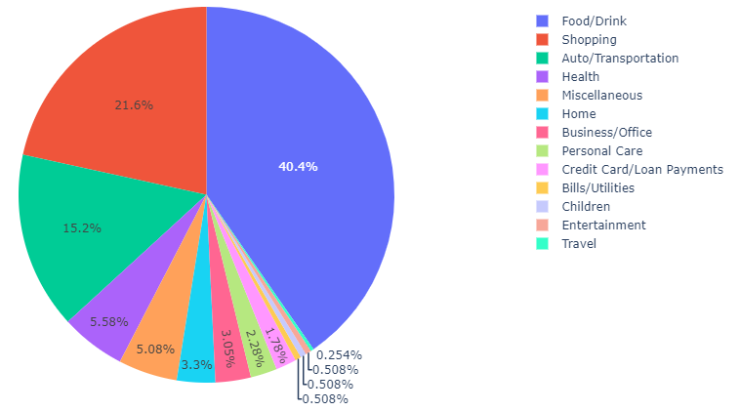
Percentage of Transaction

Slide 15
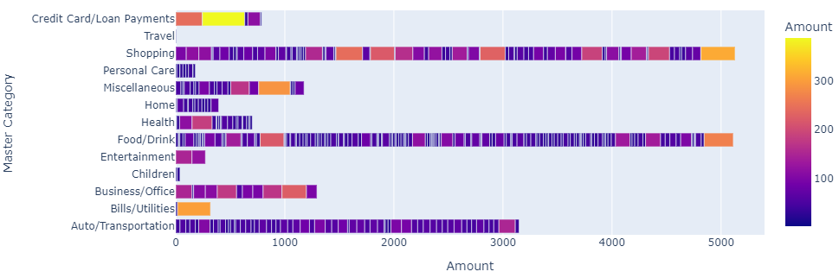
Average Transaction by Master Category

Slide 16
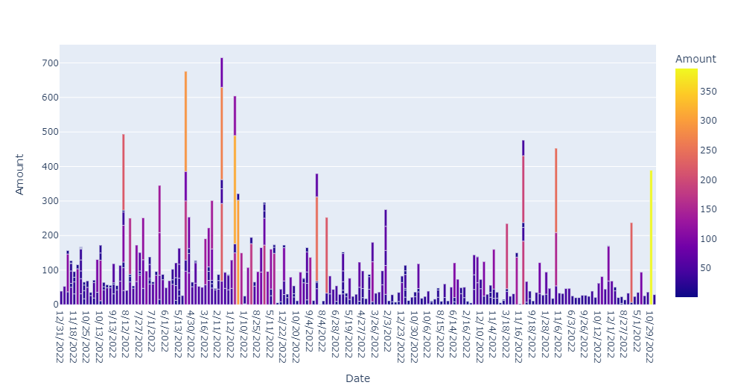
Average Transaction by Date

Slide 17
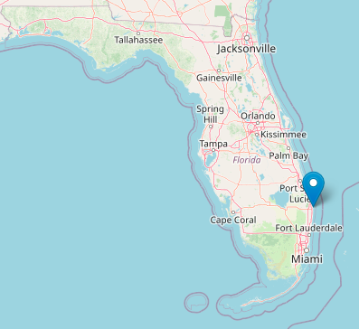
Geographical Location Transactions

Slide 18
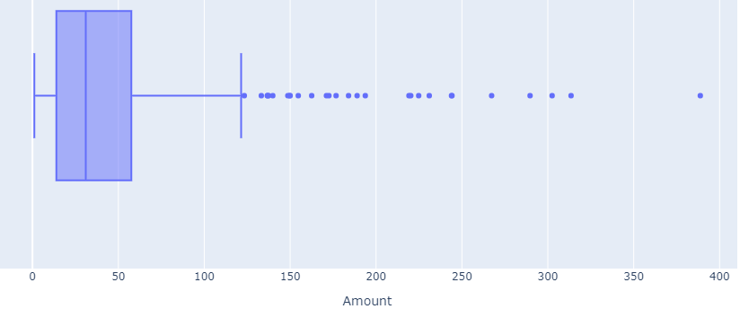
Boxplot

Slide 19
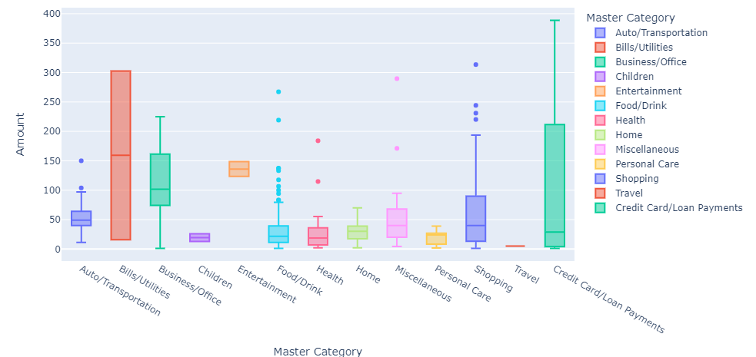
Outliers

Slide 20
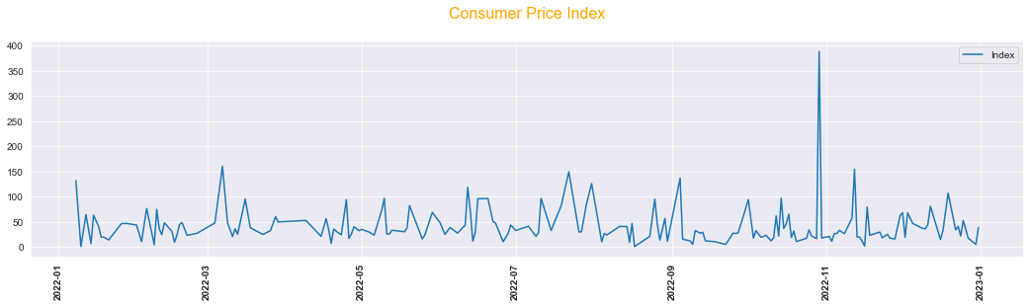
Consumer Price Index

Slide 21
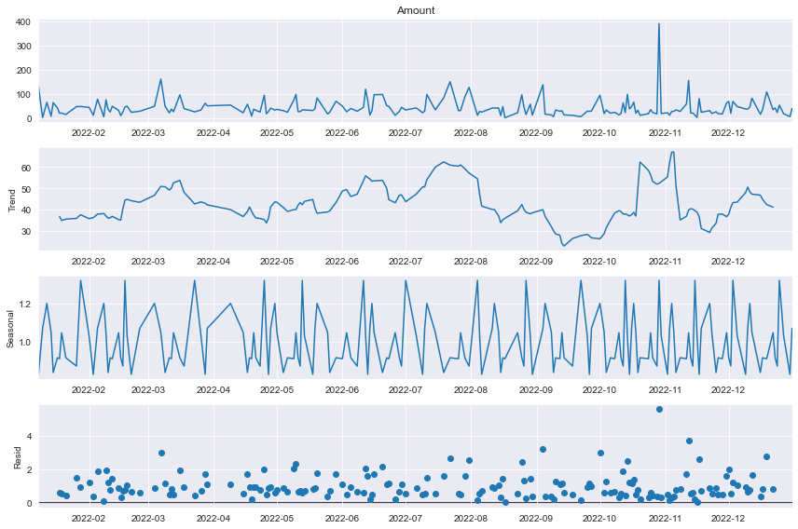
Decomposition

Slide 22
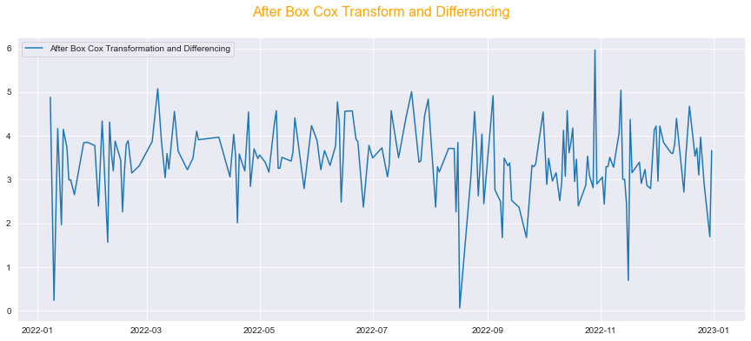
Transform and Differencing

Slide 23
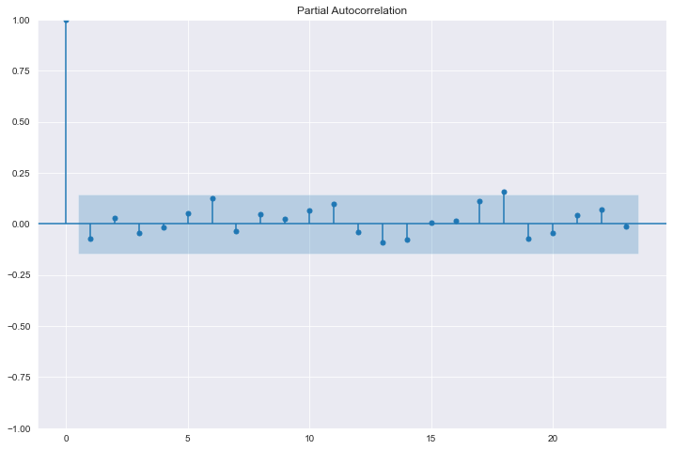
Partial Autocorrelation

Slide 24
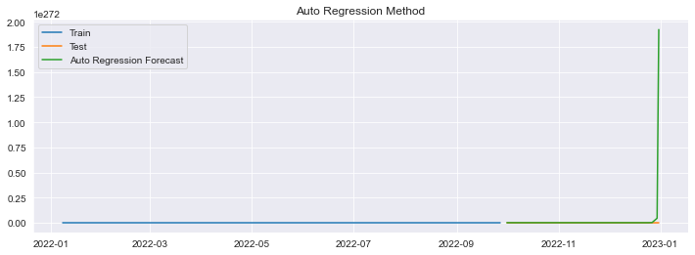
Auto Regression Method

Slide 25
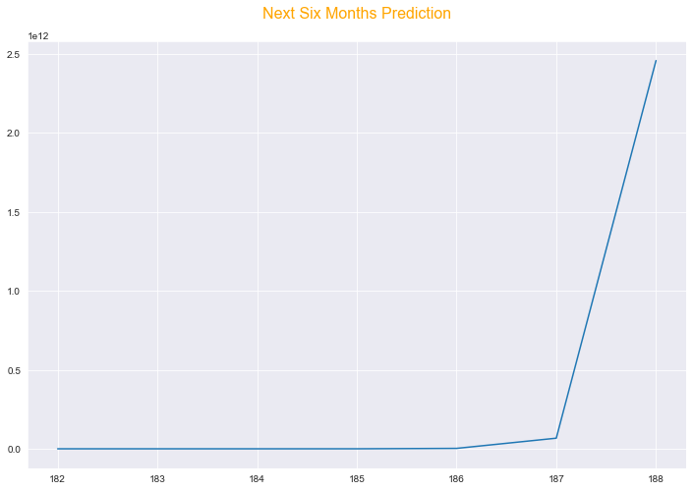
Forecasting

Slide 26
05
Summary

Slide 27
Summary
Average amount = $44.95
Most common location = West Palm Beach, FL
Most common transaction = Food/Drink
Food/Drink percentage = 40.4%
Food/Drink amount = $5112.08
Reject null hypothesis
Conclude that there is a significance difference between the groups
Forecasting for 6 months

Slide 28
06
Conclusion

Slide 29
Conclusion
Identify spending behavior
Identify when overspending
Save money
Protection from financial harms
A strong correlation between the types of category and the amount of transaction

Slide 30
07
Question?

Slide 31
Question?

