Slide 1
OLYMPIC GAMES
ANALYSIS DASHBOARD
Mini Project Presentation
Excel • Power Query • PivotTables • PivotCharts
1

Slide 2
2. Introduction
The Olympic Games contain a large amount of athlete and event data.
This project uses the data to find simple and useful patterns.
Power Query was used to clean and prepare the data.
PivotTables and PivotCharts were used for analysis.
An interactive dashboard was created using slicers.
2

Slide 3
3. Problem Statement
Raw Olympic data is large and difficult to understand directly.
Important information is spread across many rows and columns.
It is difficult to quickly compare sports, countries, gender, seasons and medals.
The goal is to convert raw data into clear visual information.
The dashboard helps users understand the data quickly.
3

Slide 4
4. Project Objectives
Clean and prepare the Olympic dataset.
Find important numbers using KPIs.
Study athlete participation over the Olympic years.
Compare sports, gender and Olympic seasons.
Analyze medal-winning countries and medal types.
Present the results in a simple interactive dashboard.
4

Slide 5
5. Dataset Used
Olympic athlete-event dataset.
10,000 records are used for this mini project.
The original data contains athlete, event, sport, year and medal information.
Important columns include Name, Sex, Age, NOC, Games, Year, Season, Sport, Event and Medal.
5

Slide 6
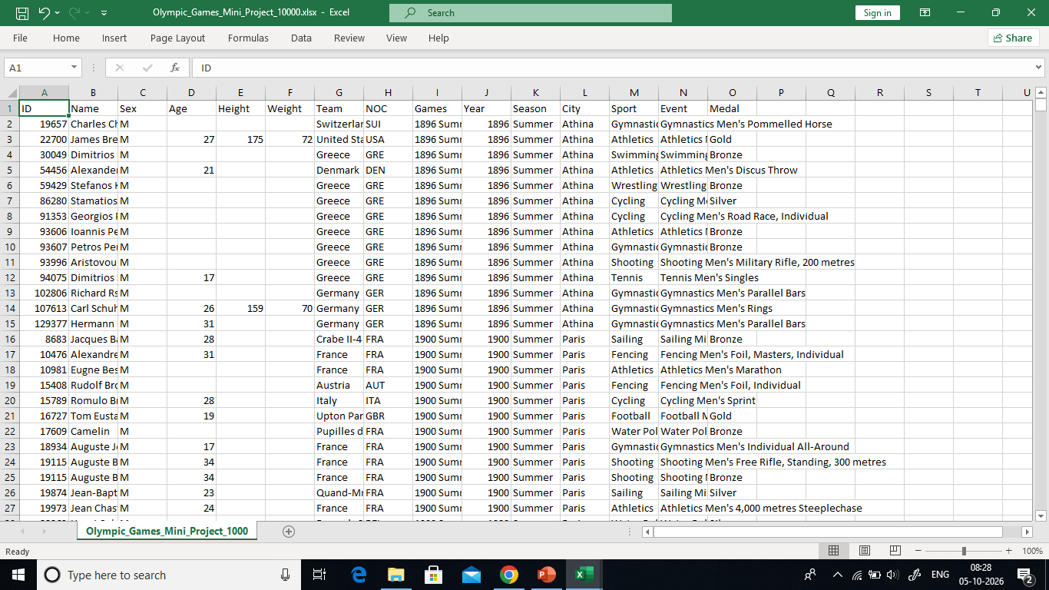
6. Raw Data Analysis
Before cleaning, the raw data was checked for blanks, duplicates, data types and country codes.
The screenshot below shows the original data.
PASTE RAW DATA SCREENSHOT HERE
6

Slide 7
7. Raw Data Issues Found
Some Age, Height and Weight values are blank.
Medal is blank when there is no recorded medal.
NOC contains short codes such as IND, USA and CHN.
Different data types need to be checked.
The data needs cleaning before analysis.
7

Slide 8
8. Preprocessing in Power Query
Remove exact duplicate rows.
Set correct data types.
Trim and clean text values.
Check missing and error values.
Check Sex, Season and Medal categories.
Merge NOC with the NOC lookup table.
Create useful columns such as Medal Status and Age Group.
8

Slide 9
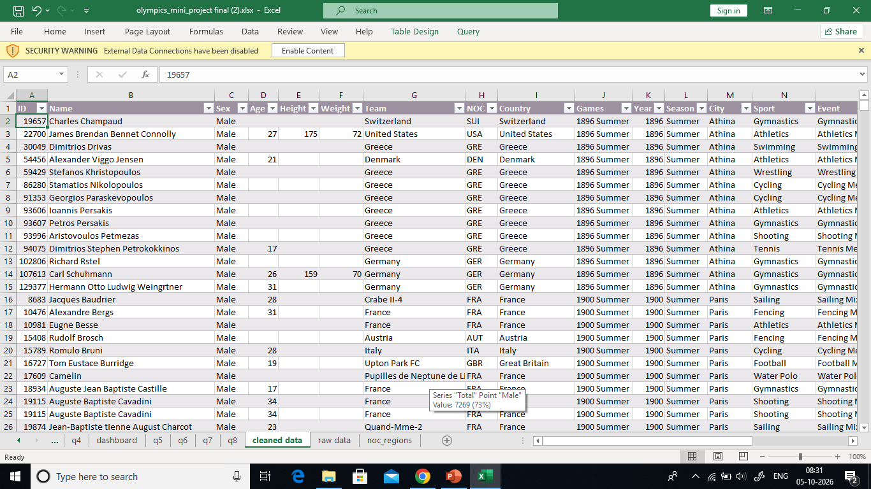
9. Preprocessed Data
After cleaning, the data is ready for PivotTables and charts.
The screenshot below shows the cleaned data.
PASTE PREPROCESSED DATA SCREENSHOT HERE
9

Slide 10
10. NOC to Country Mapping
NOC is a short code used to identify an Olympic committee.
Example: IND = India, USA = United States, CHN = China.
A separate NOC lookup table was used.
Power Query Merge matched the NOC codes.
This makes country analysis easier to understand.
10

Slide 11
11. KPIs Used in the Dashboard
Total Athlete Records
Total Countries
Total Sports
Total Medal Records
Gold Medals
Silver Medals
Bronze Medals
11

Slide 12
12. KPI Calculation – PivotTables
Total Athlete Records → Count of ID.
Total Countries → Distinct Count of NOC.
Total Sports → Distinct Count of Sport.
Total Medal Records → Count of Medal.
Gold, Silver and Bronze → Medal as Rows + Count of ID.
These values are displayed as KPI cards.
12

Slide 13
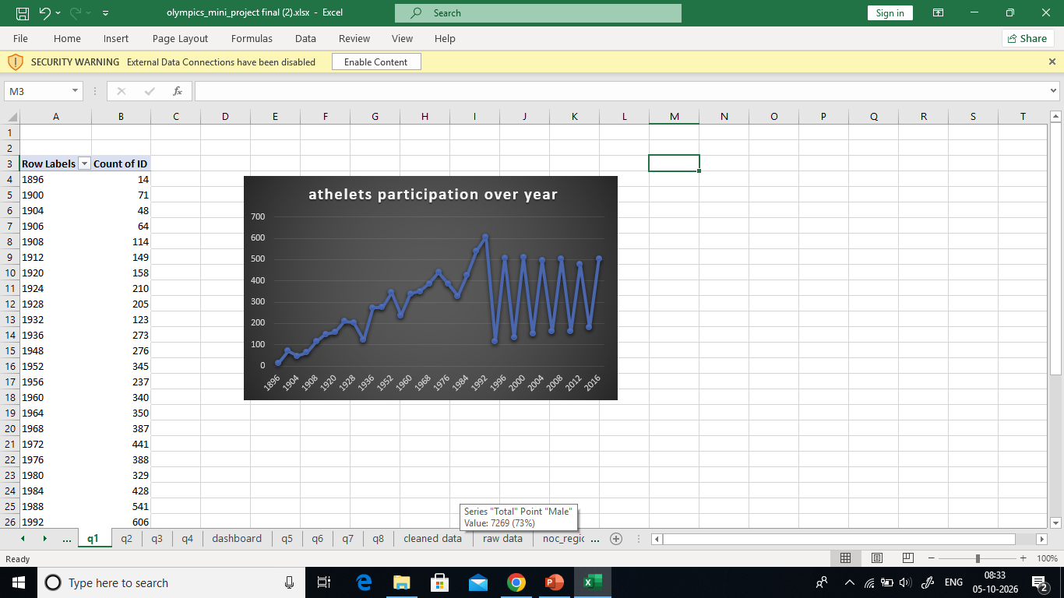
13. Chart 1 – Athlete Participation Over Years
Rows: Year
Values: Count of ID
Chart: Line Chart
Purpose: To see how athlete participation changed
over the Olympic years.
PASTE PARTICIPATION LINE CHART HERE
13

Slide 14
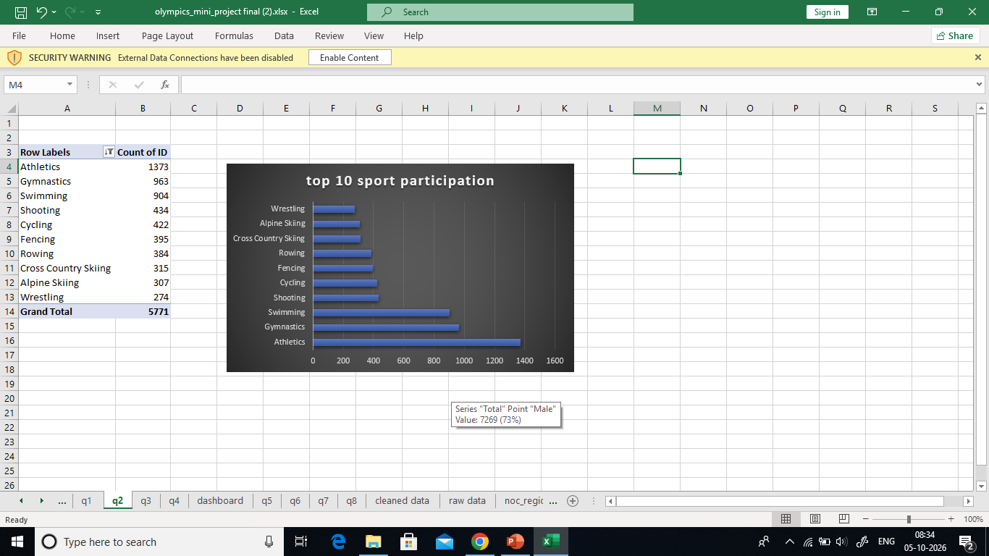
14. Chart 2 – Top 10 Sports
Rows: Sport
Values: Count of ID
Apply Value Filters → Top 10.
Chart: Bar Chart.
Purpose: To find sports with the highest
athlete participation.
PASTE TOP 10 SPORTS CHART HERE
14

Slide 15
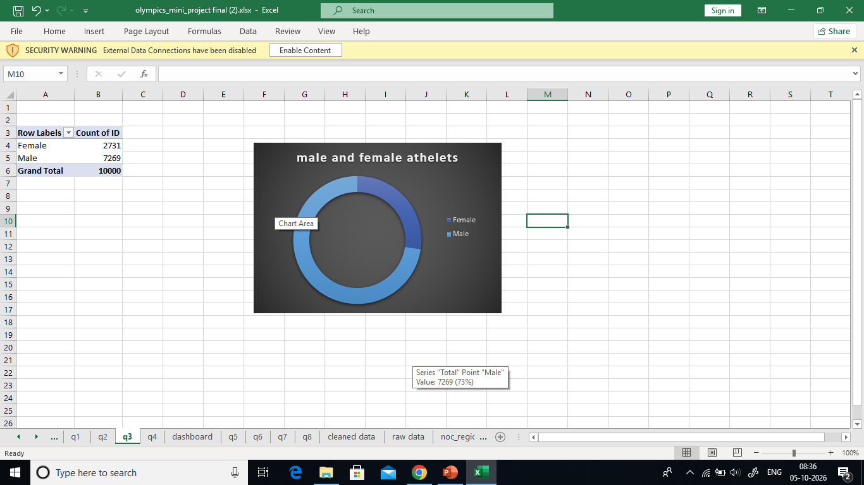
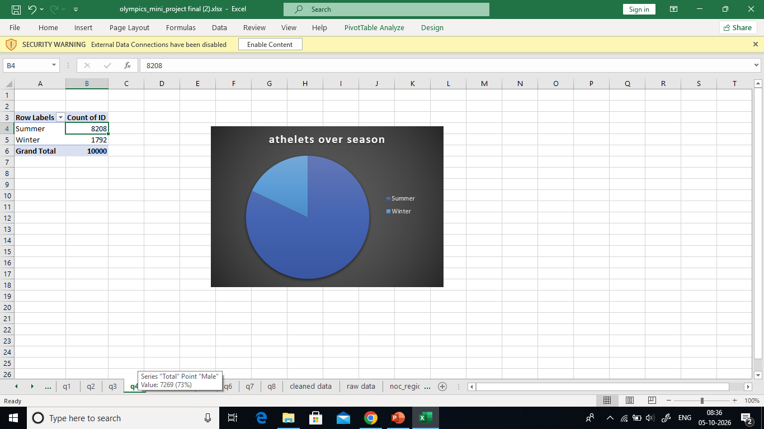
15. Chart 3 – Gender and Season
Male vs Female: Rows = Sex, Values = Count of ID, Chart = Doughnut.
Summer vs Winter: Rows = Season, Values = Count of ID, Chart = Doughnut.
These charts show how participation is divided by gender and season.
PASTE GENDER / SEASON CHARTS HERE
15

Slide 16
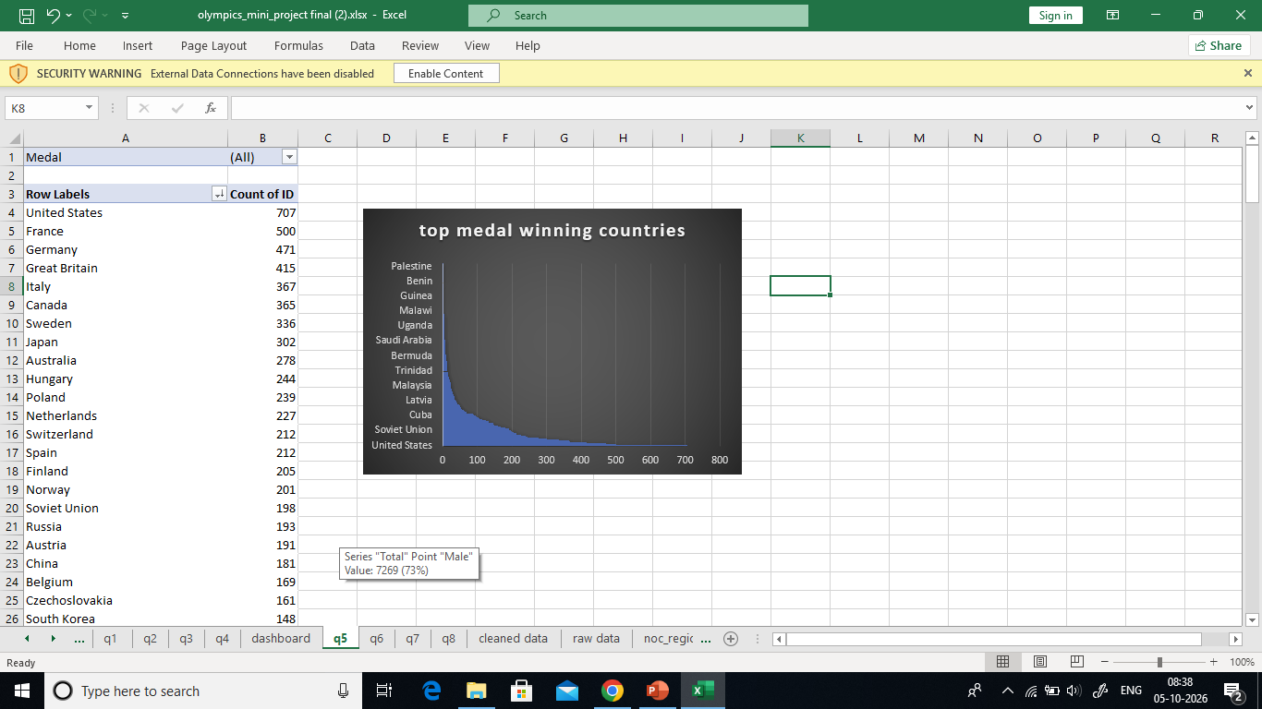
16. Chart 4 – Medal-Winning Countries
Rows: Country / NOC
Values: Count of ID
Filter: Medal Status = Medal
Sort from largest to smallest.
Chart: Bar Chart.
Purpose: To find countries with the highest
number of medal-winning records.
PASTE MEDAL-WINNING COUNTRIES CHART HERE
16

Slide 17
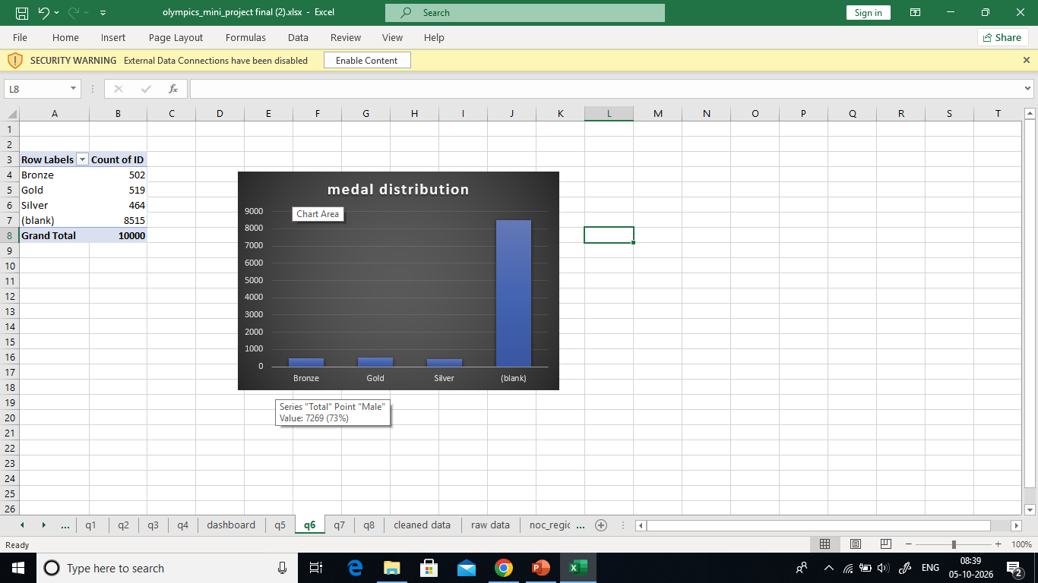
17. Chart 5 – Medal Analysis
Gold/Silver/Bronze: Rows = Medal, Values = Count of ID, Chart = Column.
Medals by Sport: Rows = Sport, Columns = Medal, Values = Count of ID.
Chart: Stacked Column.
This shows both total medals and the medal mix by sport.
PASTE MEDAL CHARTS HERE
17

Slide 18
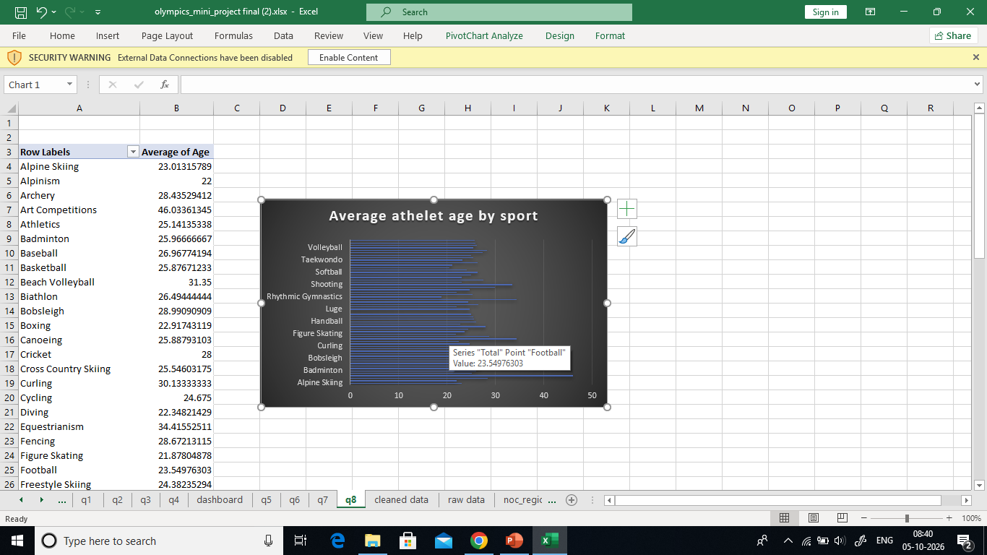
18. Chart 6 – Average Age by Sport
Rows: Sport
Values: Average of Age
Blank ages are not treated as zero.
Chart: Bar Chart.
Purpose: To compare the average athlete age across sports.
PASTE AVERAGE AGE CHART HERE
18

Slide 19
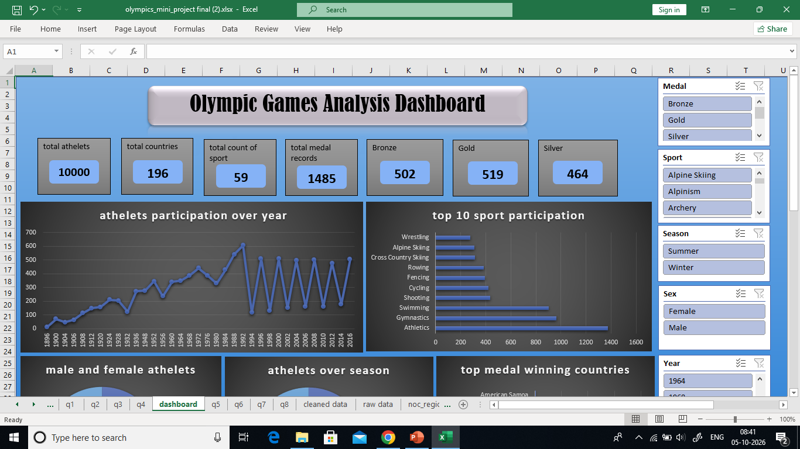
19. Slicers and Dashboard
Slicers make the dashboard interactive.
Suggested slicers: Year, Season, Sex, Sport, Country/NOC and Medal.
Clicking a slicer filters connected PivotTables and charts.
The final dashboard combines KPIs, charts and slicers in one view.
PASTE FINAL DASHBOARD SCREENSHOT HERE
19

Slide 20
20. Conclusion
The Olympic dataset was cleaned and prepared using Power Query.
KPIs give a quick summary of records, countries, sports and medals.
PivotTables and PivotCharts show participation, sports, gender, seasons, age and medals.
Slicers allow the user to explore the data interactively.
The dashboard converts raw Olympic data into simple and useful information.
20

