Slide 1
KL UNIVERSITY • BACHUPALLY CAMPUS, HYDERABAD
Department of Computer Science & Engineering
Handwritten Digit Recogniser with a Drawing Canvas
Recognising handwritten digits drawn by a user using PCA and an SVM classifier
PRESENTED BY
UNDER THE GUIDANCE OF
2520030010 G Boomika Sre
2520030174 P. Nehasree
Mr. Raghavendra
Designation, Department of CSE
KLH Bachupally Campus
Machine Learning (25SC2107E) | Sec 1 - Team 19 | Y25 2026-27 Trimester 4 | Date: 13-10-2026
Notes:
Model template - Minor Project review presentation for B.Tech II year. Replace every placeholder in angle brackets. Title slide: speak for 30 seconds - greet the panel, state the title, introduce the team and the guide. Do not read the slide word for word.

Slide 2
AGENDA
Contents
1
Introduction & Domain Background
7
Methodology & Modules
2
Problem Statement & Motivation
8
Tools and Technologies
3
Literature Survey
9
Work Completed / Demo
4
Research Gap Identified
10
Timeline & Review Plan
5
Objectives of the Project
11
Expected Outcome & Conclusion
6
Proposed System Architecture
12
References
Dept. of CSE | KL University, Bachupally Campus
2
Notes:
Keep the agenda to one slide. In a 10-12 minute review, spend the most time on literature survey, objectives and work completed.

Slide 3
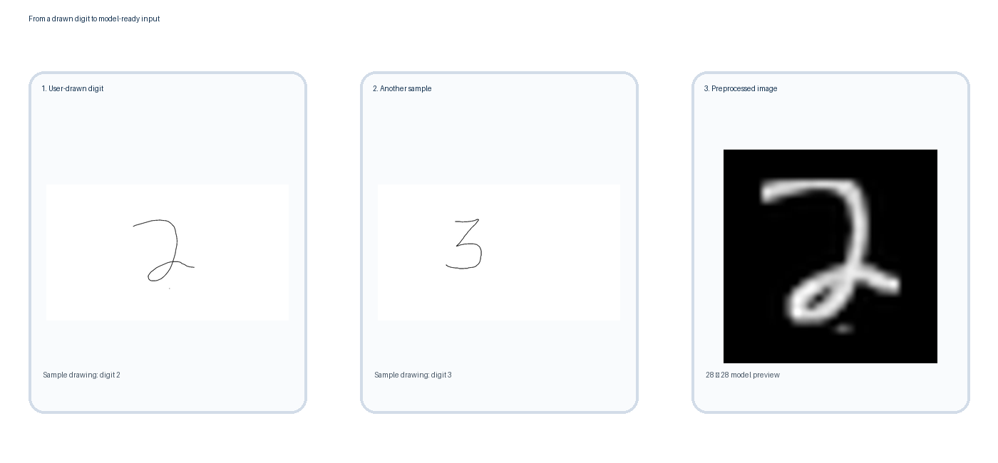
SECTION 1
Introduction & Domain Background
What is the domain?
Handwritten digit recognition means teaching a computer to read digits (0-9) using machine learning, instead of fixed rules.
Why is it relevant today?
PCA + SVM models reach 98-99% accuracy on MNIST [1][2]; similar technology is used in character recognition, document scanning and digital forms.
Where does your project sit?
We reduce each digit image to key features with PCA, classify it using SVM, and let users test it with a digit they draw in Paint / MS Whiteboard.
Panel tip
Every claim on this slide must be traceable to a reference on the last slide.
Dept. of CSE | KL University, Bachupally Campus
3
Notes:
60-90 seconds. Start broad (the domain), end narrow (your specific task). Avoid definitions copied from Wikipedia - the panel will ask for the source.

Slide 4
SECTION 2
Problem Statement & Motivation
PROBLEM STATEMENT
" Most digit-recognition demos only classify pre-existing dataset images because they lack a live input interface, which results in users being unable to test the model with their own handwriting. "
1
2
3
Who is affected?
What is the cost of the problem?
Why solve it now?
Students and developers learning ML/CV, and systems that read handwritten digits - character recognition, document scanning, digital forms.
Manual entry and verification of handwritten numeric data is slow and error-prone, and most published models are tested only on static datasets, not live user input.
PCA + SVM already reach 98%+ accuracy on MNIST, so it's practical enough for a real, interactive demo without needing deep learning.
Dept. of CSE | KL University, Bachupally Campus
4
Notes:
The problem statement must be ONE sentence. If you need two sentences, the scope is too wide for a minor project. The panel's first question is usually: who exactly benefits?

Slide 5
SECTION 3
Literature Survey
Minimum 8-10 papers studied; show 4-5 of the most relevant here (2020 onwards, journals/conferences only - no blogs).
S.No | Author & Year | Title / Technique Used | Dataset / Tools | Key Findings | Limitation / Gap
1 | Al-Hamadani (2023) | PCA + SVM classification on MNIST | MNIST (70k images) Python, scikit-learn | SVM (linear & non-linear) classified MNIST effectively | Tested only on static dataset images, no live user input
2 | Das et al. (2018) | HOG features + PCA + SVM | MNIST, EAI Trans. | 99.29% accuracy, speed close to a CNN | No end-user interface for live handwriting input
3 | Mohammadpoor et al. (2018) | HOG + PCA + SVM classifier | HODA digits, Majlesi J. | 99% recognition accuracy | Limited to pre-captured digit images, not real-time drawing
4 | Ismailova & Lu (2015) | 2D-DCT based sparse PCA | MNIST, IEEE PACRIM | 35.7% faster than standard PCA, same accuracy | No interactive canvas or deployment layer discussed
The last column is the most important one - your research gap is built from it.
Dept. of CSE | KL University, Bachupally Campus
5
Notes:
Do not read the table aloud. Speak about the trend: what most papers did, what results they reached, and what all of them left unsolved. Row 1 is a worked example - delete it and put your own paper there.

Slide 6
SECTION 4
Research Gap Identified
GAP 1
OUR PROJECT ADDRESSES
Data-level gap - most PCA/SVM studies test only on the fixed MNIST test set, never on digits a user draws themselves.
We close the deployment gap by pairing PCA + SVM with digits the user draws in Paint / MS Whiteboard, so predictions run on real handwriting, not just dataset images.
GAP 2
Method-level gap - papers report accuracy but rarely explain how to turn a messy canvas sketch into clean input the model expects.
GAP 3
A gap is a sentence that begins with "No existing work has..." or "Existing work does not..."
Deployment gap - no existing work bundles a trained PCA + SVM model with a simple app for users to try their own drawn digits.
Rule: every gap here must come from the last column of the literature survey table. A gap you cannot trace to a paper will be rejected by the panel.
Dept. of CSE | KL University, Bachupally Campus
6
Notes:
This is the slide that separates a good review from an average one. State 2-3 gaps only, and make sure each one maps to a paper you listed.

Slide 7
SECTION 5
Objectives of the Project
Write 3-4 objectives. Each one must start with an action verb and be something you can demonstrate by the final review.
To collect / prepare the MNIST dataset of 70,000 labelled handwritten digit images (60,000 train / 10,000 test).
1
To design & implement a PCA + SVM pipeline that reduces each image to key features and classifies it into one of 10 digit classes.
2
To evaluate the model using accuracy, precision, recall and a confusion matrix, compared against a simple baseline.
3
To deploy / demonstrate a simple app that loads a digit the user draws in Paint / MS Whiteboard and predicts it using the trained SVM.
4
Tip: objectives and results must match one-to-one at the final review.
Dept. of CSE | KL University, Bachupally Campus
7
Notes:
Avoid vague verbs - study, understand, analyse. Use build, classify, detect, compare, deploy. Four objectives is the right number for a minor project.

Slide 8
SECTION 6
Proposed System Architecture
INPUT
PRE-PROCESSING
CORE MODULE
OUTPUT
User draws a digit in
Paint / MS Whiteboard
Load image, grayscale, resize,
scale, reduce with PCA
Trained SVM
classifier (RBF kernel)
Predicted digit (0-9)
with confidence score
Label every arrow
Drawn image
PNG/JPG
Preprocess
grayscale • resize
Feature vector
flatten + PCA
SVM inference
RBF classifier
Prediction
digit 0–9
Each arrow should say what flows through it - raw image, cleaned CSV, feature vector, JSON response. Unlabelled arrows invite questions you cannot answer.
Online path: user drawing → preprocessing → PCA features → trained SVM → predicted digit
Dept. of CSE | KL University, Bachupally Campus
8
Notes:
Walk the panel through the diagram left to right in under a minute, naming the input and the output first. Be ready to say where your contribution sits.

Slide 9
SECTION 7
Methodology & Modules
1
Module 1 - Data
2
Module 2 - Processing
MNIST dataset (70,000 images of digits 0-9), loaded via scikit-learn, split 60k train / 10k test.
Convert the drawn image to grayscale, resize it to 28x28, scale the pixels, flatten to a vector, then reduce dimensions using PCA.
3
Module 3 - Core Logic
4
Module 4 - Interface
Support Vector Machine (RBF kernel), chosen for strong accuracy on reduced-feature digit data; compared with a Logistic Regression baseline.
The user draws a digit in MS Paint / Whiteboard and saves it as an image; the Python program loads it and the trained model displays the predicted digit.
Dept. of CSE | KL University, Bachupally Campus
9
Notes:
One module per team member works well - it also answers the panel question 'who did what'.

Slide 10
SECTION 8
Tools and Technologies
SOFTWARE
HARDWARE / PLATFORM
Language: Python 3.12 (project virtual environment)
Libraries: Streamlit, streamlit-drawable-canvas, scikit-learn, NumPy, Pillow, Joblib, Matplotlib
Dataset: MNIST (downloaded by training script)
Interface: Streamlit web app with drawing canvas
Model: PCA + SVM (RBF); Logistic Regression comparison
IDE / Tools: VS Code, Git, GitHub
Platform: Local Windows laptop
Execution: CPU-based; no GPU required
Input device: Mouse / touchpad
Model artifact: Joblib (.joblib)
Evaluation output: metrics.json
Repository: github.com/boomikaa-20/Handwritten-Digit-ML
Dept. of CSE | KL University, Bachupally Campus
10
Notes:
Name versions where you know them. If you have a GitHub repository, show the link here - it is strong evidence of real work.

Slide 11
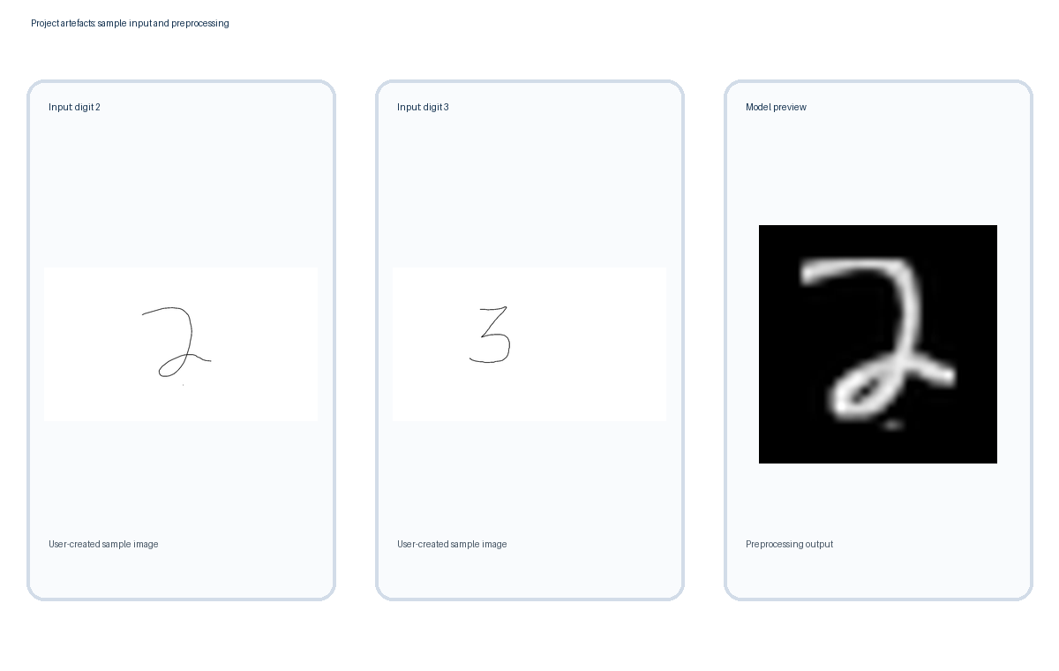
SECTION 9
Work Completed / Demo
Literature survey
Draft prepared
Dataset collection
Completed
Pre-processing pipeline
Implemented
Model training
Implemented
Drawn-image input
Working canvas
Testing & evaluation
Metrics available
Evidence shown: sample drawn digits and the model's 28×28 preprocessing preview. The app has been launched and tested locally.
Dept. of CSE | KL University, Bachupally Campus
11
Notes:
Be honest about status. Panels reward accurate self-assessment and penalise claims that fall apart under one question.

Slide 12
SECTION 10
Timeline & Review Plan
Review 0 ✓
Review 1 ✓
Review 2 • CURRENT
Final • PLANNED
Week 2
Week 5
Week 9
Week 14
Title, abstract, team roles finalised
Literature survey, gap, objectives
Architecture, working canvas, trained model and evaluation page
Final demo, verified results, report and presentation
Status at 13 Oct 2026: Review 0 and Review 1 milestones are treated as completed; Review 2 is the current implementation review; Final review remains planned.
Progress now: the Streamlit canvas, prediction pipeline, saved model artefacts and evaluation metrics are in place. Remaining: verify final metrics, test the moved web-app folder, and rehearse the demo.
Dept. of CSE | KL University, Bachupally Campus
12
Notes:
Adjust week numbers to your academic calendar. Showing a plan for the remaining weeks is what the panel wants to hear at Review 1.

Slide 13
SECTION 11
Expected Outcome & Conclusion
DELIVERABLE
MEASURABLE TARGET
BEYOND THE LAB
A working Streamlit app where users draw a digit (0–9) and receive a model prediction.
Report the measured MNIST test metrics from metrics.json; target above 95% accuracy and sub-second prediction on the local machine.
Students learning ML, and as a building block for character recognition, document scanning and digital form processing.
CONCLUSION
This project combines PCA-based feature reduction and an SVM classifier with a Streamlit drawing interface. The user can draw a digit, view a prediction, and inspect model evaluation outputs. The current scope is single-digit recognition; future work could explore multi-digit input and deployment monitoring.
Dept. of CSE | KL University, Bachupally Campus
13
Notes:
Do not introduce anything new here. The conclusion restates the problem, the gap and the promise - nothing else.

Slide 14
SECTION 12
References
IEEE style, numbered in the order they are cited in the slides. Minimum 8 references for a minor project - these are format examples only.
[1] M. N. Al-Hamadani, "Classification and analysis of the MNIST dataset using PCA and SVM algorithms," Vojnotehnicki Glasnik, vol. 71, no. 2, pp. 221-238, 2023.
[2] A. Das, T. Kundu, and C. Saravanan, "Dimensionality reduction for handwritten digit recognition," EAI Endorsed Trans. Cloud Systems, vol. 4, no. 13, 2018.
[3] M. Mohammadpoor, A. Mehdizadeh, and H. Alizadeh Noghabi, "A novel method for Persian handwritten digit recognition using support vector machine," Majlesi J. Electrical Engineering, vol. 12, no. 3, pp. 63-68, 2018.
[4] D. Ismailova and W.-S. Lu, "Fast classification of handwritten digits using 2D-DCT based sparse PCA," in Proc. IEEE Pacific Rim Conf. Communications, Computers and Signal Processing (PACRIM), 2015.
[5] Y. LeCun, C. Cortes, and C. J. Burges, "MNIST handwritten digit database," 1998. [Online]. Available: http://yann.lecun.com/exdb/mnist/ [Accessed: 18-Sep-2026].
[6] F. Pedregosa et al., "Scikit-learn: Machine learning in Python," Journal of Machine Learning Research, vol. 12, pp. 2825-2830, 2011.
[7] C. Cortes and V. Vapnik, "Support-vector networks," Machine Learning, vol. 20, no. 3, pp. 273-297, 1995.
[8] I. T. Jolliffe, Principal Component Analysis, 2nd ed. New York, NY, USA: Springer, 2002.
Every reference listed here must appear in the literature survey table, and every row of that table must appear here.
Dept. of CSE | KL University, Bachupally Campus
14
Notes:
Use Google Scholar's 'Cite' option and pick MLA/IEEE, then fix the formatting by hand. Never cite a blog, a YouTube video or a paper you have not opened.

Slide 15
Thank You
Questions & Suggestions
Team: 19
G Boomika Sre, P. Nehasree | Guide: Mr. Raghavendra > | Dept. of CSE, KLH Bachupally
Notes:
Keep the deck open on the architecture slide during questions - most panel questions point back to it.

