Slide 1

University of Khartoum
Faculty of Mathematical Sciences and Informatics
GridGuard Khartoum
AI-Based Smart Load Shedding and Energy Management System for Developing Countries
A graduation project presented to the Faculty of Mathematical Sciences and Informatics, University of Khartoum, in partial fulfilment of the requirements for the degree of Bachelor of Computer Science.
Murtada Asim Ibrahim Bakhit (18-317)
Suliman Elawad Suliman Babiker (18-310)
Abdalhay Abass Mobarak Abass (15-306)
Project Supervisor: Mrs. Abubakr Siraj
October 2026
Notes:
AI-Based Smart Load Shedding and Energy Management System for Developing Countries. A graduation project presented to the Faculty of Mathematical Sciences and Informatics, University of Khartoum, in partial fulfilment of the requirements for the degree of Bachelor of Computer Science. Project supervisor: Mrs. Abubakr Siraj. October 2026. Original university and faculty logo image supplied in the academic reference. Cover metadata: docs/academic-cover.json.

Slide 2
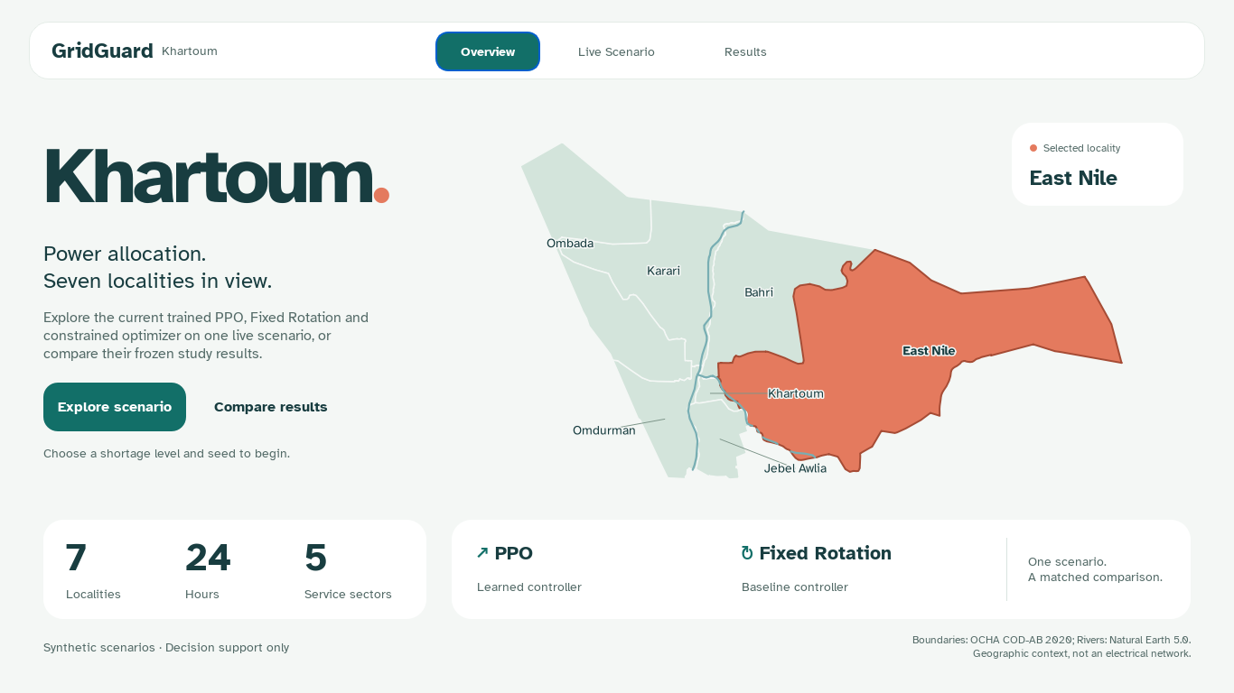
GridGuard Khartoum
Hourly shortage allocation in Khartoum
Seven localities, five sectors and a shared supply pool
Protect Hospital, Water and Bakery demand.
Allocate remaining supply to Residential and Commercial demand.
Measure service, interruption duration and distribution efficiency.
All demand and supply traces are synthetic. The map shows administrative geography.
Context: World Bank (2025). Related control research: Chen et al. (2023).
02
Notes:
GridGuard Khartoum study. Training SHA-256 e4f8b8f7c73693f713ecef69a06434ce75a3a101d2541654d7009398c4eb5624; study a4d5a849612f06eedef96e0d28e08247e5e3757eba0b4f2e4f1a893e9d4b8247; diagnostics b4c2c76e481e0f30e323ea22f9359212bac1b2018605f833682875d98face500. Context: World Bank (2025). Related control research: Chen et al. (2023). https://documents1.worldbank.org/curated/en/099050125112514628/pdf/P507788-6a843250-44f5-47da-9f07-c6b1269a091f.pdf; https://doi.org/10.1016/j.egyr.2023.03.027. Screenshot: current desktop overview. Live Scenario uses the constrained PPO actor from seed 8111, selected checkpoint 2500. Live scenario values remain separate from the frozen five-run study averages.

Slide 3
GridGuard Khartoum
The simulation and service choices
24 hourly decisions with current observations and accumulated service history
Service tier | Requested demand
Off | No sectors
Critical Only | Hospital, Water and Bakery
Full Service | All five sectors
Shortage | Supply construction
Mild | 80% of total demand
Moderate | 65%, minus 10 pp at hours 17–20
Severe | 50%, minus 15 pp at hours 16–21
Independent demand and supply perturbations within ±5%.
One supply pool. No network power flow, storage or restoration transients.
Synthetic scenarios. Decision support only.
03
Notes:
GridGuard Khartoum study. Training SHA-256 e4f8b8f7c73693f713ecef69a06434ce75a3a101d2541654d7009398c4eb5624; study a4d5a849612f06eedef96e0d28e08247e5e3757eba0b4f2e4f1a893e9d4b8247; diagnostics b4c2c76e481e0f30e323ea22f9359212bac1b2018605f833682875d98face500.

Slide 4
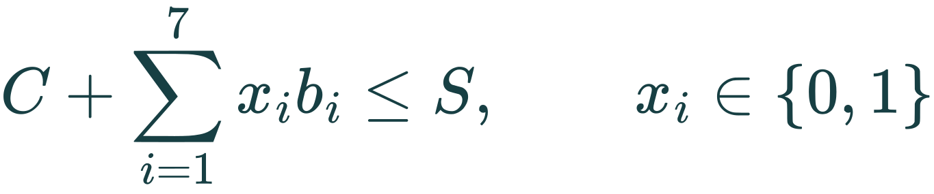
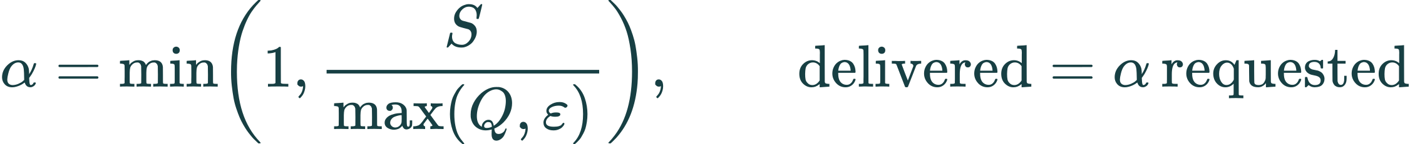
GridGuard Khartoum
Critical protection through feasible actions
PPO and Constrained Optimization share 128 Critical Only / Full Service combinations
Critical reservation
C: total critical demand bᵢ: locality noncritical demand S: available supply
Shared proportional dispatch uses ε = 10⁻⁸. If critical demand cannot fit, the all-Critical-Only fallback still records the resulting interruption.
Masking: Huang and Ontañón (2022). Safety distinction: García and Fernández (2015).
04
Notes:
GridGuard Khartoum study. Training SHA-256 e4f8b8f7c73693f713ecef69a06434ce75a3a101d2541654d7009398c4eb5624; study a4d5a849612f06eedef96e0d28e08247e5e3757eba0b4f2e4f1a893e9d4b8247; diagnostics b4c2c76e481e0f30e323ea22f9359212bac1b2018605f833682875d98face500. Masking: Huang and Ontañón (2022). Safety distinction: García and Fernández (2015).

Slide 5
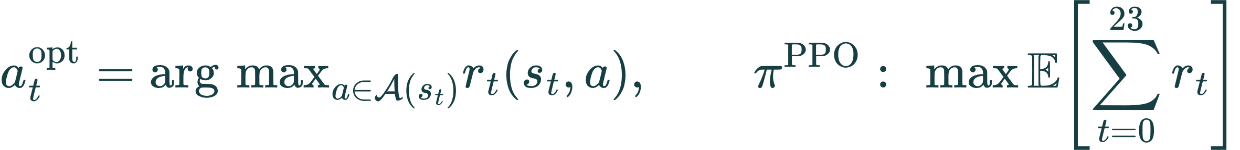
GridGuard Khartoum
Three decision procedures
The optimizer and PPO receive equivalent causal information and the same feasible set
Controller | Decision rule | Horizon
Fixed Rotation | Three localities Full Service for each three-hour block | Fixed schedule
Constrained Optimization | Checks 128 assignments and maximizes current reward over the feasible set | Current hour
PPO | Chooses the highest-logit feasible action from a learned policy | Daily training objective
Synthetic scenarios. Decision support only.
05
Notes:
GridGuard Khartoum study. Training SHA-256 e4f8b8f7c73693f713ecef69a06434ce75a3a101d2541654d7009398c4eb5624; study a4d5a849612f06eedef96e0d28e08247e5e3757eba0b4f2e4f1a893e9d4b8247; diagnostics b4c2c76e481e0f30e323ea22f9359212bac1b2018605f833682875d98face500.

Slide 6
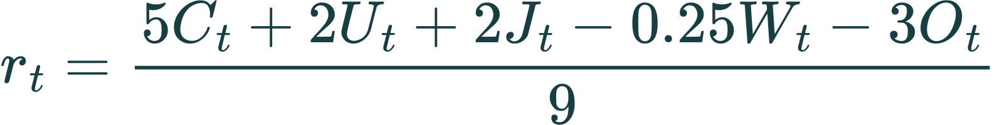
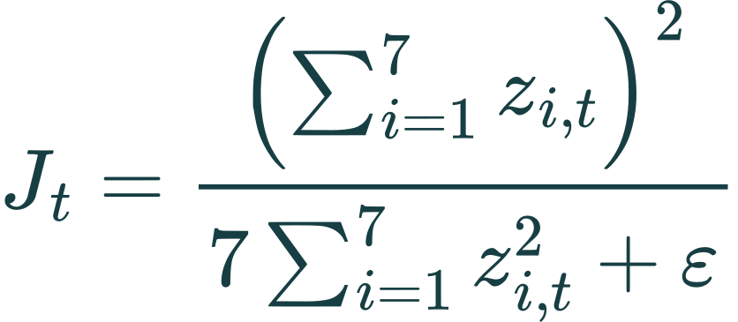
GridGuard Khartoum
Reward and public service measures
The training objective combines protection, utilization, fairness and switching
C: hourly critical service U: supply utilization J: cumulative-service fairness
W: fraction changing tier O: excess requested power / total demand
zᵢ,t is cumulative served energy / cumulative demand. Report mean hourly Jain fairness, direct duration measures and energy separately from daily reward.
Fairness definition: Jain, Chiu and Hawe (1984).
06
Notes:
GridGuard Khartoum study. Training SHA-256 e4f8b8f7c73693f713ecef69a06434ce75a3a101d2541654d7009398c4eb5624; study a4d5a849612f06eedef96e0d28e08247e5e3757eba0b4f2e4f1a893e9d4b8247; diagnostics b4c2c76e481e0f30e323ea22f9359212bac1b2018605f833682875d98face500. Fairness definition: Jain, Chiu and Hawe (1984).

Slide 7
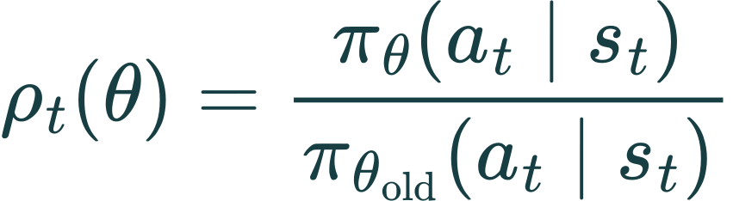
GridGuard Khartoum
Masked PPO training
Separate actor and critic networks: 46 inputs, two 256-unit tanh layers, 128 actor logits
The same stored feasibility mask defines both policy probabilities.
Advantages normalize over the full rollout. Value targets remain fixed.
γ = 1.0, GAE λ = 0.95, zero terminal value. The critic term is exactly 0.25 MSE. Entropy coefficient decreases from 0.01 to 0.001.
PPO: Schulman et al. (2017). Masking: Huang and Ontañón (2022).
07
Notes:
GridGuard Khartoum study. Training SHA-256 e4f8b8f7c73693f713ecef69a06434ce75a3a101d2541654d7009398c4eb5624; study a4d5a849612f06eedef96e0d28e08247e5e3757eba0b4f2e4f1a893e9d4b8247; diagnostics b4c2c76e481e0f30e323ea22f9359212bac1b2018605f833682875d98face500. PPO: Schulman et al. (2017). Masking: Huang and Ontañón (2022).

Slide 8
GridGuard Khartoum
Five independent runs and frozen selection
Fresh initialization, disjoint training streams and a fixed training budget
Training element | Configuration
Training seeds | 1729, 2718, 3141, 5772, 8111
Each run | 3,000 iterations × 256 episodes × 24 hours
Total PPO exposure | 92,160,000 transitions
Initialization | Fairness Rule demonstrations: 32,760 states, 10 epochs
PPO updates | 4 epochs, minibatch 1,024, learning rate 0.0003 to zero
Select the best validation reward among checkpoints with zero critical/power violations and fairness/utilization at least Fixed Rotation overall and at every shortage level.
Synthetic scenarios. Decision support only.
08
Notes:
GridGuard Khartoum study. Training SHA-256 e4f8b8f7c73693f713ecef69a06434ce75a3a101d2541654d7009398c4eb5624; study a4d5a849612f06eedef96e0d28e08247e5e3757eba0b4f2e4f1a893e9d4b8247; diagnostics b4c2c76e481e0f30e323ea22f9359212bac1b2018605f833682875d98face500.

Slide 9
GridGuard Khartoum
Matched evaluation and uncertainty
All final-test decisions follow the frozen five-run validation selection
Split | Independent base draws | Coupled conditions
Validation | 5 seeds × 32 = 160 | 480
Final test | 10 seeds × 32 = 320 | 960
12 methods: Fixed Rotation, optimizer, five selected PPO actors and five iteration-600 actors.
11,520 trajectories. Bootstrap resamples five training runs and matched base-draw clusters.
10,000 resamples. Two primary claims use adjusted 97.5% intervals.
Statistical reliability: Agarwal et al. (2021).
09
Notes:
GridGuard Khartoum study. Training SHA-256 e4f8b8f7c73693f713ecef69a06434ce75a3a101d2541654d7009398c4eb5624; study a4d5a849612f06eedef96e0d28e08247e5e3757eba0b4f2e4f1a893e9d4b8247; diagnostics b4c2c76e481e0f30e323ea22f9359212bac1b2018605f833682875d98face500. Statistical reliability: Agarwal et al. (2021).

Slide 10
GridGuard Khartoum
Main outcomes on 960 matched conditions
PPO values average the five independently trained policies equally
PPO and the optimizer preserve critical service. Their remaining differences concern allocation.
Synthetic scenarios. Decision support only.
10
Notes:
GridGuard Khartoum study. Training SHA-256 e4f8b8f7c73693f713ecef69a06434ce75a3a101d2541654d7009398c4eb5624; study a4d5a849612f06eedef96e0d28e08247e5e3757eba0b4f2e4f1a893e9d4b8247; diagnostics b4c2c76e481e0f30e323ea22f9359212bac1b2018605f833682875d98face500.

Slide 11
GridGuard Khartoum
PPO improves service over Fixed Rotation
Paired effects are PPO minus Fixed Rotation. Intervals have adjusted 97.5% coverage.
Outcome | Effect [lower, upper]
Critical interruption (locality-hours) | -102.050 [-102.081, -102.025]
Jain fairness (percentage points) | +9.260 [+9.142, +9.371]
Utilization (percentage points) | +25.782 [+25.702, +25.859]
Full declared comparison: PASSED
This compares the complete constrained system with a supply-blind fixed schedule. The critical-service rule contributes to the improvement.
Synthetic scenarios. Decision support only.
11
Notes:
GridGuard Khartoum study. Training SHA-256 e4f8b8f7c73693f713ecef69a06434ce75a3a101d2541654d7009398c4eb5624; study a4d5a849612f06eedef96e0d28e08247e5e3757eba0b4f2e4f1a893e9d4b8247; diagnostics b4c2c76e481e0f30e323ea22f9359212bac1b2018605f833682875d98face500.

Slide 12
GridGuard Khartoum
A reward and fairness gain with a utilization tradeoff
Paired effects are PPO minus Constrained Optimization. Adjusted 97.5% intervals.
Outcome | Effect [lower, upper]
Daily reward | +0.0499 [+0.0406, +0.0577]
Jain fairness (percentage points) | +2.237 [+2.096, +2.373]
Utilization (percentage points) | -0.399 [-0.464, -0.341]
Switching (percentage points) | +7.218 [+6.531, +8.112]
Full service-guarded improvement criterion: NOT MET
The utilization loss exceeds the allowed 0.2-point margin. Both protect critical service.
Synthetic scenarios. Decision support only.
12
Notes:
GridGuard Khartoum study. Training SHA-256 e4f8b8f7c73693f713ecef69a06434ce75a3a101d2541654d7009398c4eb5624; study a4d5a849612f06eedef96e0d28e08247e5e3757eba0b4f2e4f1a893e9d4b8247; diagnostics b4c2c76e481e0f30e323ea22f9359212bac1b2018605f833682875d98face500.

Slide 13
GridGuard Khartoum
Duration fairness and total interruption burden
Episode duration measures are calculated before averaging
Measure | Fixed Rotation | Optimizer | PPO
Zero-service blackout (locality-hours) | 96.00 | 0.00 | 0.00
Blackout pairwise gap (hours) | 1.71 | 0.00 | 0.00
Critical-interruption pairwise gap (hours) | 1.90 | 0.00 | 0.00
Longest critical interruption (hours) | 8.00 | 0.00 | 0.00
Critical Only removes locality-wide zero-service blackouts while Residential and Commercial demand can remain unmet. Zero duration does not mean Full Service.
Synthetic scenarios. Decision support only.
13
Notes:
GridGuard Khartoum study. Training SHA-256 e4f8b8f7c73693f713ecef69a06434ce75a3a101d2541654d7009398c4eb5624; study a4d5a849612f06eedef96e0d28e08247e5e3757eba0b4f2e4f1a893e9d4b8247; diagnostics b4c2c76e481e0f30e323ea22f9359212bac1b2018605f833682875d98face500.

Slide 14
GridGuard Khartoum
Shortage-specific allocation outcomes
Results keep the Mild, Moderate and Severe conditions visible
Critical interruption is zero for PPO and the optimizer at every tested shortage level.
Synthetic scenarios. Decision support only.
14
Notes:
GridGuard Khartoum study. Training SHA-256 e4f8b8f7c73693f713ecef69a06434ce75a3a101d2541654d7009398c4eb5624; study a4d5a849612f06eedef96e0d28e08247e5e3757eba0b4f2e4f1a893e9d4b8247; diagnostics b4c2c76e481e0f30e323ea22f9359212bac1b2018605f833682875d98face500.

Slide 15
GridGuard Khartoum
Validation progress across all five training runs
31 checkpoints per run. Checkpoint selection never consults final-test performance.
Seeds: 1729 2718 3141 5772 8111
Synthetic scenarios. Decision support only.
15
Notes:
GridGuard Khartoum study. Training SHA-256 e4f8b8f7c73693f713ecef69a06434ce75a3a101d2541654d7009398c4eb5624; study a4d5a849612f06eedef96e0d28e08247e5e3757eba0b4f2e4f1a893e9d4b8247; diagnostics b4c2c76e481e0f30e323ea22f9359212bac1b2018605f833682875d98face500.

Slide 16
GridGuard Khartoum
Training reward and loss
120 recorded updates per seed, every 25 iterations. No smoothing.
Thin lines: five seeds. Dark line: mean. Dashed limits: mean ± sample SD, not a CI.
Reward describes the pre-update rollout. Losses average all minibatches of that update’s four epochs.
Synthetic scenarios. Decision support only.
16
Notes:
GridGuard Khartoum study. Training SHA-256 e4f8b8f7c73693f713ecef69a06434ce75a3a101d2541654d7009398c4eb5624; study a4d5a849612f06eedef96e0d28e08247e5e3757eba0b4f2e4f1a893e9d4b8247; diagnostics b4c2c76e481e0f30e323ea22f9359212bac1b2018605f833682875d98face500.

Slide 17
GridGuard Khartoum
Policy entropy and update diagnostics
120 recorded updates per seed, every 25 iterations. No smoothing.
Thin lines: five seeds. Dark line: mean. Dashed limits: mean ± sample SD, not a CI.
Entropy, KL and clipping average all minibatches of the logged update. They are not 25-update moving averages.
Synthetic scenarios. Decision support only.
17
Notes:
GridGuard Khartoum study. Training SHA-256 e4f8b8f7c73693f713ecef69a06434ce75a3a101d2541654d7009398c4eb5624; study a4d5a849612f06eedef96e0d28e08247e5e3757eba0b4f2e4f1a893e9d4b8247; diagnostics b4c2c76e481e0f30e323ea22f9359212bac1b2018605f833682875d98face500.

Slide 18
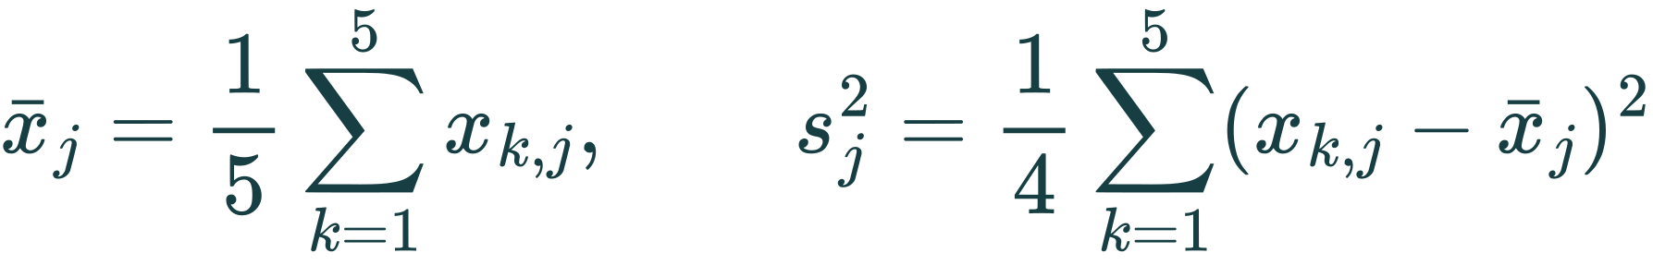
GridGuard Khartoum
Between-seed validation variance
Sample variance of the five run means on the same validation scenarios
31 checkpoints include behavior-cloning iteration 0. This is between-run variance, not critic explained variance or final-test uncertainty.
Synthetic scenarios. Decision support only.
18
Notes:
GridGuard Khartoum study. Training SHA-256 e4f8b8f7c73693f713ecef69a06434ce75a3a101d2541654d7009398c4eb5624; study a4d5a849612f06eedef96e0d28e08247e5e3757eba0b4f2e4f1a893e9d4b8247; diagnostics b4c2c76e481e0f30e323ea22f9359212bac1b2018605f833682875d98face500.

Slide 19
GridGuard Khartoum
Longer training improves reward but loses utilization
Same-run iteration-600 snapshots are a within-schedule reference
Seed | Selected iteration | Reward at 600 | Selected reward | Difference
1729 | 2900 | 23.4497 | 23.4835 | +0.0338
2718 | 3000 | 23.4654 | 23.4913 | +0.0258
3141 | 2900 | 23.4699 | 23.5034 | +0.0335
5772 | 3000 | 23.4781 | 23.5014 | +0.0233
8111 | 2500 | 23.4732 | 23.5040 | +0.0309
Mean daily reward +0.0295. Utilization −0.2417 percentage points.
The full additional-training criterion fails its utilization and shortage guardrails. The 600 snapshots use the planned 3,000-iteration schedule.
Synthetic scenarios. Decision support only.
19
Notes:
GridGuard Khartoum study. Training SHA-256 e4f8b8f7c73693f713ecef69a06434ce75a3a101d2541654d7009398c4eb5624; study a4d5a849612f06eedef96e0d28e08247e5e3757eba0b4f2e4f1a893e9d4b8247; diagnostics b4c2c76e481e0f30e323ea22f9359212bac1b2018605f833682875d98face500.

Slide 20
GridGuard Khartoum
Learned next-hour demand prediction
Ridge AR(3): 768 training traces and 320 separate evaluation traces
Forecasts use past demand and identical target hours. Prediction does not enter PPO.
Synthetic scenarios. Decision support only.
20
Notes:
GridGuard Khartoum study. Training SHA-256 e4f8b8f7c73693f713ecef69a06434ce75a3a101d2541654d7009398c4eb5624; study a4d5a849612f06eedef96e0d28e08247e5e3757eba0b4f2e4f1a893e9d4b8247; diagnostics b4c2c76e481e0f30e323ea22f9359212bac1b2018605f833682875d98face500.

Slide 21
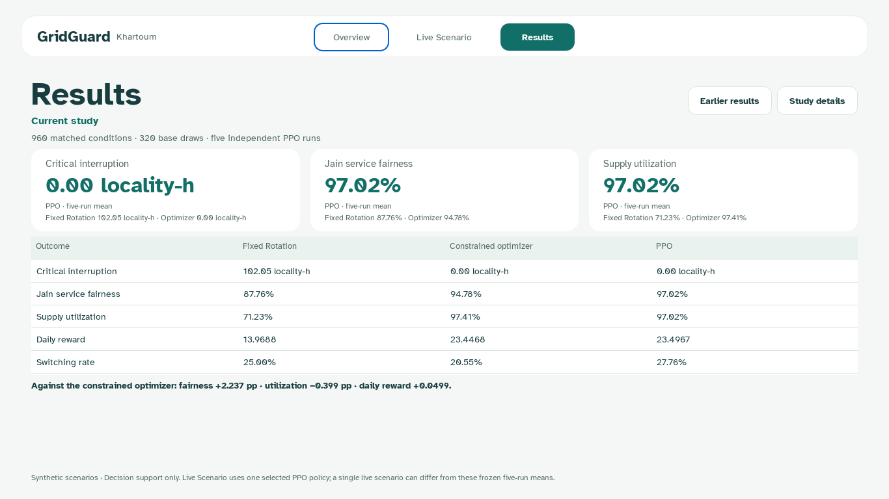
GridGuard Khartoum
Current study results in the desktop app
Synthetic decision support. Live Scenario uses one selected actor. Results show the five-run study.
21
Notes:
GridGuard Khartoum study. Training SHA-256 e4f8b8f7c73693f713ecef69a06434ce75a3a101d2541654d7009398c4eb5624; study a4d5a849612f06eedef96e0d28e08247e5e3757eba0b4f2e4f1a893e9d4b8247; diagnostics b4c2c76e481e0f30e323ea22f9359212bac1b2018605f833682875d98face500. Synthetic decision support. Live Scenario uses one selected actor. Results show the five-run study. Screenshot: current desktop Results. Live Scenario uses the constrained PPO actor from seed 8111, selected checkpoint 2500, and the study constrained optimizer. The Results page retains the five-run aggregate on 960 matched conditions. This single live policy and an individual replay do not replace those averages. The complete scientific comparison and its utilization limitation remain on slides 12 and 22.

Slide 22
GridGuard Khartoum
Conclusions and the next engineering step
Against Fixed Rotation
Against the optimizer
The constrained PPO system improves critical service, fairness and utilization on fresh matched synthetic scenarios.
PPO improves fairness and daily reward but uses less supply and switches more often. The full criterion fails.
Ridge AR(3) improves prediction over the two simple baselines.
Earlier Fairness Rule comparisons remain unfavorable for PPO.
Measured demand and feasible feeder actions are needed before operational evaluation.
Synthetic scenarios. Decision support only.
22
Notes:
GridGuard Khartoum study. Training SHA-256 e4f8b8f7c73693f713ecef69a06434ce75a3a101d2541654d7009398c4eb5624; study a4d5a849612f06eedef96e0d28e08247e5e3757eba0b4f2e4f1a893e9d4b8247; diagnostics b4c2c76e481e0f30e323ea22f9359212bac1b2018605f833682875d98face500.

Slide 23
GridGuard Khartoum
References 1 of 2
Alphabetized author-date references
Agarwal, R., Schwarzer, M., Castro, P.S., Courville, A. and Bellemare, M.G. (2021) “Deep reinforcement learning at the edge of the statistical precipice”, NeurIPS 34. https://arxiv.org/abs/2108.13264
Chen, H., Zhuang, J., Zhou, G., Wang, Y., Sun, Z. and Levron, Y. (2023) “Emergency load shedding strategy for high renewable energy penetrated power systems based on deep reinforcement learning”, Energy Reports, 9, pp. 434–443. https://doi.org/10.1016/j.egyr.2023.03.027
García, J. and Fernández, F. (2015) “A comprehensive survey on safe reinforcement learning”, JMLR, 16(42), pp. 1437–1480. https://jmlr.org/papers/v16/garcia15a.html
Huang, S. and Ontañón, S. (2022) “A closer look at invalid action masking in policy gradient algorithms”, FLAIRS Conference Proceedings, 35. https://doi.org/10.32473/flairs.v35i.130584
Synthetic scenarios. Decision support only.
23
Notes:
Agarwal, R., Schwarzer, M., Castro, P.S., Courville, A. and Bellemare, M.G. (2021) “Deep reinforcement learning at the edge of the statistical precipice”, NeurIPS 34. https://arxiv.org/abs/2108.13264
Chen, H., Zhuang, J., Zhou, G., Wang, Y., Sun, Z. and Levron, Y. (2023) “Emergency load shedding strategy for high renewable energy penetrated power systems based on deep reinforcement learning”, Energy Reports, 9, pp. 434–443. https://doi.org/10.1016/j.egyr.2023.03.027
García, J. and Fernández, F. (2015) “A comprehensive survey on safe reinforcement learning”, JMLR, 16(42), pp. 1437–1480. https://jmlr.org/papers/v16/garcia15a.html
Huang, S. and Ontañón, S. (2022) “A closer look at invalid action masking in policy gradient algorithms”, FLAIRS Conference Proceedings, 35. https://doi.org/10.32473/flairs.v35i.130584

Slide 24
GridGuard Khartoum
References 2 of 2
Alphabetized author-date references
Jain, R., Chiu, D.-M. and Hawe, W.R. (1984) A quantitative measure of fairness and discrimination for resource allocation in shared computer systems. DEC Research Report TR-301.
Schulman, J., Wolski, F., Dhariwal, P., Radford, A. and Klimov, O. (2017) “Proximal policy optimization algorithms”. https://doi.org/10.48550/arXiv.1707.06347
World Bank (2025) Accelerating Sustainable and Clean Energy and Digital Access Transformation in Sudan (P507788). Project Information Document, appraisal stage, PIDIA01286, 1 May. documents.worldbank.org, project P507788.
Synthetic scenarios. Decision support only.
24
Notes:
Jain, R., Chiu, D.-M. and Hawe, W.R. (1984) A quantitative measure of fairness and discrimination for resource allocation in shared computer systems. DEC Research Report TR-301.
Schulman, J., Wolski, F., Dhariwal, P., Radford, A. and Klimov, O. (2017) “Proximal policy optimization algorithms”. https://doi.org/10.48550/arXiv.1707.06347
World Bank (2025) Accelerating Sustainable and Clean Energy and Digital Access Transformation in Sudan (P507788). Project Information Document, appraisal stage, PIDIA01286, 1 May. documents.worldbank.org, project P507788.

