Slide 1
GRADUATION PROJECT DEFENSE
GridGuard Khartoum
PPO-assisted load shedding and energy management for developing countries
Murtada Asim Ibrahim Bakhit (18-317)
Suliman Elawad Suliman Babiker (18-310)
Abdalhay Abass Mobarak Abass (15-306)
Offline research simulation | August 2026
Notes:
Open with the project question: can a learned policy allocate limited modeled supply more effectively than a traditional schedule?
[Sources]
- docs/source/graduation-project-proposal.pdf
- docs/REPORT.md
[/Sources]

Slide 2
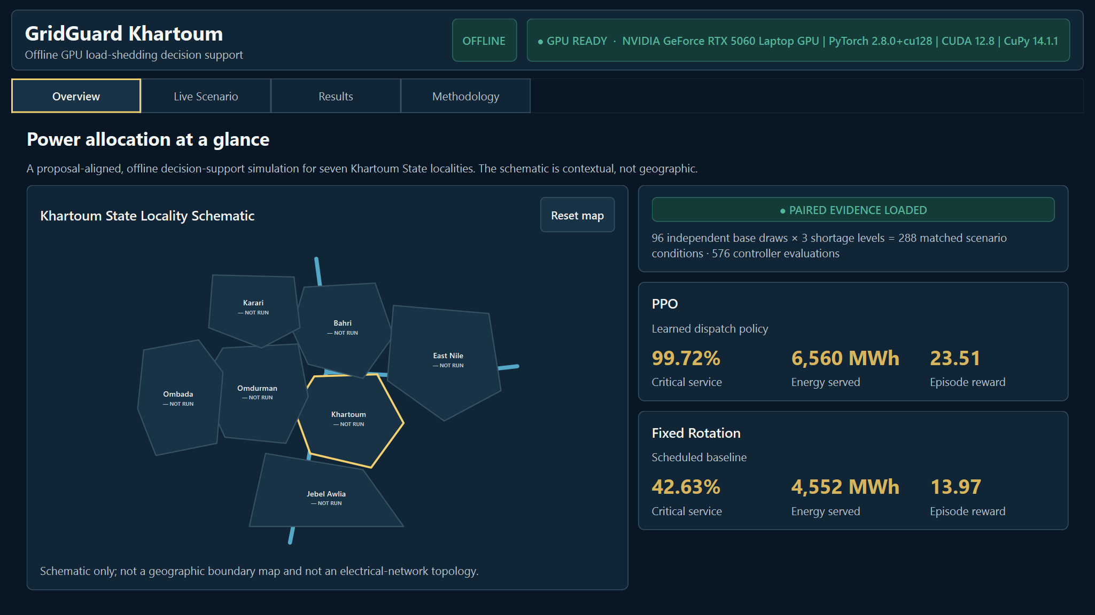
GRIDGUARD KHARTOUM
A shortage creates seven simultaneous allocation choices
Protect Hospital, Water, and Bakery demand
Use the available supply without exceeding it
Share service across seven modeled localities
Synthetic decision-support scope - not a live grid controller
OFFLINE GPU RESEARCH SIMULATION
2
Notes:
Frame the problem as constrained allocation, not a claim that the simulator models the full electrical network. The schematic provides presentation context only.
[Sources]
- docs/METHODOLOGY.md (Simulation domain; Limitations)
- docs/assets/screenshots/overview.png
[/Sources]

Slide 3
GRIDGUARD KHARTOUM
The proposal became a clean, auditable desktop system
Seeded
scenarios
Shared CUDA
tensors
PPO and
Fixed Rotation
Paired
evidence
Desktop
replay
Controller evidence path
Demand projection
Display only - never enters PPO, dispatch, reward, or benchmark evidence
Offline after installation | hash-bound artifacts | fail-closed startup
OFFLINE GPU RESEARCH SIMULATION
3
Notes:
Walk left to right. The controller path and display-only forecast are deliberately separated so a presentation feature cannot silently change the claim.
[Sources]
- docs/IMPLEMENTATION.md (System overview; Display-only forecast)
- docs/decisions/ADR-001-gpu-runtime.md
[/Sources]

Slide 4
GRIDGUARD KHARTOUM
PPO and Fixed Rotation receive exactly the same scenario
96
288
576
x 3
x 2
independent
base draws
matched scenario
conditions
controller-scenario
evaluations
PPO
Fixed Rotation
32-value causal observation
Learned 7-locality joint action
Three-hour schedule blocks
No demand or fairness observation
Every stored delta is PPO - Fixed Rotation
OFFLINE GPU RESEARCH SIMULATION
4
Notes:
Stress the pairing: both controllers receive the same immutable Scenario object. The 288 conditions are severity variants of 96 independent base draws, not 288 independent draws; together they produce 576 controller-scenario evaluations.
[Sources]
- docs/METHODOLOGY.md (Controller decisions; Matched evaluation design)
- data/evidence/paired-benchmark.json, SHA-256 2c3e71e48c4c7bff4fe609d42a76ca4f770f6dd717cd7d45d5e8e0d99fdf2d11
[/Sources]

Slide 5
GRIDGUARD KHARTOUM
GPU-first simulation, PPO inference, and paired bootstrap
PyTorch
cuda:0
CuPy
scenarios
simulation
PPO inference
cluster bootstrap
CUDA sort
linear percentiles
no CPU fallback
Validated presentation runtime
RTX 5060 Laptop GPU | PyTorch 2.8.0+cu128
CUDA 12.8 | CuPy 14.1.1 | DLPack coherence
Startup blocks on GPU, model, evidence, or provenance failure
OFFLINE GPU RESEARCH SIMULATION
5
Notes:
The performance-critical scenario, simulation, PPO, metric, and bootstrap paths run on CUDA. One explicit final host transfer supports canonical evidence assembly and validation; it is not a controller fallback. The release gate validates Torch, CuPy, CUDA, DLPack sharing, the PPO artifact, and evidence before launch.
[Sources]
- docs/IMPLEMENTATION.md (GPU-first execution; Verification strategy)
- docs/decisions/ADR-001-gpu-runtime.md
[/Sources]

Slide 6
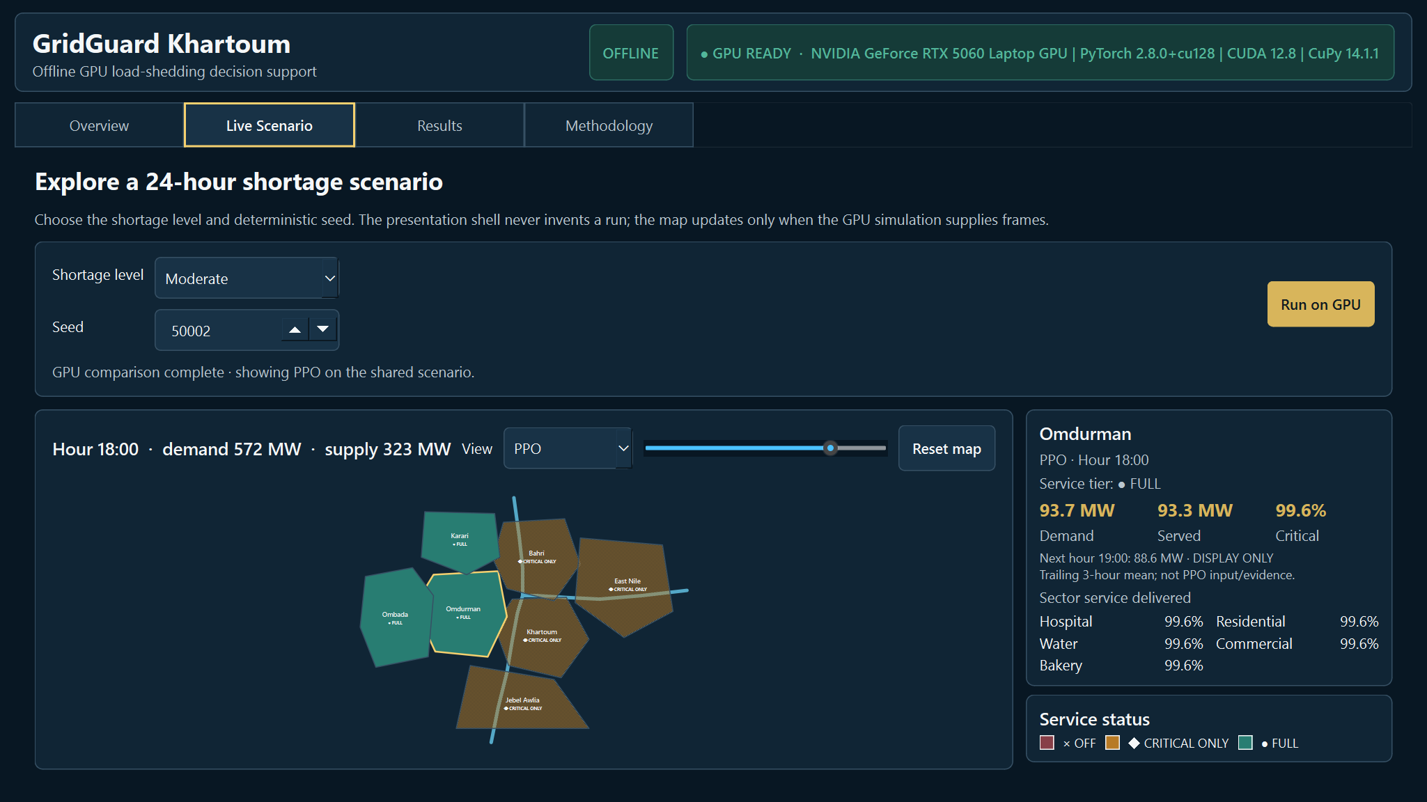
GRIDGUARD KHARTOUM
The desktop replays one audited GPU scenario
Switch controller | scrub 24 hours | inspect locality | forecast is DISPLAY ONLY
OFFLINE GPU RESEARCH SIMULATION
6
Notes:
Demo this after the slide: choose a shortage and seed, run once, then change controller and hour without changing the scenario. Point out demand, served MW, critical ratio, sector service, and the display-only next-hour projection.
[Sources]
- docs/IMPLEMENTATION.md (Desktop presentation)
- docs/assets/screenshots/live.png
[/Sources]

Slide 7
GRIDGUARD KHARTOUM
PPO protects nearly all modeled critical demand
99.72%
42.63%
PPO critical-service ratio
Fixed Rotation
Critical service
42.63%
99.72%
+57.09 pp
Critical-outage locality-hours
102.07 -> 18.67
OFFLINE GPU RESEARCH SIMULATION
7
Notes:
This is the strongest proposal-facing result. The critical-service ratio is modeled critical energy served divided by critical demand. Critical-outage locality-hours use the locked 99% threshold and are diagnostic, not a bootstrap endpoint.
[Sources]
- docs/RESULTS.md (Reproduced paired aggregate comparison)
- data/evidence/paired-benchmark.json
[/Sources]

Slide 8
GRIDGUARD KHARTOUM
PPO serves 2,008 MWh more and uses supply more effectively
Served energy
4,552 MWh
6,560 MWh
Utilization
71.22%
97.65%
Curtailed energy
Fixed 6,142 MWh
PPO 4,134 MWh
+2,008 MWh served
+26.43 pp utilization
-2,008 MWh curtailed
OFFLINE GPU RESEARCH SIMULATION
8
Notes:
Served and curtailed energy are complementary under the energy identity, so present them as two views of the same allocation change rather than independent endpoints.
[Sources]
- docs/RESULTS.md (Reproduced paired aggregate comparison)
- data/evidence/paired-benchmark.json
[/Sources]

Slide 9
GRIDGUARD KHARTOUM
All seven paired intervals favor PPO
Outcome
PPO - Fixed
Cluster-bootstrap 95% interval
Episode reward
+9.54
[9.54, 9.55]
Critical service
+57.09 pp
[57.06, 57.11] pp
Utilization
+26.43 pp
[26.32, 26.53] pp
Jain fairness
+9.16 pp
[9.09, 9.23] pp
Served energy
+2,008 MWh
[2,000, 2,017] MWh
Curtailed energy
-2,008 MWh
[-2,017, -2,000] MWh
Switching rate
-3.11 pp
[-3.48, -2.75] pp
10,000 deterministic seed-stratified paired cluster replicates
OFFLINE GPU RESEARCH SIMULATION
9
Notes:
Positive favors PPO for higher-is-better outcomes; negative favors PPO for lower-is-better outcomes. The bootstrap resamples 96 base-draw clusters inside seed strata and keeps all 3 shortage variants together.
[Sources]
- docs/METHODOLOGY.md (Paired uncertainty calculation)
- docs/RESULTS.md (Paired differences and 95% intervals)
- data/evidence/paired-benchmark.json, SHA-256 2c3e71e48c4c7bff4fe609d42a76ca4f770f6dd717cd7d45d5e8e0d99fdf2d11
[/Sources]

Slide 10
GRIDGUARD KHARTOUM
The advantage is consistent, not driven by one seed
9 / 9
Safety and diagnostics
shortage-by-seed cells favor PPO
for every primary outcome
0.00%
power-balance violation rate
in both controllers
Reward
9/9
-3.11 pp
aggregate switching rate
Critical service
9/9
Utilization
9/9
Oversubscription stays diagnostic:
direction was mixed across cells
Fairness
9/9
Served energy
9/9
Curtailed energy
9/9
OFFLINE GPU RESEARCH SIMULATION
10
Notes:
All 6 primary outcomes favor PPO in all 9 cells. Switching favors PPO overall but in 7 of 9 cells. Oversubscription is lower in aggregate for PPO but mixed by cell, so it is not presented as a consistent primary advantage.
[Sources]
- docs/RESULTS.md (Consistency across the nine evaluation cells)
- data/evidence/paired-benchmark.json, SHA-256 2c3e71e48c4c7bff4fe609d42a76ca4f770f6dd717cd7d45d5e8e0d99fdf2d11
[/Sources]

Slide 11
GRIDGUARD KHARTOUM
The evidence answers the proposal - within a strict boundary
What this establishes
What this does not establish
PPO beats Fixed Rotation in the locked simulator
Field performance on Sudan's electrical grid
Critical-service protection and fairness improve
Network stability, voltage, or protection behavior
The result is reproducible from pinned artifacts
Superiority over every possible controller
The desktop demonstrates one shared scenario honestly
Forecast accuracy from real operational data
Historical evidence stored 18 batch-cell summaries. Episode rows and intervals were regenerated from the audited simulator and frozen PPO checkpoint.
OFFLINE GPU RESEARCH SIMULATION
11
Notes:
This boundary is part of the result, not a weakness to hide. The accepted historical artifact did not contain episode rows, so the paired rows and intervals are a reviewed regeneration, not reconstructed historical observations.
[Sources]
- docs/RESULTS.md (Two evidence layers; Limitations)
- docs/METHODOLOGY.md (Limitations and threats to validity)
[/Sources]

Slide 12
GRIDGUARD KHARTOUM
THE ANSWER
PPO > Fixed Rotation
under the locked synthetic evaluation protocol
Verified - pinned model, evidence, provenance, and release gate
Interactive - one shared GPU scenario with locality-level replay
Honest - synthetic scope, historical boundary, and limitations visible
Next: validate with representative operational data and electrical-network constraints
OFFLINE GPU RESEARCH SIMULATION
12
Notes:
Close by answering the original question, then transition to the live demonstration. The next scientific step is operational-data and network-constraint validation before any field-facing use.
[Sources]
- docs/RESULTS.md (Result statement; Interpretation)
- docs/REPORT.md
[/Sources]

