Slide 1
Tuning Model Manually
Select parameters
Set values to these parameters
Write for loops (number of for loops equals to number of selected parameters)

Slide 2
Tuning Model Automatically
For model’s parameters
RandomizedSearchCV
GridSearchCV
For whole process of building model
Auto Machine Learning (AutoML)

Slide 3
AutoML
Platforms
Google: Cloud AutoML
Microsoft: Azure Machine Learning
Amazon: SageMaker Autopilot
Landing AI: LandingLens
Chimes AI: tukey

Slide 4
AutoML
Packages
Auto-sklearn
AutoGluon
FLAML
H2O AutoML
LightAutoML
Pycaret
MLJAR
TPOT
MLBox
Auto-PyTorch
AutoKeras
talos

Slide 5
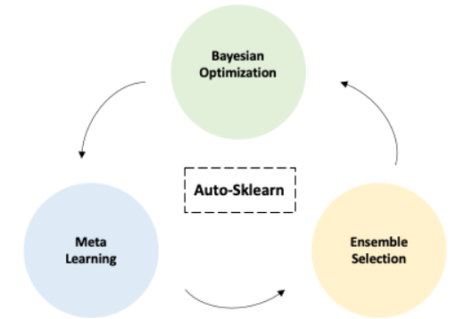
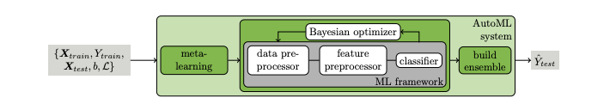
Auto-sklearn
auto-sklearn https://automl.github.io/auto-sklearn/master/installation.html
auto-sklearn for anaconda https://anaconda.org/conda-forge/auto-sklearn

