Slide 1
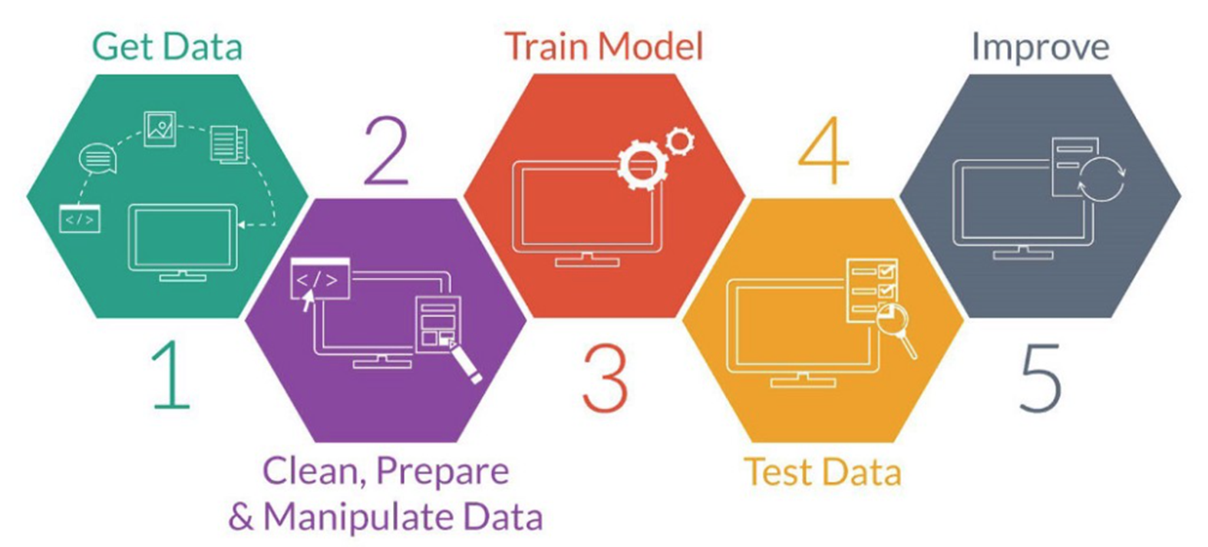
Course Module Arrangement
Last semester
Weeks 5~6, 9~10
Weeks 12~15
6
Case Study
Applications
Weeks 10~12
Weeks 2~5
Week 1: overview
Week 7: Ching Ming HOL
Week 8: Midterm Project
Week 16: Final Project
https://www.wipo.int/edocs/mdocs/globalinfra/en/wipo_ip_itai_ge_18/wipo_ip_itai_ge_18_p5.pdf

Slide 2
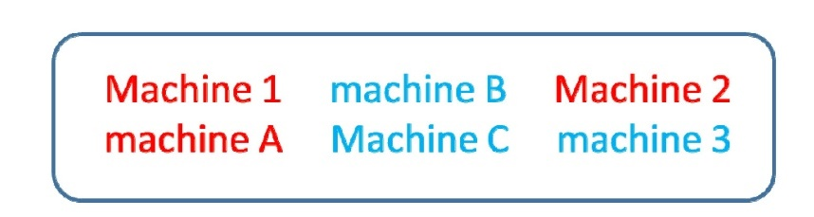
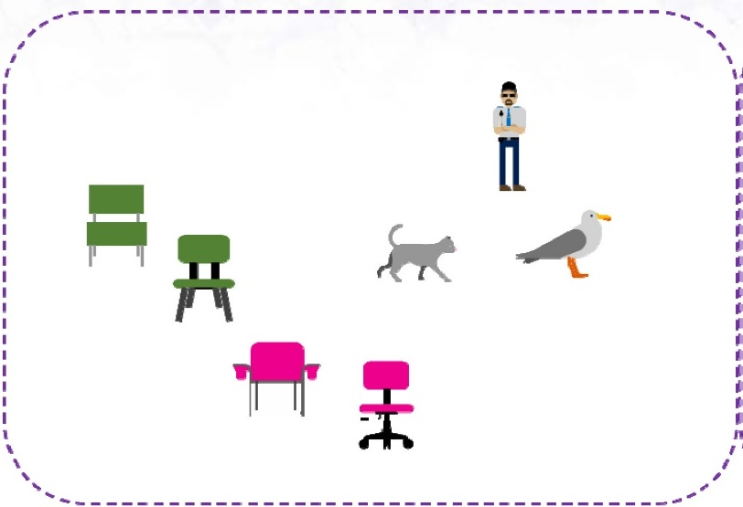
Book: 人工智慧-全華

Slide 3
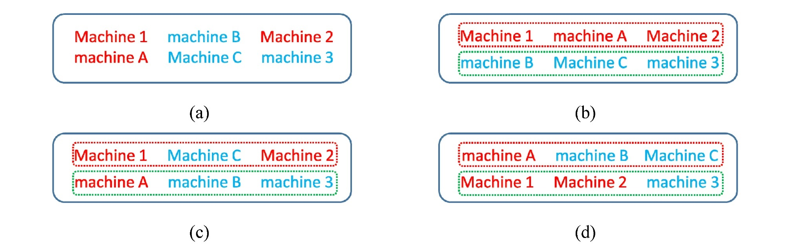
Book: 人工智慧-全華

Slide 4
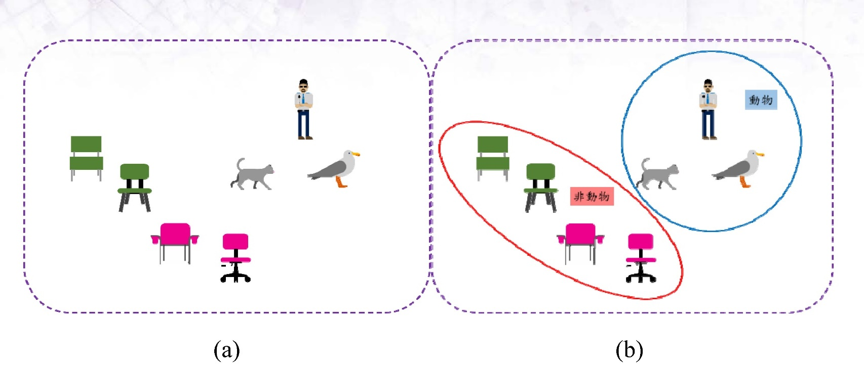
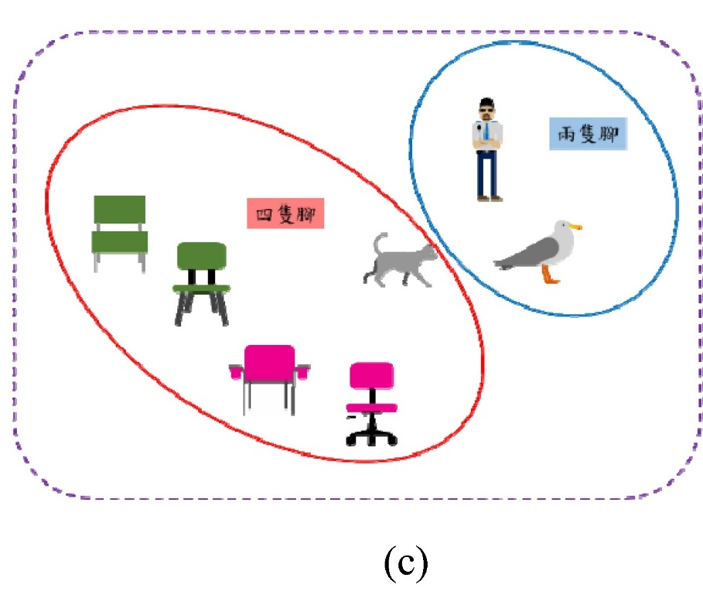
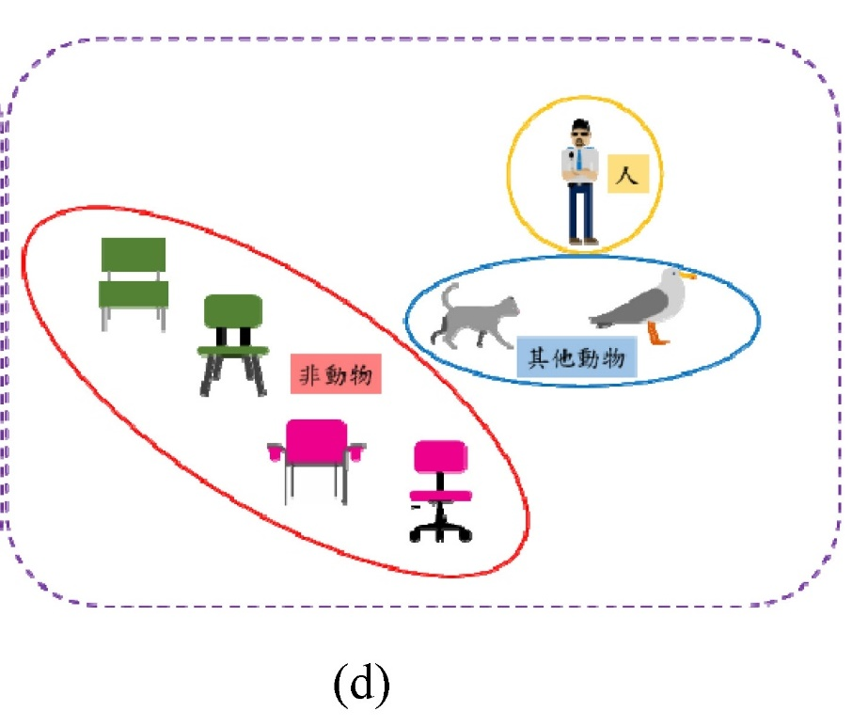
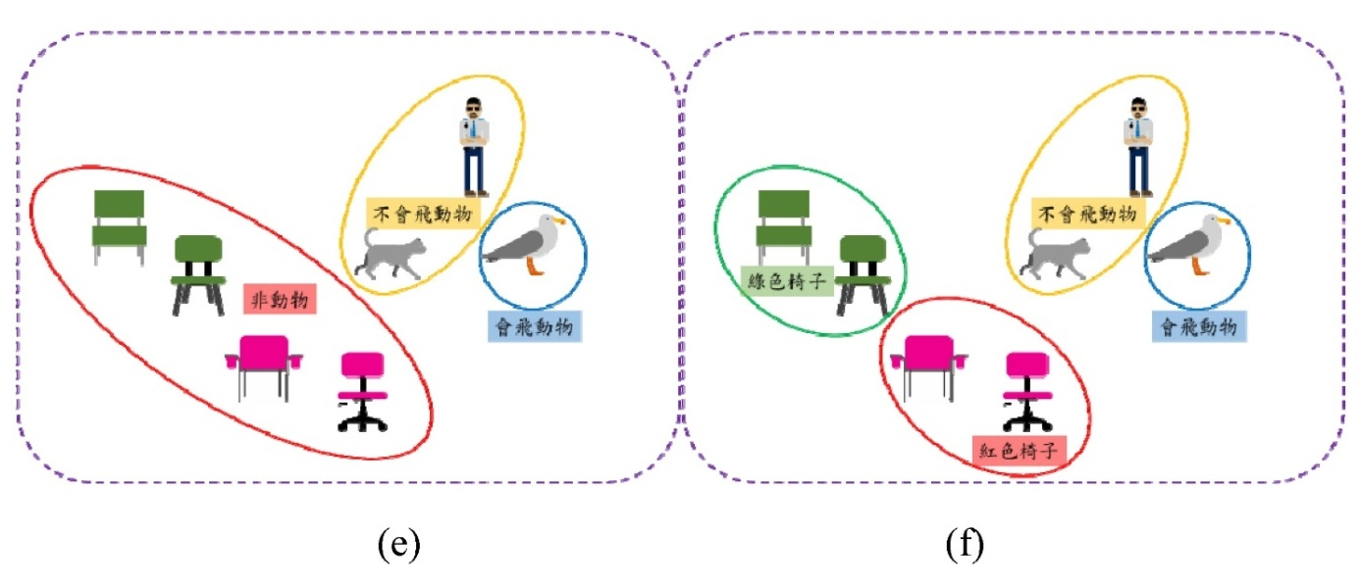
Book: 人工智慧-全華

Slide 5
K-means algorithm
Specify number of clusters K
Initialize centroids by first shuffling the dataset and then randomly selecting K data points for the centroids without replacement
Keep iterating until there is no change to the centroids. i.e assignment of data points to clusters is not changing
Compute the sum of the squared distance between data points and all centroids
Assign each data point to the closest cluster (centroid)
Compute the centroids for the clusters by taking the average of the all data points that belong to each cluster

Slide 6
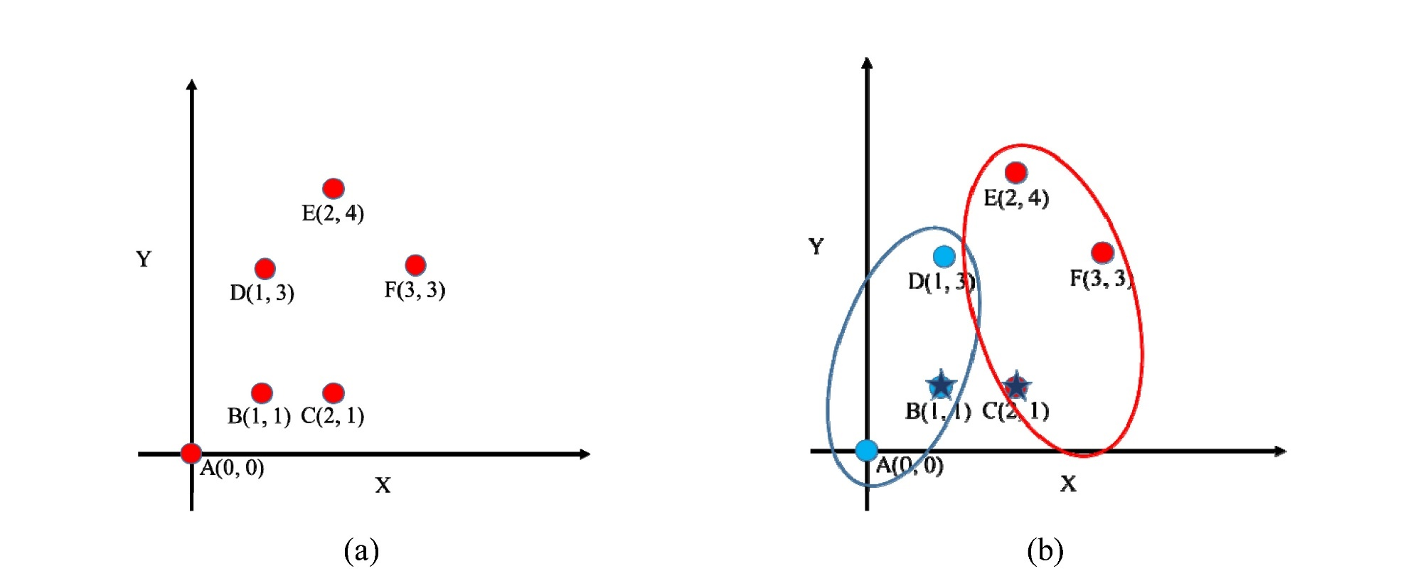
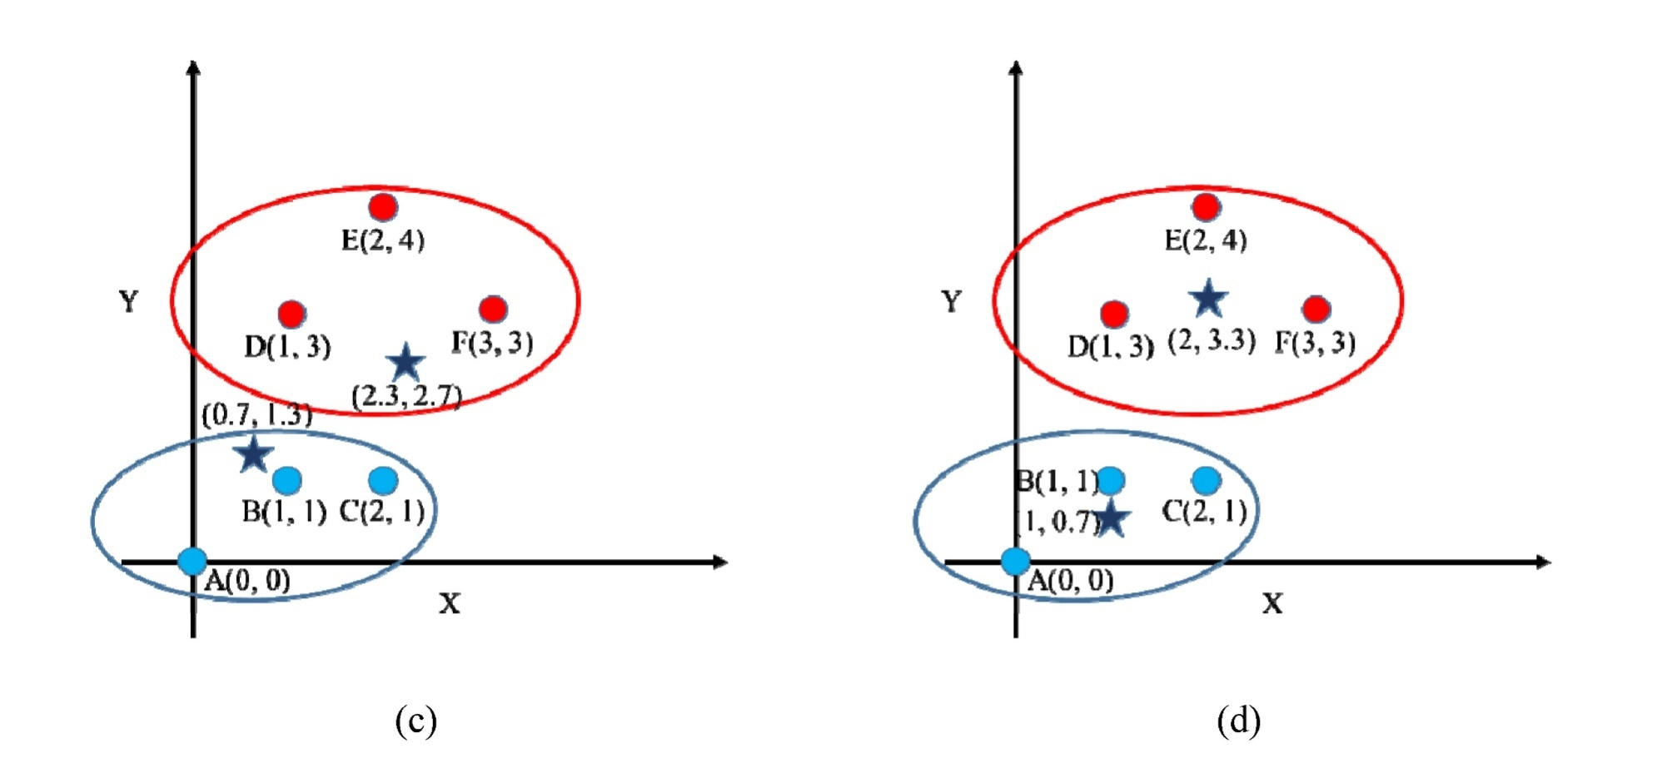
Book: 人工智慧-全華

Slide 7
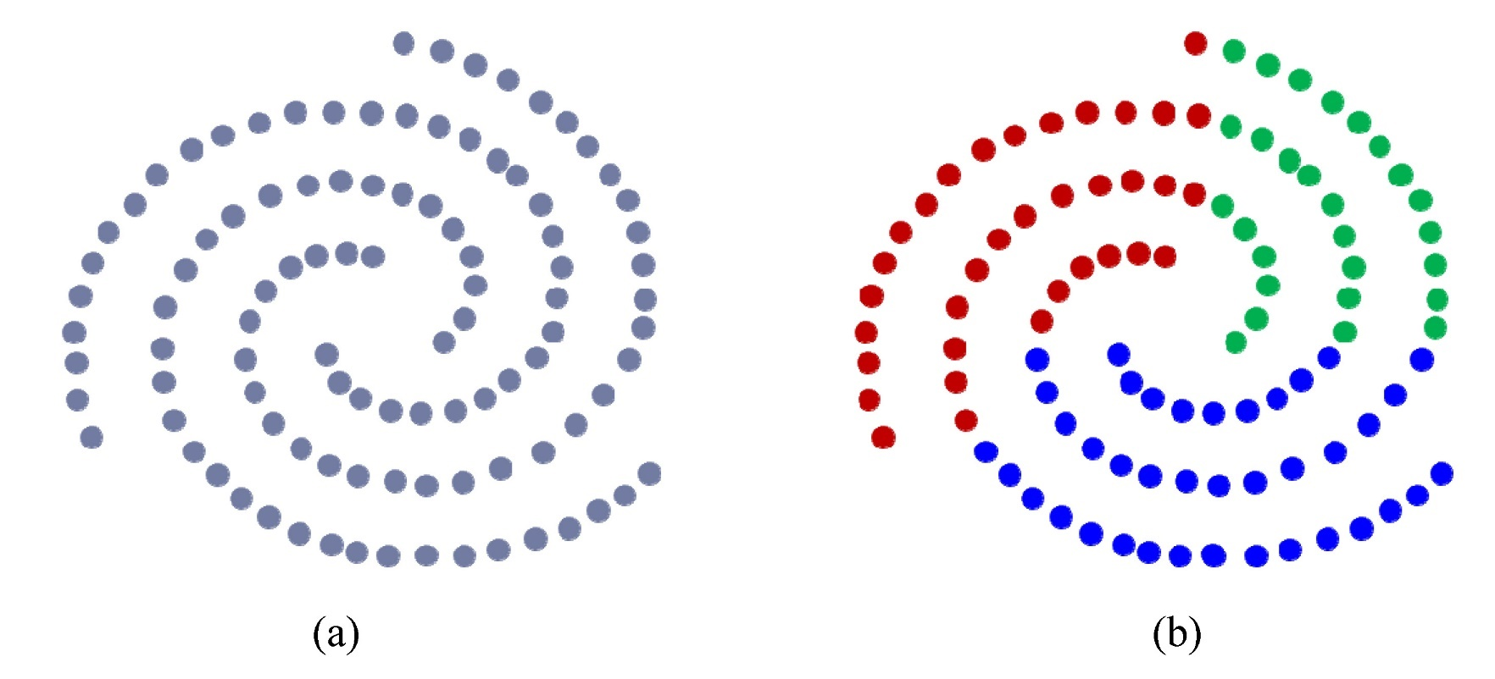
Book: 人工智慧-全華

Slide 8
DBSCAN algorithm
Find the points in the ε (eps) neighborhood of every point, and identify the core points with more than the minimum number of points required to form a dense region (minPts) neighbors
Find the connected components of core points on the neighbor graph, ignoring all non-core points
Assign each non-core point to a nearby cluster if the cluster is an ε (eps) neighbor, otherwise assign it to noise
A naive implementation of this requires storing the neighborhoods in step 1, thus requiring substantial memory

Slide 9
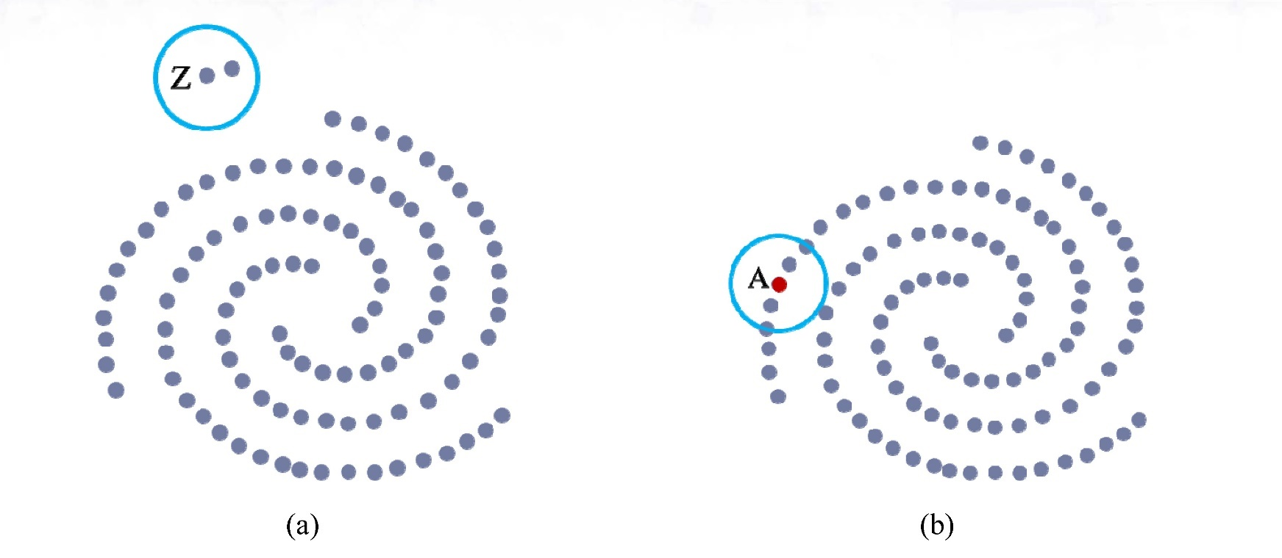
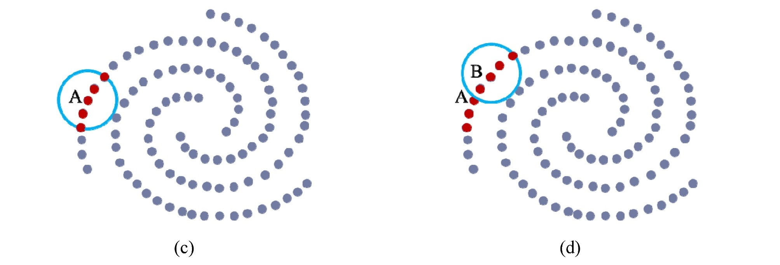
Book: 人工智慧-全華

Slide 10
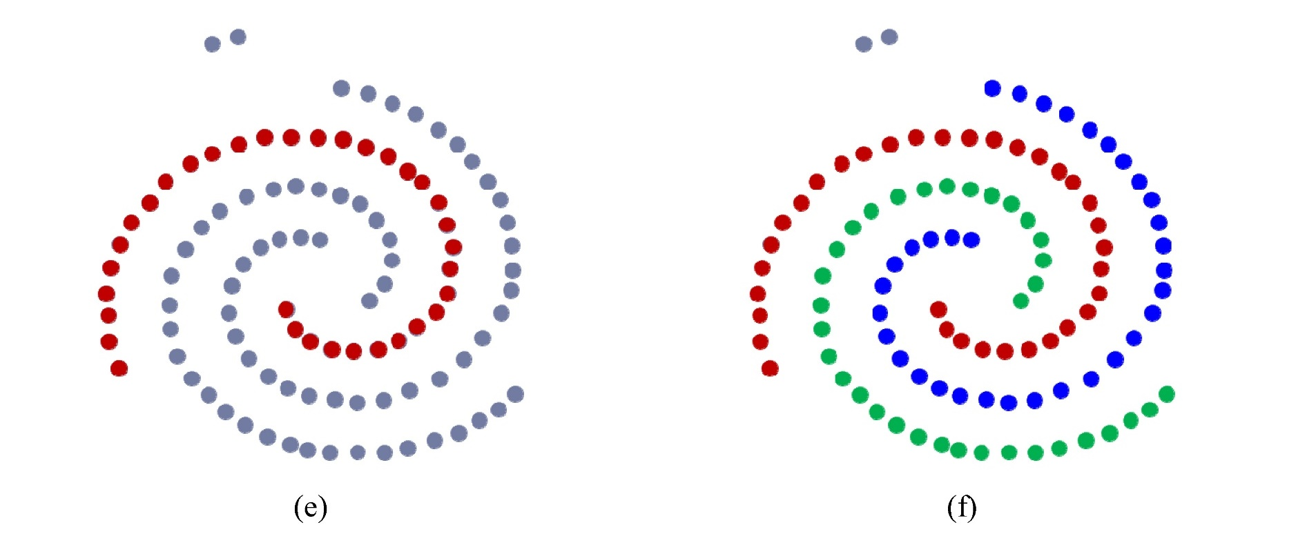
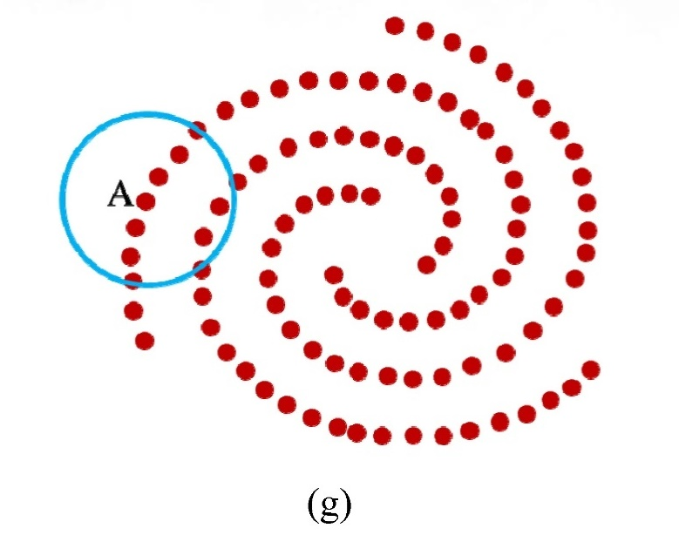
if set a larger ε
Book: 人工智慧-全華

Slide 11
Hierarchical Clustering
agglomerative clustering: bottom-up start: every node is a cluster repeat: merge similar nodes/clusters together (to a cluster) stop: all in one cluster
divisive clustering: top-down start: all in one cluster repeat: split a set to multiple clusters/nodes stop: every node is a cluster

Slide 12
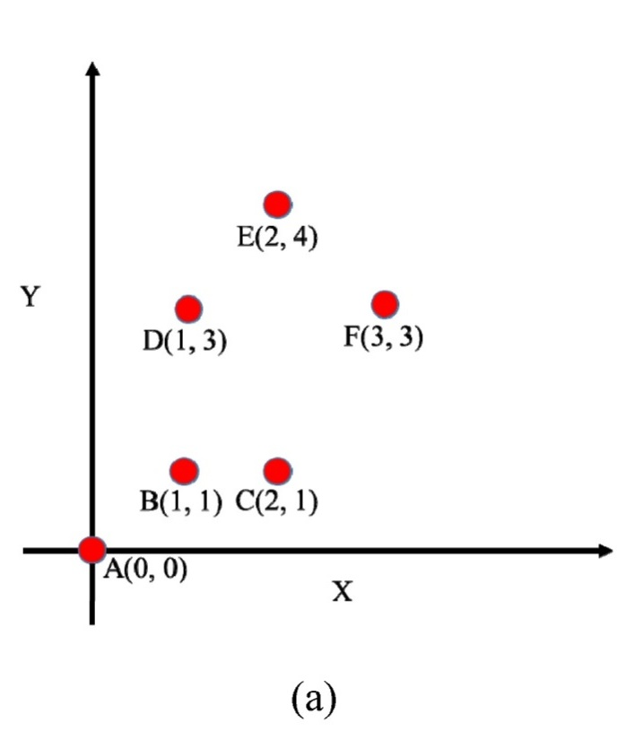
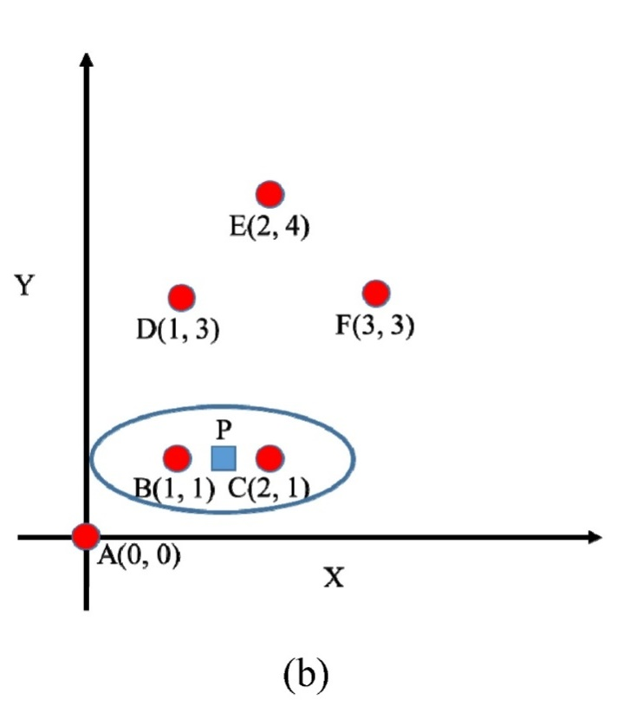
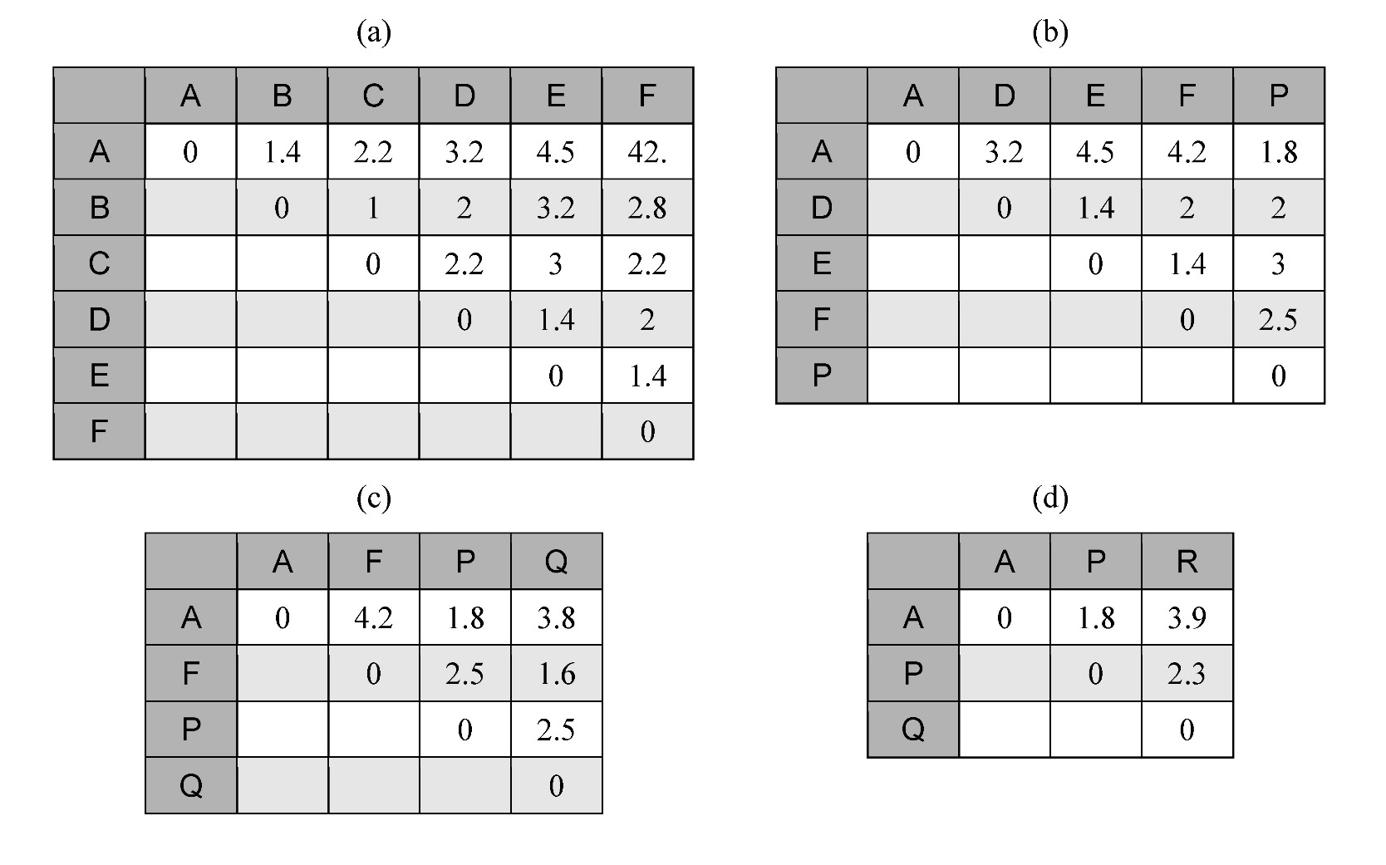
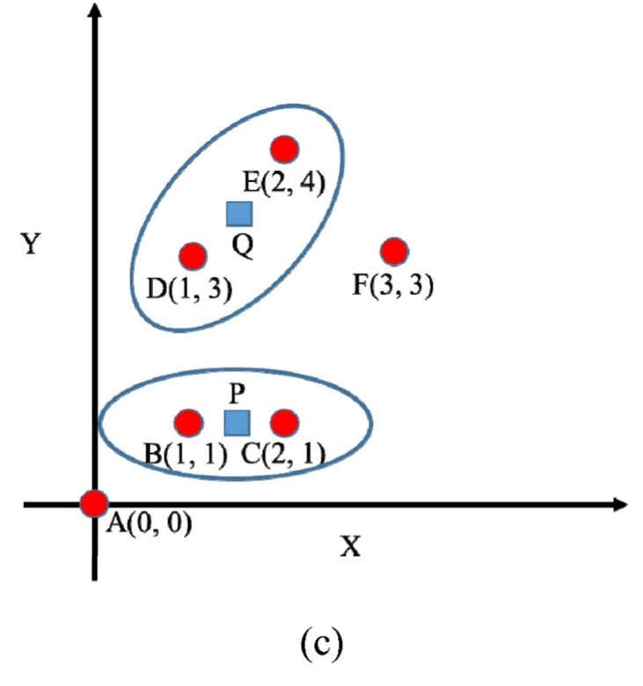
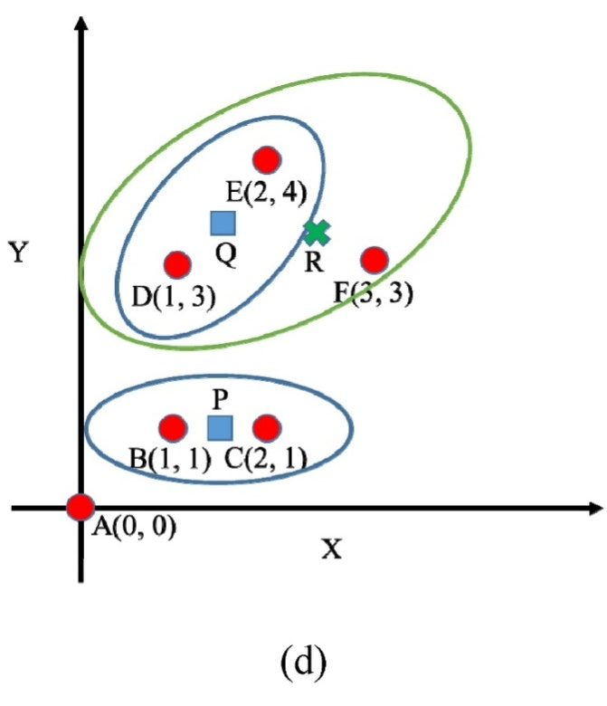
Book: 人工智慧-全華

Slide 13
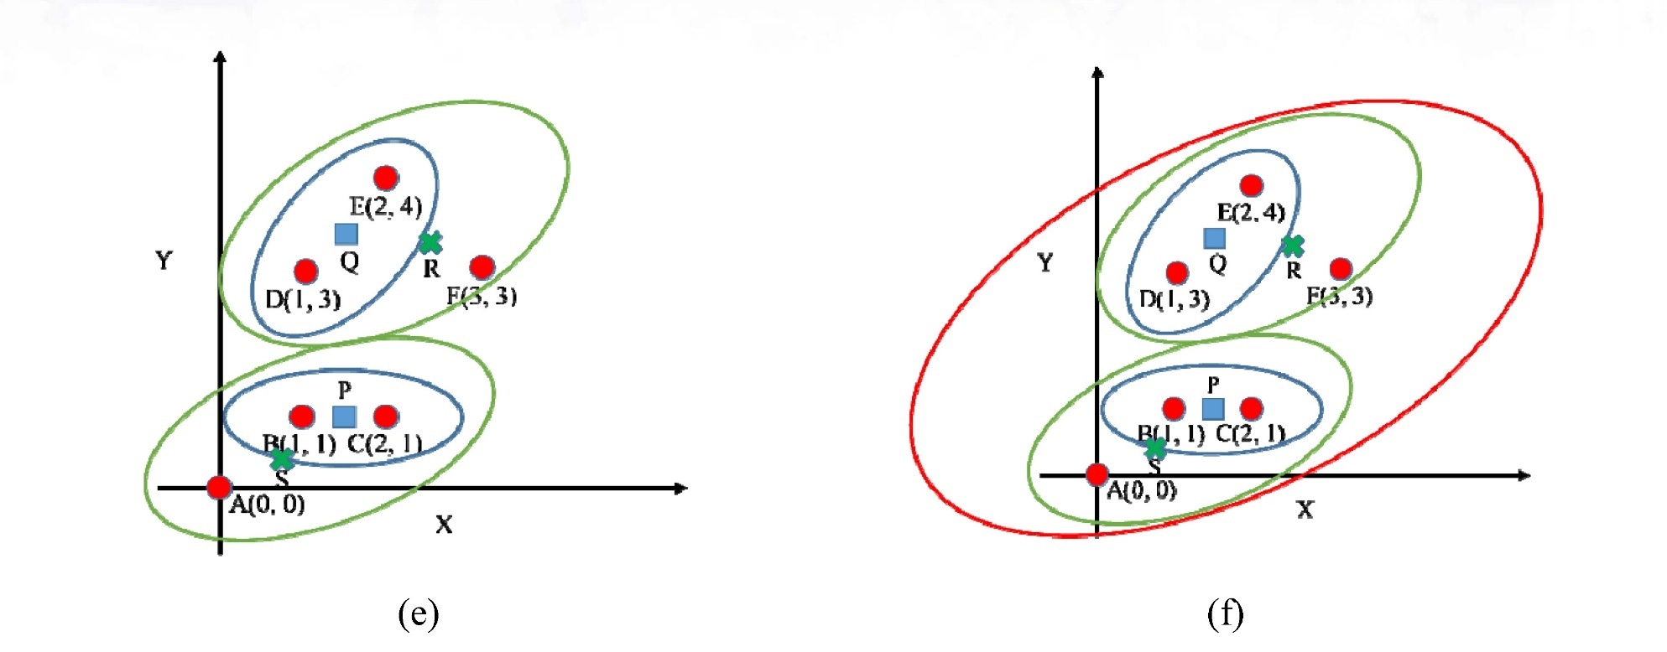
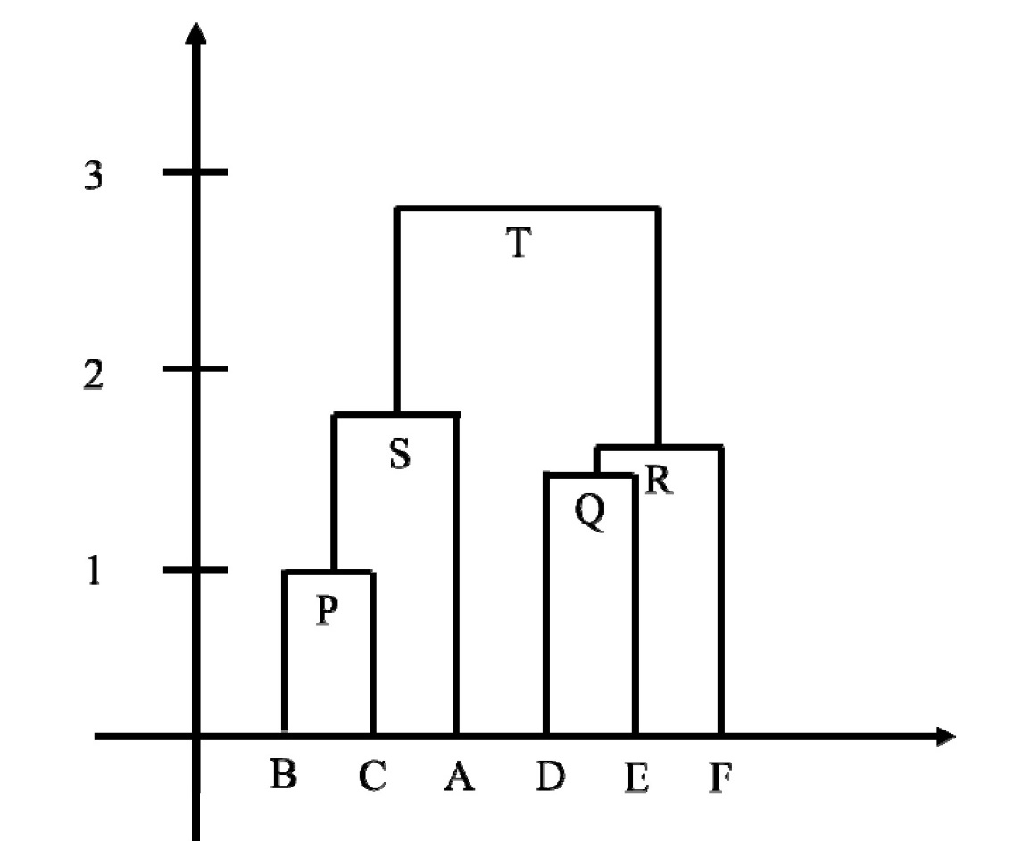
Book: 人工智慧-全華

